Slide 1
Colegio SagradoCorazón Venta de Baños 2020
Christmas Quiz

Slide 2
The Rules
Each round has 10 questions. The questions will appear on the board and only be read once.
A tie break situation will be decided any way your teacher sees as fit.
No shouting out. This spoils the fun.
The teacher’s word is final.
GOOD LUCK!

Slide 3
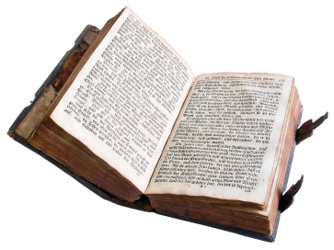
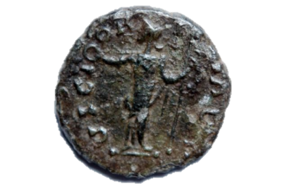
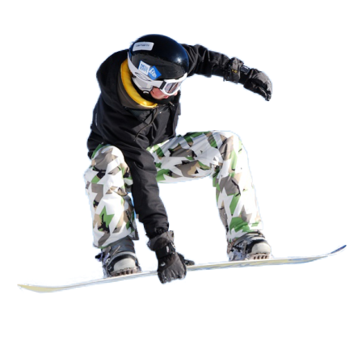
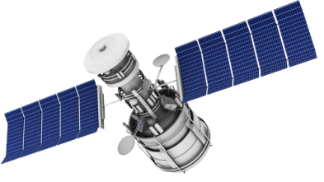
The Rounds
Click on the image for the round
Christmas
Nature
Literature
History
Sport
Science & Technology
Entertainment
Geography

Slide 4
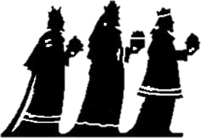
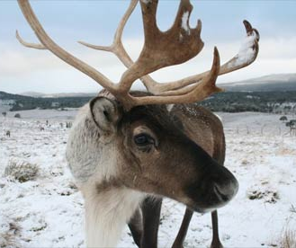
Christmas
What colour are the berries of Mistletoe?
What were the gifts the ‘Three Magi’ took to Jesus in the nativity story?
Lapland is considered the home of Father Christmas, but which country is it in?
Which of these is not one of Santa’s reindeer? Dancer, Prancer, Dasher or Bouncer

Slide 5
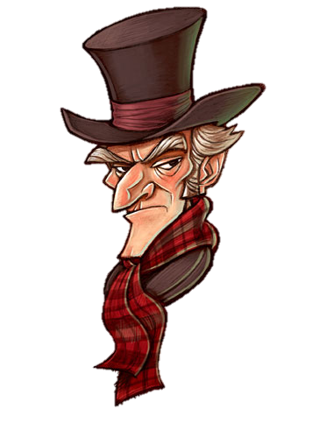
What feast did Good King Wenceslas look upon in the famous Christmas carol?
In what ocean would you find Christmas Island?
Charles Dickens wrote ‘A Christmas Carol’, but what was the name of Scrooge’s employee?
In the famous song, ‘The Twelve Days of Christmas’, how many swans were a-swimming?

Slide 6
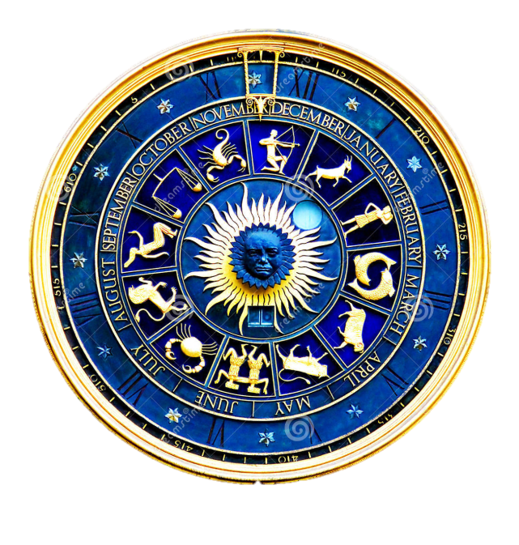
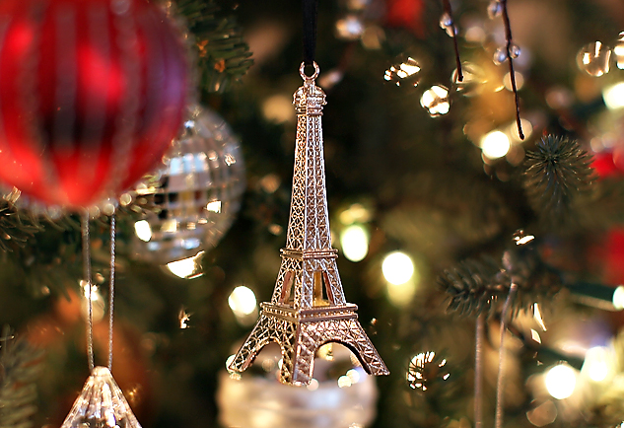
What Christmas item takes its name from the Old French word ‘estincelle’, meaning spark?
What is the star sign of people born on the 25th of December?
Back to the category board.

Slide 7
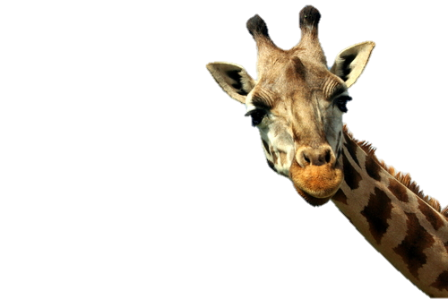
Nature
Rockhopper, Jackass and Emperor are all types of what?
What type of animal was Moby Dick?
What colour is a Giraffe’s tongue?

Slide 8
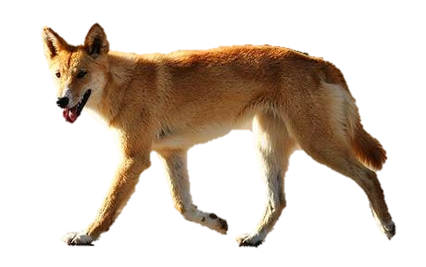
What country does the wild dog the ‘Dingo’ come from?
What is Britain’s only venomous snake?
A snipe is what type of animal?
Where would you find a Nautilus?

Slide 9
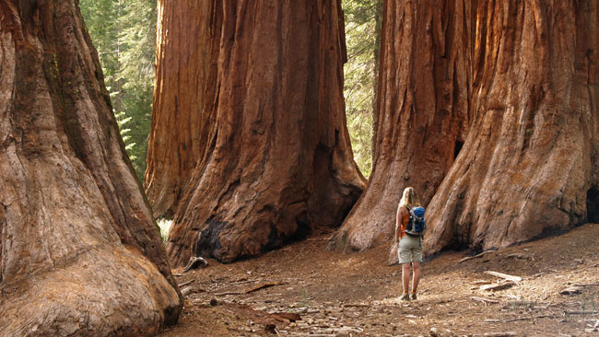
In which mountain range would you find the Edelweiss flower?
What is the most numerous bird in the world with 50 billion individuals?
What is the tallest tree in the world.
Back to the category board.

Slide 10
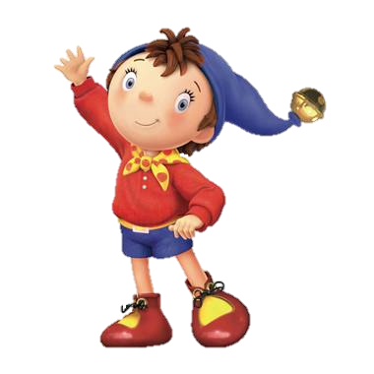
Literature
Who created Noddy?
In which book would you meet Mole, Ratty and Mr Toad?
What is the surname of Wendy, John and Michael in Peter Pan?
What is the name of Long John Silver’s parrot?

Slide 11
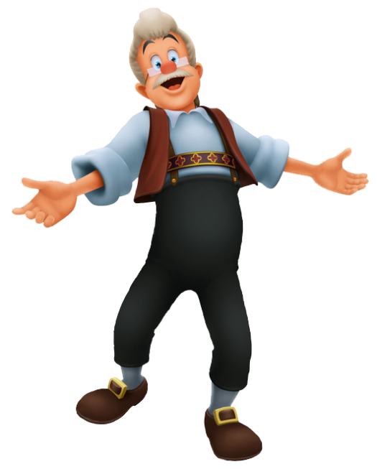
Who wrote the ‘Just So’ stories?
A A Milne created ‘Hundred Acre Wood’, but which famous bear lives there?
Who was created by Gepetto the carpenter?

Slide 12
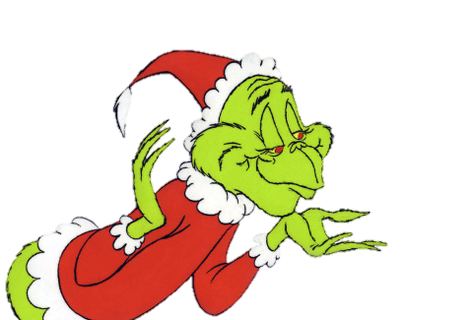
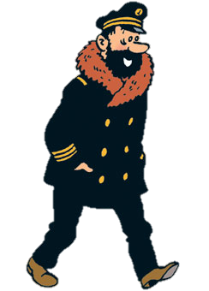
Who wrote ‘How the Grinch Stole Christmas’?
What is the name of the lion in ‘The Lion, The Witch and the Wardrobe’?
Who has a dog called Snowy and is friends with Captain Haddock?
Back to the category board.

Slide 13
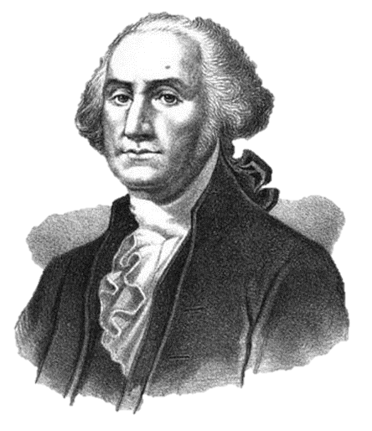
History
2014 marked the centenary of the start of the First World War, but what year will mark the end?
Who was the first President of America
Huddersfield was the hometown of an English Prime Minister. What was his name?

Slide 14
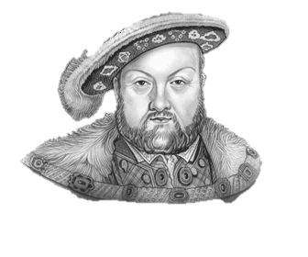
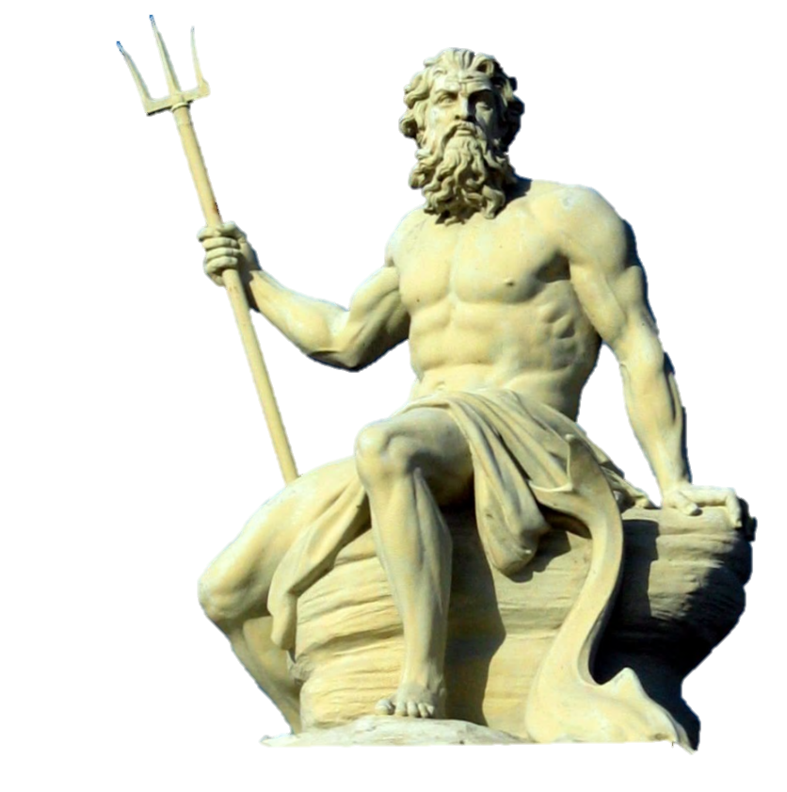
How many wives did Henry VIII have?
Apollo, Hermes and Poseidon are all Gods from which Ancient Civilisation?
6. What was Queen Victoria’s husband called?

Slide 15
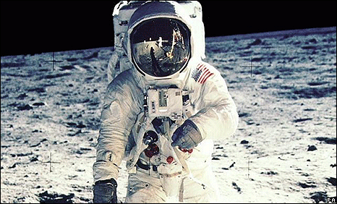
Who was the first recorded King of England?
Which group of people were native to the British Isles?
In February I’m going to visit the ruins of Pompei, but what was the name volcano that destroyed it?
In what year did Neil Armstrong become the first man to set foot on The Moon?
Back to the category board.

Slide 16
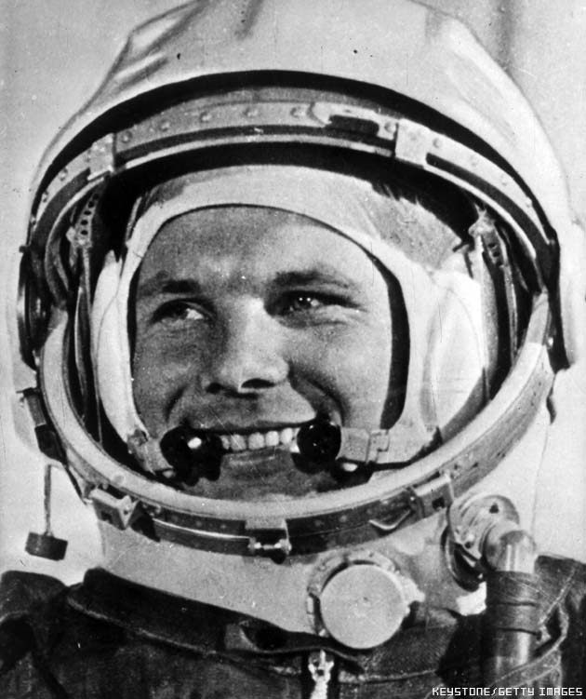
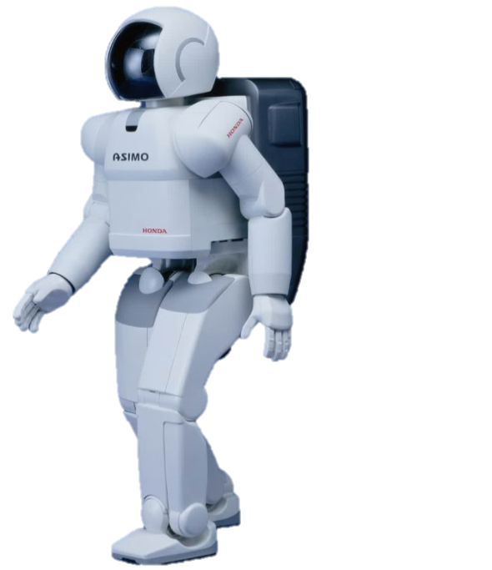
Science and Technology
Who was the first man in space?
On the moon, what colour is the sky?
Which car manufacturer invented the humanoid robot ASIMO?

Slide 17
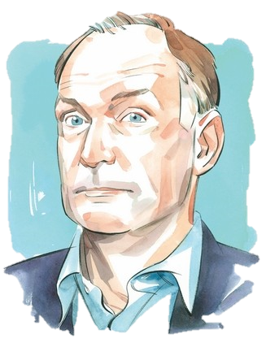
Olympus Mons in the tallest mountain in the solar system, but which planet is it on?
What is the name of a single dot on a computer screen?
Tim Berners Lee is the man credited with the invention of what?

Slide 18
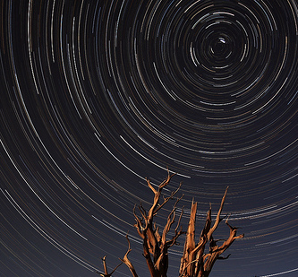
What is the only vowel not to appear on the top row of a keyboard?
What star can be used to work out the direction of north?
What is the term for the bending of light as it passes from one medium to another.
What is the only muscle in the body to be joined at one end.
Back to the category board.

Slide 19
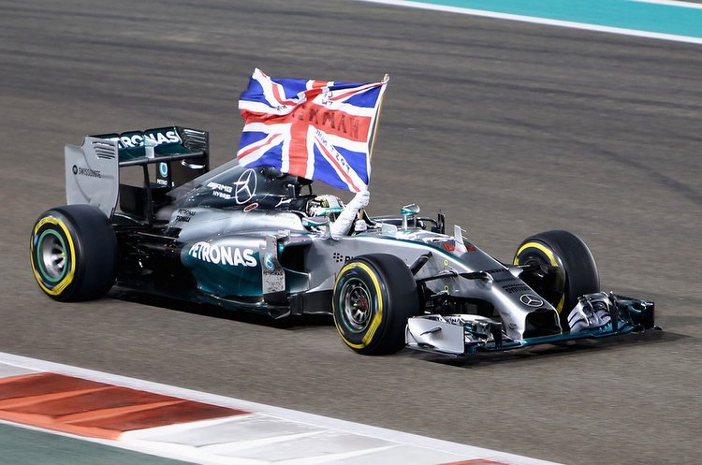
Sport
What sport takes place in a velodrome?
Lewis Hamilton became the 2014 Formula One World Champion with Mercedes, but what team did he used to drive for?
Huddersfield is the birthplace of which sport?
Super G, Slalom and the Downhill are all events in which Winter sport?

Slide 20
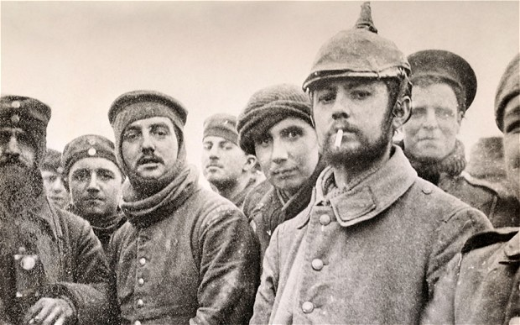
The Premier League team ‘Stoke City’ play at which stadium?
What colour is the leader’s jersey in the Tour de France?
On Christmas day in 1914, a truce between British and German troops took place. What game did they famously play?
In netball, what does WA stand for?

Slide 21
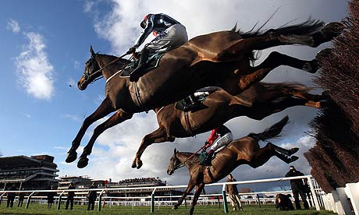
Amy Williams is a famous Winter Olympian, but what event did she win her Gold medal in?
What famous horse race takes place at Aintree racecourse one Saturday in spring?
Back to the category board.

Slide 22
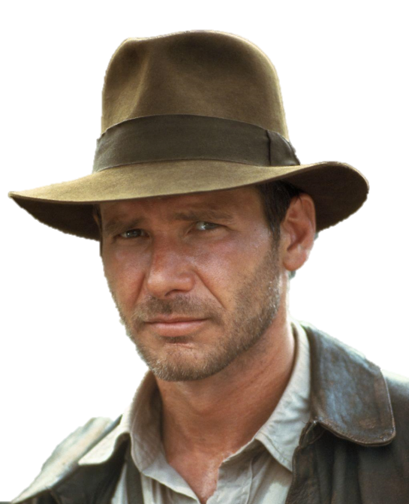
Entertainment
The character ‘Jack Skellington’ appears in which 1993 Tim Burton film?
In which film does the line “Toto, I’ve a feeling we’re not in Kansas anymore” belong?
What is the profession of Indiana Jones?

Slide 23
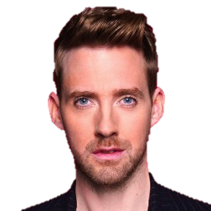
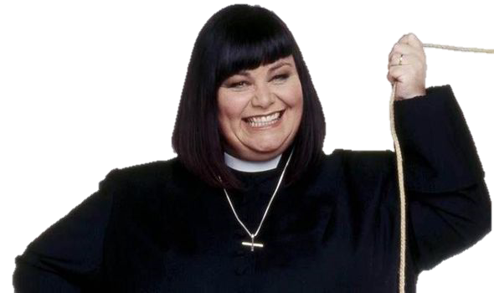
Ricky Wilson is one of the coaches on The Voice, but which band is he the lead singer of?
Who presents BBC Radio 2’s breakfast show?
What is the name of the actress who plays the Vicar of Dibley?

Slide 24
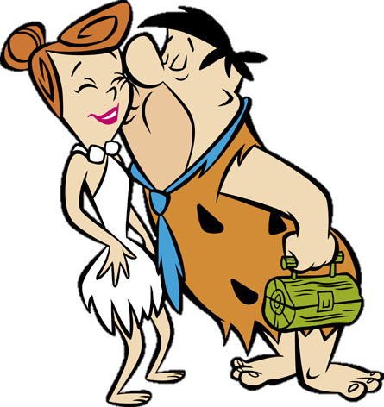
Which well known cartoon character made his screen debut in 1928 in ‘Steamboat Willie’?
Peter Capaldi, Matt Smith, and David Tennant all share what link?
What film by Steven Spielberg tells the story of an alien wanting to get home?
10. What is the name of the town the Flintstones are from?
Back to the category board.

Slide 25
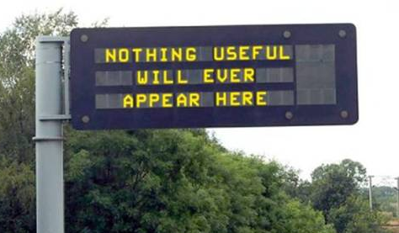
Geography
At more than 6.5 million square miles, what is the largest country in the world?
And which has the largest population, at more than 1.3 billion?
What colour are motorways on British road maps?

Slide 26
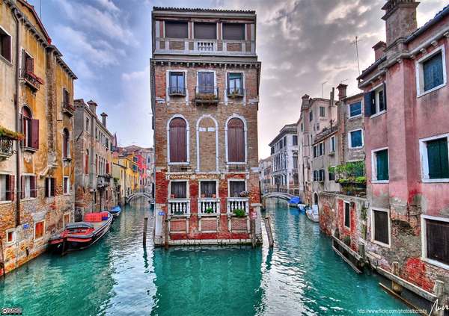
Which Scottish loch with a length of about 24 miles, is reputed to contain a monster?
Which desert covers much of northern Africa?
Which Italian city is famous for its canals?

Slide 27
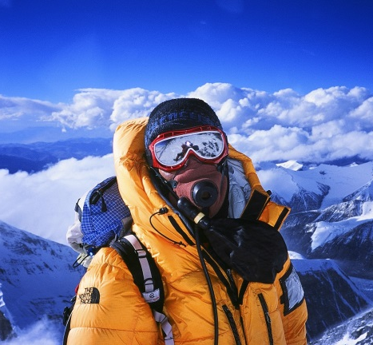
Canberra is the capital of what Country?
In which US city would you find Manhattan, Brooklyn and the Bronx?
What are the only two countries to have a land border with the USA?
10. What is the tallest mountain in the world?
Back to the category board.

