Slide 1

BRITAIN
An introspective view through cinema

Slide 2


The evolution
British cinema is thus often associated with costume and historical dramas, black humor or romance, like in films like Nothing Hill, Harry Potter or Pride and Prejudice but there is much more to analyze and to learn from it.

Slide 3

1920s
The first moving pictures displayed, were made by British inventor William Friese Greene, who shot different scenes in Hyde Park.
Incident at Clovelly Cottage
The objective of the cinema of this time was only pure entertainment.
1923: the Turning Point.
Films started to synchronise sound and photography.
Films developed significantly in terms of technology
Both WWI and WWII obliged filmmakers to dedicate themselves to the documentary or action films.
The cinema made during the wars was aimed to process the grief of the wars, however the cinema after the wars was intended to entertain
Source:
https://www.filminquiry.com/history-british-cinema-1-rise-studio-film/
https://es.slideshare.net/ruthers64/history-of-british-cinema-16238974

Slide 4
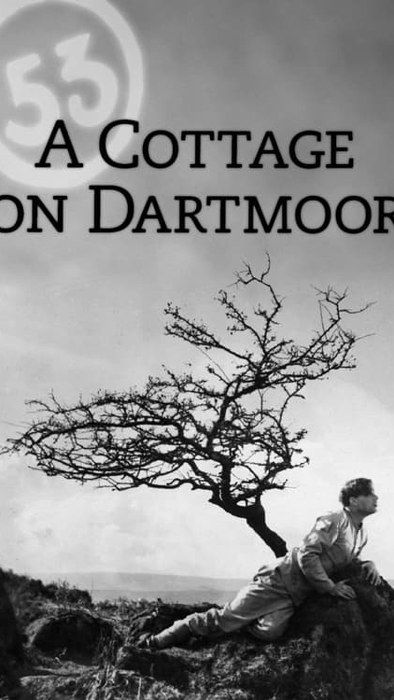
Silent Films
This cinema was fresh and diverse, it was not influenced by the Hollywood mentality. So it offered a great variety of styles of film making.
There were not rigid genres or over-familiar formats.
From this period there are certain film makers that appear as very influential:
Anthony Asquith: A Cottage on Dartmoor
A story of jealousy, love and redemption.
British International Pictures: Piccadilly
Set in London’s glittering West End, it’s a sultry tale of ambition, seduction and murder, undercut with issues of race
Source:
https://www.filminquiry.com/history-british-cinema-1-rise-studio-film/
https://es.slideshare.net/ruthers64/history-of-british-cinema-16238974

Slide 5
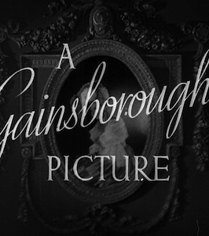
The Gainsborough Melodramas
This studios created in 1924 were based in London.
Despite the many films, they had to close in 1951.
Most of the films are set in an idolized and nostalgic past.
Many films were set in a simpler recent past since what the audience asked for, was films which reflect the simplicity and luxury of the pre-war life.
The themes these films dealt with were inspired in the Victorian literature:
  Love across class
  Social expectations for women at the time
Source:
https://www.filminquiry.com/history-british-cinema-1-rise-studio-film/
https://es.slideshare.net/ruthers64/history-of-british-cinema-16238974

Slide 6
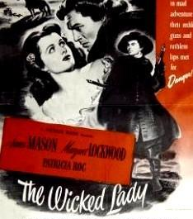
The Gainsborough Melodramas
Why the Gainsborough Melodramas were so influential?
New female audience:
  Women with financial and sexual independence.
  Families started to split up.
  Birth rate fell sharply
  contraceptive use increased
  Casual sexual relationships flourished.
Films provided the female audience with :
  Escapist fantasies set in the distant past.
  Powerful images of female independence and rebellion
The most iconic film of this type of cinema was:
  The Wicked Lady:
  A woman defying the social, moral and sexual code.
Source:
https://www.filminquiry.com/history-british-cinema-1-rise-studio-film/
https://es.slideshare.net/ruthers64/history-of-british-cinema-16238974

Slide 7
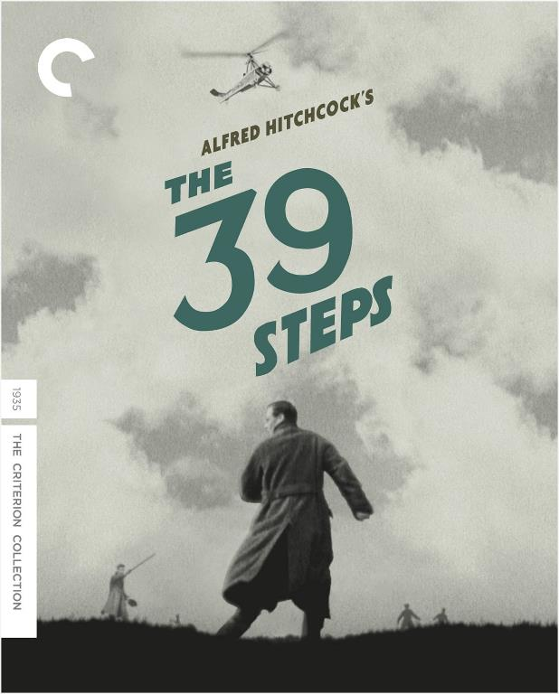
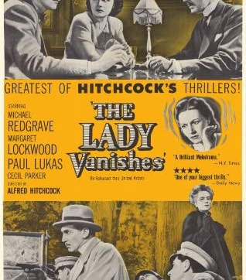
The 1930s
Everything should be presented by visual means, avoiding the use of "interminable dialogue, which must inevitably send a cinema audience to sleep"
Comedy was the predominant genre in this decade.
The most recognizable films of this period were those by Alfred Hitchcock.
The 39 steps
The Lady Vanishes
The Man Who Knew Too Much
Source:
https://www.filminquiry.com/history-british-cinema-1-rise-studio-film/
https://indiefilmhustle.com/hitchcock-create-suspense/
https://pov.imv.au.dk/Issue_04/section_2/artc1A.html

Slide 8
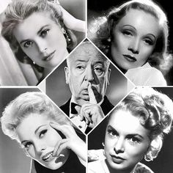
Hitchcock’s features:
Details:
  Importance of a thoroughly detailed screenplay
Voyeurism and sexuality
MacGuffin:
  Give specific importance to an item that it is irrelevant to the plot.
Blonde Women:
  Better seen in a black and white cinema
  Look of Goddess with an inner sexual passion.
Suspense, not surprise:
  Hitcock intended to build tension around what might occur so that the characters are not taken by surprise but rather they learn progressively the truth.
Emotions are vital in Hitchcock's narrative.
They are evoked by gripping situations given by the motion picture.
Source:
https://www.filminquiry.com/history-british-cinema-1-rise-studio-film/
https://indiefilmhustle.com/hitchcock-create-suspense/
https://pov.imv.au.dk/Issue_04/section_2/artc1A.html

Slide 9
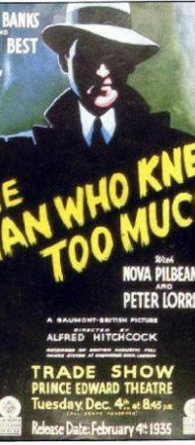
Difference between Surprise and suspense:
Suspense: audience is aware of what’s going to happen, but the anticipation is what makes it so nerve-racking.
Surprise: there is a shock because there’s no expectation of what’s to happen.
Technique:
Showing the audience what the character is unaware of.
show it at the beginning of the scene what might harm the character in the future.
Play the scene like there’s nothing wrong.
From time to time, remind the spectators of the pending threat.
“It is indispensable that the public is made aware of all the facts involved. Otherwise, there is no suspense.”
Source:
https://www.filminquiry.com/history-british-cinema-1-rise-studio-film/
https://indiefilmhustle.com/hitchcock-create-suspense/
https://pov.imv.au.dk/Issue_04/section_2/artc1A.html

Slide 10
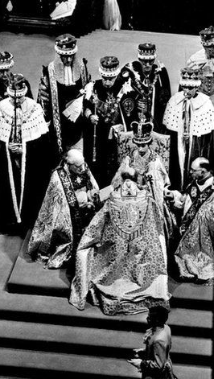
1940s-1950s
Was there any film that really outstood during these decades?
Compare
History
vs
Film
The 1940s:
Thought to be the golden era of British Cinema.
Britain was represented as a wealthy nation.
Directors did their most acclaimed work:
  David Lean
  Michael Powell
  Carol Reed
The 1950s:
Cinema at this period was bankrupted.
The two 2 cinema British companies had to close.
Genres developed :
  Comedies
  Documentary film
The most important film documentary in this period was the coronation of Queen Elisabeth II
Source:
https://www.filminquiry.com/history-british-cinema-1-rise-studio-film/
https://es.slideshare.net/ruthers64/history-of-british-cinema-16238974

Slide 11
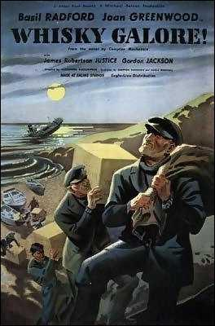
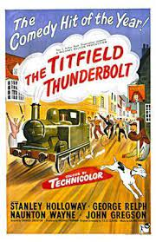
The Ealing Comedy
It combined British eccentricity with post-war anxieties
Themes:
Rural communities have to become united so to preserve their traditions against the will of outside forces
Focuses kindly on the stereotypes of the different nationalities across Britain.
Explored issues that affected the lives of those suffering in the aftermath of war.
Differences:
Gainsborough melodramas were escapism.
Ealing comedies dealt with war issues with a certain affection
Future influences:
The Englishman Who Went up a Hill but Came Down a Mountain
Post-war Britain was in the process of rebuilding its communities and culture, films explored the power of people were an important motivational force for film-goers
Source:
https://www.filminquiry.com/history-british-cinema-1-rise-studio-film/
https://es.slideshare.net/ruthers64/history-of-british-cinema-16238974

Slide 12
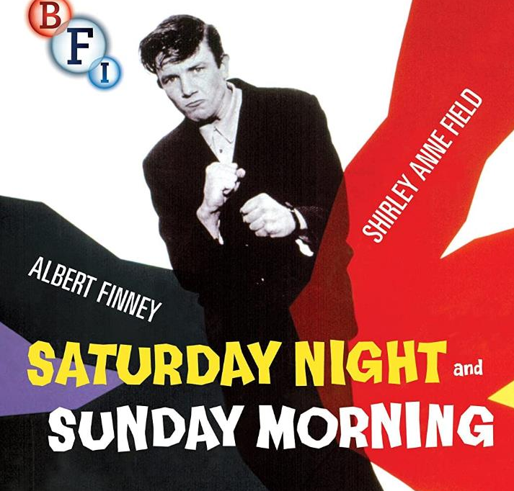
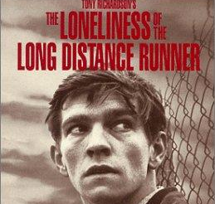
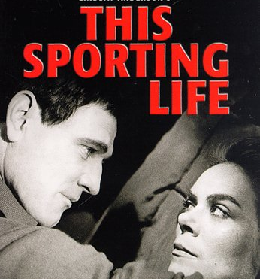
The 1960s: The ‘kitchen sink’ dramas:
Exposed the social problems of modern society
Offering a grim and austere image of the working-class youths in the North.
“Angry young men" disenchanted with modern society and spent their free time drinking at pubs
Raw and unpleasant themes which it dealt:
  Crumbling marriages, the hard work of unskilled work, sexual orientation, blocked aspirations, abortions, marginalized youth, homelessness, class and race discrimination.
Source:
https://www2.bfi.org.uk/news-opinion/news-bfi/features/where-begin-kitchen-sink-dramas

Slide 13
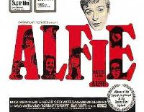
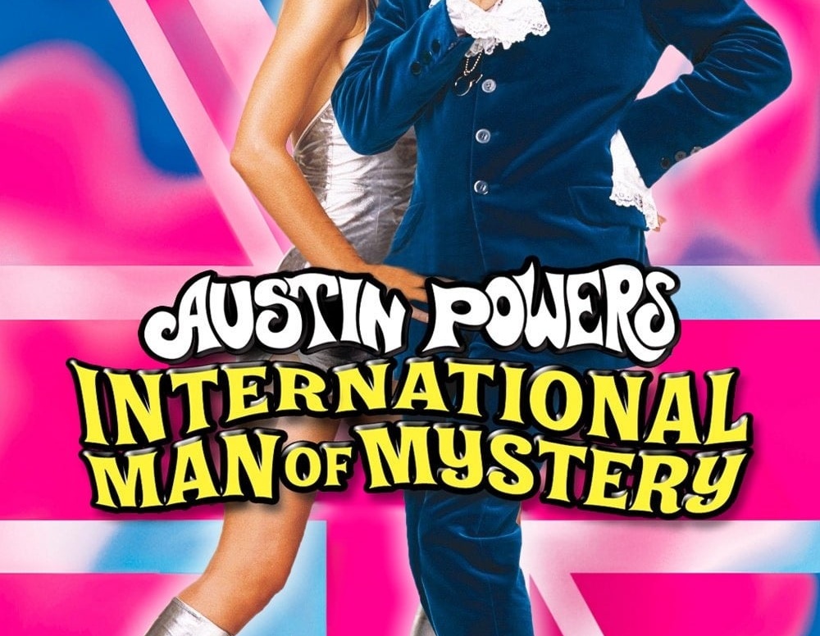
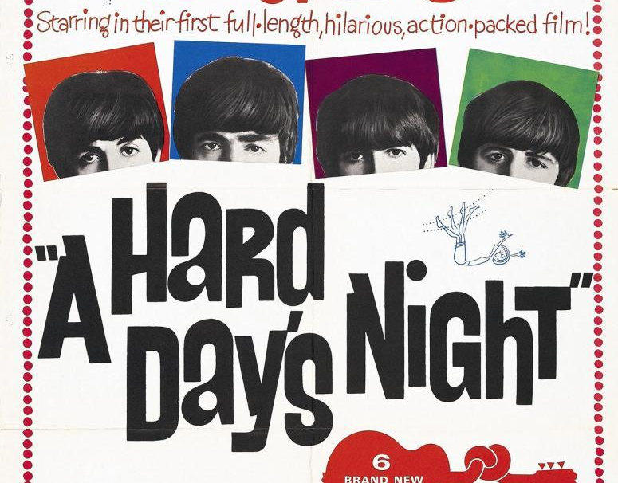
1960s: The ‘Swinging London’ films:
Offered a colorful and glamorous portrait of London where authority and morals seem to be collapsing due to the seductive but destructively new youth culture.
Britain was undergoing a cultural revolution symbolized by:
  Pop music and fashion (Beatles, the miniskirt)
  Iconic shopping areas: the King’s Road, Kensington and Carnaby Street;
  The political involvement of anti-nuclear campaigns;
  The sexual revolution
Source:
https://thehistoryvault.co.uk/memory-and-the-movies-1960s-cinema-going-in-britain/
https://mubi.com/es/lists/swinging-london-1964-1967

Slide 14
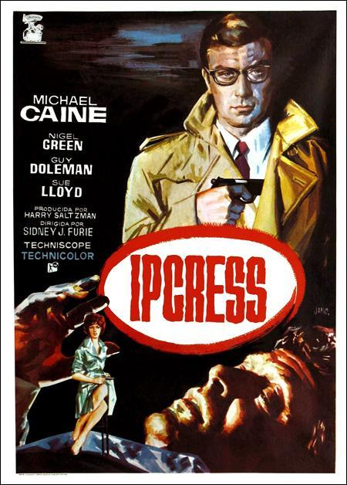
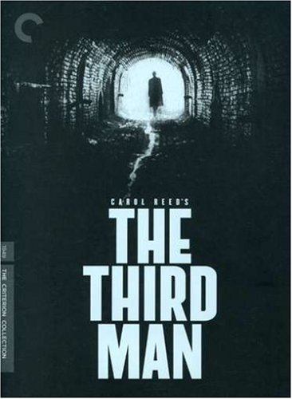
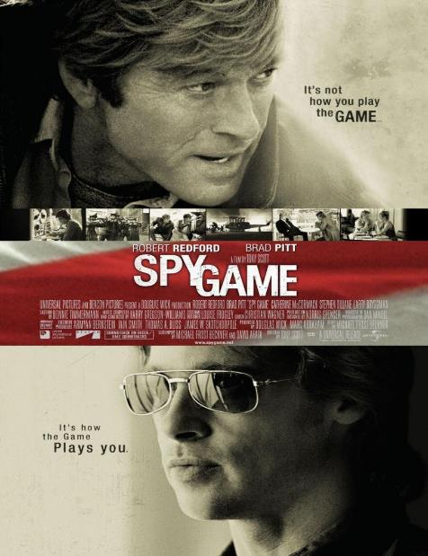
1960s: The Spies
American film companies supported financially the British cinema.
Causes and Implications of the Spy Films Boom:
  Socialisation of politics: Demands for democratic participation and partnership by ordinary people forced into the open the remaining hidden, secret organs of the State.
  Cold War a “war in the mind”: the participants anticipated hypothetical scenarios and projected their own thinking onto their respective opponents.
  The adaptation of spy novels
  New features: special effects and action-packed scripts
Eastern Spy films:
Trumpeted the superior values of socialism
A means of critical reflection on the logic of the Cold War
Source:
https://www.bpb.de/gesellschaft/bildung/filmbildung/63199/the-cold-war-in-the-cinema

Slide 15
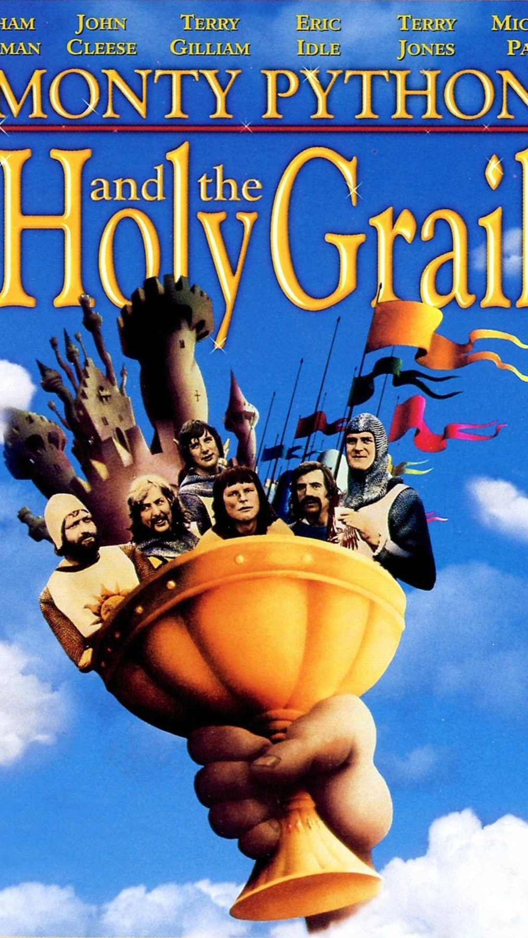
1970s: The Monty Python
Group of Oxford educated comedians.
Started as a British television comedy sketch
A 1960s symbol of the social upheaval and youth-oriented counterculture.
They produce daring, surreal, unorthodox and untraditional sketches.
Their humour was sarcastic, scatological, and intellectual.
Satirise the idiosyncrasies of British life
Use of stream of consciousness technique in the sketches.
Scripts were democratically written: if the majority found the idea to be humorous, it would be included in the show.
Difference in the conception of humor:
  Oxford-educated: was more visual, and conceptually more bizarre
  Cambridge-educated: more verbal and more aggressive
Muchachada Nui?
La hora Chanante?
Source:
https://montypython.fandom.com/wiki/Monty_Python
https://www.britannica.com/topic/Monty-Pythons-Flying-Circus

Slide 16
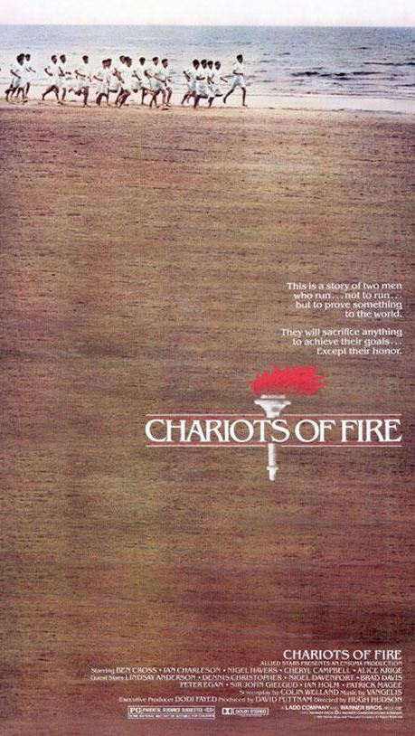
80-90s:Thatcherism and British Cinema
Policies of deregulation so to create a rapid free market in all industries, breaking down state monopolies and opening up new areas for competition.
Britain moved from being a society whose philosophy was based on collective solutions to a culture of free enterprise.
Thatcher’s program:
  Control of inflation
  Reduction of public expenditure.
  Reduction of taxation
  Reform the trade unions, and reduce its power
  Deregulate the labor market
  Privatization of the public own corporations.
  Victory in the Falkland's a rebirth of national spirit.
Chariots of Fire embodied the values of the Thatcher administration (hard work, self-improvement, individualization with society)
The wining of the British boys was parallel to winning the Falklands.
Source:
https://www2.bfi.org.uk/sites/bfi.org.uk/files/downloads/bfi-back-to-the-future-the-fall-and-rise-of-the-british-film-industry-in-the-1980s.pdf

Slide 17

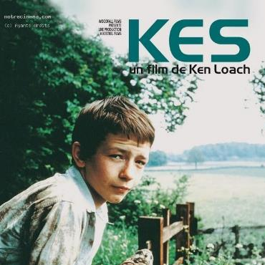
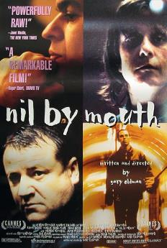
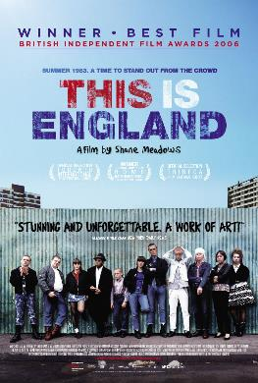

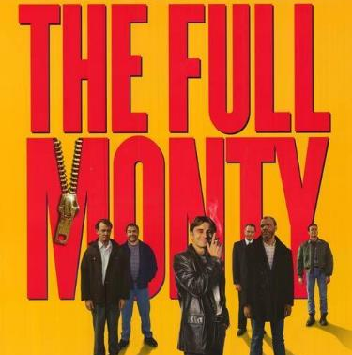
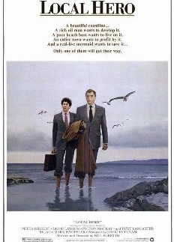
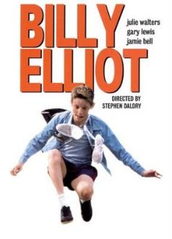
80-90s:Thatcherism and British Cinema
There are two different currents in the portrait of the Working class:
Visceral depiction: it shows how the class system affects negatively (almost violently) the family life, the relationships and even the growing up.
  Kes
  This Is England
  I, Daniel Blake
Stereotyped depiction: terraced housing, northern accents, macho males and the remains of grim industrial factories. Very much stereotyped and not very realistic. Its ends, however, have finals that seem to depict victory of the working class
  Full Monty
  Billy Elliot
Source:
https://aaronguthrie.medium.com/the-representation-of-class-in-contemporary-british-film-and-tv-afc5882dd7d3
http://artsites.ucsc.edu/faculty/gustafson/FILM%20162.W10/readings/hill.britcinema.pdf

Slide 18
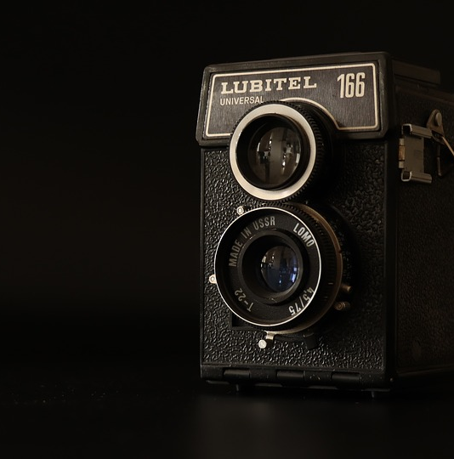
Nowadays British Cinema
There is a renaissance of British cinema.
Why?
Social:
  Audience’s Age: the 45+ age group has become one of the largest growth markets in UK cinemas. They prefer more mature characters and strong storylines.
  British actors and directors are on demand: Olivia Colman, James McAvoy, Carey Mullighan, Christian Bale; Danny Boyle and Peter Greengrass
Cultural:
  Themes: The British audience appreciate Films which they can comment afterwards at cafés or pubs. Consequently films based on literary works or specific aspects of social history or parts of the country are often well received.
Economic:
  Warner Bros Leavesden, Pinewood and Shepperton Studios are financially doing very well.
Source:
https://www.managementtoday.co.uk/british-film-industry-back-brink/food-for-thought/article/1580814
https://www.independentcinemaoffice.org.uk/advice-support/how-to-start-a-cinema/understanding-audiences/

Slide 19
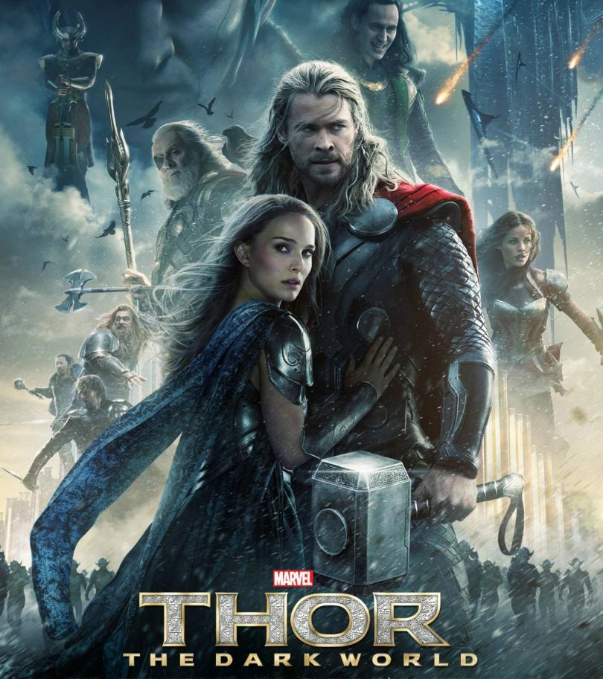
What makes a film to be British
The British Film Institute officially labels a film being British if it passes a sort of cultural test.
A film has to score at least 16 points out of 31 to pass.
The cultural test is based on whether certain conditions are fulfilled:
  Characters speaking English
  British locations are used
  Cast and crew are British.
Source:
https://www.slideshare.net/EmmaJaneSixx/what-makes-a-film-british-57824328

Slide 20
Cultural Test by BFI
Section A: Cultural Content (Total18 points)
  Film set in the UK or EEA 4 p.
  Lead characters British or EEA citizens or residents 4 p.
  Film based on British or EEA subject matter or underlying material 4 p.
  Original dialogue recorded mainly in English or UK indigenous language or EEA language 6 p.
Section B Cultural Contribution (Total 4 points)
  The film demonstrates British creativity, British heritage and/or diversity 4p.
Section C Cultural Hubs (Total 5 points)
  At least 50% of the principal photography or SFX takes place in the UK 2p.
  At least 50% of the VFX takes place in the UK 2 p.
  If 80% of principal photography or VFX or SFX takes place in the UK 2 p.
  Music Recording/Audio Post Production/Picture Post Production 1 p.
Section D Cultural Practitioners: (Total Section 8 points)
  Director 1 p. // Scriptwriter 1 p. // Producer 1 p. // Composer 1 p. // Lead Actors 1 p. // Majority of Cast 1 p.
  Key Staff (lead cinematographer, lead production designer, lead costume designer, lead editor, lead sound designer, lead visual effects supervisor, lead hair and makeup supervisor) 1 p.
  Majority of Crew 1 p.
Source:
https://www.slideshare.net/EmmaJaneSixx/what-makes-a-film-british-57824328

Slide 21
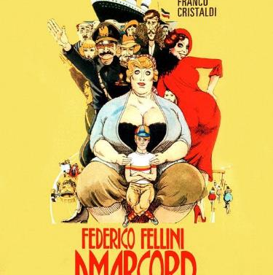
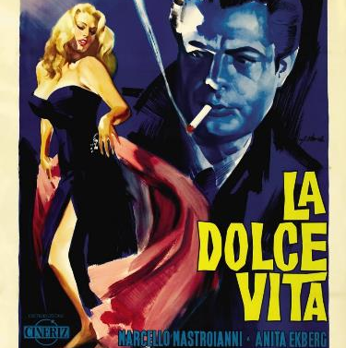
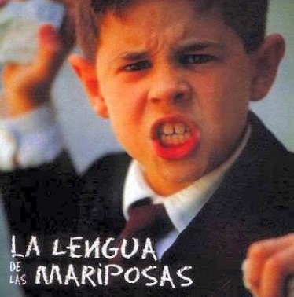
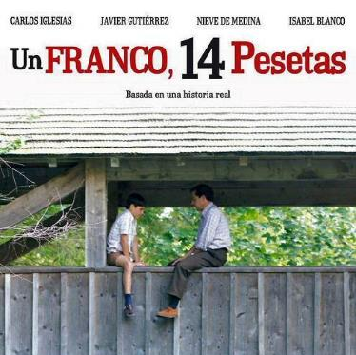


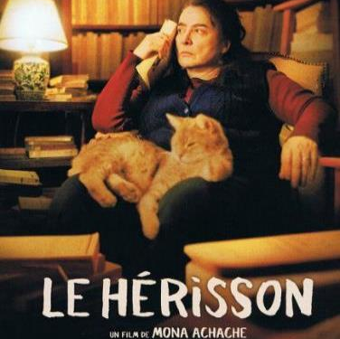
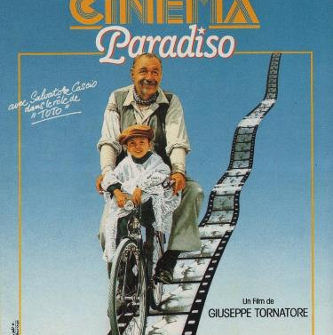




European cinema
Why not compare it?
What themes do they deal with?
Is there any similarity?
Is there any national identity?

Slide 22
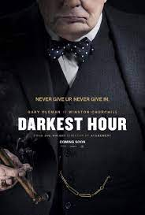

Practice: Compare films
European cinema
How do French portrait their national figures?
How do English portrait themselves?
What self-conception do each country have of themselves?

Slide 23
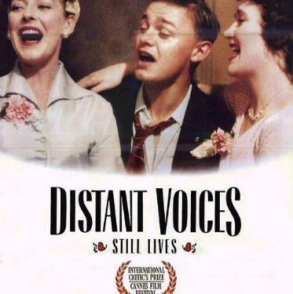
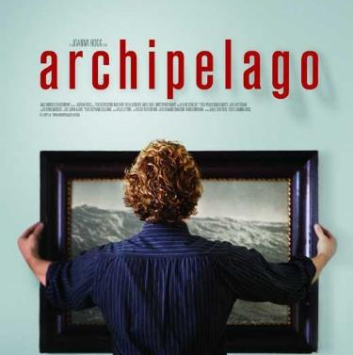
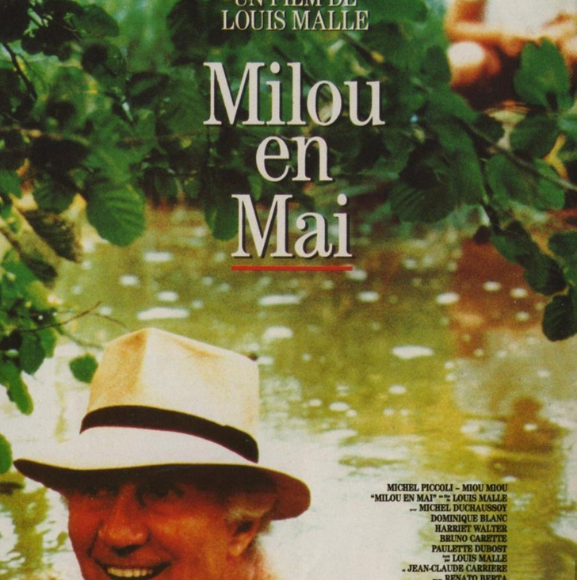


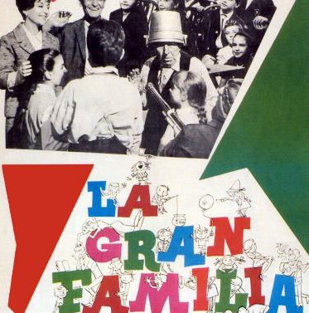

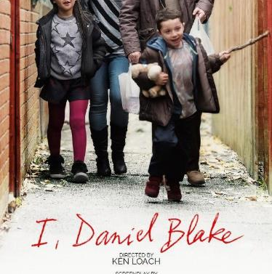
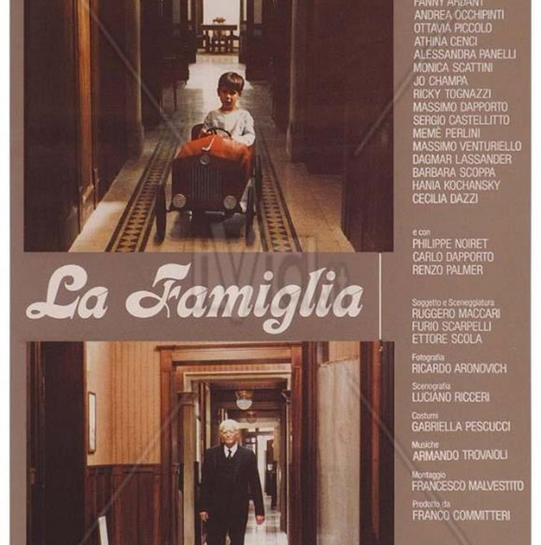
Practice: Compare films
European cinema
How do each cinema portrait the family?
What is the tone of the films?
Does it represent the family nowadays? Is there any change? Why?
Evolution of houses

Slide 24

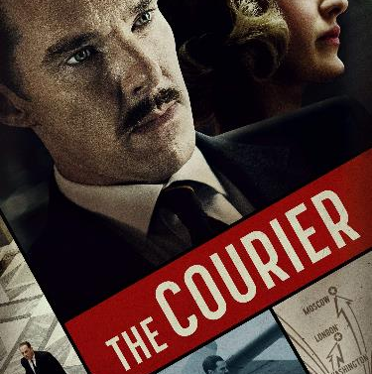


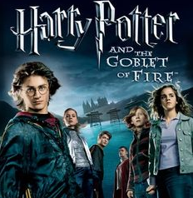

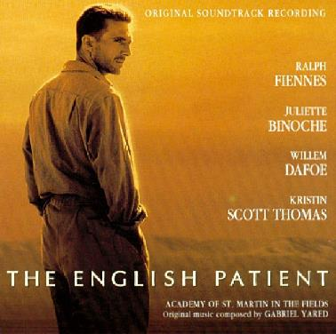

Are these films British?
Rate them according to the BFI cultural test
Can you suggest any other British film?

Slide 25
Webgraphy?
Anónimo. 2013. History of the British Cinema. Slideshare. Recuperado de: https://es.slideshare.net/ruthers64/history-of-british-cinema-16238974
Anónimo. 2021. The 100 Greatest Films of All Time. BFI. Recuperado de: https://www.bfi.org.uk/sight-and-sound/greatest-films-all-time
Anónimo. S.f. Hitchcock's cinematic style: a study of Marion Crane's metaphorical journey into darkness. POV. Recuperado de: https://pov.imv.au.dk/Issue_04/section_2/artc1A.html
Anónimo. S.f. Monty Python. MontyPython Fandom. Recuperado de: https://montypython.fandom.com/wiki/Monty_Python ç
Anónimo. s.f. Películas preciosas, interesantes e increíbles. MUBI. Recuperado de: https://mubi.com/es/lists/swinging-london-1964-1967
Anónimo. S.f. The British Cinema and Thatcherism. UC Santa Cruz. Recuperado de: http://artsites.ucsc.edu/faculty/gustafson/FILM%20162.W10/readings/hill.britcinema.pdf
Anónimo. S.f. Understanding Audiences: Different films, different people. Independent Cinema Office. Recuperado de: https://www.independentcinemaoffice.org.uk/advice-support/how-to-start-a-cinema/understanding-audiences/
Anónimo.2021. 6 Filmmaking Techniques Alfred Hitchcock Used to Create Suspense. Indie Film Hustle. Recuperado de: https://indiefilmhustle.com/hitchcock-create-suspense/
Bedford, Tom. 2018. The History of British Cinema Part 1: The Rise Of The Studio Film. Film inquiry. Recuperado de: https://www.filminquiry.com/history-british-cinema-1-rise-studio-film/
Britannica, The Editors of Encyclopaedia.2022. "Monty Python's Flying Circus". Encyclopedia Britannica, Recuperado de: https://www.britannica.com/topic/Monty-Pythons-Flying-Circus
Classen, Christoph. 2011. The Cold War in the Cinema: The Boom in Spy Films in the 1960s, its Causes and Implications. Bundeszentrale für polistische Bildung. Recuperado de: https://www.bpb.de/lernen/filmbildung/63199/the-cold-war-in-the-cinema-the-boom-in-spy-films-in-the-1960s-its-causes-and-implications/
Guthrie, Aaron. 2015. The representation of class in contemporary British Film and TV. Aaron Guthrie. Recuperado de: https://aaronguthrie.medium.com/the-representation-of-class-in-contemporary-british-film-and-tv-afc5882dd7d3
Jones, Matthew. S.f. Memory and the Movies: 1960s Cinema-going in Britain. The History Vault. Recuperado de: https://thehistoryvault.co.uk/memory-and-the-movies-1960s-cinema-going-in-britain/
Laffoley, Emma Jane. 2016. What makes a film British? SlideShare. Recuperado de: https://www.slideshare.net/EmmaJaneSixx/what-makes-a-film-british-57824328
Mitchell, Neil. 2016. Where to begin with kitchen sink drama. BFI. Recuperado de: https://www2.bfi.org.uk/news-opinion/news-bfi/features/where-begin-kitchen-sink-dramas
Simpson, Paul. 2019. How the British film industry came back from the brink. Management Today. Recuperado de: https://www.managementtoday.co.uk/british-film-industry-back-brink/food-for-thought/article/1580814
Wickham, Phil y Mettler, Erinna. 2005. The Fall and Rise of the British Film Industry in the 1980s. BFI. Recuperado de: https://www2.bfi.org.uk/sites/bfi.org.uk/files/downloads/bfi-back-to-the-future-the-fall-and-rise-of-the-british-film-industry-in-the-1980s.pdf

