Slide 1
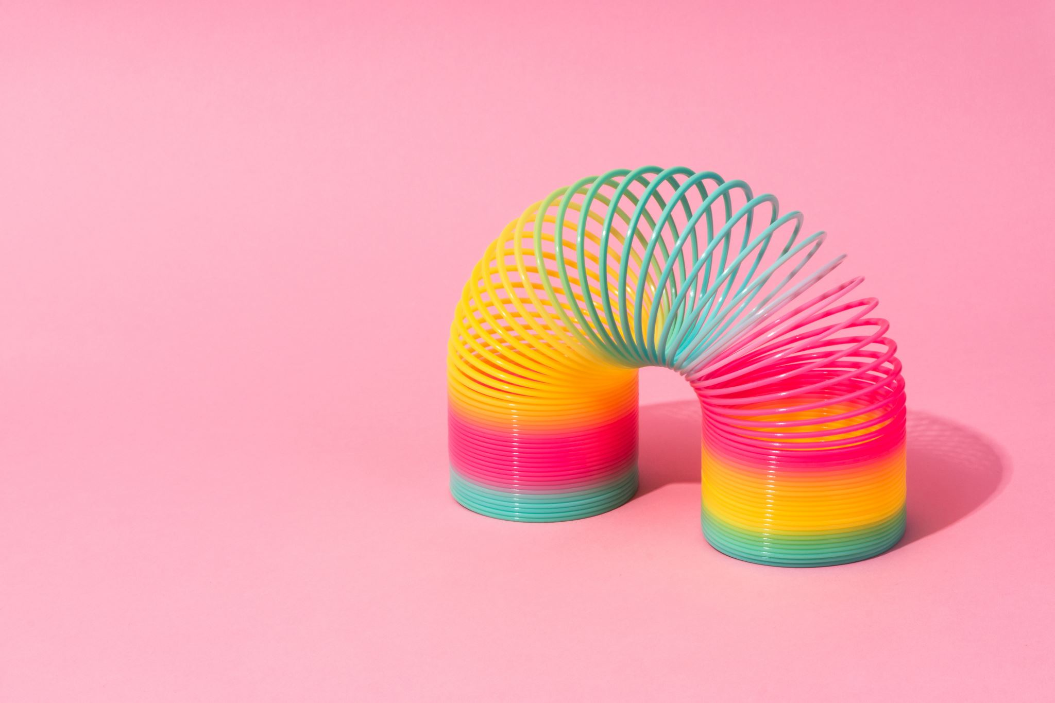
GRAPHIC ORGANISERS
TO IMPROVE WRITING SKILLS

Slide 2
Tell us about yourself...
What you teach
If you already use graphic organisers
What you hope to get from today...
Graphic overload!

Slide 3

Talk outline
GRAPHIC ORGANISERS​
1. Definition​
2. Book review organisers
- Flow map ​
3. Brainstorming​
- Bubble maps​
- Circle maps​
  T maps​
4. Compare & contrast​
- Venn diagrams​
- Multi-bubble map​
5. Cause & effect​
6. Others​
- Tree map​
- Brace map​
- Bridge map

Slide 4
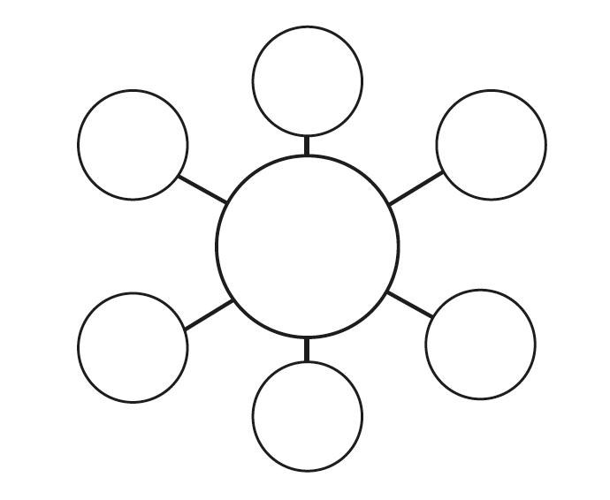

Talk outline
Tree mapTree map
GRAPHIC ORGANISERS
1. Definition
2. Book review organisers
- Flow map
3. Brainstorming
- Bubble maps
- Circle maps
  T maps
4. Compare & contrast
- Venn diagrams
- Multi-bubble map
5. Cause & effect
6. Others
- Tree map
- Brace map
- Bridge map
Flow map
Brace map
T maps
Bubble maps
Tree map
Bridge map
Definition
Circle maps
Brainstorming
Others
V
GRAPHIC
ORGANISERS
Book review
organisers
Compare
& contrast​
Venn diagrams
Cause
& effect
Multi-bubble
map
Flow map

Slide 5
1. Description
Removing
Language
barriers
Breaking down
information
Showing, not telling
ADVANTAGES
Can be an
end in themselves
Force of dual presentation
Focus on process

Slide 6
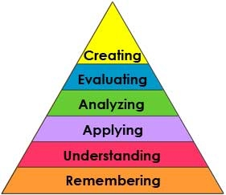
BLOOM
HOTS: Higher Order Thinking Skills
LOTS: Lower Order Thinking Skills
Relate, copy, describe, repeat & tell

Slide 7
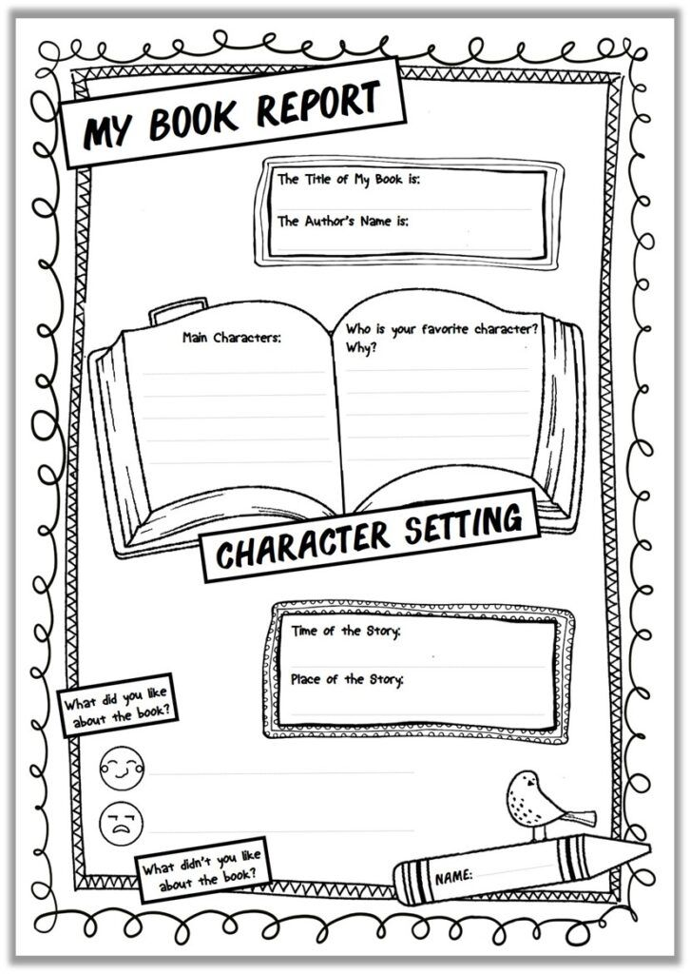
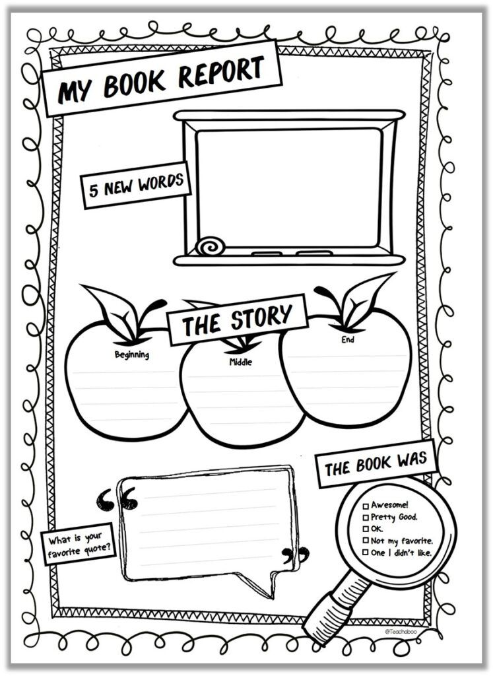
2. book reviews
http://www.teachaboo.com/printable-book-report-book-review/

Slide 8

IMPROVING THE BLANK PAGE
Nothing so facilitates good writing...
...as actually having something to say.
T.S. Elliot

Slide 9
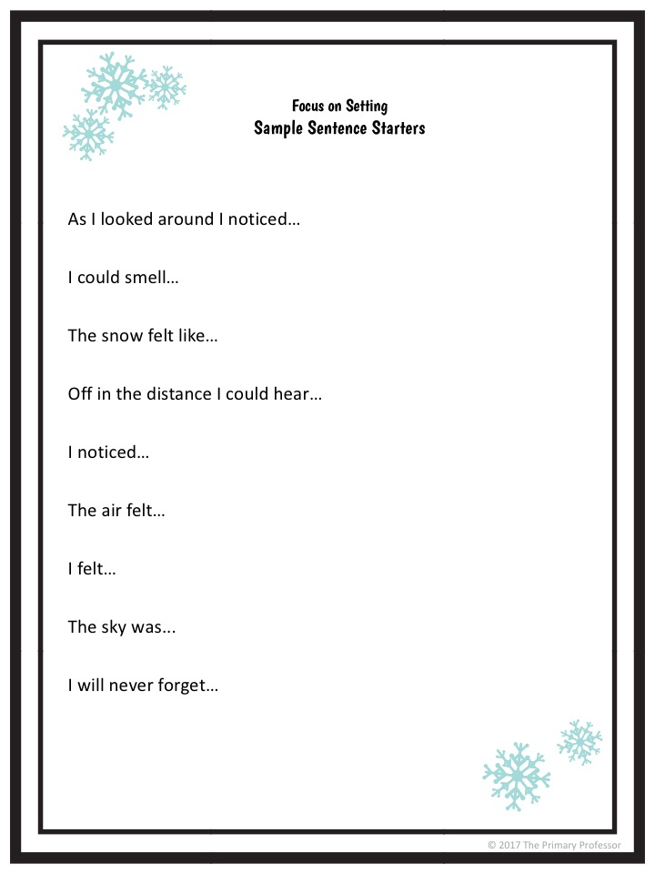
Sentence starters
Image from: https://www.teachwriting.org/blog/2017/12/19/descriptive-writing-lesson-a-winter-setting

Slide 10
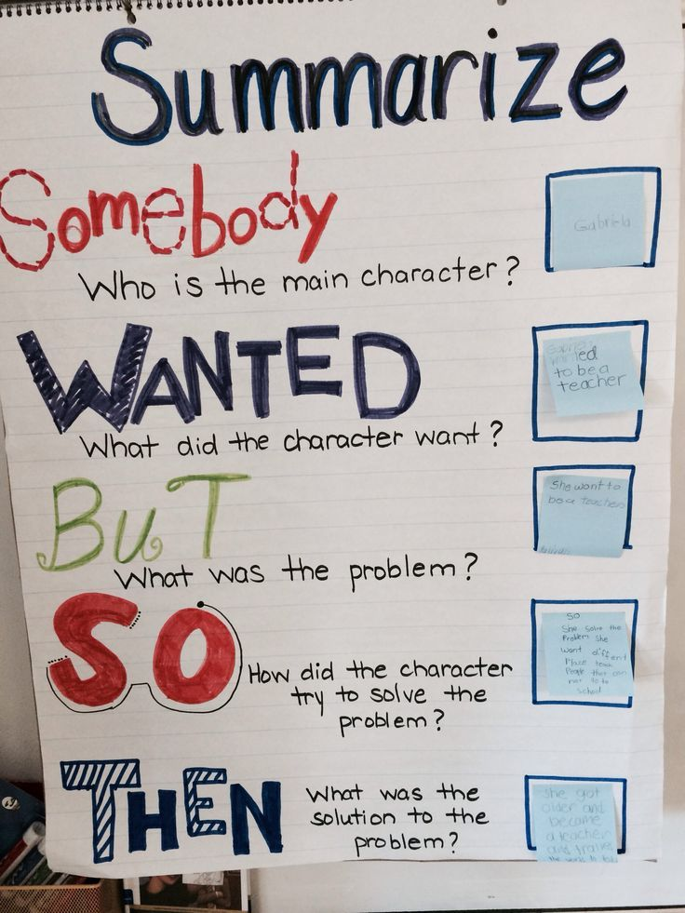
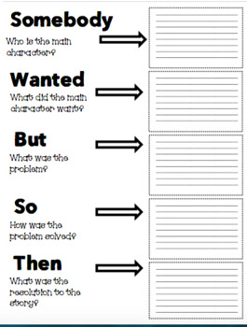
https://www.teacherspayteachers.com/Product/Somebody-Wanted-But-So-Then-Graphic-Organizer-3151583

Slide 11
Reflexion...
CHOOSE AN ORGANISER WHICH FITS THE BOOK
What do you want them to think about?
Visible thinking
Organising for future writing
Characters
Setting
Plot
Beginning
Middle
End
Situation
Problem
Solution

Slide 12
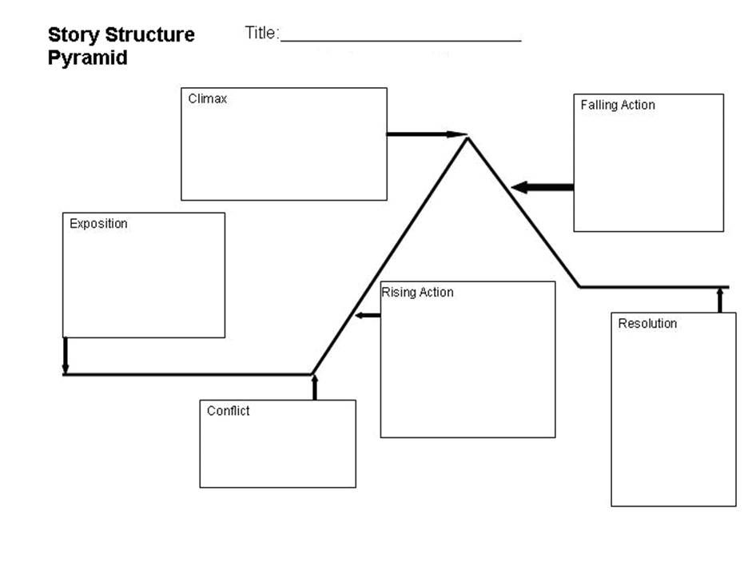
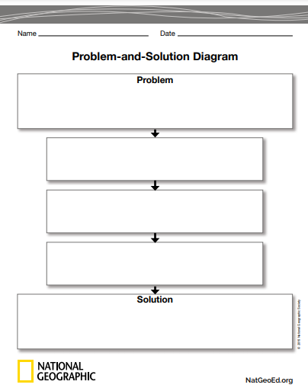
https://www.ereadingworksheets.com/worksheets/reading/story-structure/story-structure-graphic-organizer-01/
https://awritingvice.wordpress.com/2016/03/13/writing-plot-worksheets/

Slide 13
.
.
.
2a. FLOW MAP

Slide 14
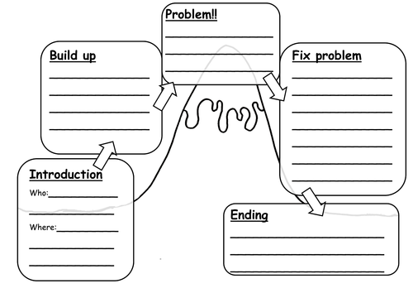
Graphic story organiser: sequence
First
Next
Then
Finally
https://www.tes.com/teaching-resource/story-mountain-6335177

Slide 15
The more you think about something,
The more connections you make,
The better your learning

Slide 16
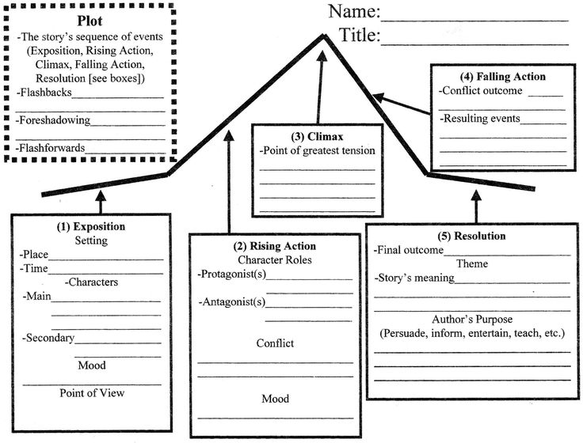
Graphic story organiser: make links
https://ferisgraphics.blogspot.com/2018/04/daedalus-and-icarus-graphic-organizer.html

Slide 17
BLOOM
Identifying a problem and the solution...
At what level are the students
engaged?
Choose, identify, solve...
Compare, explain, interpret
Relate, copy, describe, repeat & tell

Slide 18
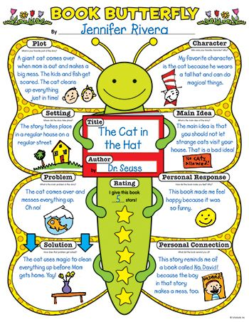
Story organisers
Don't loose sight of your real aim
Is the story map an end in itself?
Do you want them to write the summary? Linking words
Do you want them to write a parallel story?
Try to get your students thinking
Make personal connections

Slide 19
brainstorming
Obtaining and organising ideas

Slide 20
3a. BUBBLE MAP

Slide 21
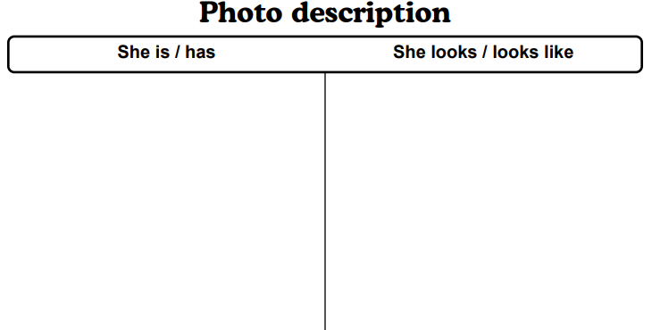





.
Description and T chart
slim
Well-dressed
… surprised
… slim
… well-dressed
… Chinese ??
… a secretary?
Chinese
surprised
secretary

Slide 22




.
Description and T chart
slim
well-dressed
… surprised
… Chinese
… a secretary (or an executive?)
… slim
… well-dressed
… of Asian origin
… a tablet
Chinese
surprised
secretary

Slide 23
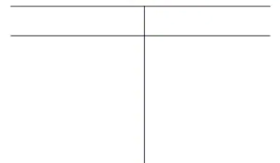
3b. "T" CHART

Slide 24
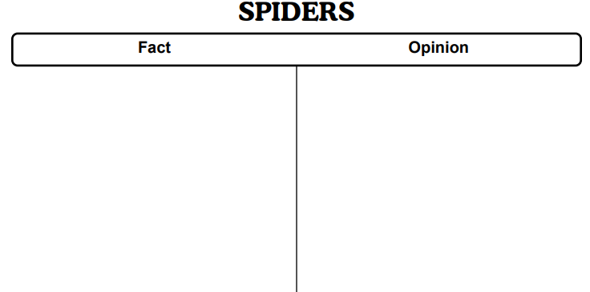








.
8 legs 8 legs
horrible
Spider map and T chart
horrible
8 legs
... 8 legs … horrible
… arachnids … ugly
… webs
webs
arachnids
ugly

Slide 25





8 legs 8 legs
horrible
Spider map and T chart
8 legs
horrible
has
is
... 8 legs … horrible
… arachnids … ugly
… webs
is
spins
is
webs
arachnids
ugly

Slide 26
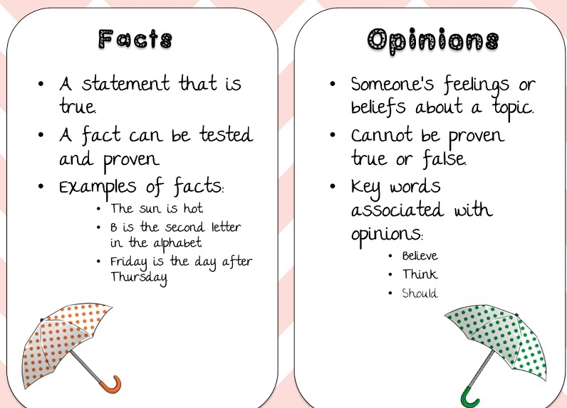
https://www.edrawmax.com/t-chart/

Slide 27
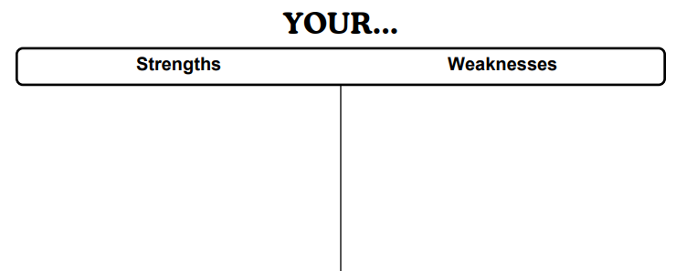
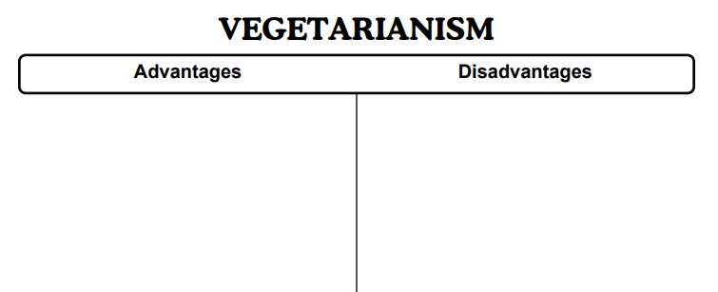
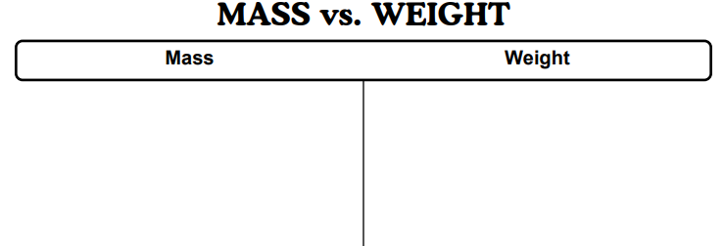
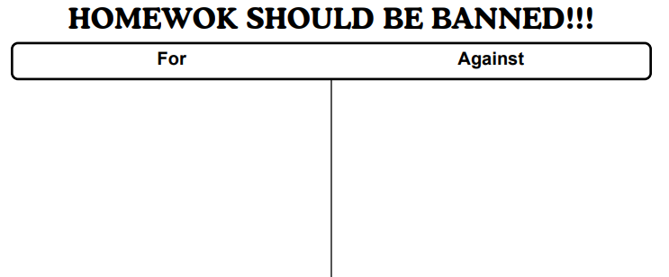
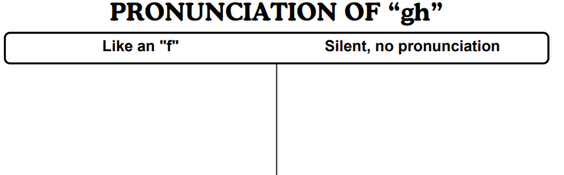
True & false
Then & now
Before & after...
Make your own conclusion!
Templates generated by: https://www.worksheetworks.com/miscellanea/graphic-organizers/tchart.html

Slide 28
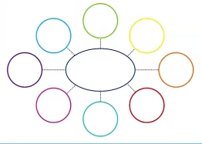
BUBBLE PROBLEMS
ENERGY
Tex.o
Image from: Twinkl

Slide 29
BUBBLE PROBLEMS:
Success
Or
Failure?
SOLAR
NUCLEAR
ENERGY
FOSSIL
Preestablished nº of bubbles
Random use of colours
WIND
Tex.o
Image from: Twinkl

Slide 30
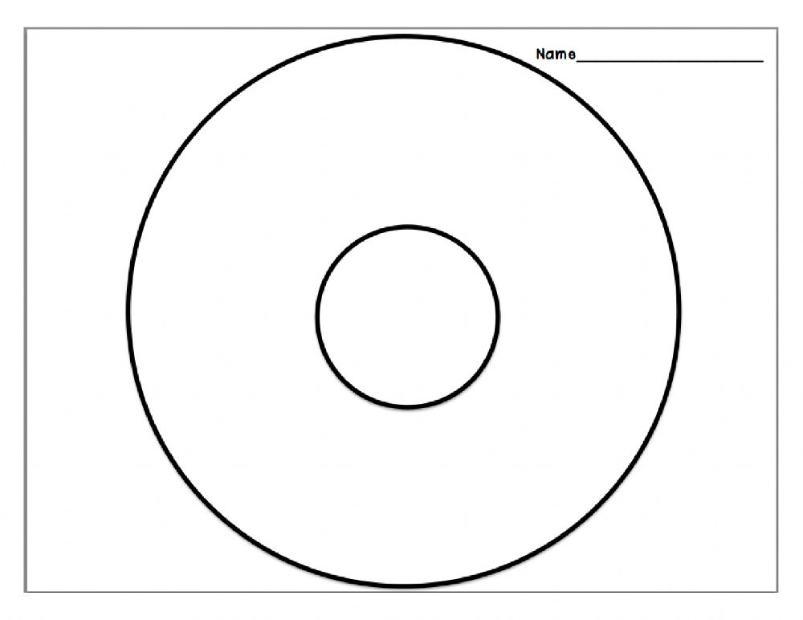
Brainstorming
3c. CIRCLE MAP

Slide 31
COMPARE & COMMENT
SOLAR
NUCLEAR
FOSSIL
FOSSIL
ENERGY
WIND
SOLAR
ENERGY
WIND
NUCLEAR
Tex.o
Image from: Twinkl

Slide 32
Preparing a 4 paragraph essay
ENERGY
RENEWABLE
NON-RENEWABLE
FOSSIL
Gas
WIND
SOLAR
ENERGY
Biomass
NUCLEAR
Hydroelectric
Use a different colour for each level.
Each level is a paragraph.
The first level is the introduction. Thesis sentence!
The 2nd line gives the key sentences to the next 2 paragraphs
The 3rd line is the body of each paragraph
Concusion (Repeat the beginning, NO new information)

Slide 33
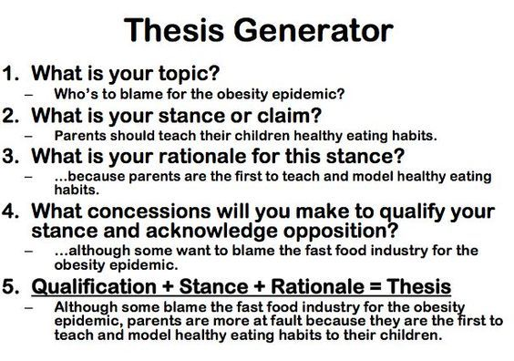
Thesis statement
ENERGY
RENEWABLE
NON-RENEWABLE
Each level is a paragraph.
The first level is the introduction. Thesis sentence!
The 2nd line gives the key sentences to the next 2 paragraphs
The 3rd line is the body of each paragraph
Concusion (Repeat the beginning, NO new information)

Slide 34
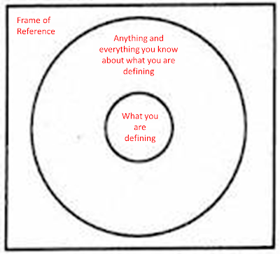
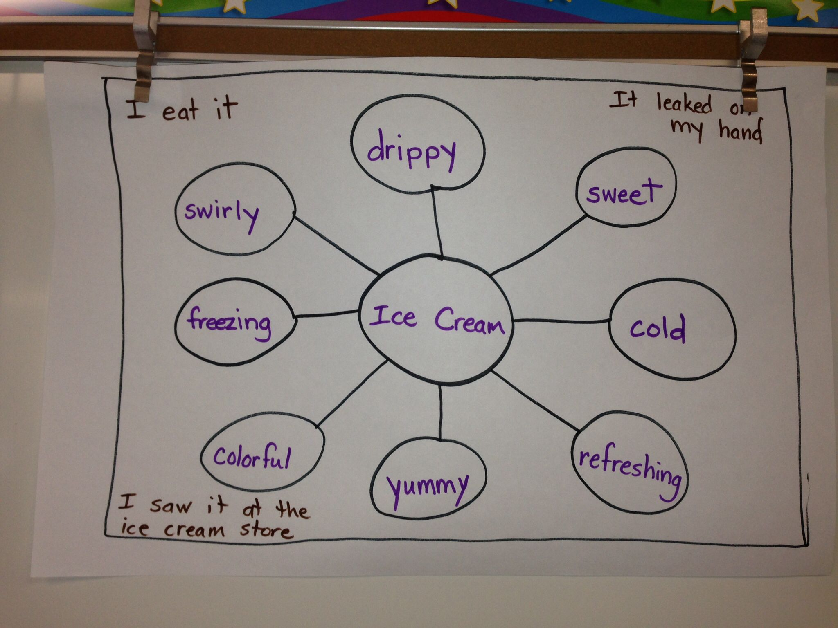
BRAINSTORMING organisers: reflexions
Use a circle map to collect info
Let them draw only the bubbles they need
How are you going to use the info?
Do you need to reorganise it? Colours!! T charts.
Language needs: T chart.
Spend time on the thesis sentence

Slide 35
Bubble map writing activity
A poem

Slide 36
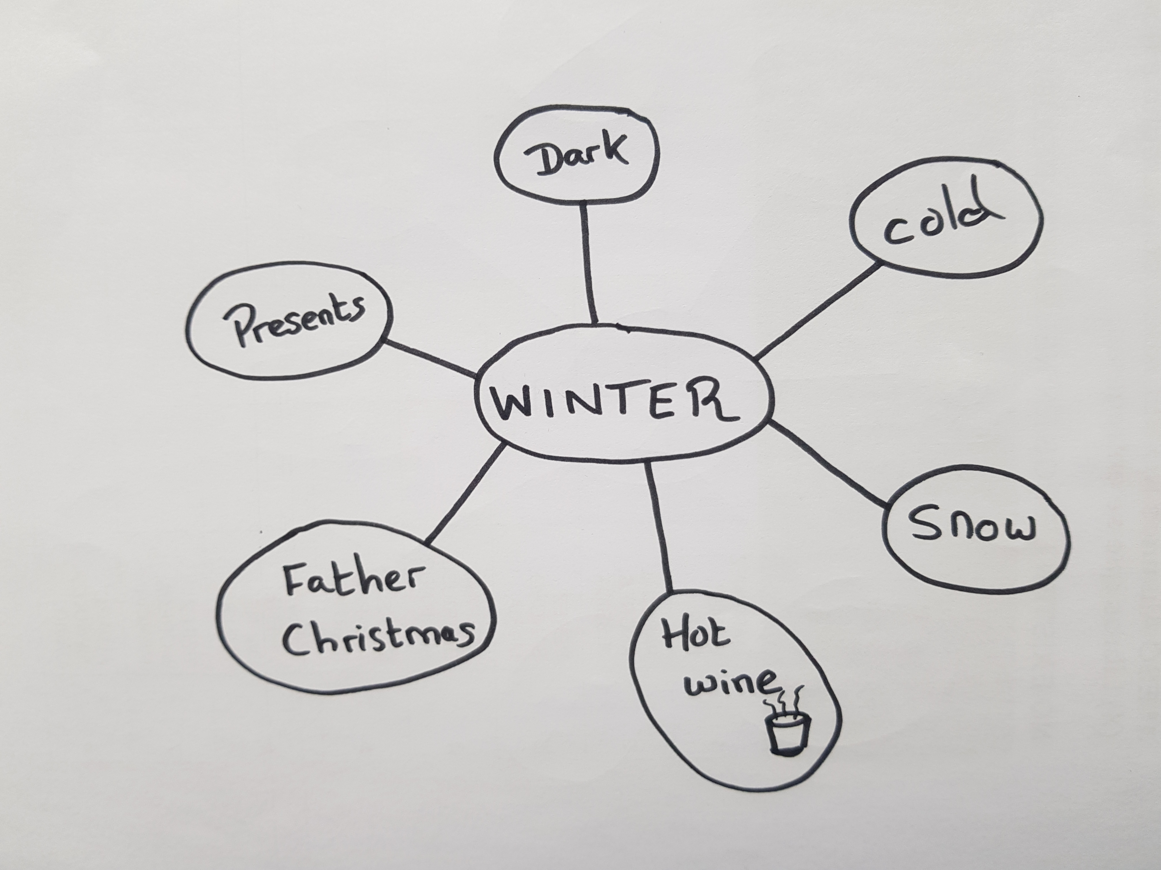
WINTER is...
...PRESENTS
...DARK
...COLD
...SNOW
...HOT WINE
...FATHER CHRISTMAS
More detail for each idea: where, when, who with...

Slide 37
WINTER is...
Winter is...
Winter is...
Winter is...
Winter is...
Winter is...
Winter is...
SNOW in the air
COLD in my fingers
HOT WINE in my hands
DARK in the streets
FATHER CHRISTMAS in the sky
PRESENTS under the tree
WINTER!​
By Noelle

Slide 38
compare & contrast
Organising and comparing ideas

Slide 39
BLOOM
HOTS: Higher Order
Thinking Skills
Differenciate, link, attribute, question, structure, deduce, compare, contrast...
Choose, identify, solve...
Compare, explain, interpret
Relate, copy, describe, repeat & tell

Slide 40
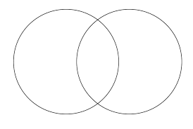
4a. VENN DIAGRAMS

Slide 41
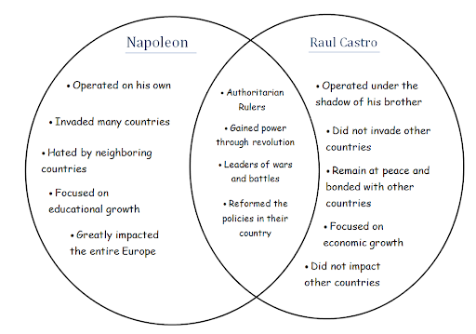
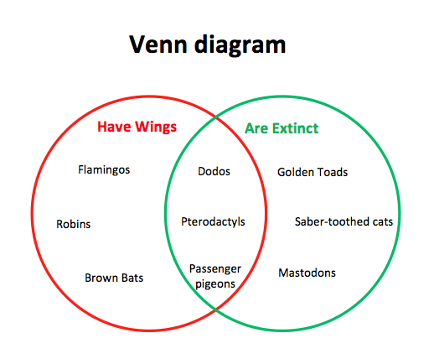
Venn diagrams
Images from: https://www.mywordtemplates.org/diagram/template1501.html
https://www.google.com/url?sa=i&url=http%3A%2F%2Fgorppoll.weebly.com%2Fvenn-diagram-napoleoncastro.html&psig=AOvVaw2JlsqXhgs0-qy0ZCh-wFD1&ust=1620287557593000&source=images&cd=vfe&ved=0CAIQjRxqFwoTCMi-qNSHsvACFQAAAAAdAAAAABAE

Slide 42
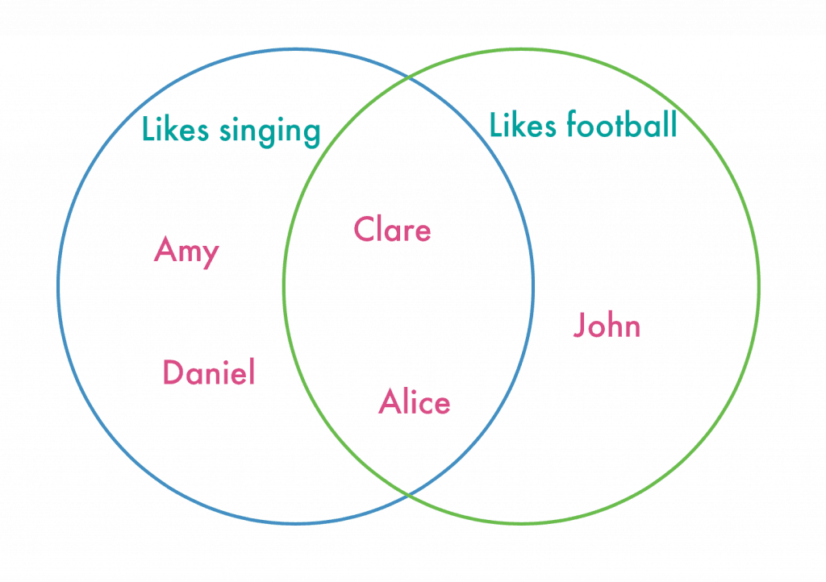
Venn diagram:
Survey
Pepe
Language:
Two of us like...
Only one of us likes...
Two of us like both... and ...
https%3A%2F%2Fnurturestore.co.uk%2Feasy-venn-diagram-lesson-with-printable&psig=AOvVaw37mE8tTl9ajCIYYoiqrCbQ&ust=1619436275357000&source=images&cd=vfe&ved=0CAIQjRxqFwoTCMir67GkmfACFQAAAAAdAAAAABAP://www.mywordtemplates.org/diagram/template1501.html
Pepe likes NEITHER … NOR...

Slide 43
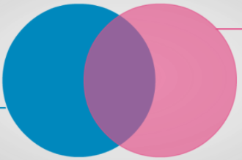
Venn diagram: hiStory
Language: IN THE PAST v NOW (Also good for T chart)
Contrast past and present ...ate v eat
… lived v live
Image created with: https://creately.com/blog/examples/venn-diagram-templates-examples/#blankVenn
https%3A%2F%2Fnurturestore.co.uk%2Feasy-venn-diagram-lesson-with-printable&psig=AOvVaw37mE8tTl9ajCIYYoiqrCbQ&ust=1619436275357000&source=images&cd=vfe&ved=0CAIQjRxqFwoTCMir67GkmfACFQAAAAAdAAAAABAP://www.mywordtemplates.org/diagram/template1501.html

Slide 44
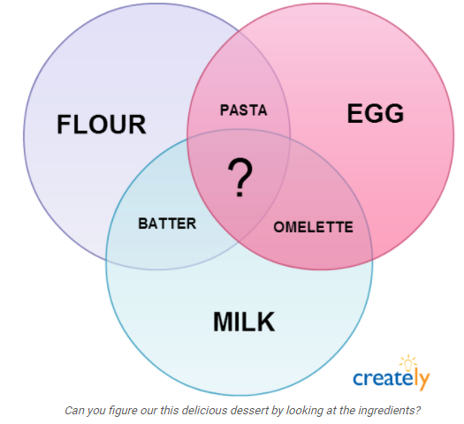
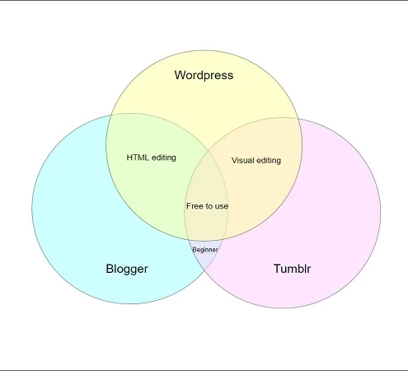
And even...
Making a riddle!!
Passive voice:
Flour and eggs are used to...
Flour and milk can be used to...
https://https://gitmind.com/venn-diagram-template.html.com/venn-diagram-template.html​
https://https://gitmind.com/venn-diagram-template.html.com/venn-diagram-template.html
https://creately.com/blog/diagrams/creative-venn-diagrams/

Slide 45
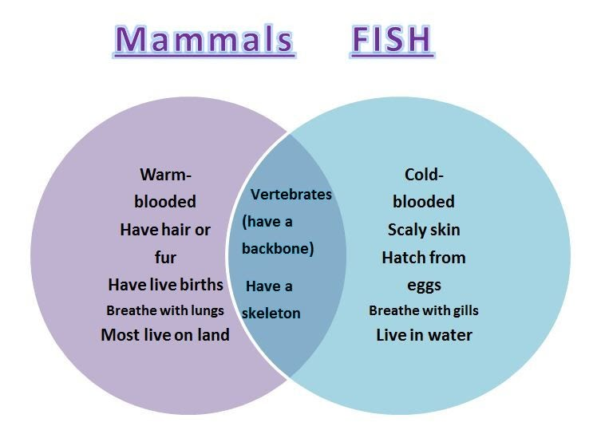

Science: compare animals
https://www.jockington.com/2020/10/mammals-vs-birds-venn-diagram.html

Slide 46
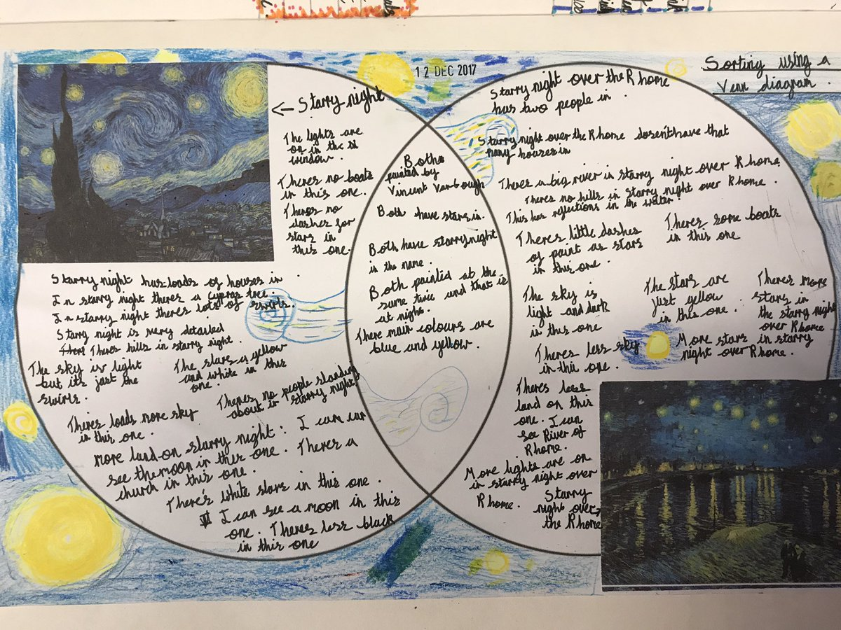
be creative!
https://twitter.com/gomersalart/status/940605802573893632

Slide 47
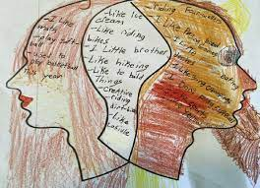
Really creative!
When Venn Diagrams Intersect Art and Math
Sarah B. Bush, Karen S. Karp, Tova Lentz and Jennifer Nadler
Available at: https://www.jstor.org/stable/10.5951/teacchilmath.23.7.0414?seq=1

Slide 48
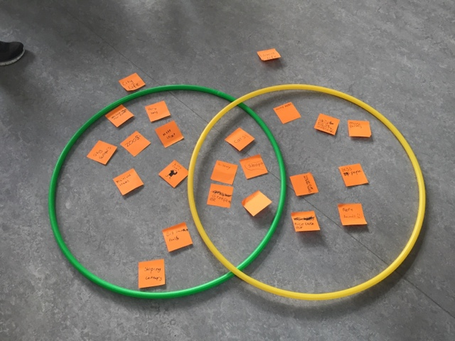
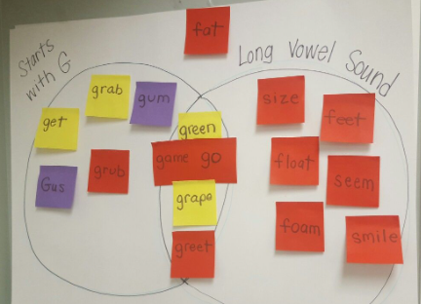
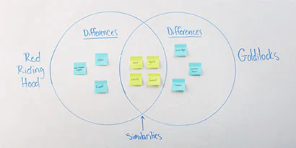
Using post-its
http://p2sps2014.blogspot.com/2015/09/topic-venn-diagram.html
https://www.post-it.co.in/3M/en_IN/post-it-in/ideas/articles/venn-diagram/
https://www.pinterest.es/pin/123215739786708964/

Slide 49
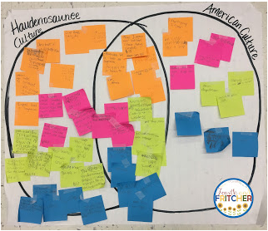

Preparing to write...
https://fourthandfritcher.blogspot.com/2017/01/sticky-note-shenanigans-to-increase.html

Slide 50
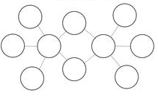
4b. DOUBLE
BUBBLE MAP

Slide 51
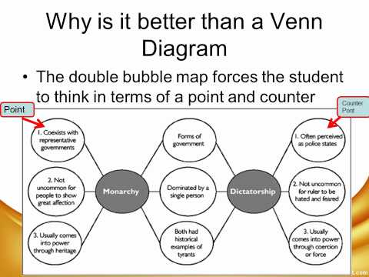
https://youtu.be/snq_NlYkBMk

Slide 52
DOUBLE BUBBLE MAP
Writing practice
NATURAL SCIENCE: Planets, living things, ecosystems...
SOCIAL SCIENCE: Egyptians v Romans, Then & now, continents,...
LITERACY: characters in a book, characters from different books, character & me,…
MUSIC: different composers, instruments...
SPORT: football v basketball...
TUTORIAL: ...

Slide 53

5. cause and effect

Slide 54
CAUSE
effect
the result of something
what happened
The next event in the story (or experiment or historical event)
The driving force of the text
The reason why things happen
The thing that makes other things happen
Remember, the cause happens first

Slide 55
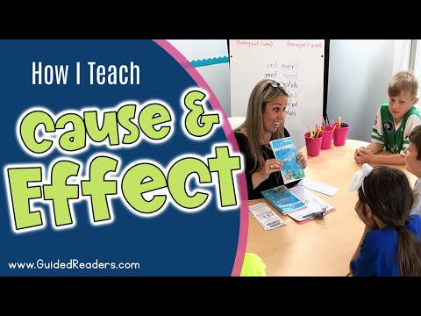
https://youtu.be/RQxwkGQurIY?t=211

Slide 56
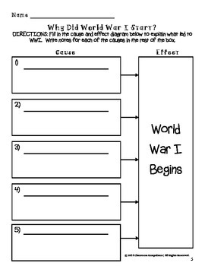
Various causes
One effects ​
https://www.teacherspayteachers.com/Product/Causes-Effects-of-World-War-I-Sorting-Activity-Bonus-Graphic-Organizers-1230551

Slide 57

One cause,
Various effects ​
70,000 killed immediately
HIROSHIMA
US lost moral standing
End of WWII
Beginning of nuclear arms race

Slide 58
Cause – event – effect: THE DOMINO EFFECT ​
I went to bed late
Cause 1
I didn't hear the alarm clock
Cause 2
EVENT
I missed
the
bus
EFFECT 1
Effect 1:
I got to school late
EFFECT 2
Effect 2:
The teacher gave me extra homework
The extra homework could cause a circle effect...

Slide 59
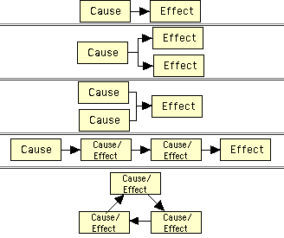
Cause & effect organiser types ​
https://www.enchantedlearning.com/graphicorganizers/causeandeffect/

Slide 60
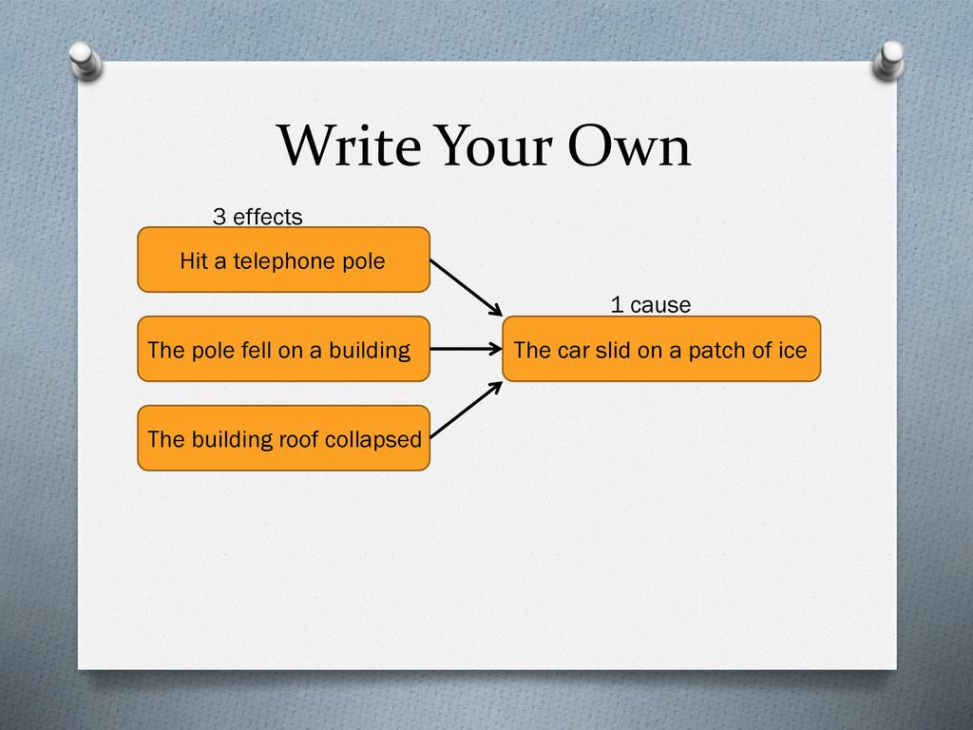
Cause & Effect organisers:
Does this work?
https://slideplayer.com/slide/12260996/

Slide 61

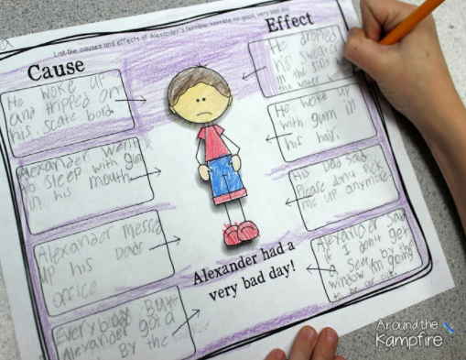
Cause & Effect
https://www.teachrspayteachers.com/Product/Alexander-Terrible-Horrible-No-Good-Very-Bad-Day-Activities-PowerPoint-1587305
https://aroundthekampfire.com/2016/03/cause-and-effect-with-alexander-and-the-terrible-horrible-no-good-very-bad-day.html

Slide 62
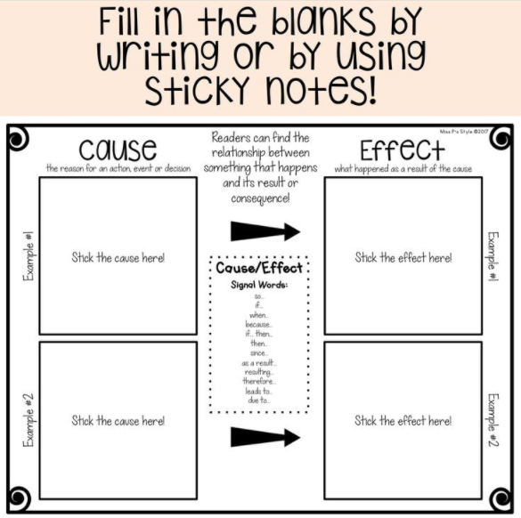
Cause with wrong effect!
Cause & effect
signal word chaos
so...
if...
when...
because...
if...then
since...
as a result...
resulting...
therefore...
leads to...
due to...
https://line.17qq.com/articles/shghhhswy.html

Slide 63
effect
Cause
Reading "forward"
… , so
… Consequently,
… Therefore,
… As a result,
Reading "backward"
because
due to (something)
owing to (something)
as a result of (doing something)
Think carefully of the way to use each connector

Slide 64

Writing:
We have the effect (pollution) and we're looking for the causes (the reason why)
Explain why pollution is damaging the Earth
Example from: https://eltngl.com/assets/downloads/greatwi_pro0000000335/gw5_unit6.pdf

Slide 65

Tree diagram
Categorise information
Place the topic at the top
Place the sub-categories below
Put examples on the lines
Use colours for each level
Can use to prepare an essay
Each column is a paragraph

Slide 66


Flow map
Categorise information
Place the topic at the top
Place any sub-categories below
Put examples on the lines
Use colours for each level
Can use to prepare an essay
Use the boxes to add information

Slide 67

Notice the extra information (although this should be joined with a line, not an arrow
Image from: https://wowlit.org/on-line-publications/stories/storiesi3/5/

Slide 68

Brace map
Whole to part
See the relation between objects
Higher thinking skill (HOTS)
Good vocabulary review
Start with the whole, or with the parts

Slide 69





Paraphrasing v summarising
https://www.smekenseducation.com/summary-writing-parallels-espn/ Idea from: https://www.smekenseducation.com/writing-simple-summaries-and-de/

Slide 70

Lincon's mobile
Download free here:
https://www.socialstudiescentral.com/2013/10/18/tip-of-the-week-iphone-from-the-past/

Slide 71


exit tickets
https://theartofeducation.edu/2017/01/27/use-exit-tickets/

Slide 72
TIPS
Think carefully of your aim
Choose the map which reflects this, not the prettiest one!
MODEL, always model first
Use colours, always the same ones for the same function (in the whole school)
Then pair & share. So everyone understands/adds/corrects
Only write when they have something to produce (ideas) and the way to produce it correcly (language)
With time, they will chose the best organiser for what they want to do

Slide 73

The Slinky syndrome
https://youtu.be/EoJgU2GrXEw

Slide 74
RESOURCES

Slide 75
Graphic organisers explained: https://www.teachingenglish.org.uk/article/graphic-organisers
Thinking maps explained: https://www.scoe.org/files/AH_maps.pdf
Thinking map tutorial: https://sites.google.com/site/gonewberncats/resouces/thinking-maps
Exploring flowcharts as a tool for thinking: https://wowlit.org/on-line-publications/stories/storiesi3/5/
Teaching cause and effect: https://www.literacyideas.com/teaching-cause-effect-in-english#:~:text=It%20is%20the%20reason%20that,results%20from%20a%20preceding%20cause.
Writing a cause & effect essay: https://eltngl.com/assets/downloads/greatwi_pro0000000335/gw5_unit6.pdf
Graphic organisers linked to thinking skills: https://carla.umn.edu/cobaltt/modules/strategies/gorganizers/PROTO/overview.html
RESOURCES
Variety of free resources from Teachers Pay Teachers: https://www.pinterest.es/peanutgallery19/my-tpt-shop-freebies/
Free graphic organisers: https://freeology.com/graphicorgs/
or... https://www.educationoasis.com/printables/graphic-organizers/
or... https://www.hmhco.com/blog/free-graphic-organizer-templates
Lessons using graphic organisers...: https://my.hrw.com/nsmedia/intgos/html/igo_lessons.htm
… with free organisers https://my.hrw.com/nsmedia/intgos/html/igo.htm
Pros & Cons The definitive debating ideas website! https://www.procon.org/
Editable graphic organisers: https://carla.umn.edu/cobaltt/modules/strategies/gorganizers/EDITABLE.HTML

Slide 76
GRAPHIC ORGANISER GENERATORS​
Generate a concept web https://www.teach-nology.com/web_tools/graphic_org/concept_web/ ​
Generate a T chart: https://www.worksheetworks.com/miscellanea/graphic-organizers/tchart.html​
Generate a venn diagram: https://www.teach-nology.com/web_tools/graphic_org/venn_diagrams/​
Generate a timeline: https://www.teach-nology.com/web_tools/materials/timelines/ ​

