Slide 1
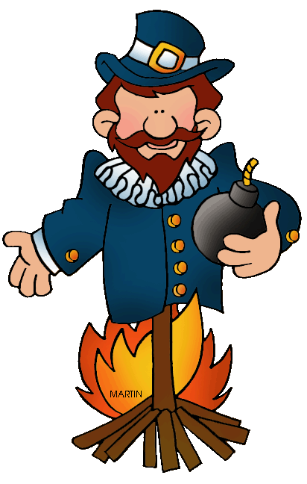
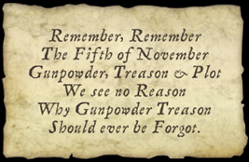
Bonfire night

Slide 2
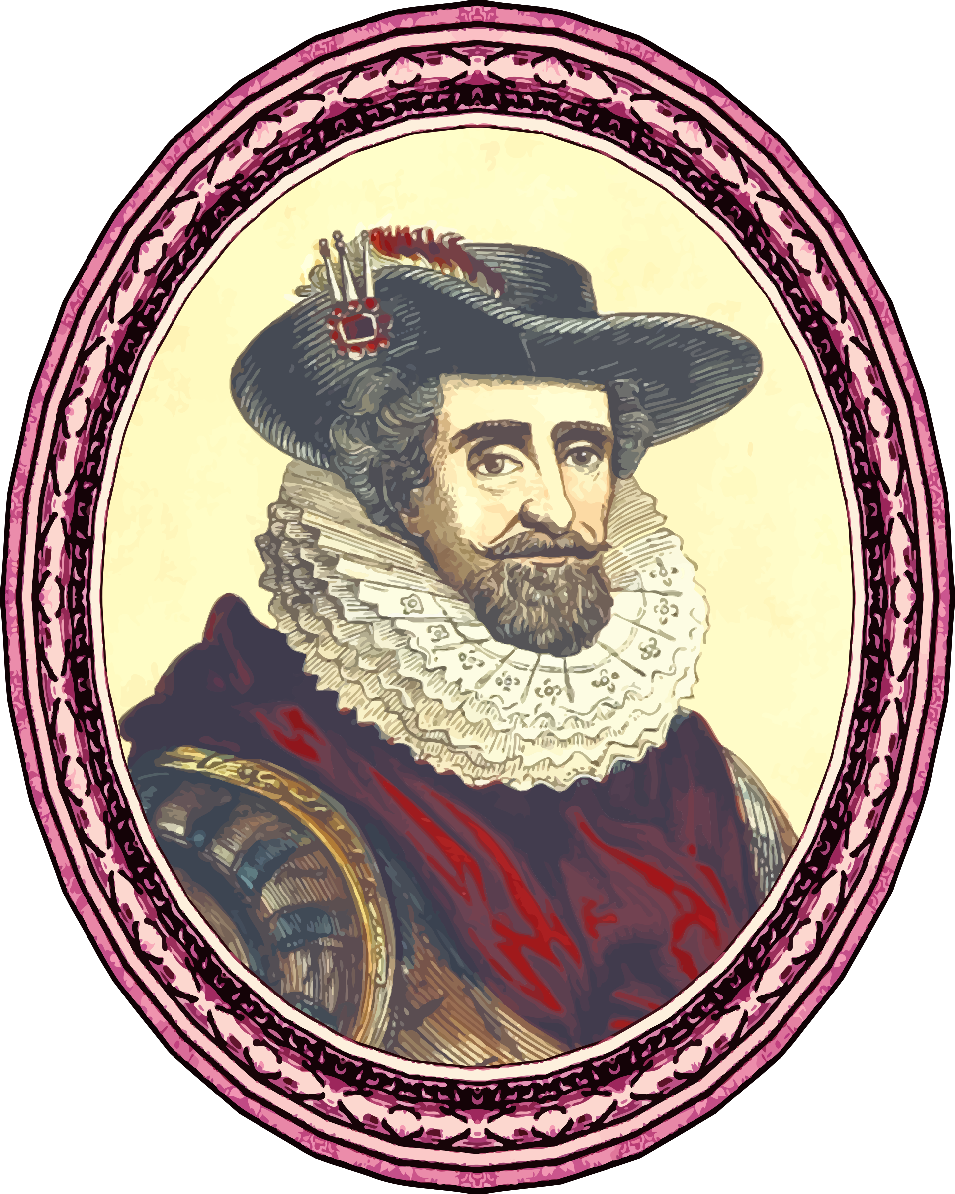
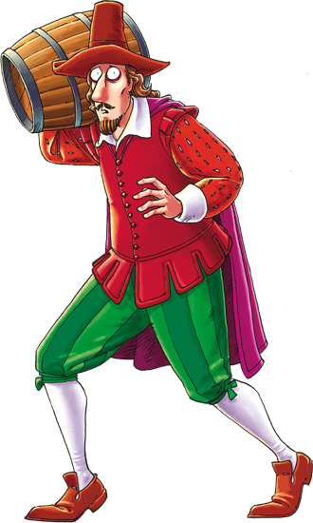
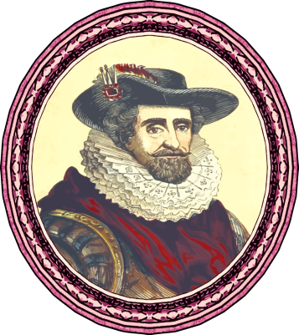
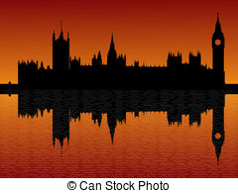
WHAT HAPPENED?
In 1605, a man called Guy Fawkes and his friends planned to blow up the Houses of Parliament with the King James I inside. Their plot was discovered and they were arrested and executed for treason.

Slide 3
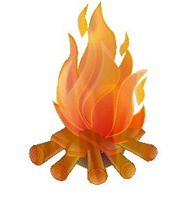
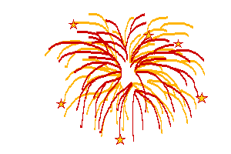
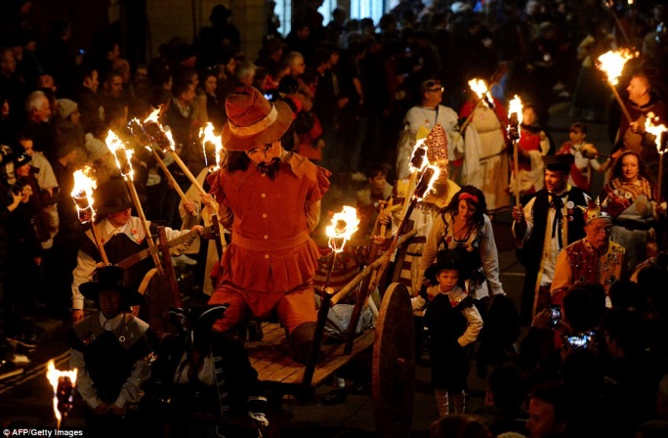
Bonfire night traditions
It’s celebrated in the UK with fireworks, bonfires and parades. Straw dummies representing Guy Fawkes are tossed on the bonfire.

Slide 4
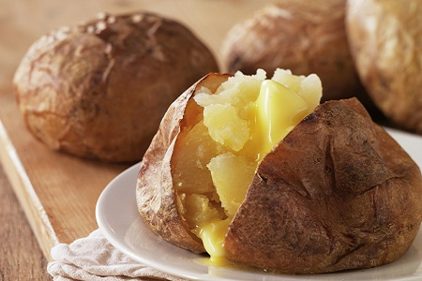
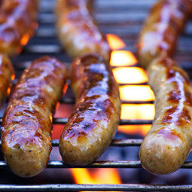
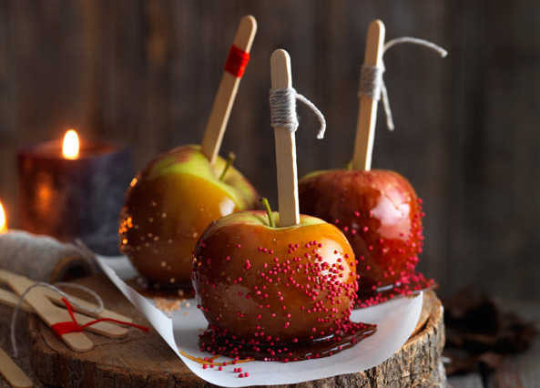
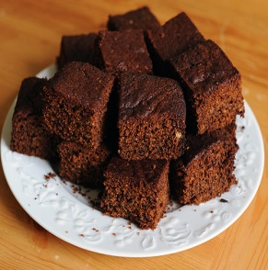
Bonfire night food
People eat toffee apples , jacket potatoes (potatoes baked in the ashes of the fire), a cake called Yorkshire Parkin and sausages.

Slide 5
conversation
Do you use fireworks to celebrate special occasions? Which ones?
How do you feel about fireworks, crackers and sparklers?
How can we be safe with fireworks?

