Slide 1
ESTRELLAS:
COMPOSICIÓN Y EVOLUCIÓN
Javier Cabero Rego
(Vocal del Grupo de Observadores Astronómicos de Ávila)
Foto de fondo: Paco Gil (Vicepresidente del GOAA)

Slide 2
PERO… ¿QUÉ ES LA FUSIÓN?
H |  |  |  |  |  |  |  |  |  |  |  |  |  |  |  |  | He
 |  |  |  |  |  |  |  |  |  |  |  |  |  |  |  |  | 2
1
Li | Be |  |  |  |  |  |  |  |  |  |  | B | C | N | O | F | Ne
 |  |  |  |  |  |  |  |  |  |  |  | 5 | 6 | 7 | 8 | 9 | 10
3 | 4
Na | Mg |  |  |  |  |  |  |  |  |  |  | Al | Si | P | S | Cl | Ar
 |  |  |  |  |  |  |  |  |  |  |  | 13 | 14 | 15 | 16 | 17 | 18
 | 12
11
K | Ca | Sc | Ti | V | Cr | Mn | Fe | Co | Ni | Cu | Zn | Ga | Ge | As | Se | Br | Kr
19 | 20 | 21 | 22 | 23 | 24 | 25 | 26 | 27 | 28 | 29 | 30 | 31 | 32 | 33 | 34 | 35 | 36
Rb | Sr | Y | Zr | Nb | Mo | Tc | Ru | Rh | Pd | Ag | Cd | In | Sn | Sb | Te | I | Xe
37 | 38 | 39 | 40 | 41 | 42 | 43 | 44 | 45 | 46 | 47 | 48 | 49 | 50 | 51 | 52 | 53 | 54
Cs | Ba | La | Hf | Ta | W | Re | Os | Ir | Pt | Au | Hg | Tl | Pb | Bi | Po | At | Rn
55 | 56 | 57 | 72 | 73 | 74 | 75 | 76 | 77 | 78 | 79 | 80 | 81 | 82 | 83 | 84 | 85 | 86
Fr | Ra | Ac
87 | 88 | 89
 |  |  | Ce | Pr | Nd | Pm | Sm | Eu | Gd | Tb | Dy | Ho | Er | Tm | Yb | Lu
 |  |  | 58 | 59 | 60 | 61 | 62 | 63 | 64 | 65 | 66 | 67 | 68 | 69 | 70 | 71
 |  |  | Th | Pa | U
 |  |  | 90 | 91 | 92
H |  |  |  |  |  |  |  |  |  |  |  |  |  |  |  |  | He
 |  |  |  |  |  |  |  |  |  |  |  |  |  |  |  |  | 2
1
Li | Be |  |  |  |  |  |  |  |  |  |  | B | C | N | O | F | Ne
 |  |  |  |  |  |  |  |  |  |  |  | 5 | 6 | 7 | 8 | 9 | 10
3 | 4
Na | Mg |  |  |  |  |  |  |  |  |  |  | Al | Si | P | S | Cl | Ar
 |  |  |  |  |  |  |  |  |  |  |  | 13 | 14 | 15 | 16 | 17 | 18
 | 12
11
K | Ca | Sc | Ti | V | Cr | Mn | Fe | Co | Ni | Cu | Zn | Ga | Ge | As | Se | Br | Kr
19 | 20 | 21 | 22 | 23 | 24 | 25 | 26 | 27 | 28 | 29 | 30 | 31 | 32 | 33 | 34 | 35 | 36
Rb | Sr | Y | Zr | Nb | Mo | Tc | Ru | Rh | Pd | Ag | Cd | In | Sn | Sb | Te | I | Xe
37 | 38 | 39 | 40 | 41 | 42 | 43 | 44 | 45 | 46 | 47 | 48 | 49 | 50 | 51 | 52 | 53 | 54
Cs | Ba | La | Hf | Ta | W | Re | Os | Ir | Pt | Au | Hg | Tl | Pb | Bi | Po | At | Rn
55 | 56 | 57 | 72 | 73 | 74 | 75 | 76 | 77 | 78 | 79 | 80 | 81 | 82 | 83 | 84 | 85 | 86
Fr | Ra | Ac | Rf | Db | Sg | Bh | Hs | Mt | Ds | Rg | Cn | Nh | Fl | Mc | Lv | Ts | Og
87 | 88 | 89 | 104 | 105 | 106 | 107 | 108 | 109 | 110 | 111 | 112 | 113 | 114 | 115 | 116 | 117 | 118
 |  |  | Ce | Pr | Nd | Pm | Sm | Eu | Gd | Tb | Dy | Ho | Er | Tm | Yb | Lu
 |  |  | 58 | 59 | 60 | 61 | 62 | 63 | 64 | 65 | 66 | 67 | 68 | 69 | 70 | 71
 |  |  | Th | Pa | U | Np | Pu | Am | Cm | Bk | Cf | Es | Fm | Md | No | Lr
 |  |  | 90 | 91 | 92 | 93 | 94 | 95 | 96 | 97 | 98 | 99 | 100 | 101 | 102 | 103

Slide 3
PERO… ¿QUÉ ES LA FUSIÓN?
Protón (+)
Neutrón

Slide 4
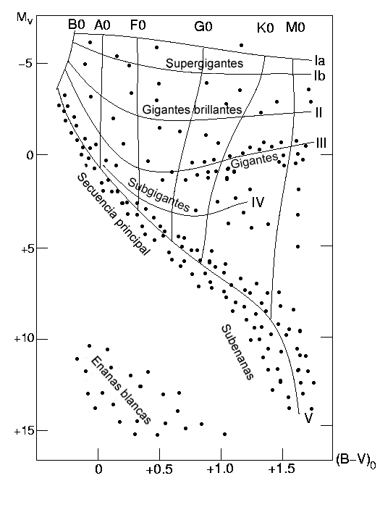
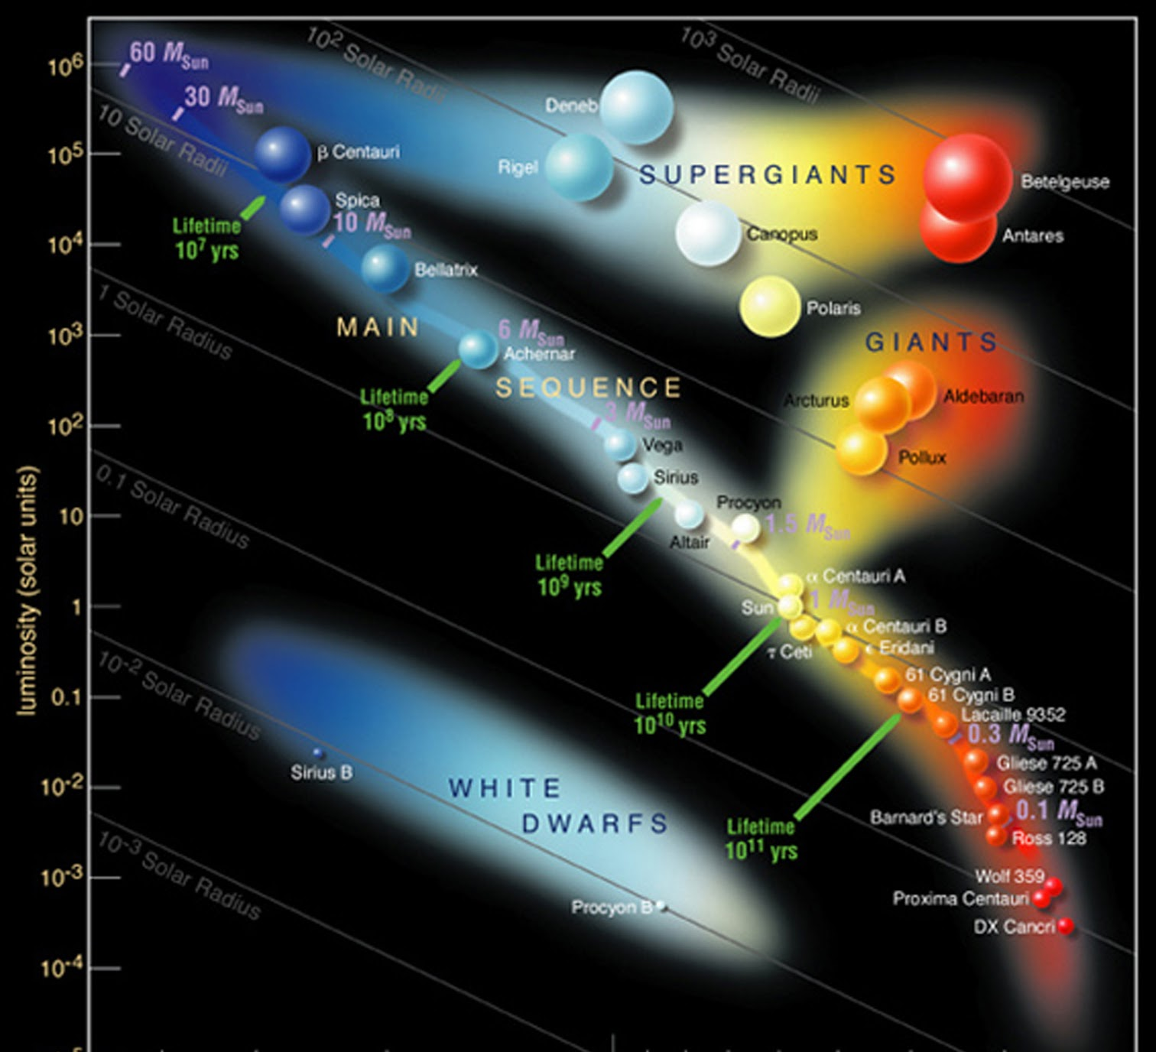
LA SECUENCIA PRINCIPAL
Diagrama Hertzsprung-Russell

Slide 5
120 M_{sol}
T_{sup} ≈ 50.000 K
2-3 Millones de años
1 M_{sol}
T_{sup} ≈ 6.000 K
10.000 Millones de años
11 M_{sol}
T_{sup} ≈ 20.000 K
15 Millones de años
0’1 M_{sol}
T_{sup} ≈ 3.000 K
10 Billones de años

Slide 6
LOS CAMINOS DE EVOLUCIÓN ESTELAR
Enana marrón
Enana roja
Enana azul
Enana blanca
Enana negra
< 0’08 M_{Sol}
0’08 – 0’8 M_{Sol}
Estrella
amarilla
Nebulosa planetaria
0’8 – 9
M_{Sol}
Gigante
roja
E. neutrones
9 – 30 M_{Sol}
Gigante
azul
Supergigante
amarilla
Supergigante
roja
Supernova
> 30 M_{Sol}
Supergigante
azul
Variable
luminosa
azul
Wolf-
Rayet
Agujero
negro

