Slide 1
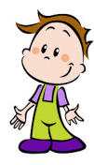
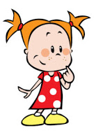
LET´S MAKE
IT
GREAT
Tania Álvarez Ruiz

Slide 2
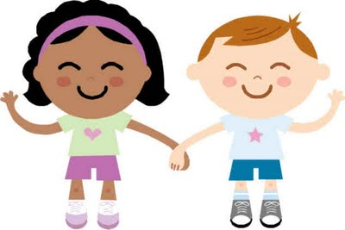
GREETINGS
Good Afternoon
Good Evening
Hello!
Hi!
Good Morning

Slide 3
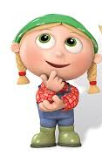
GREETINGS
How are you?
How are you doing?
How do you do?

Slide 4
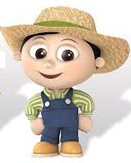
GREETINGS
I´m fine, thanks
I´m ok
I´m very well
I´m not very well

Slide 5
FAREWELLS
Good bye
See you later
Have a nice day
Nice to meet you
Bye bye
See you tomorrow
Have a nice weekend
Nice to meet you

Slide 6
PRESENTATION
Hello, what´s your name?
My name is Rodrigo.
(I´m Rodrigo)

Slide 7
PRESENTATION
And, what´s your last name?
My last name is Rodas Lastras.

Slide 8
PRESENTATION
How old are you?
I am 8 years old.

Slide 9
PRESENTATION
Where do you live?
I live in a small town called Ávila

Slide 10
PRESENTATION
And, when is your birthday?
My birthday is on February the 6th

