Slide 1


Slide 2
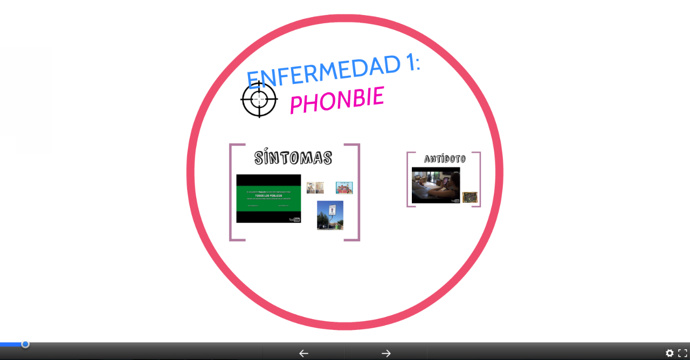

Slide 3

https://www.youtube.com/watch?v=GUtMyb0R5lk

Slide 4
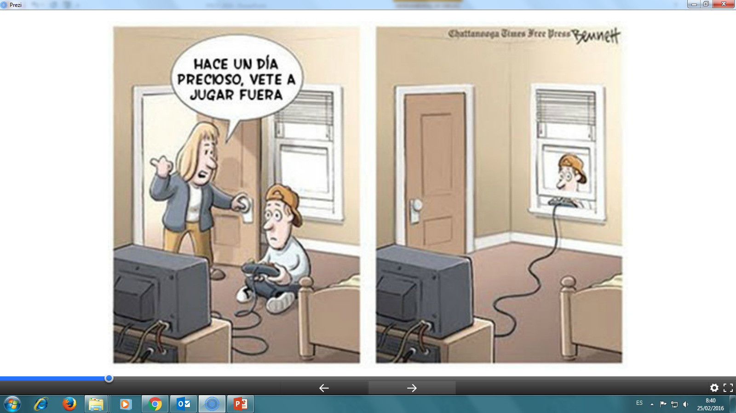

Slide 5


Slide 6
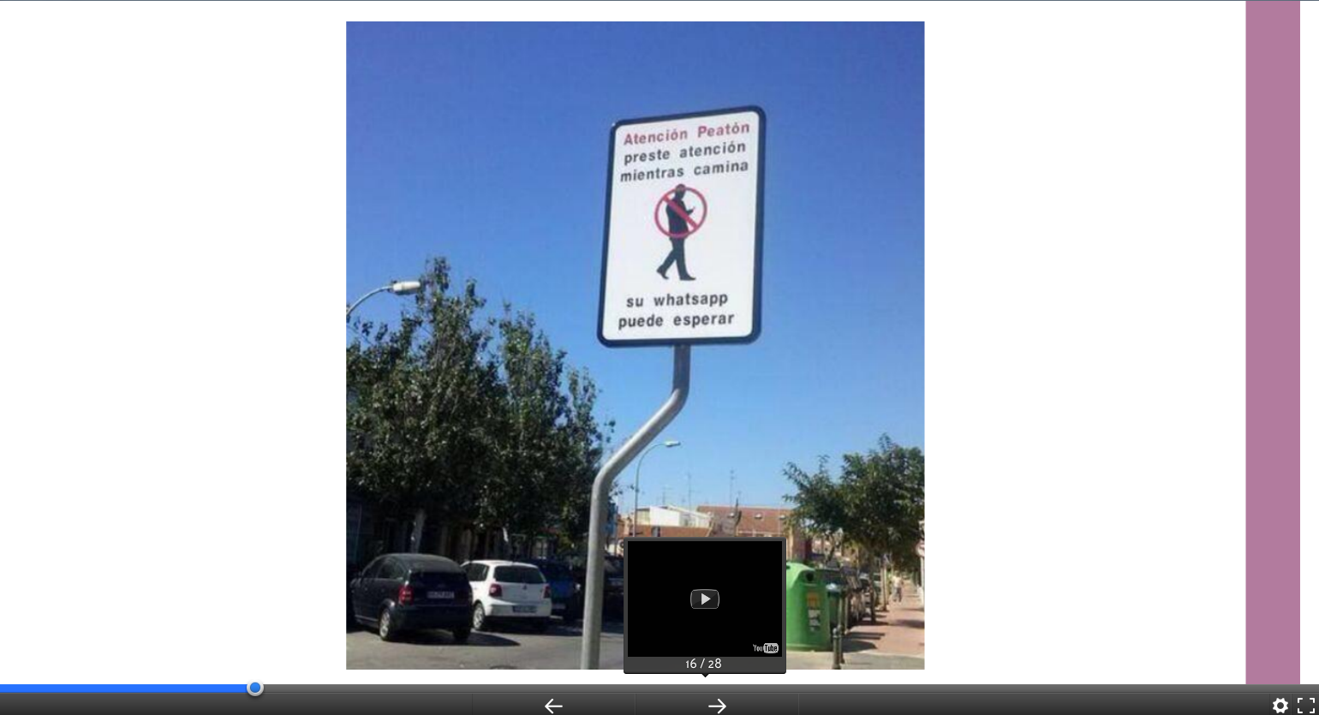

Slide 7
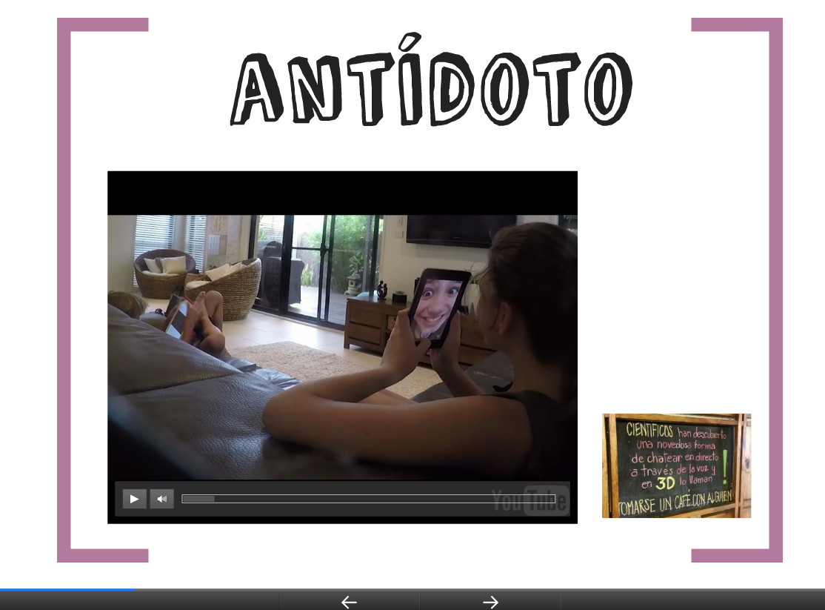
https://www.youtube.com/watch?v=HUgv5MDF0cQ

Slide 8
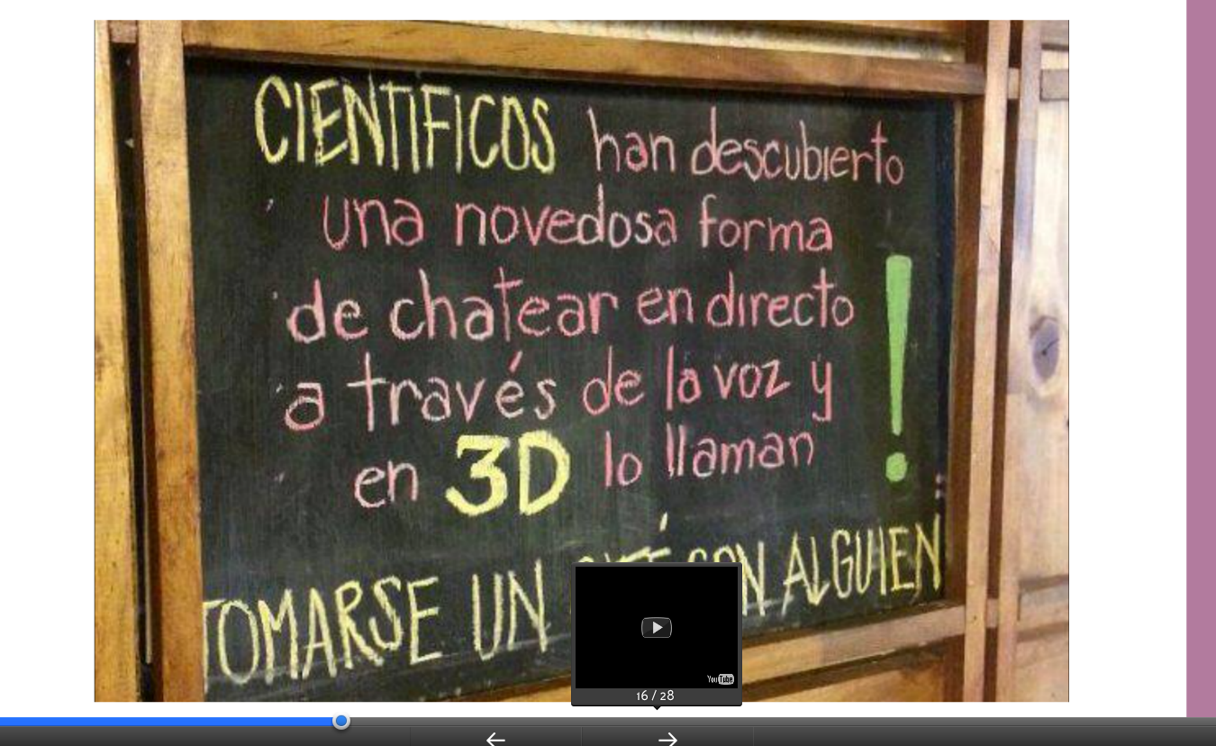

Slide 9


Slide 10


Slide 11
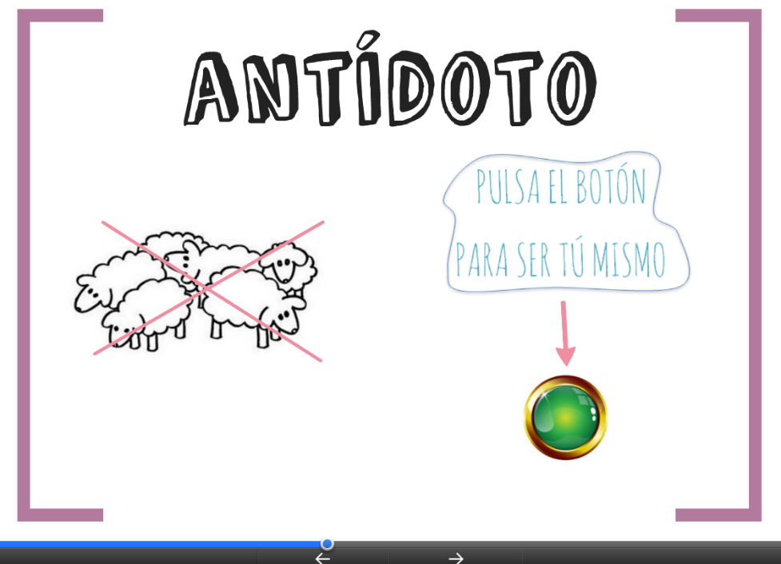

Slide 12


Slide 13


Slide 14
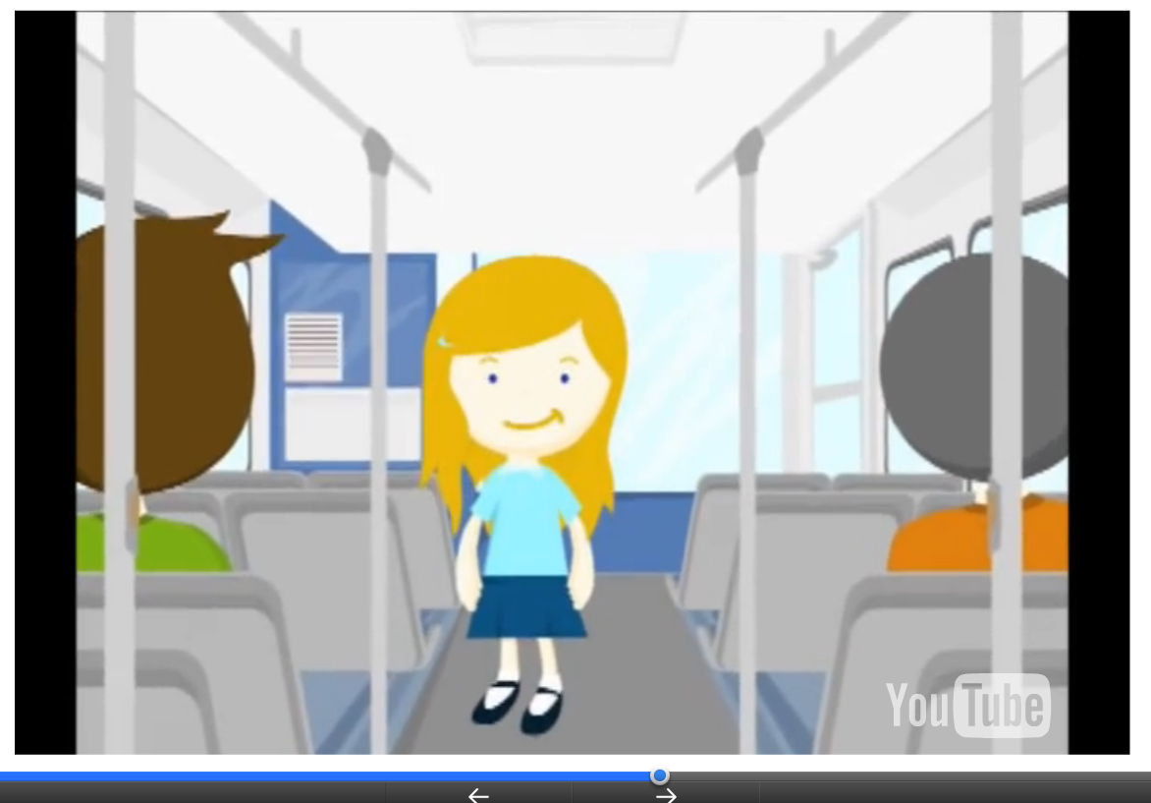
https://www.youtube.com/watch?v=WCvkZ_TVGT8

Slide 15
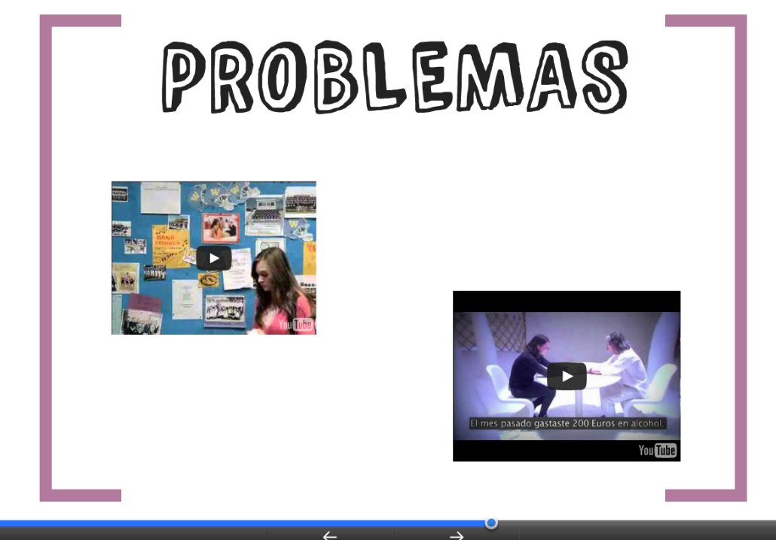

Slide 16
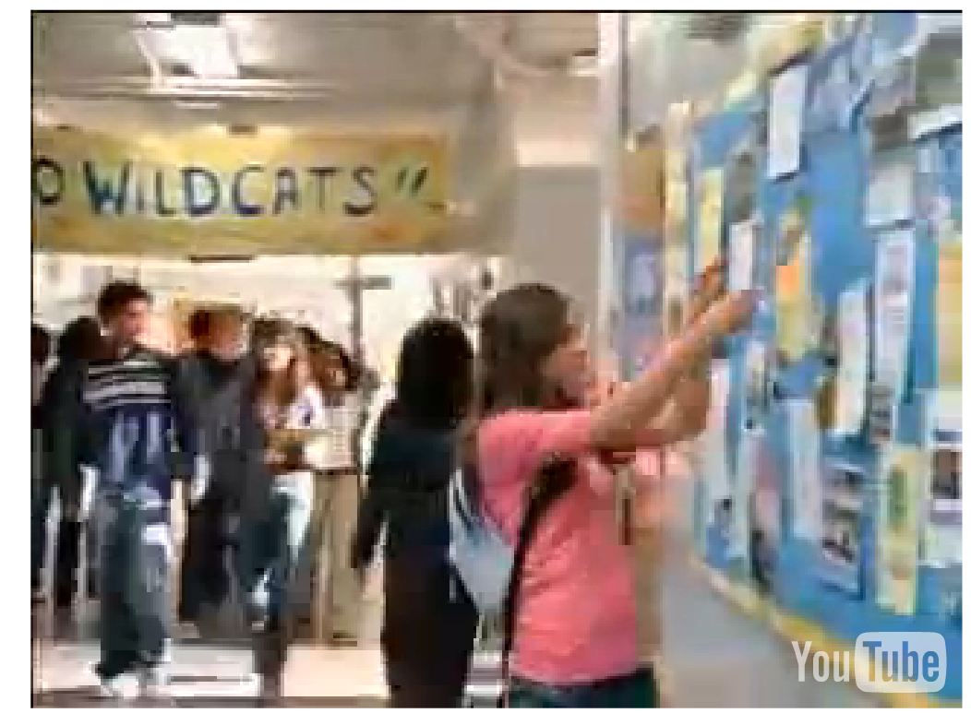
https://www.youtube.com/watch?v=C8PQg0D_-7s

Slide 17
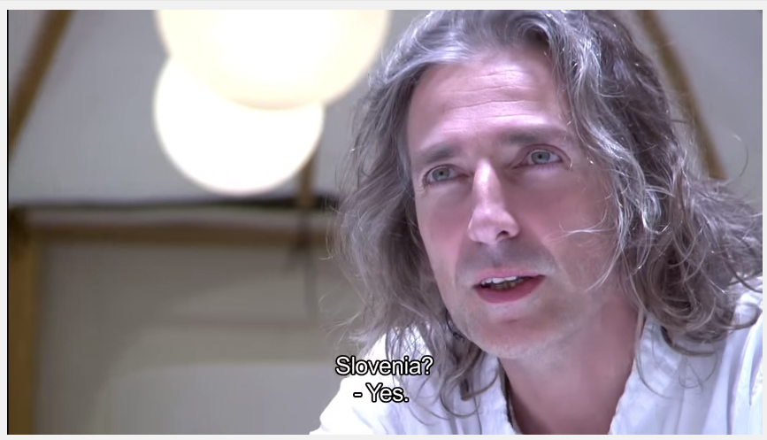
https://www.youtube.com/watch?v=F7pYHN9iC9I

Slide 18


Slide 19


Slide 20


Slide 21
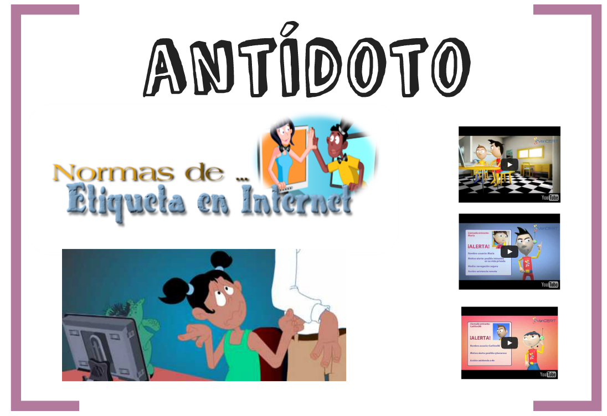

Slide 22

https://www.youtube.com/watch?v=prjaUR4-5p4

Slide 23
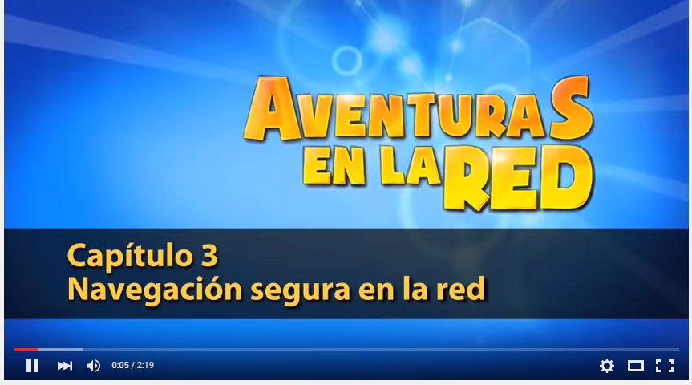
https://www.youtube.com/watch?v=3CLpzduot5o

Slide 24

https://www.youtube.com/watch?v=8HKXL1VSQuc

Slide 25


