Slide 3
https://www.youtube.com/watch?v=GUtMyb0R5lk

Slide 4
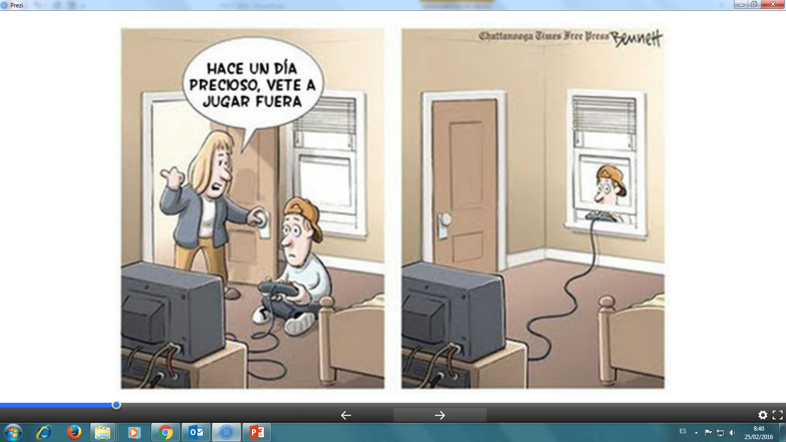

Slide 7
https://www.youtube.com/watch?v=HUgv5MDF0cQ

Slide 14
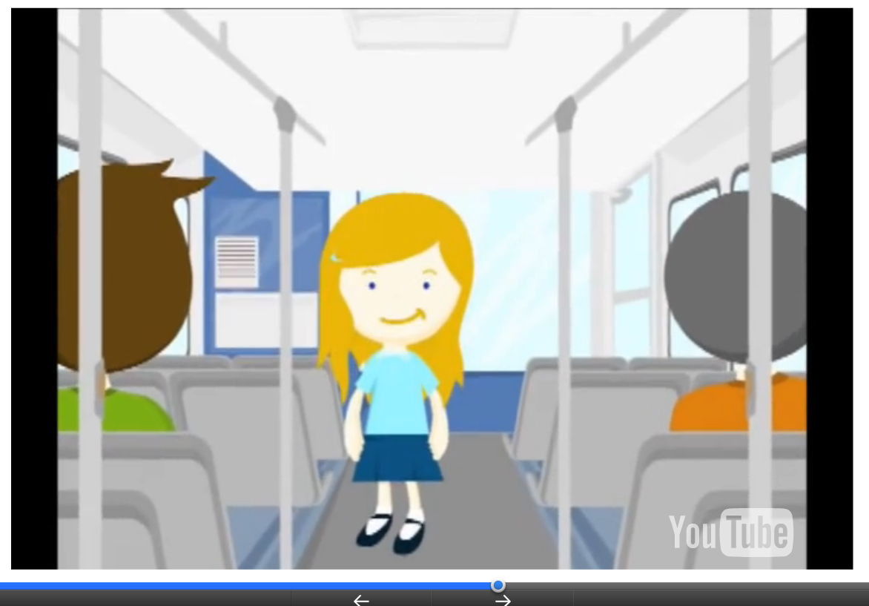
https://www.youtube.com/watch?v=WCvkZ_TVGT8

Slide 16
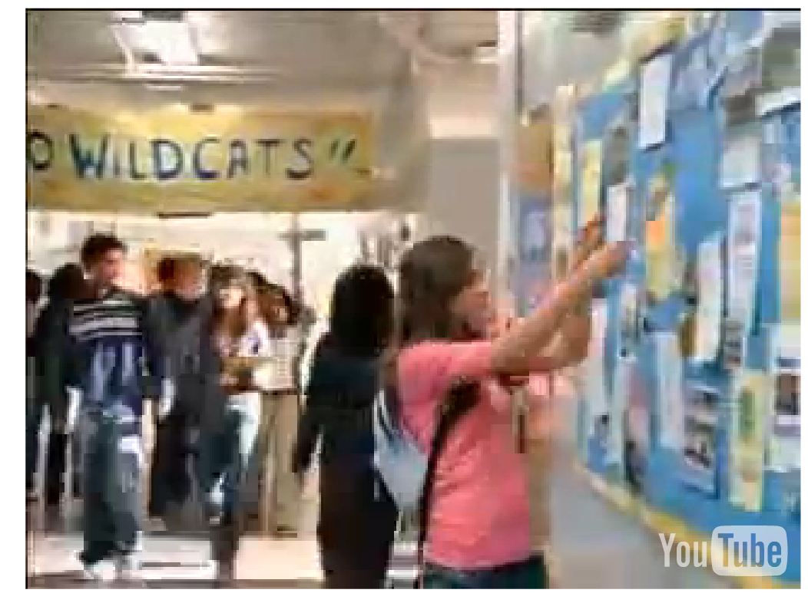
https://www.youtube.com/watch?v=C8PQg0D_-7s

Slide 17
https://www.youtube.com/watch?v=F7pYHN9iC9I

Slide 22
https://www.youtube.com/watch?v=prjaUR4-5p4

Slide 23
https://www.youtube.com/watch?v=3CLpzduot5o

Slide 24
https://www.youtube.com/watch?v=8HKXL1VSQuc

