Slide 1
A LITTLE BIT OF EVERYTHING
KATHRYN ESCRIBANO
FEBRUARY, 2021
CFIE DE VALLADOLID
SESSION 1

Slide 2
GREETINGS

Slide 3
To the tune of Frère Jacques
Good morning. Good morning
How are you? How are you?
I am very well. I am very well.
Thank you. Thank you.

Slide 4
HELLO SONG - COCOMELON

Slide 5
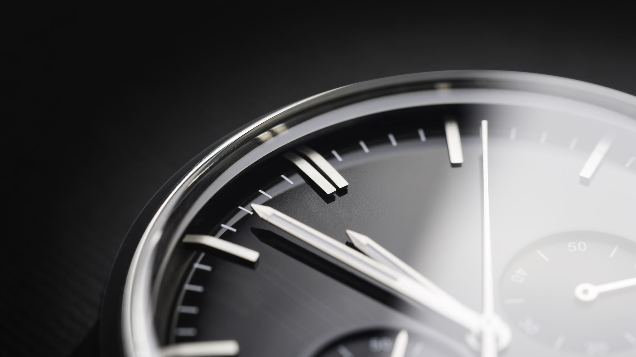
ROUTINE

Slide 6
What are we doing today?

Slide 7
KANBAN OR...

Slide 8
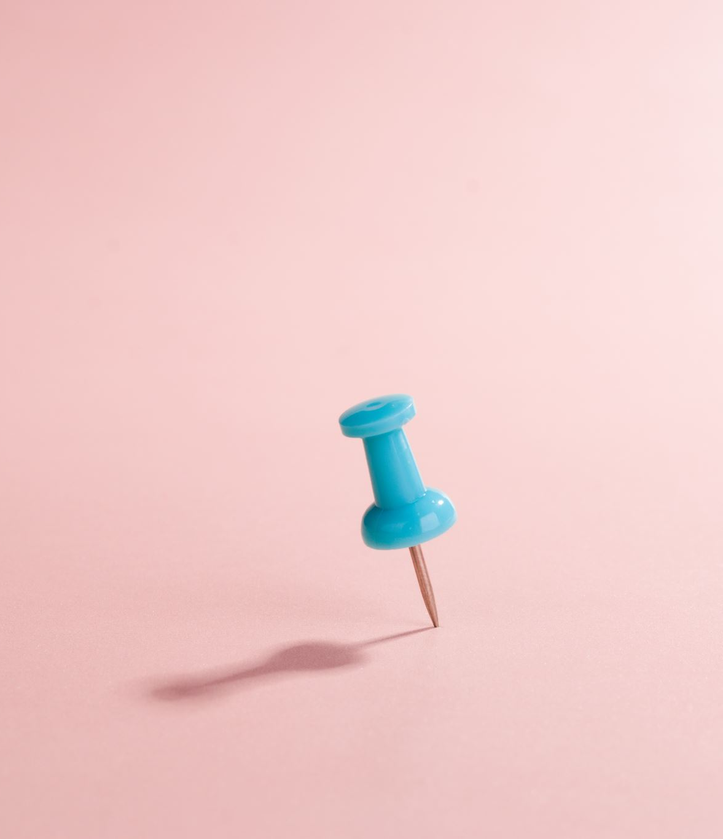
PLANNING

Slide 9
THIS YEAR I WANT TO...

Slide 10
BRAIN BREAK

Slide 11
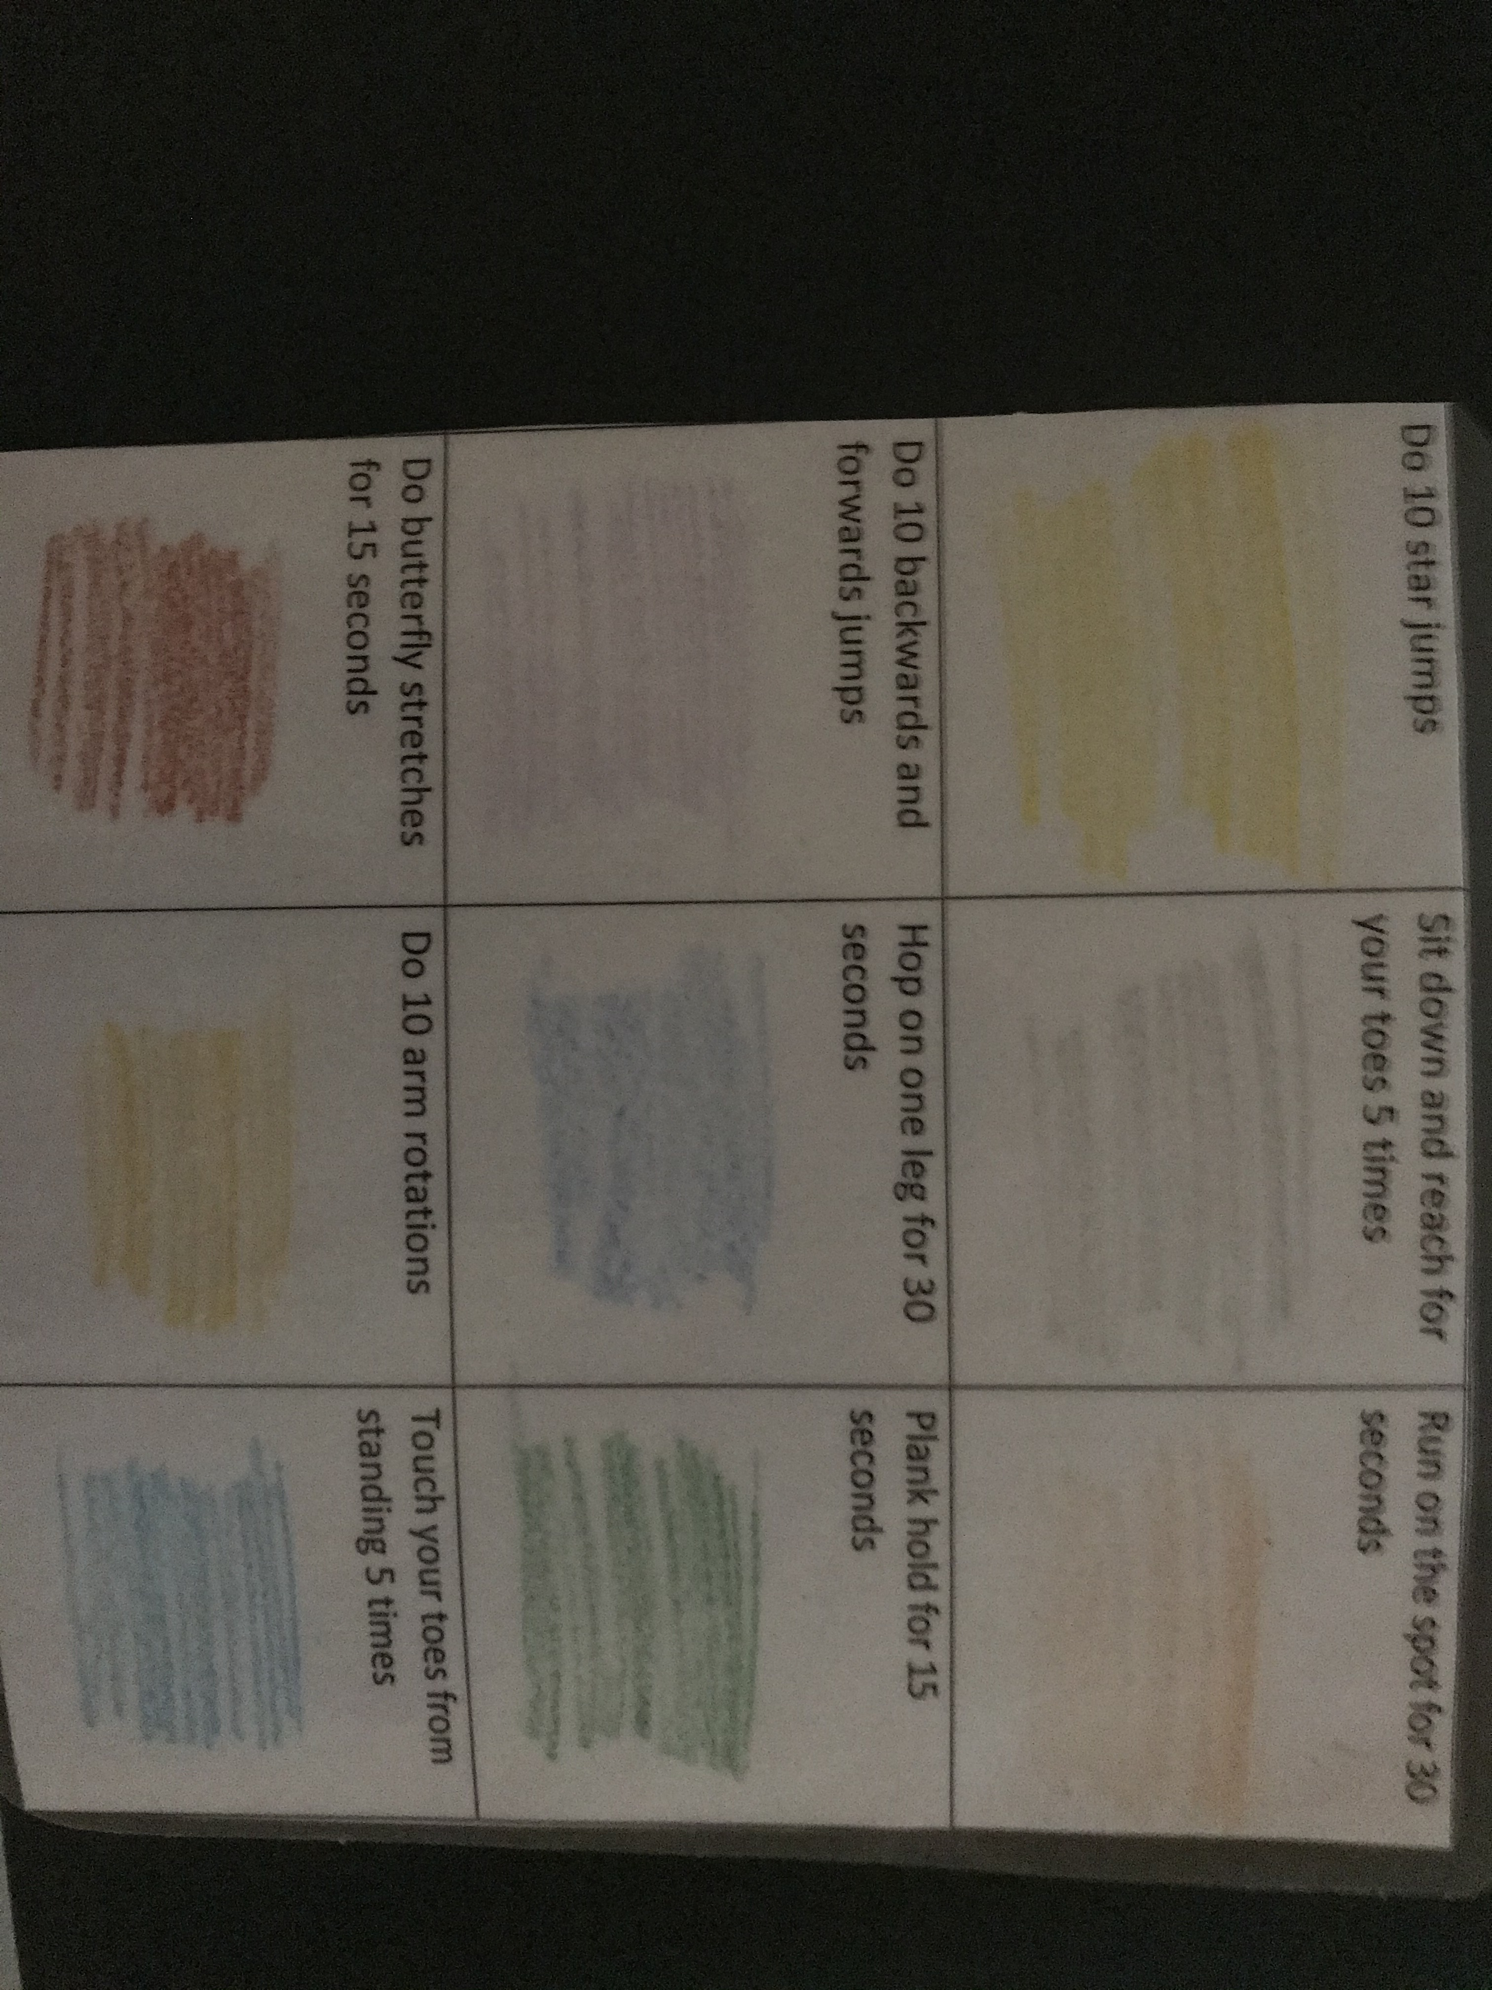
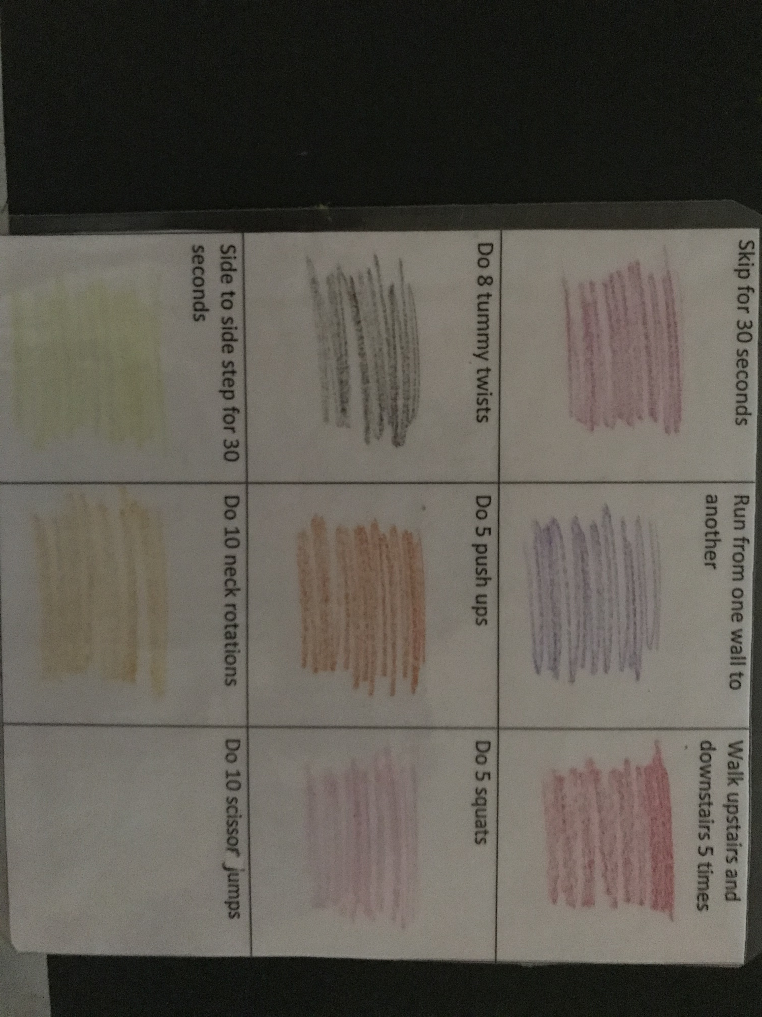
KEEPING FIT

Slide 12
A LITTLE BIT OF THEORY

Slide 13
Read these reasons for using games and decide which are your top three. Can you share more reasons?
1 They are motivational.
2 They encourage cooperation.
3 They offer the child security as they create predictability.
4 Children are easily distracted but games sustain interest.
5 Children like fun and games.
6 They create the desire to communicate.
7 They encompass a number of intelligences.
8 Grammar and vocabulary are assimilated subconsciously.
9 Children like interacting.
10 It’s not necessary to understand everything to join in.
11 It’s easy to praise children on their performance, which is satisfying for them.
12 They give children an active role in the class.

Slide 15
PLAYGROUND GAMES
ORANGES AND LEMONS

Slide 16
IN AND OUT THE DUSTY BLUEBELLS

Slide 17
DUCK DUCK GOOSE

Slide 18
LADDERS

Slide 20
BRAIN BREAK

Slide 22
PHONICS

Slide 23
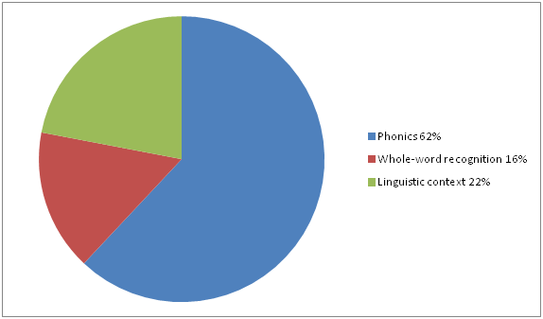

Slide 24
M /m/ | A /æ/ | S /s/ | E /e/ | P /p/ | N /n/ | O /ɒ/ | B /b/
L /l/ | C/K /k/ | F /f/ | G /g/ | I /ɪ/ | H /h/ | SH /ʃ/ | D /d/
T /t/ | CH /tʃ/ | U /ʌ/ | R /r/ | J /dʒ/ | V /v/ | Y /j/ | W /w/
Z /z/ | QU /kw/ | X /ks/ | TH /θ/ | TH /ð/ | OO /ʊ/ | OO /uː/ | NG /ŋ/
ER /ɜː/ /ə/ | AY /eɪ/ | EE /iː/ | IGH /aɪ/ | OA /əʊ/ /oʊ/ | UE /u/ | AW /ɔː/ | AR /ɑː/
OW /aʊ/ | OY /ɔɪ/ | AIR /eə/ | EAR /ɪə/ | URE /ʊə/ |  | /ʒ/

Slide 25
PHONEMES AND DIFFERENTIATING

Slide 26
LITERACY

Slide 27
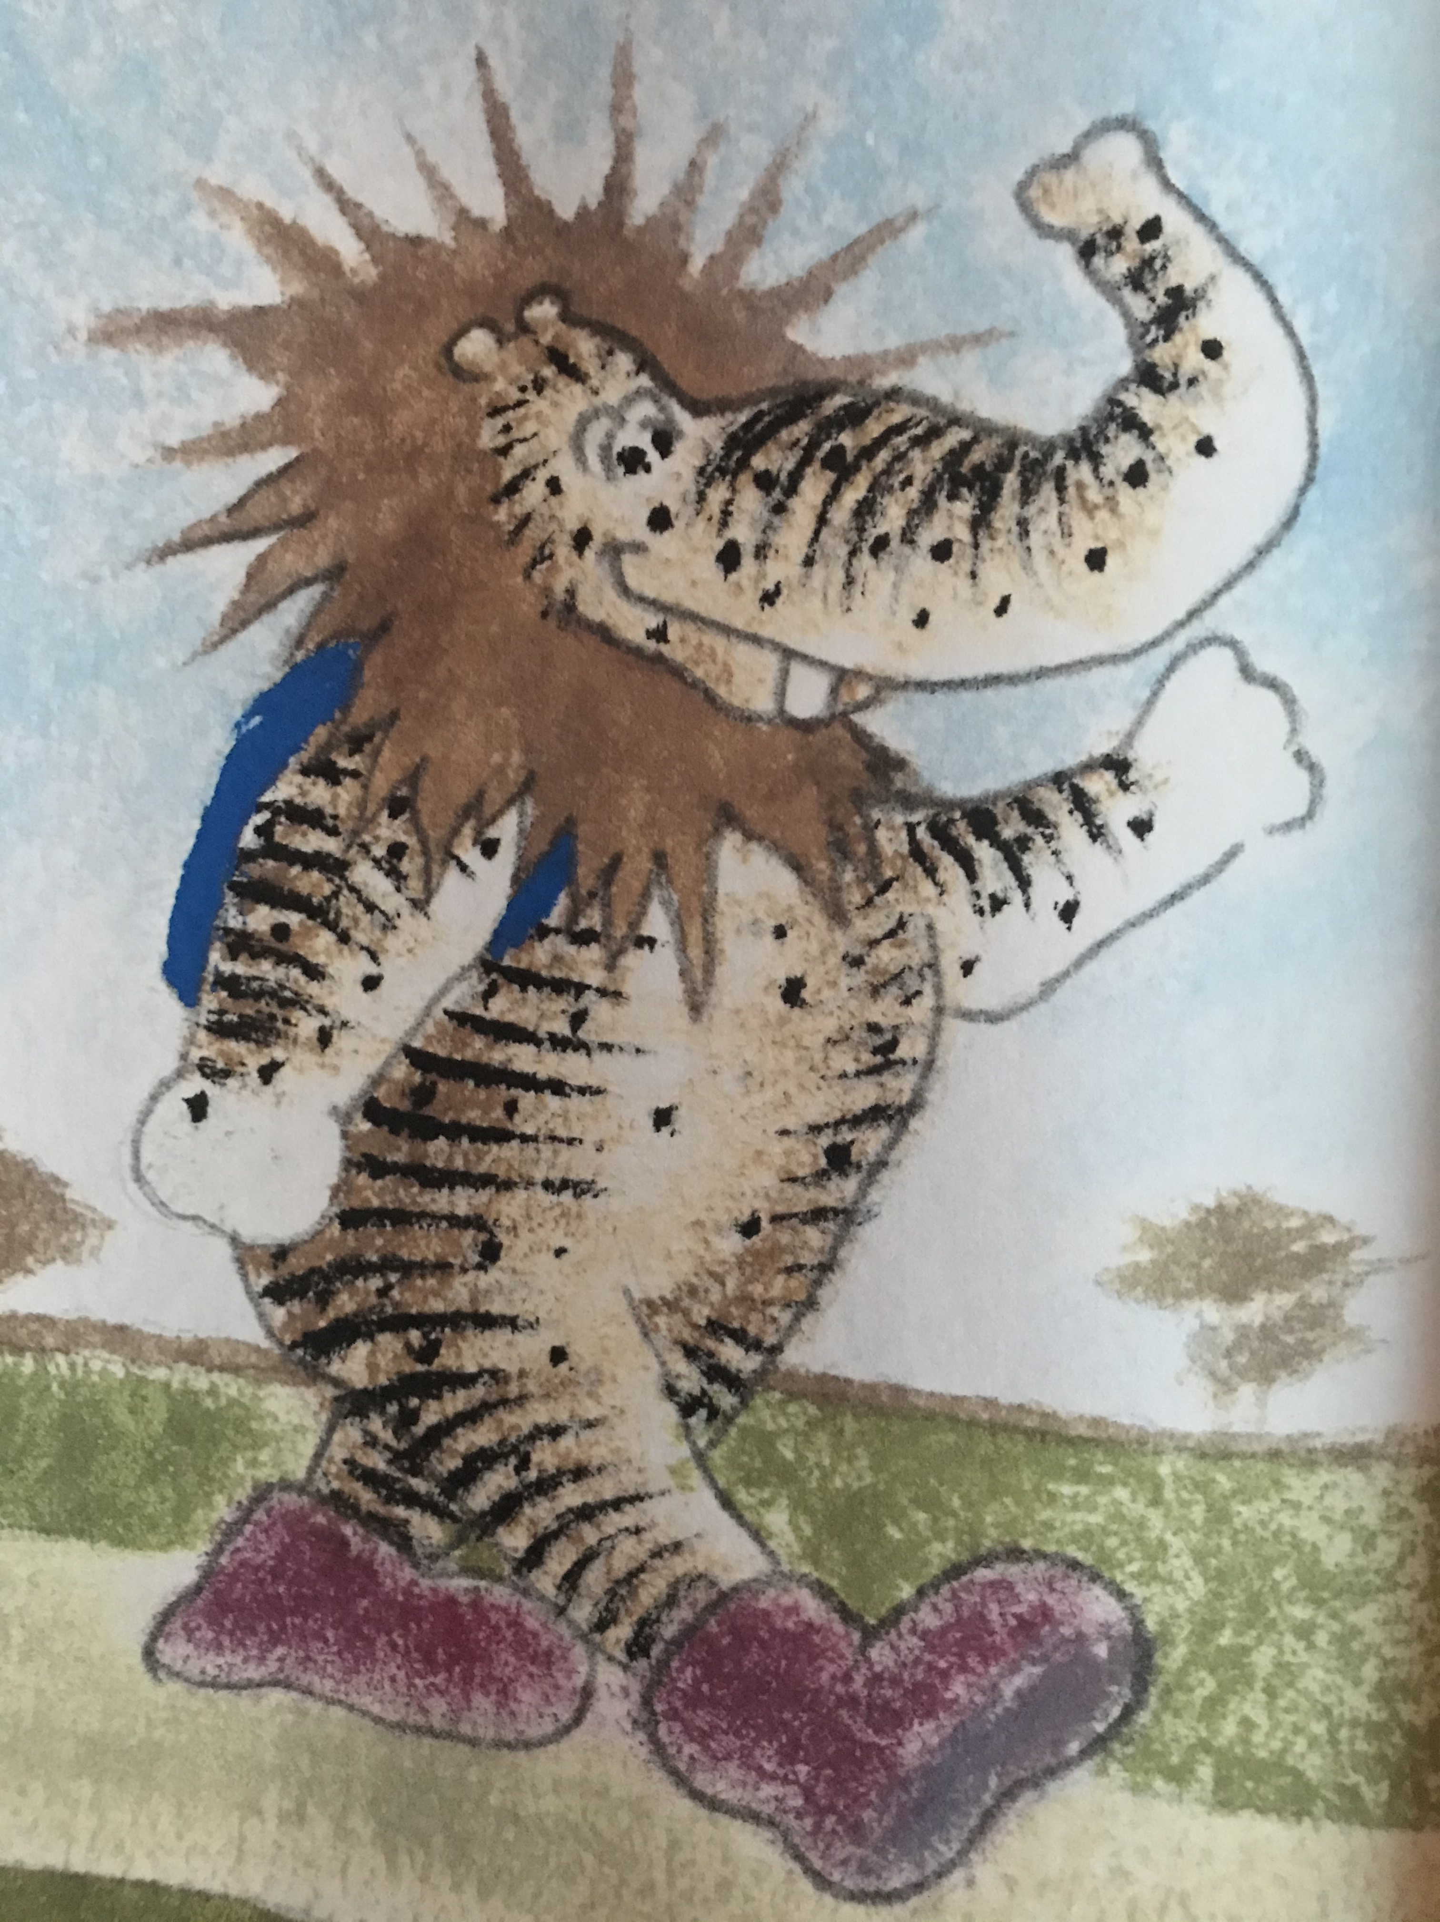
I WISH I HAD...

Slide 28
CRAFTS

Slide 29
A LEOPARD HAS LOTS OF SPOTS

Slide 30
ELEPHANTS HAVE WRINKLES

Slide 31
THE LION DANCE

Slide 32
TIGER STRIPES
THERE IS AN ANIMAL WITH LOVELY STRIPES AND IT IS CALLED A TIGER
T-I-G-E-R
T-I-G-E-R
T-I-G-E-R
AND IT IS CALLED A TIGER.
(TO THE TUNE OF BINGO)

Slide 33
HIPPO

Slide 34
BRAIN BREAK

Slide 35
RHYME AND FREEZE

Slide 36
GAMES

Slide 37
GRID | SCAVENGER | UNDER OVER | BASKETBALL
SEARCHLIGHT | BALANCING | COUNTING | SHOPPING
MIMING | HOW MANY? | LAST ONE STANDING | BINGO
PICTIONARY | FIND AND MATCH | WASHING LINE | NOUGHTS AND CROSSES
RELAY RACE | PELMANISM | RED ROVER | ISN'T IT FUNNY?
ROCK, PAPER, SCISSORS | FOLLOW THE TRAIL | GLOCKENSPIEL | WHO HAS MOST LETTERS?

Slide 39
SONGTIME

Slide 40
WASH YOUR HANDS

Slide 41
BRAIN BREAK

Slide 43
CHALLENGE

Slide 44
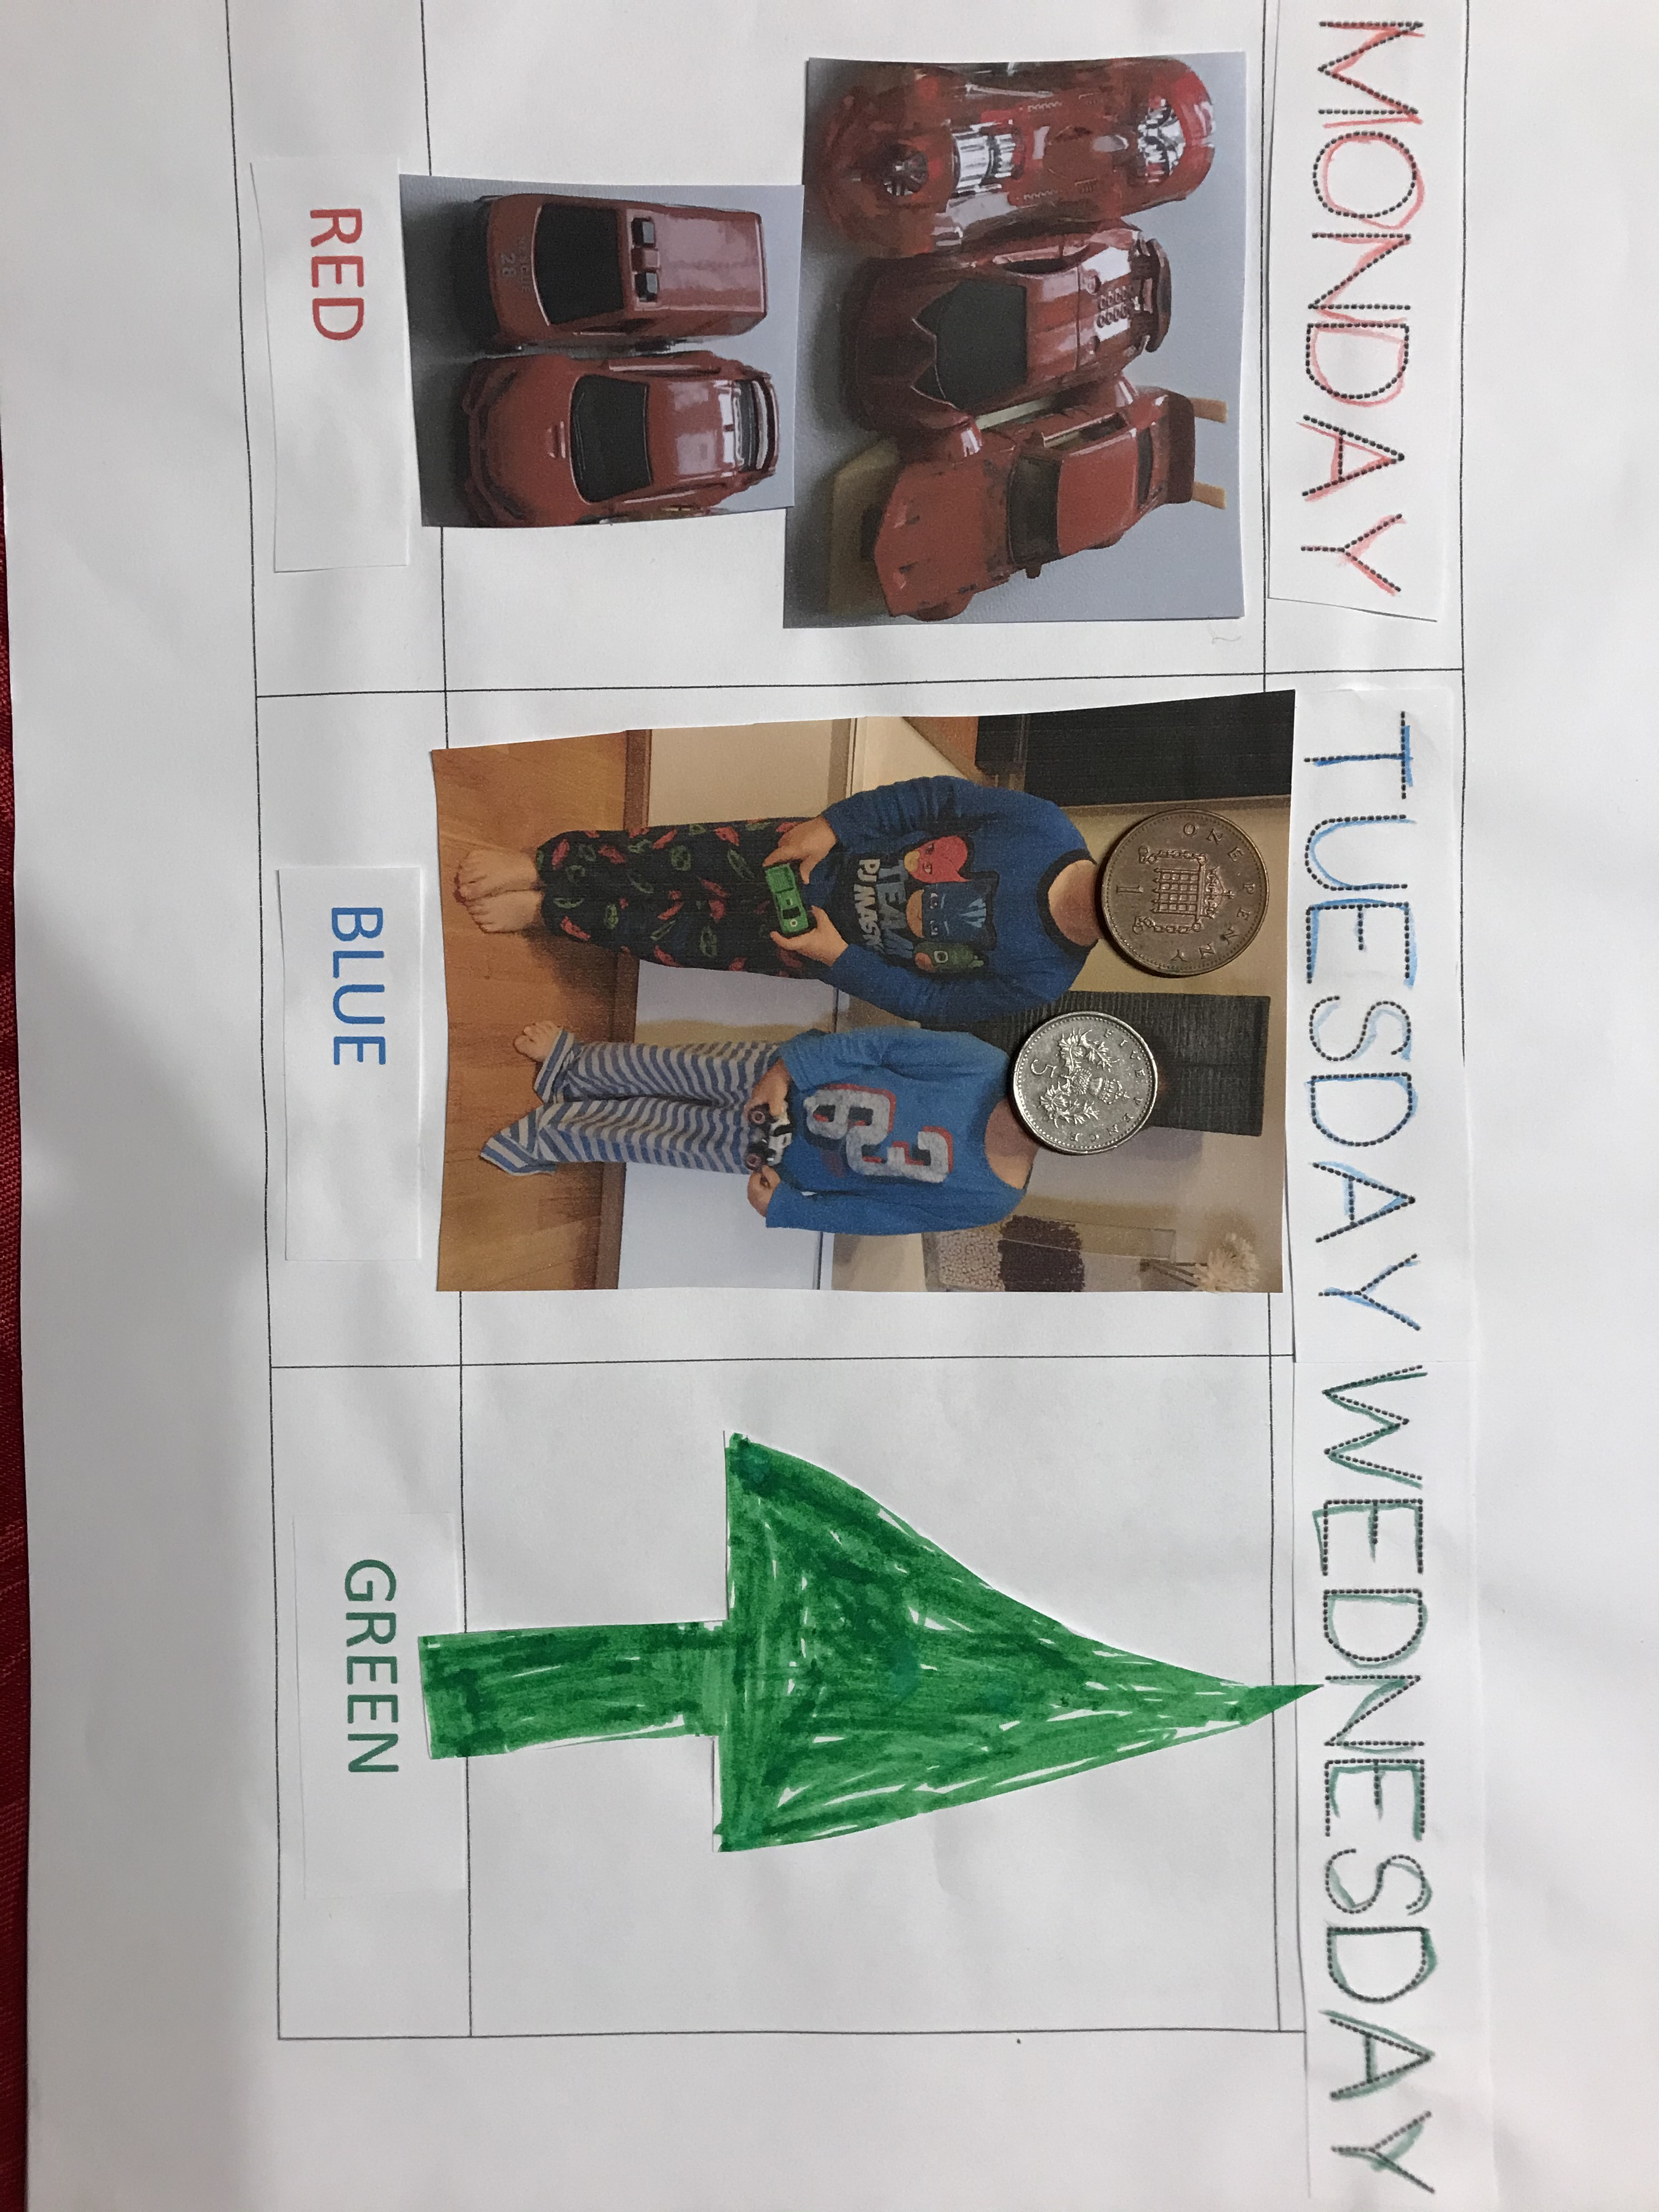
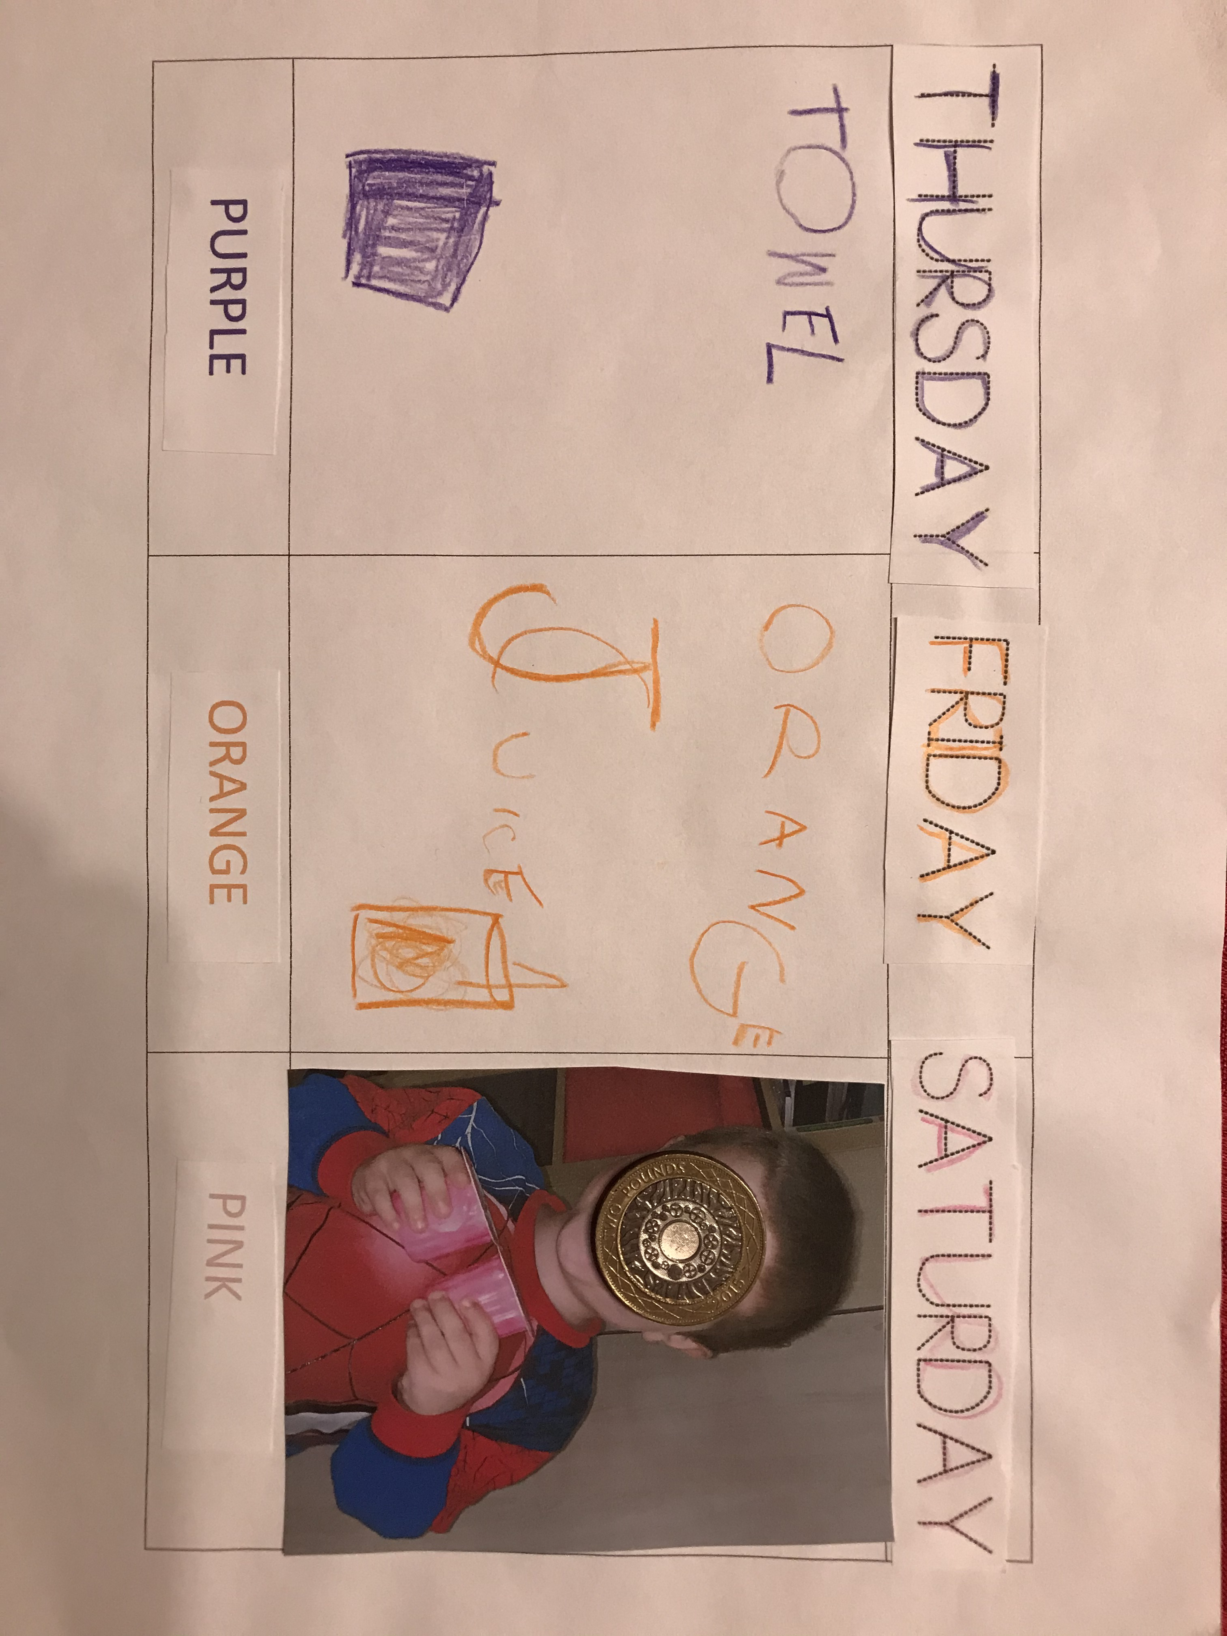
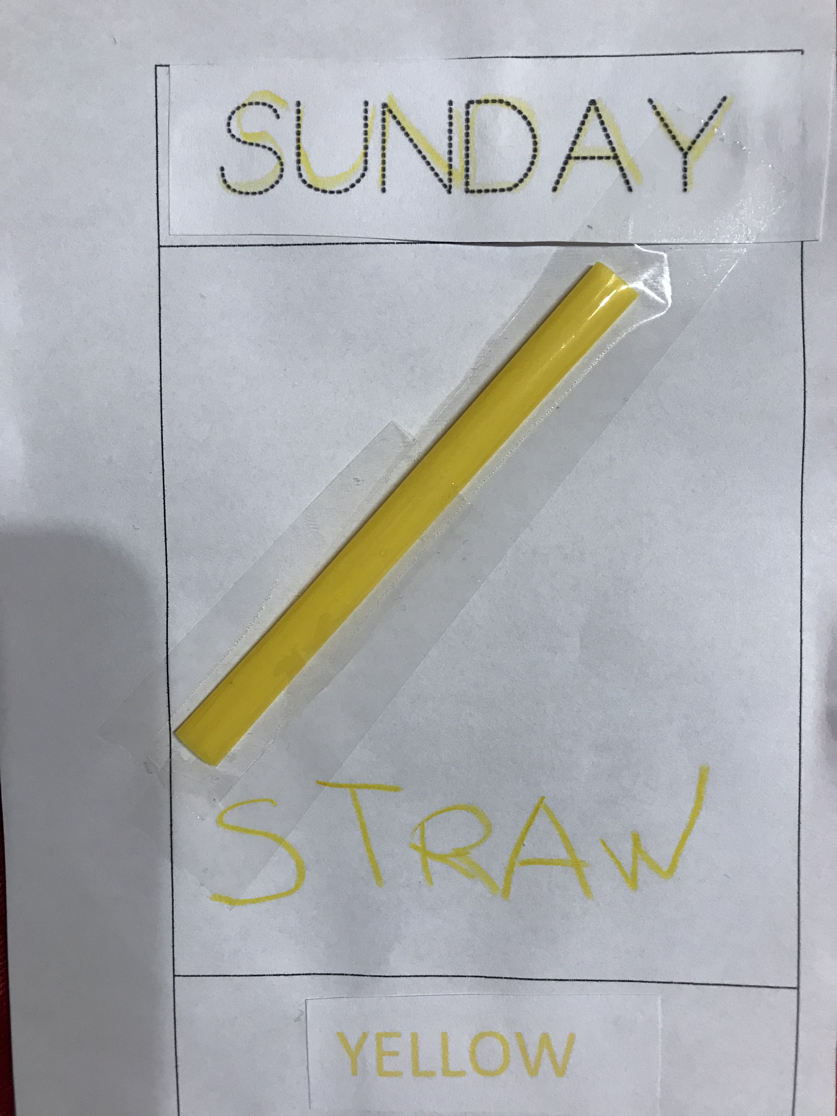

Slide 45
TIP

Slide 46
POINT HOUSE
A FLOOR, TWO WALLS, A CEILING, A ROOF, A CHIMNEY, SOME SMOKE, A DOOR, TWO WINDOWS...

Slide 47
BRAIN BREAK

Slide 48
BOOM CHICKA BOOM

Slide 49
WORKSHEETS

Slide 50
https://www.liveworksheets.com/

Slide 51
PICTURE

Slide 52
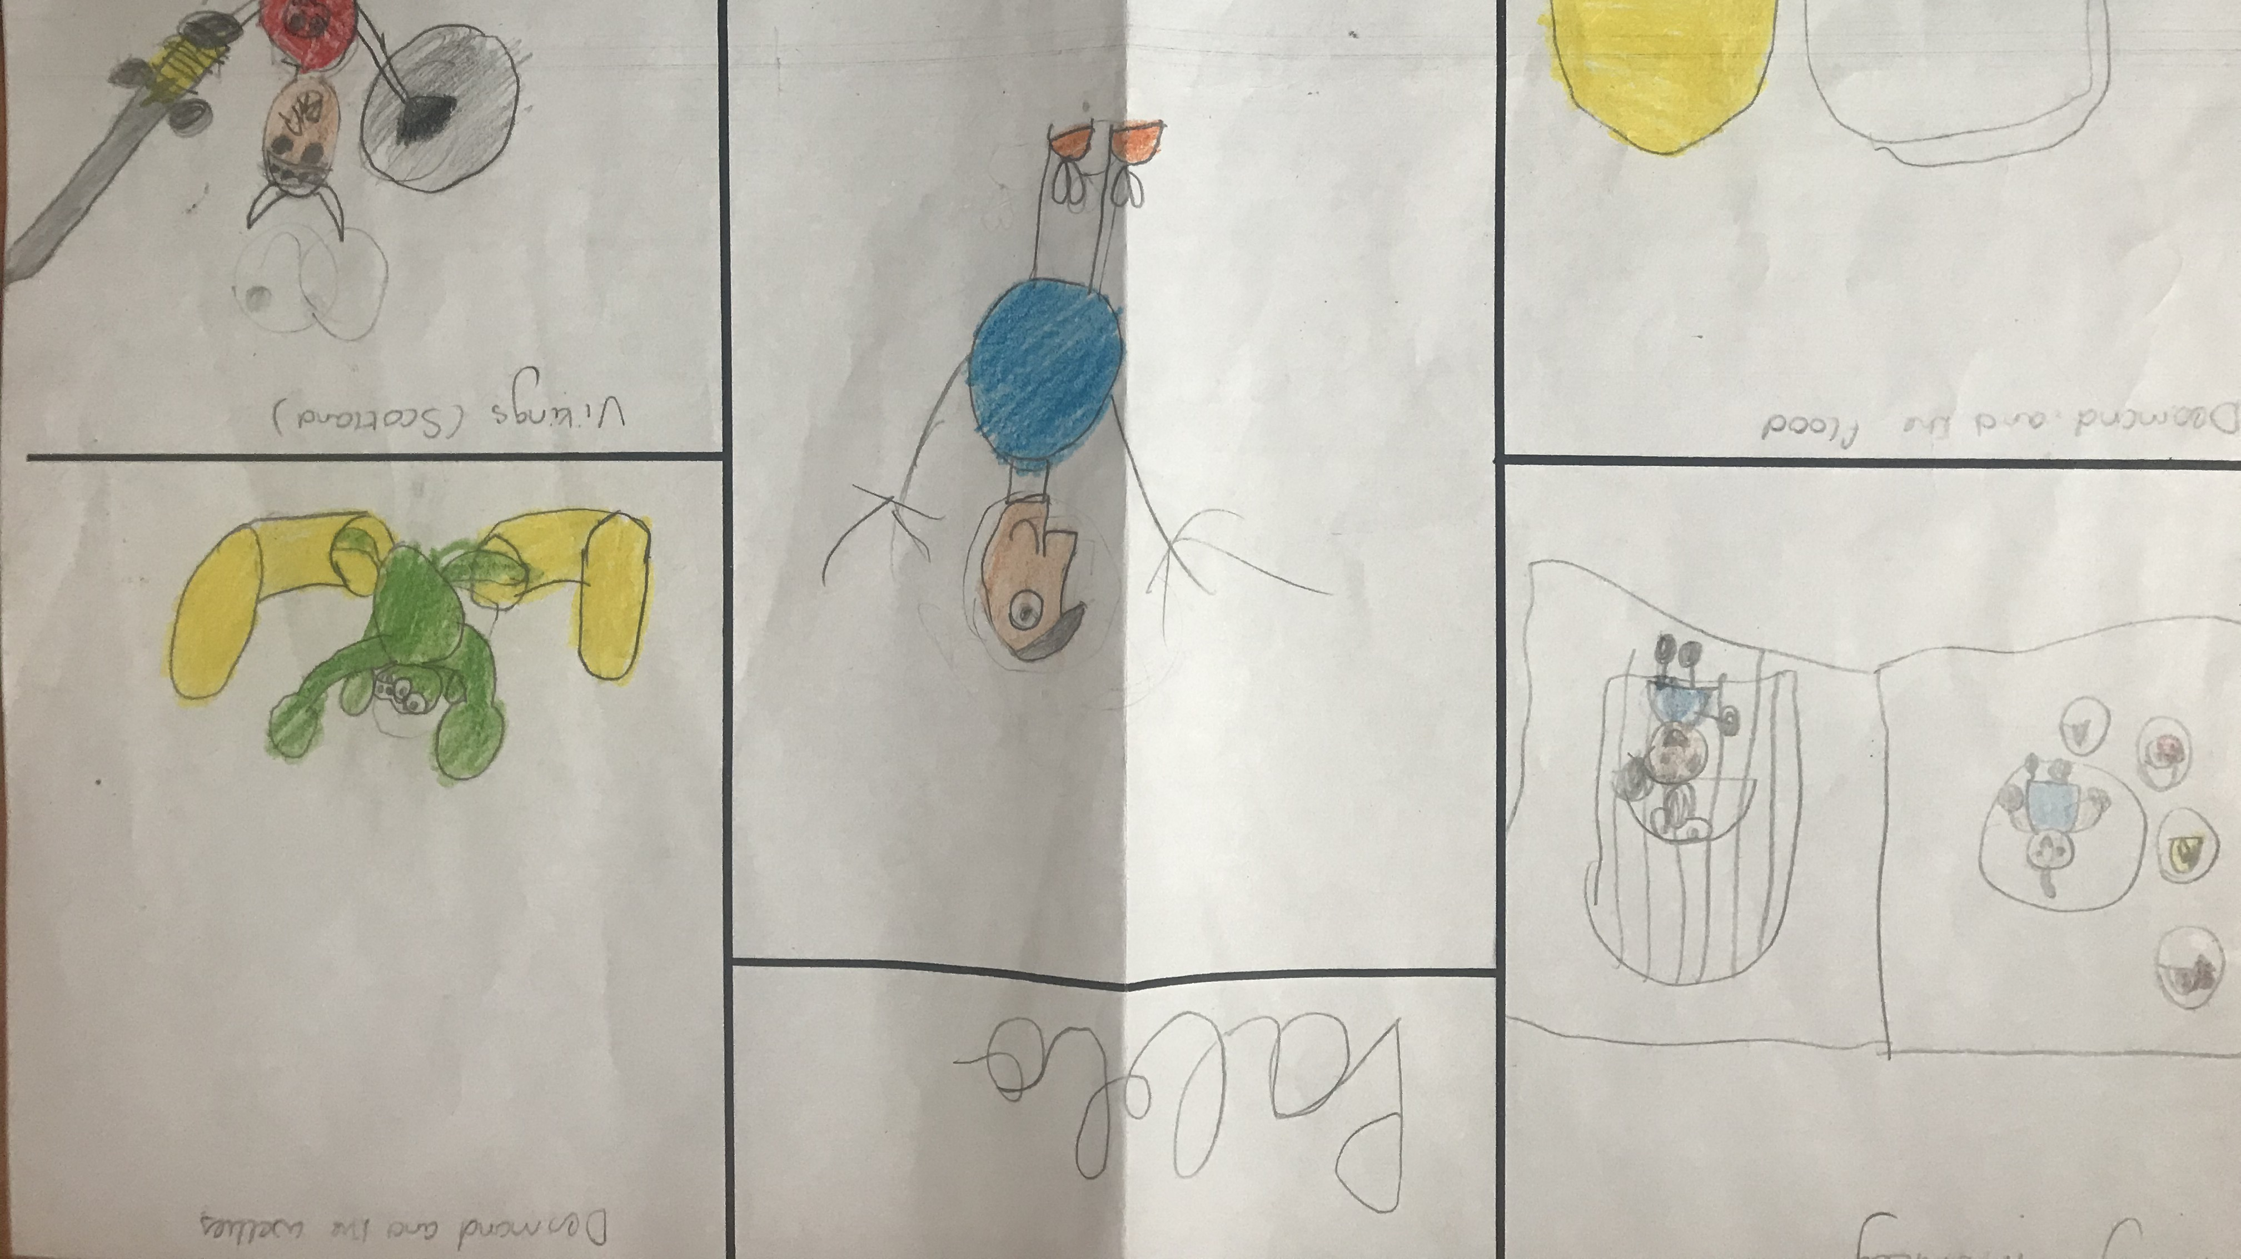

Slide 53
SAYING GOODBYE
BYE BYE,
SEE YOU TOMORROW.
BYE BYE,
SEE YOU TOMORROW.
BYE BYE,
SEE YOU TOMORROW.
BYE BYE, BYE BYE.

