Slide 1
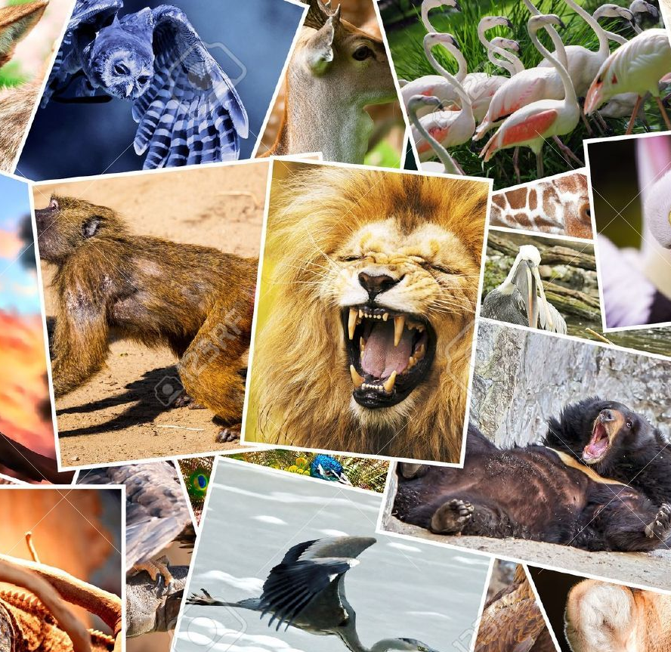
ANIMALS

Slide 2
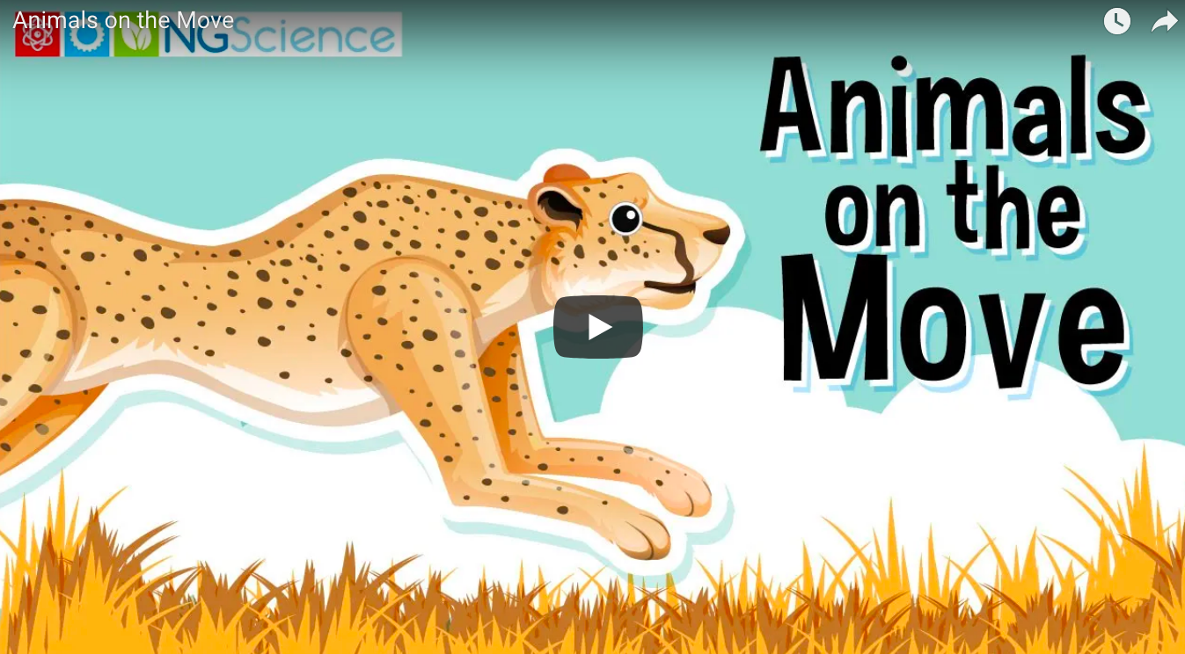
ADVANCE ORGANIZER
https://www.youtube.com/watch?v=ds0LNFZipLU
Haga clic para agregar texto

Slide 3
CONTENTS
INFANTIL (MARIA) | PRIMERO (CARMEN) | SEGUNDO (URBANO)
ACTIONS ANIMALS PARTS OF THE BODY (head, | ACTIONS ANIMALS LIVING AND NON-LIVING THINGS VERTEBRATES AND INVERTEBRATES | ACTIONS ANIMALS LIVING AND NON-LIVING THINGS VERTEBRATES AND INVERTEBRATES

Slide 4
CALP
INFANTIL | PRIMERO | SEGUNDO
Animals Move Walk Fly Run Jump Slither Swim Legs Tail Wings Fins Beak body) | Invertebrate, vertebrate, fly, slither, swim, walk, amphibian, bird, fish, mammal, reptile | Vertebrates, mammals, birds, fish, amphibians, reptiles, carnivore, herbivore, omnivore, oviparous, viviparous, hair/fur, scales, feathers, moist skin, lung, gills.

Slide 5
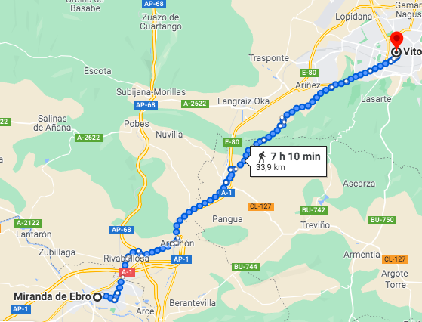
DRIVING QUESTION
You are an animal helper, some animals are lost; how could you help them getting back home?

Slide 6
KEY QUESTIONS
INFANTIL​ | PRIMERO​ | SEGUNDO​
Is this a....?​ Can you see humans?​ Can you see letters?​ Can you see any colors?​ ​ | What's your favourite animal?​ Is this a crocodile?​ Can you walk? Can you slither?​ ​ | What´s your favourite animal? Is this a mammal? Can it fly? Can it run?​

Slide 7
FINAL PRODUCT
In teams, students will create a performance + video/travel guide (Grade 1 and 2)/performance+ 3D collage using plasticine (Kindergarden) / that is going to be shared with the other teams.

Slide 8
DESCRIPTIVE TASK
THERE ARE DIFFERENT WAYS OF MOVING FROM ONE PLACE TO ANOTHER

Slide 9
TYPES OF MOVING

Slide 10
BRAINSTORMING AND COMMUNICATING
DRAW WHAT YOU CAN SEE
WHAT WAY DO YOU PREFER?
CAN WE HELP ANIMALS TO GO BACK?

Slide 11
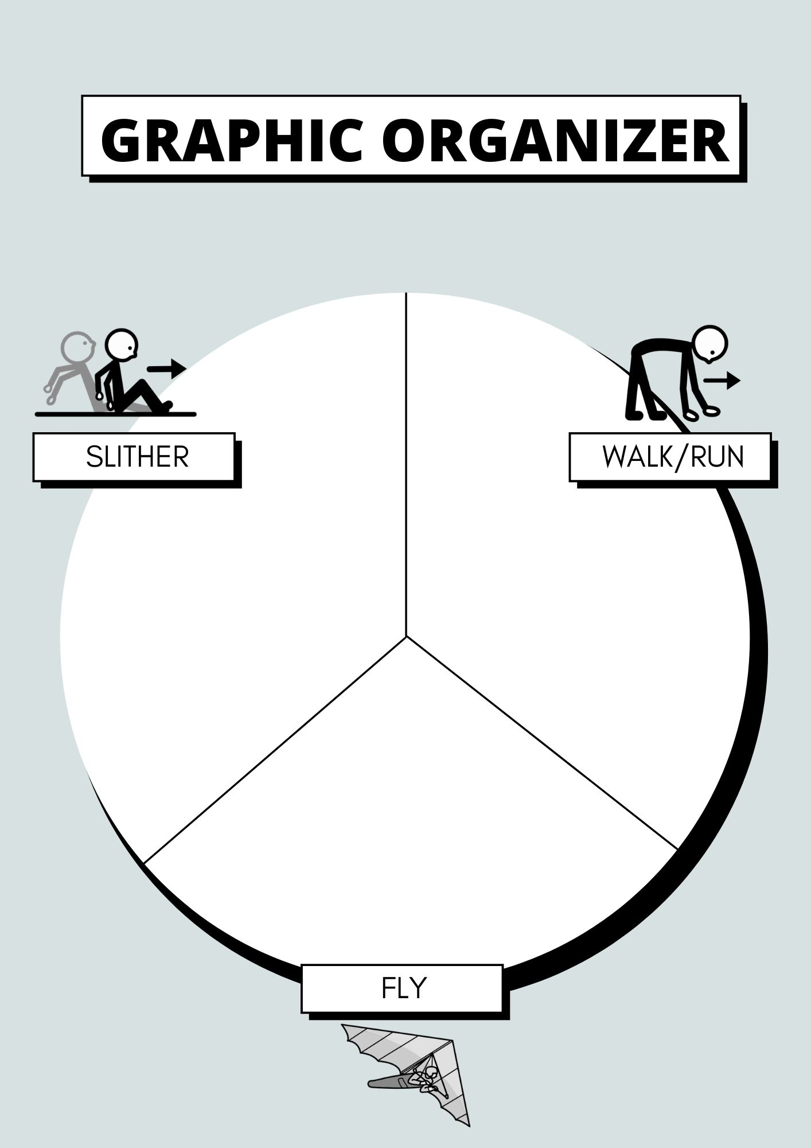

Slide 12
SUCCESS CRITERIA
How do you move from Miranda to Vitoria?
If you were an animal helper, what do you need to know to help animals to move from one place to another?
I need to know this about animals to be an animal helper:
Animals move …
Animals' body are ...
Animals need …

Slide 13
LET'S CREATE A CHECKLIST!

Slide 14
DESIGN THINKING STEPS
EMPATHIZE
EMPATHIZE: Who are we making this project for? We are making this project to help animals to move from one place to another.
DEFINE
DEFINE: What do they need? Students need to learn animals characteristics and their different ways of moving as well as to know how the landscape from one point to another, is.
IDEATE
IDEATE: What could we make? analyze how the landscape is, compare and contrast animals' characteristics through TBL and a graphic organizer.
PROTOTYPE
PROTOTYPE: draw a sketch of the prototype
PROJECT
PROJECT PRODUCT: 3D poster using plasticine, performance using real object to represent the landscape, a video to record the performarce.

Slide 15
DESIGN THINKING TASKS Inquiry: How do animals move?

Slide 16
WAYS OF MOVING- ANALYZE

Slide 17
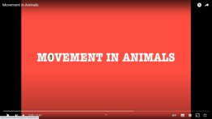
WAYS OF MOVING- ANALYZE
https://www.youtube.com/watch?v=c0qOYZXPIac

Slide 18
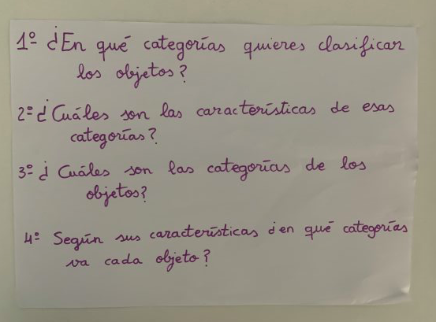
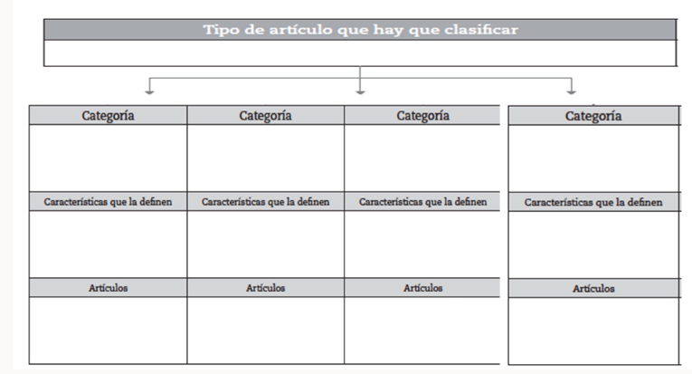
INQUIRY: WHAT SIMILARITIES AND DIFFERENCES CAN YOU SEE IN THESE ANIMALS?
GRAPHIC ORGANIZER
THINKING MAP
THINKING MAP

Slide 21
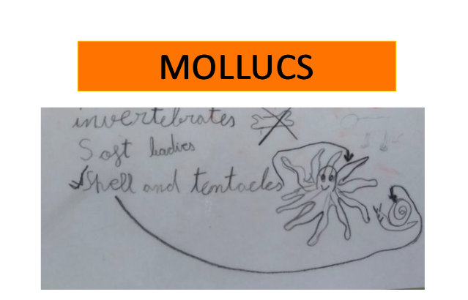

Slide 23
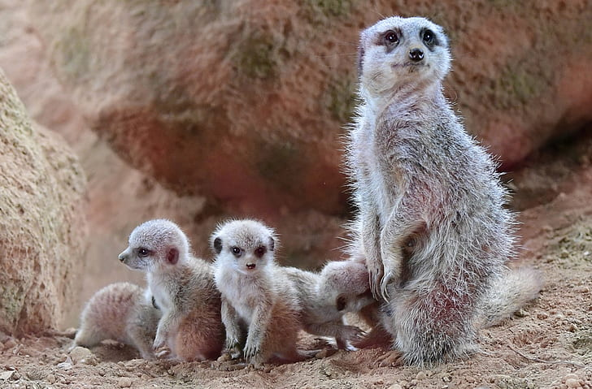
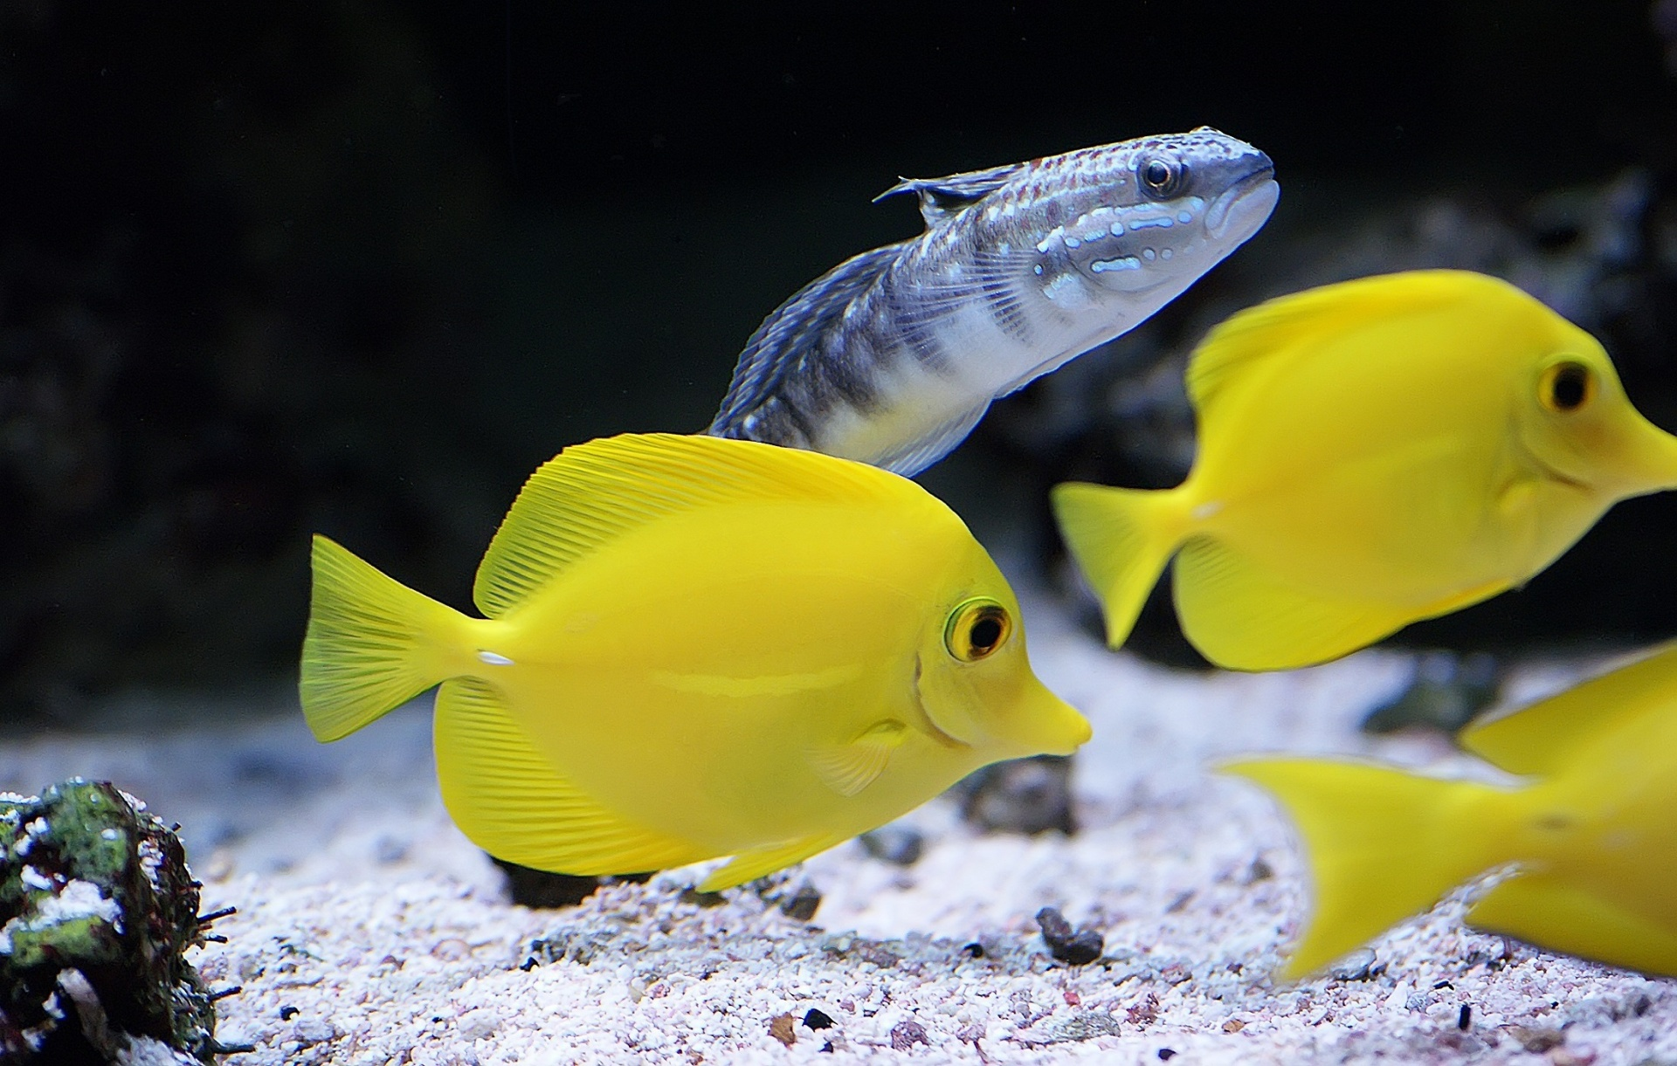
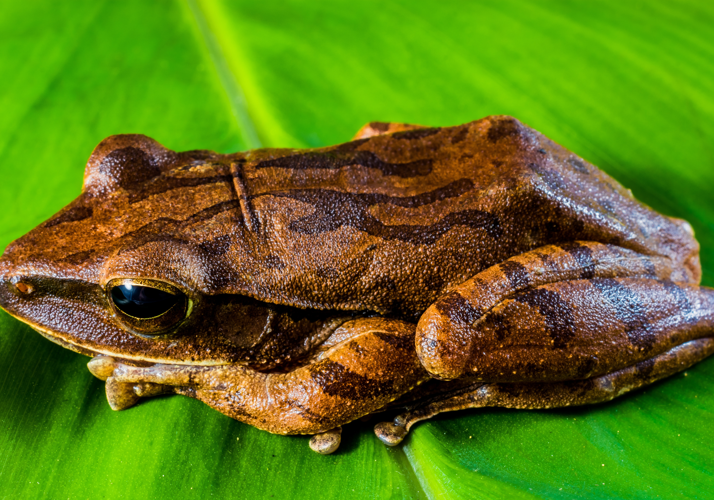
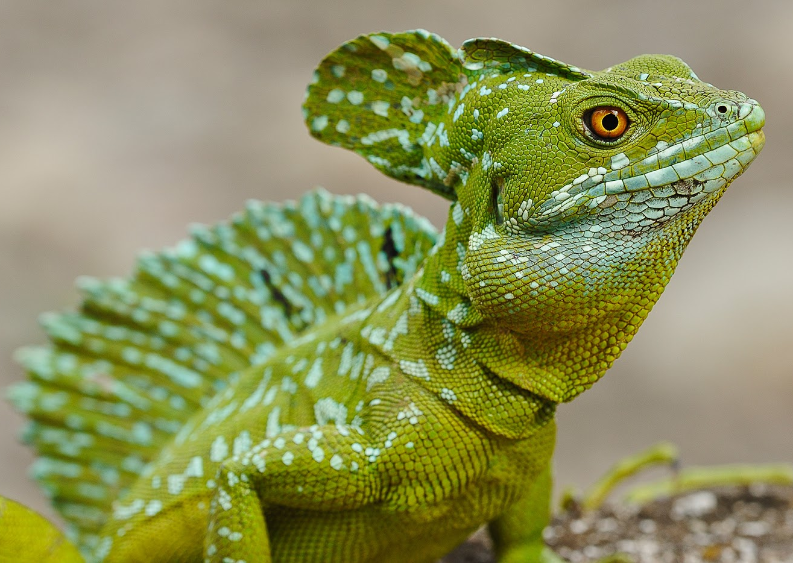
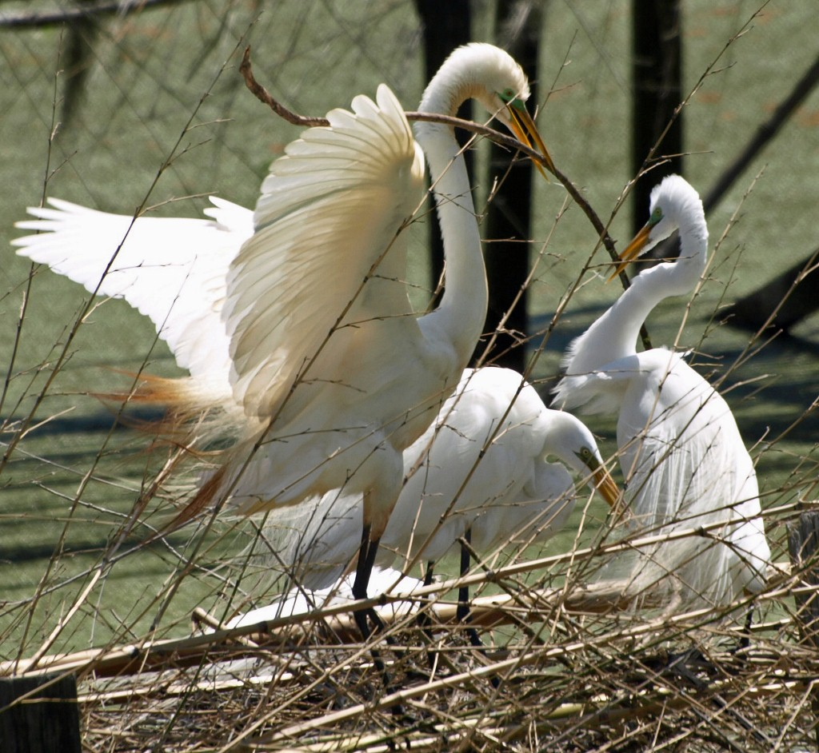
MAMMALS
VERTEBRATES
FISH
AMPHIBIANS
REPTILES
BIRDS
Esta foto de Autor desconocido se concede bajo licencia de CC BY-NC-ND.
Esta foto de Autor desconocido se concede bajo licencia de CC BY.

Slide 24
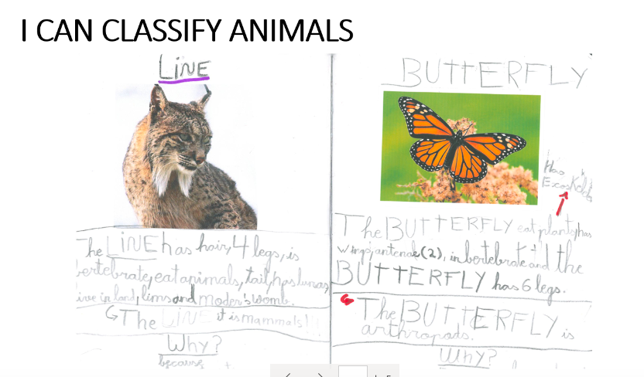
Students' examples

Slide 26
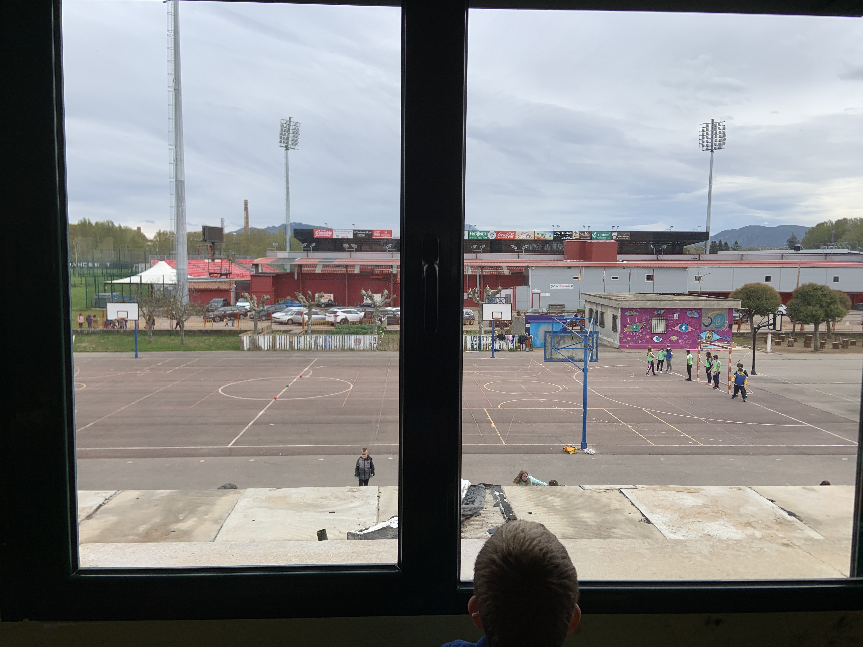
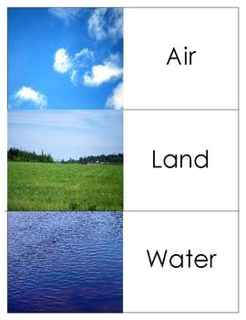
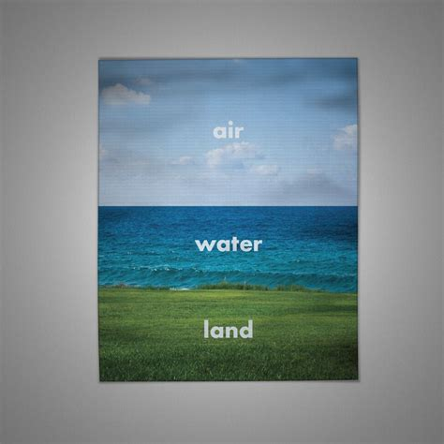
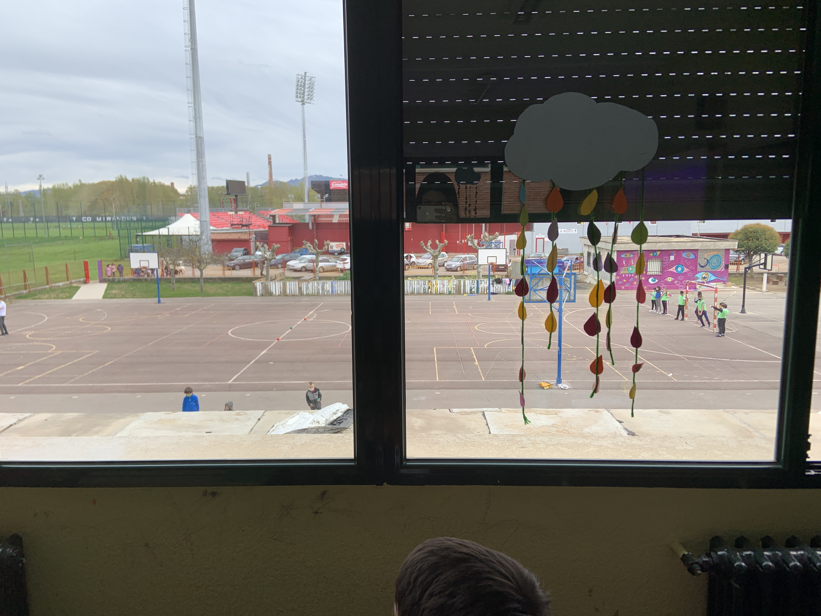
INQUIRY: LOOK THROUGH THE WINDOW, HOW CAN THESE ANIMALS MOVE HERE?

Slide 27
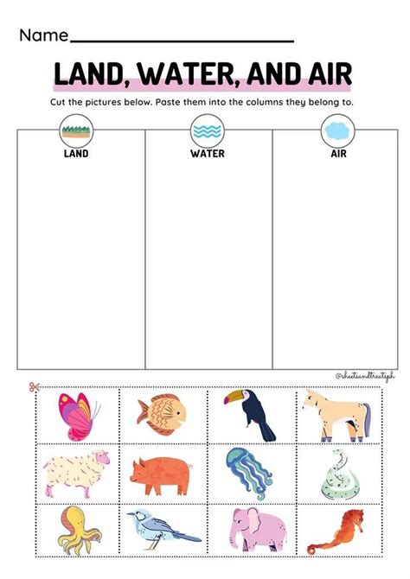
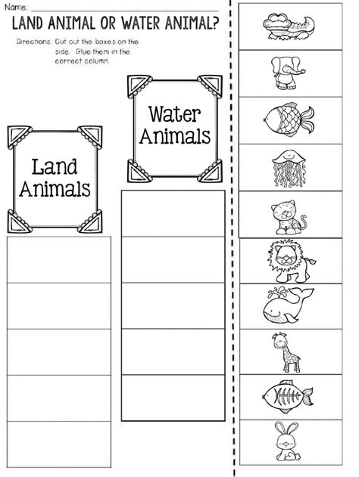
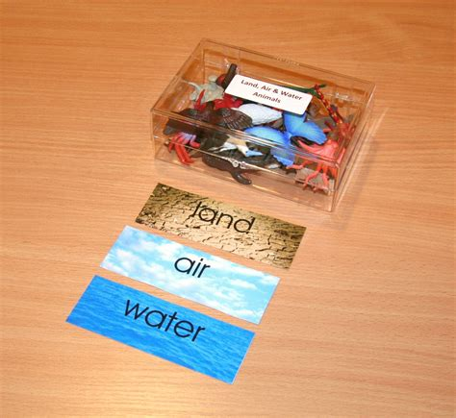
Landscapes- Analyze

Slide 28
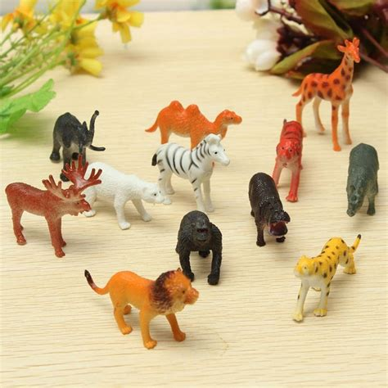
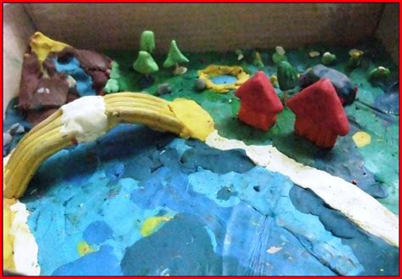
CREATE- THE FINAL PRODUCT (performance, brochure/travel guide/ plasticine 3D collage

Slide 29
Miranda de Ebro's animals
Some animals are lost and they need help to get back home
They learn animals' characteristics to be able to comparte and contrast and therefore classify animals.
They learn landscapes' characteristcs as well as animals ways of moving
Students work in small groups and learn how to do so asuming different 'roles' among the group.

Slide 30
SKETCH (PROTOTYPE)
Create a performance
Represent the landscape the path using plasticine
Use oral communication to explain how the are going to move from one place to another
Create a brochure including whatever is important to know to help them get back home.
Tablets
Plasticine
Paper
Pencil
Colors
Animal toys
Design the final products

Slide 31
EVALUATE
LET'S MAKE A CHECKLIST IN SMALL GROUPS
Animals' characteristics
Animals' classficiation
Landscapes' characteristics
Ways of moving
SUCCESS CRITERIA : I CAN …............
LEVEL

