Slide 1
Implementation of the mobile devices in Opole region

Slide 2
1. Teacher traning activities and projects
2. Activities, projects, experiences in schools
3. Proposals for improvement and future expextations

Slide 3
1. Teacher traning activities and projects organised by RZPWE
Projects
Workshops for teachers
Platforms for teachers
Niwki programme

Slide 4
Projects
Opolska e-szkoła, szkołą przyszłości
Sztuczna inteligencja I-programowanie

Slide 5
Opolska e szkoła, szkołą przyszłości
2012-2016
two editions of the project
111 schools were equipped with laptops (5500), terminals with access to electronic register (3000), programms for school management, 222 IBM servers
Platform for creating multimedia materials
7000 teachers and 61 000 students are registered on the platform

Slide 6
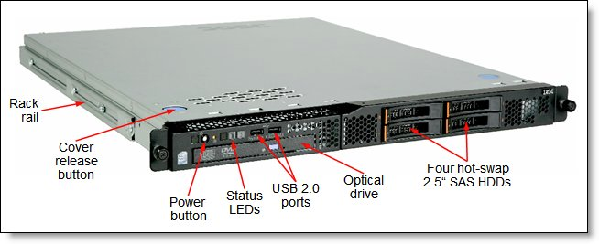
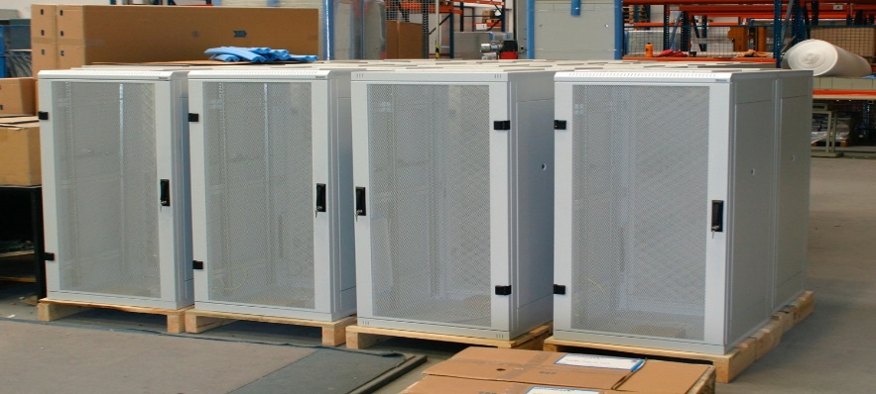
Schools were equipped

Slide 7
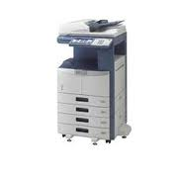
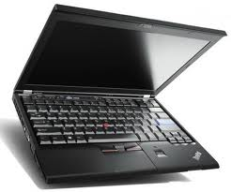
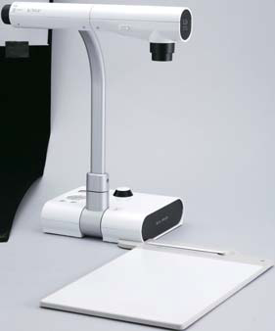
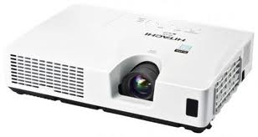
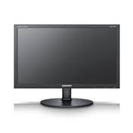
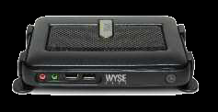
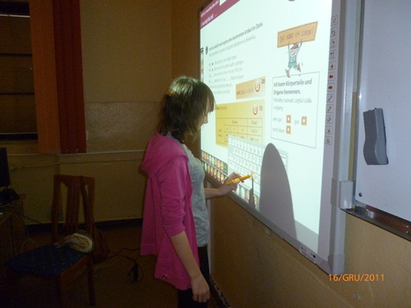
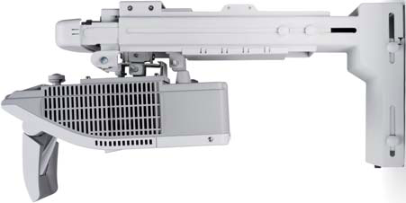

Slide 8
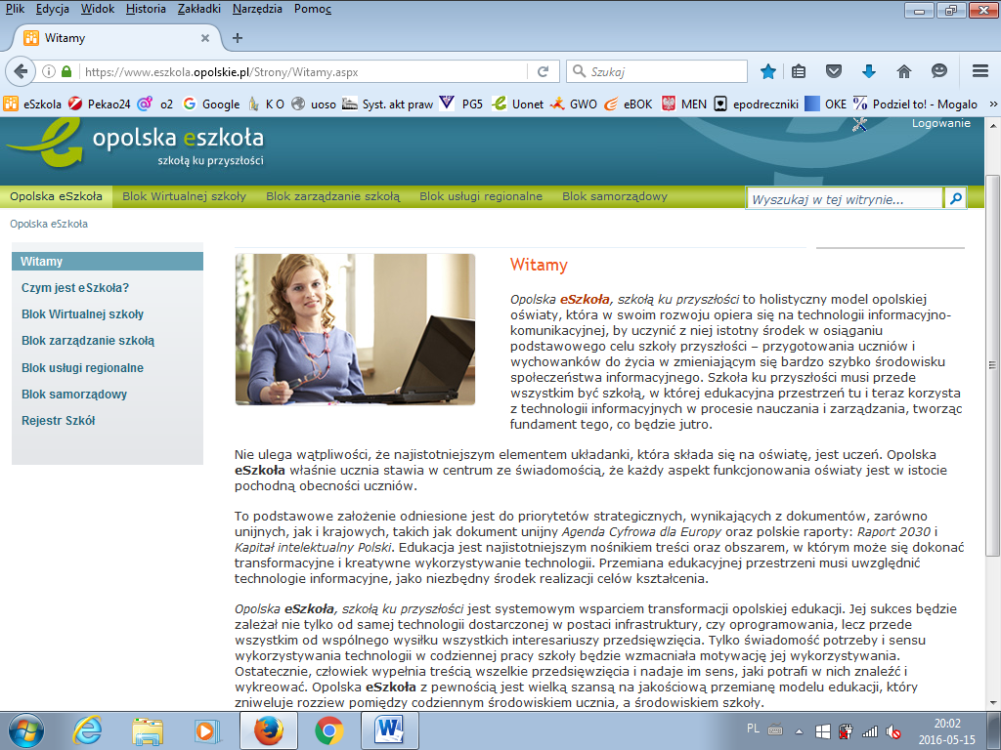
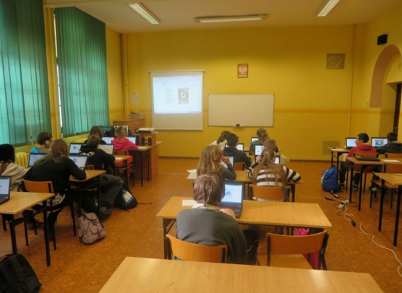
https://www.eszkola.opolskie.pl

Slide 9
Sztuczna inteligencja I- programowanie
Workshops for teachers- blended learning
Workshops for students
200 teachers and 2200 students-early education
01.09.2017-31.12.2019
200 teachers equipped with tablets, electronic versions of educational materials used in programming

Slide 10
Workshops for teachers
Fllipped classroom in education
QR codes without secrets
Actionbound in escape room
Plickers for foreign language teachers
Models of using ICT at schools-300 teachers
Developing key competences
New technologies as motivation for learning/teaching
How to use ICT potencial at school

Slide 11
Workshops for teachers
Scratch
Scratch Junior
Present yourself in Prezi
Smartphone lesson- how to prepare the effective lesson
Modern forms of communication with parents and students

Slide 12
Niwki programme
Workshops for teachers of German language:
Blogging creative German teacher
How to use flipped classroom in school practice
Multimedialer Deutschlehrer: photos, pictures, comics
Genially with genial.ly
Checking and marking online with Plickers and Google
Learningapps, Plickers, Quizizz, riddles, vocabulary sudoku, qr codes on German lesson

Slide 13
Platforms for teachers
Networks for teachers using e-learning platforms like:
doskonaleniewsieci
eTwinning ( 300 teachers in years 2016-18)

Slide 14
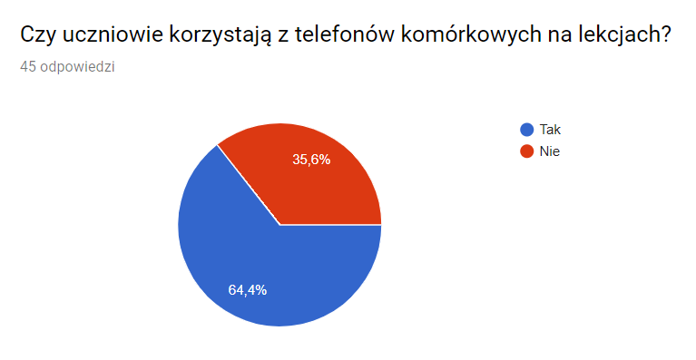
Interesting activities, projects, experiences, etc. carried out in schools of Opole region
Questionnaire to 45 advisors working in RZPWE

Slide 15
Use of smarthones
Quizizz
kahoot, QR codes
dictionaries,
LearnC++ / LearnSQL
matematyczne ZOO, multiplication table, Learningapps.org,
calculator,
Zdrowe Zakupy, Youtube, Messenger

Slide 16
School subjects & smartphones
Maths
Foreign languages
Music, History
Polish language
Chemistry, Physics, Biology, Geography
IT,
Additional activities
programming

Slide 17
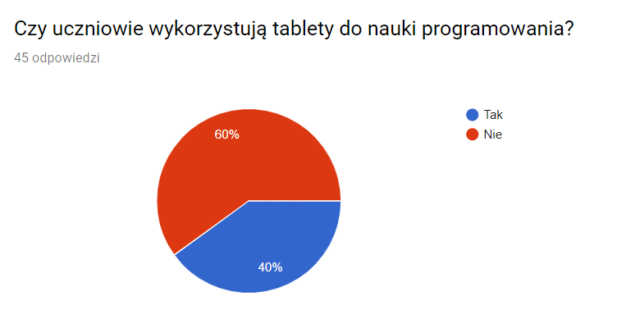
Use of tablets:
in programming

Slide 18
2. Use of tablets with tools like
Learningapps.org, Scholaris, Jigsawplanet, Matzoo, Ortofigle, Kahoot, Kod QR, Koło foruny, Niezbędnik multimedialny MAC,
e- podręczniki ( multimedial coursebooks)

Slide 19
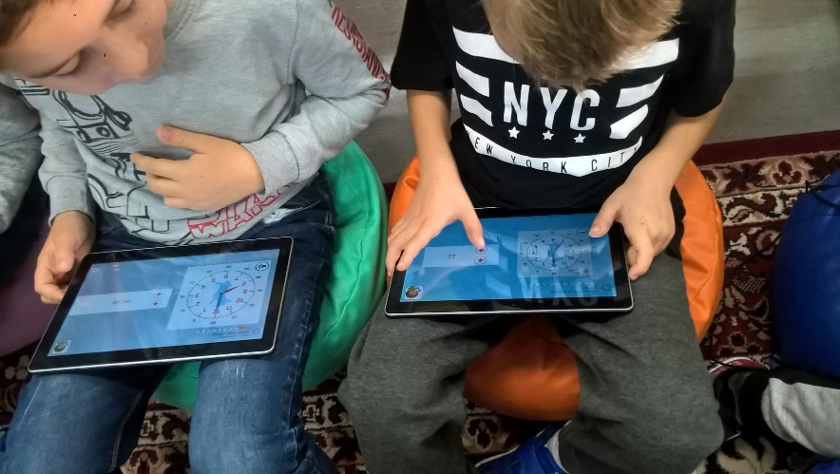
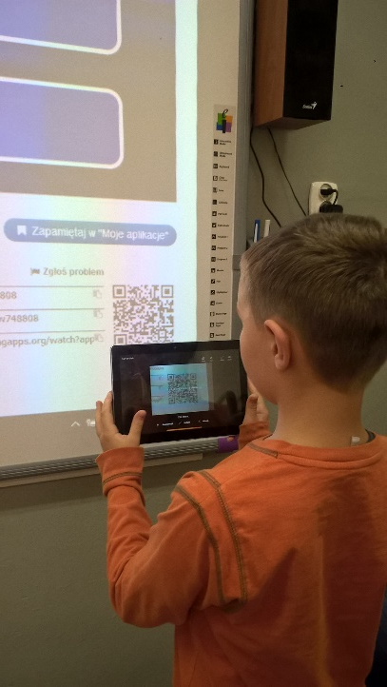
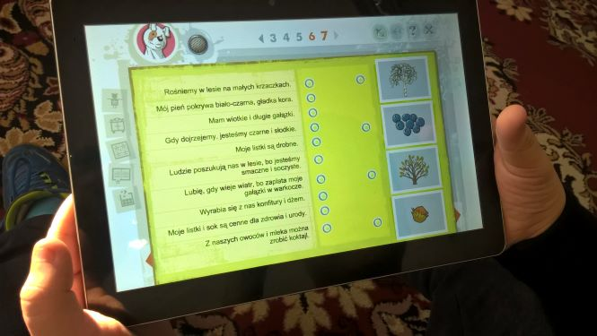
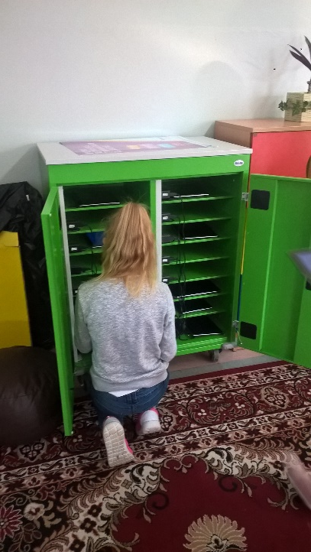
PSP 1 Zdzieszowice

Slide 20
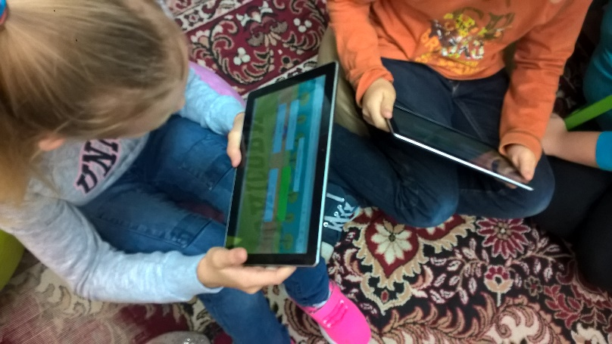
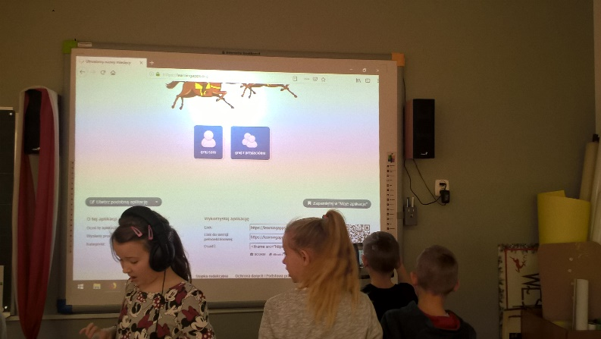
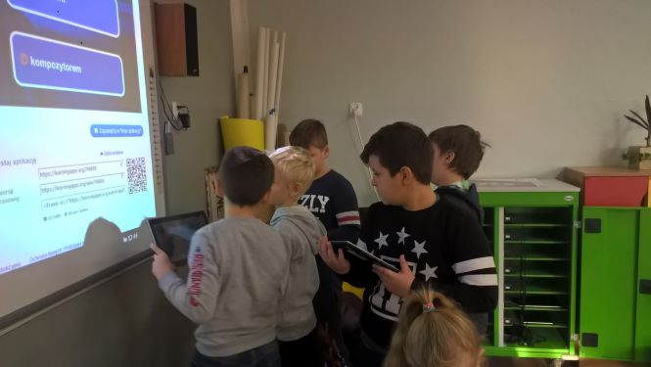

Slide 21
Film
https://www.youtube.com/watch?v=MiMmhnz9frs

Slide 22
PSP 15 Opole
PSP 15 Opole
Erasmus + projects:
From Europe 1010 BC to Europe 2020 PC
http://www.psp15.opole.pl/projekty-miedzynarodowe/erasmus/1464-uczniowie-prezentuja-ulubione-aplikacje-w-procesie-edukacji.html

Slide 23
PSP 1 Strzelce Opolskie
PSP 1 Strzelce Opolskie
http://www.psp1stop.ehost.pl/index.php?option=com_content&view=article&id=568:w-rezerwacie-geologicznym&catid=116:ipadwjedynce&Itemid=126

Slide 24
Proposals for improvement and future expectations regarding teacher training in mobile devices in short-term
Changing the teacher centered teaching to learner centered teaching
Improving teachers ICT competences
supplementing traditional teaching methods with e-learning and m-learning solutions
adaptation of the teaching process to the changing perceptual model (iconography, comprehensive reading, short texts, difficulty concentrating on long text)

