Slide 1
THE WAY
OF
Saint JAMES
1st to 6th
Primary

Slide 2
CONTENT AREAS 1st to 4th Primary
01
02
03
04
WHERE
WHAT
Cardinal points and directions, orientation, weather, maps...
Symbols
WHO
HOW
Pilgrims, nationalities, equipment...
Means of transport

Slide 3
CONTENT AREAS 5th to 6th Primary
01
02
04
03
WHAT
WHERE
Equipment, accomodation, languages..
French Way, towns, stages...
HOW
WHO
Pilgrims,countries, nationalites...
Symbols, emotions, feelings...

Slide 4
CALP 1st and 2nd Primary
Shell
Map
Walk
Arrows
Bottle
Pilgrims
Ride
Corner
Horse
Hostel
Bike
Backpack
Go ahead

Slide 5
CALP 3rd and 4th Primary
Shell
Walking
Stick
West
Compass
Backpack
East
Hermitage
Sleeping bag
French
Waistcoat
Foggy
German
Path
Stormy
World
Pumpkin
Hostel
Village
Hundred
Bunk bed
Country

Slide 6
CALP 5th and 6th Primary
On the way to/route
Stamps
Pilgrimage/pilgrim
Latin cross
Challenge
Yellow arrow
Landmark
Equipment/outfit
Ultreia et Suseia
Scallop Shell
Face difficulties
Pumpkin (squash, gourd)
Blisters
Walking stick
Hostel
Credentials “Compostelana”

Slide 7
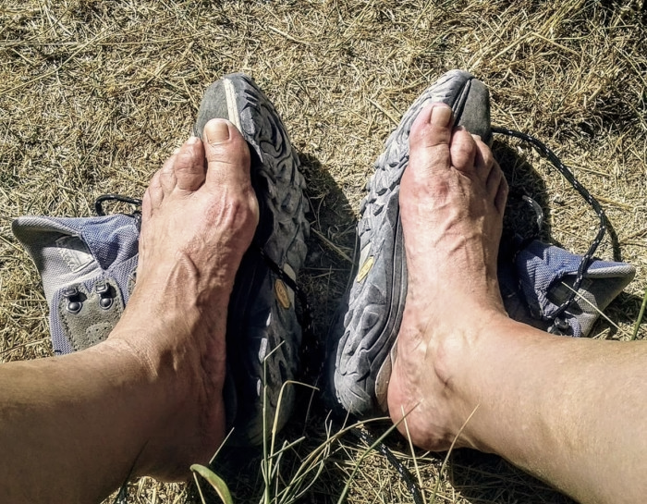

Slide 8
ADVANCE ORGANIZER

Slide 9
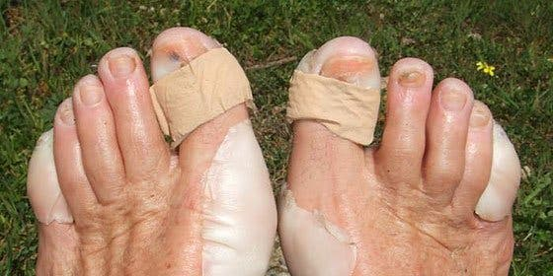
OUCH!

Slide 11
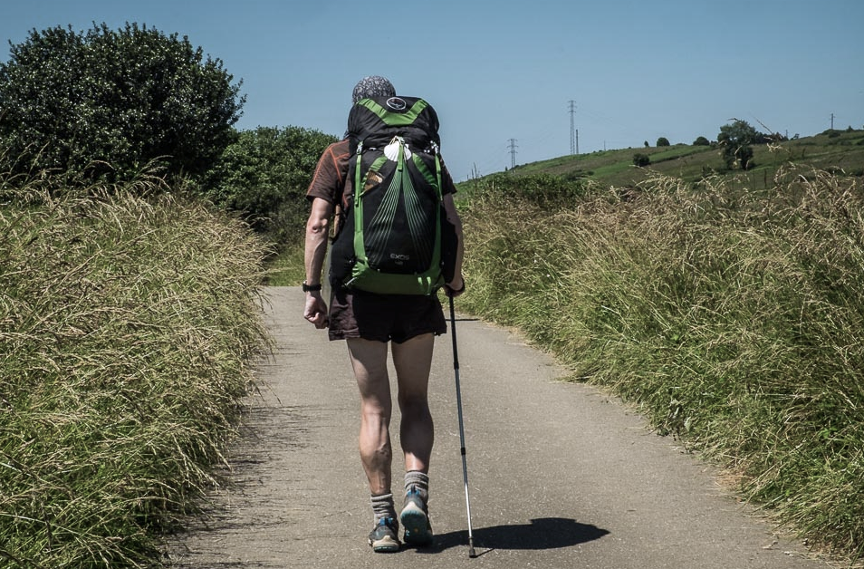
DRIVING QUESTION
As a citizen, how can you help him find his way?

Slide 12
I WONDER … 1st, 2nd and 3rd Primary
Who are they?
Are the at school?
Where are they ?
Are they happy /sad/tired?
Are they walking/riding a horse...?
Are they friends?
What have they got?

Slide 13
I WONDER …4th, 5th and 6th Primary
Who are they?
What are they wearing?
Where are they going to?
How are they going to that place?
Why do people want to do this?
How are they feeling?
Who are they going with?
What do they need?

Slide 14
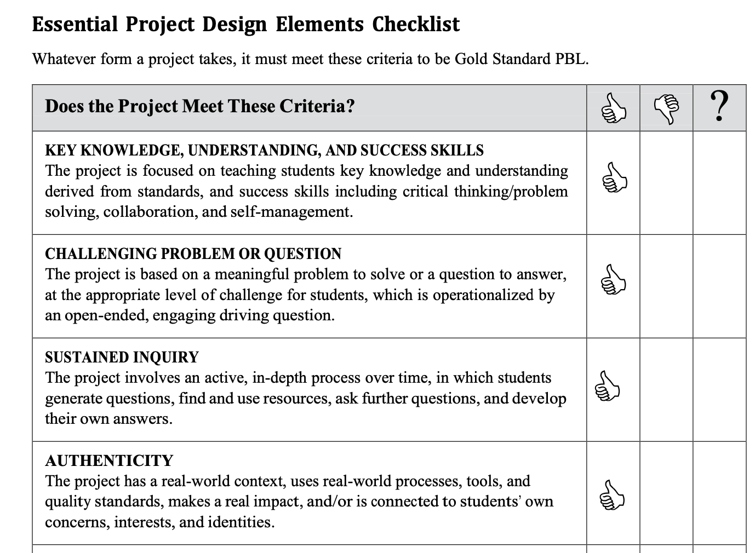

Slide 15
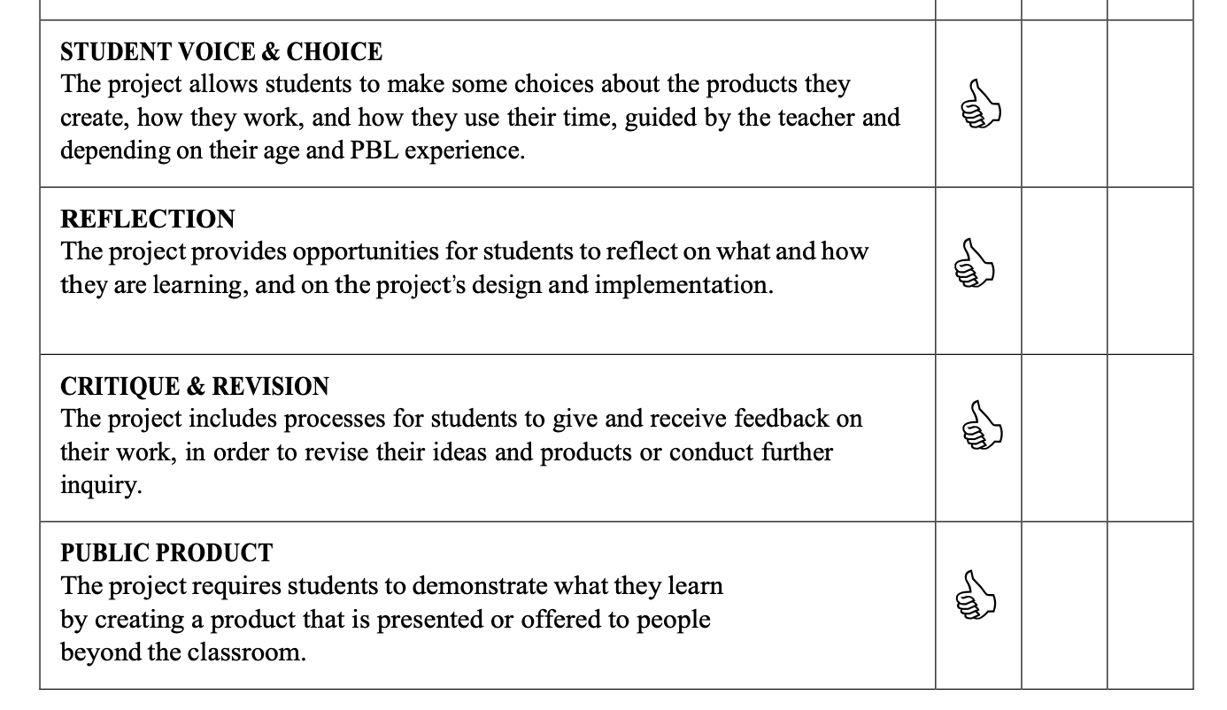

Slide 20
HOTS
ANALYZE
EVALUATE
CREATE
21st Century Skills
Inquiry & Innovation
Feedback
These 3 areas of PBL

Slide 21
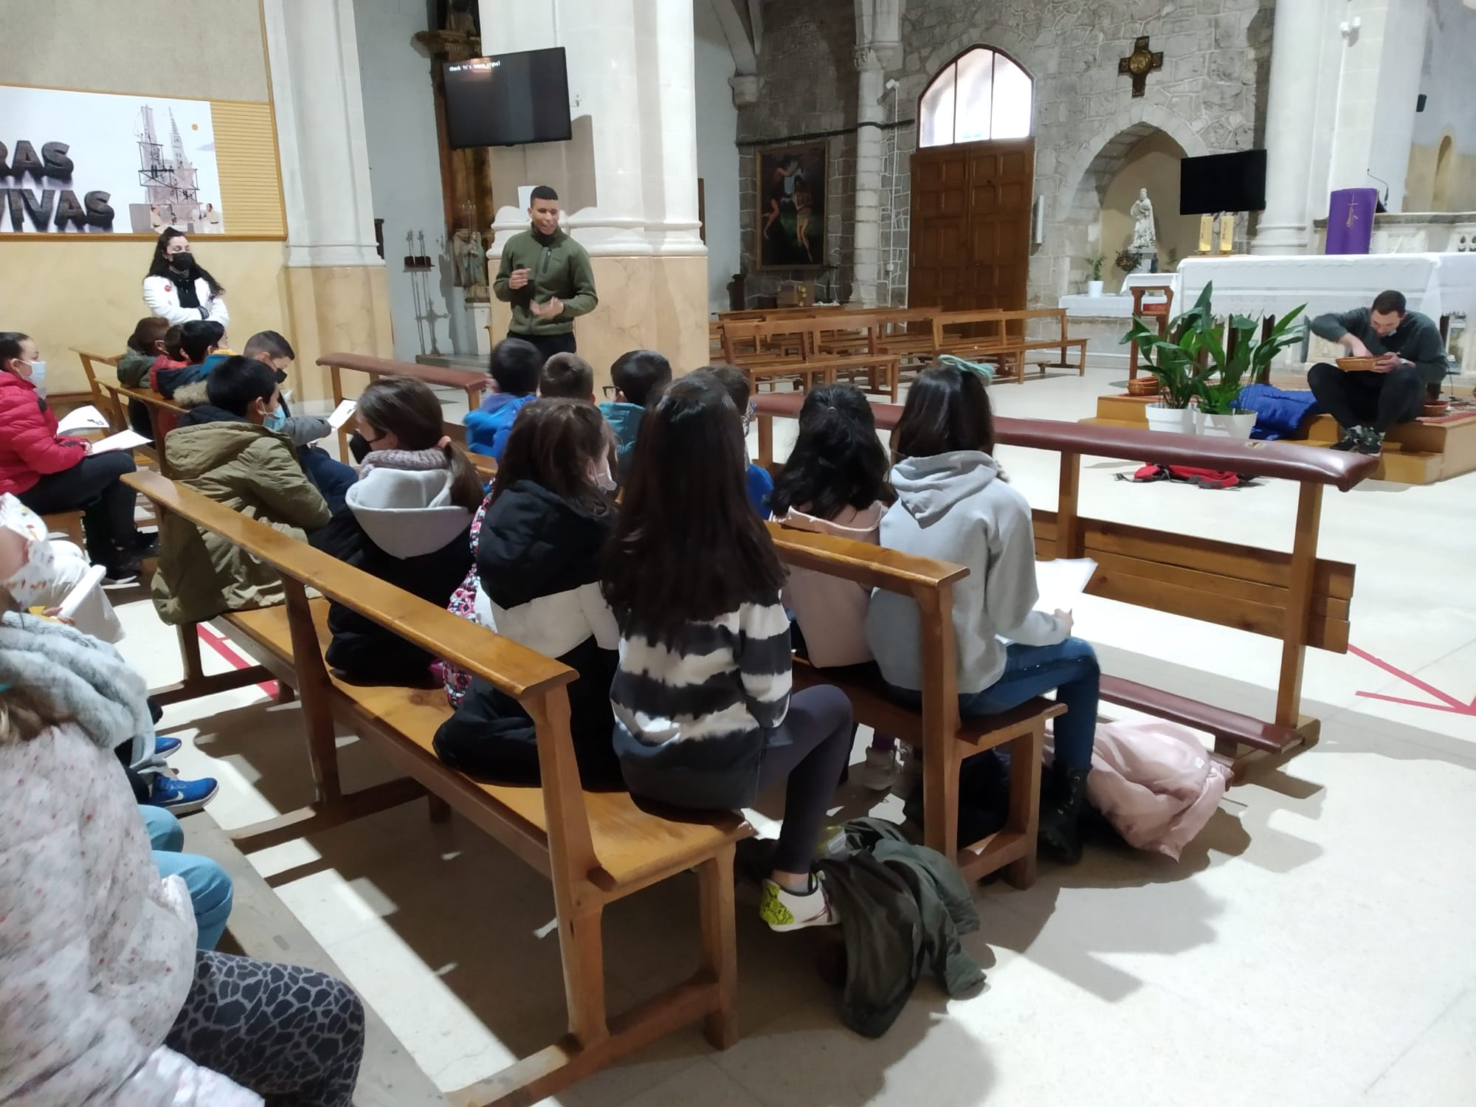
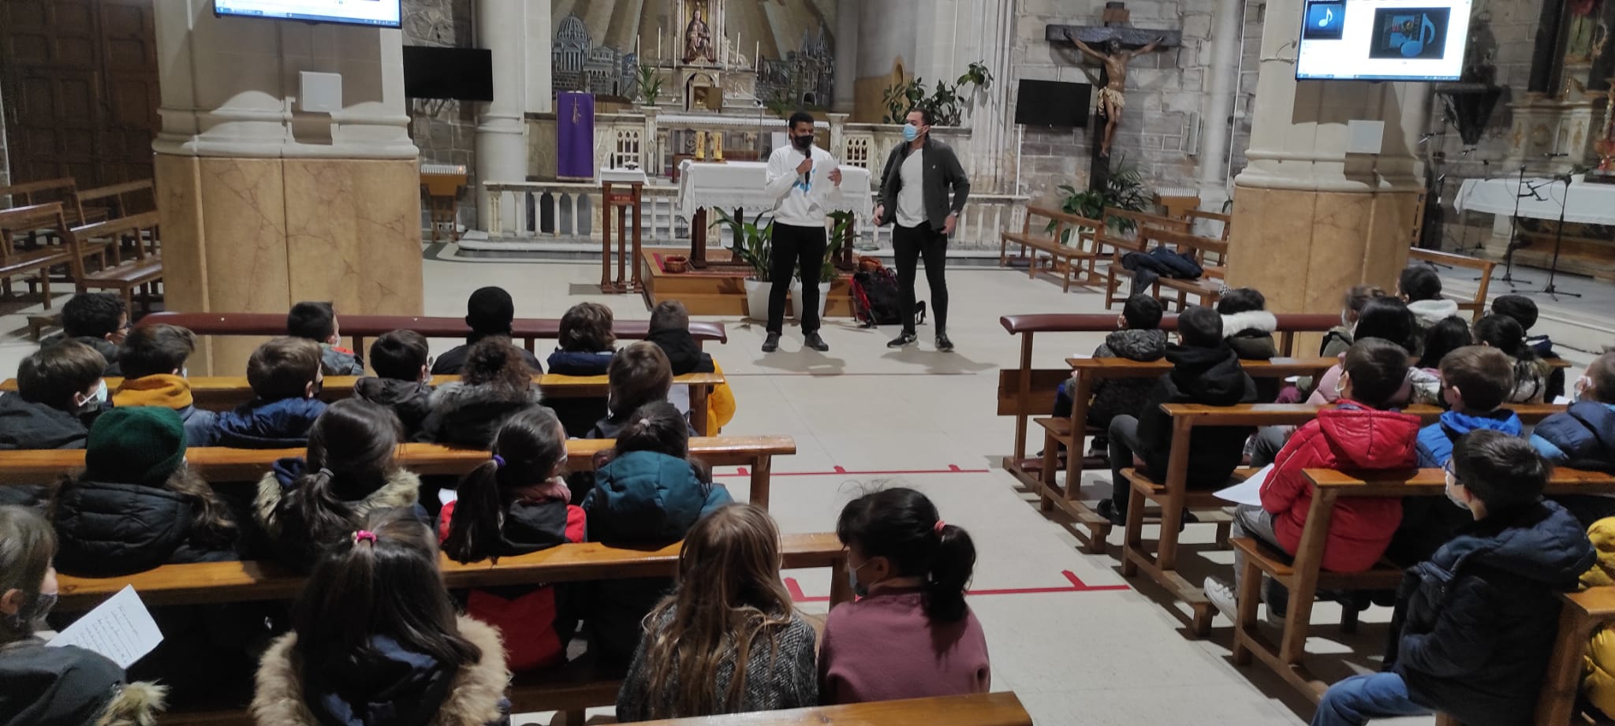
Interviewing a pilgrim

Slide 22
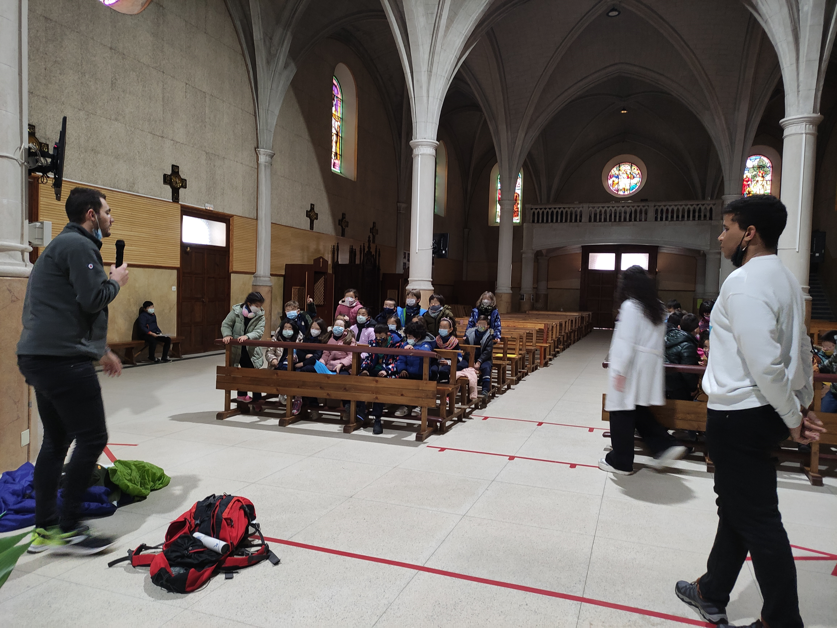

Slide 23
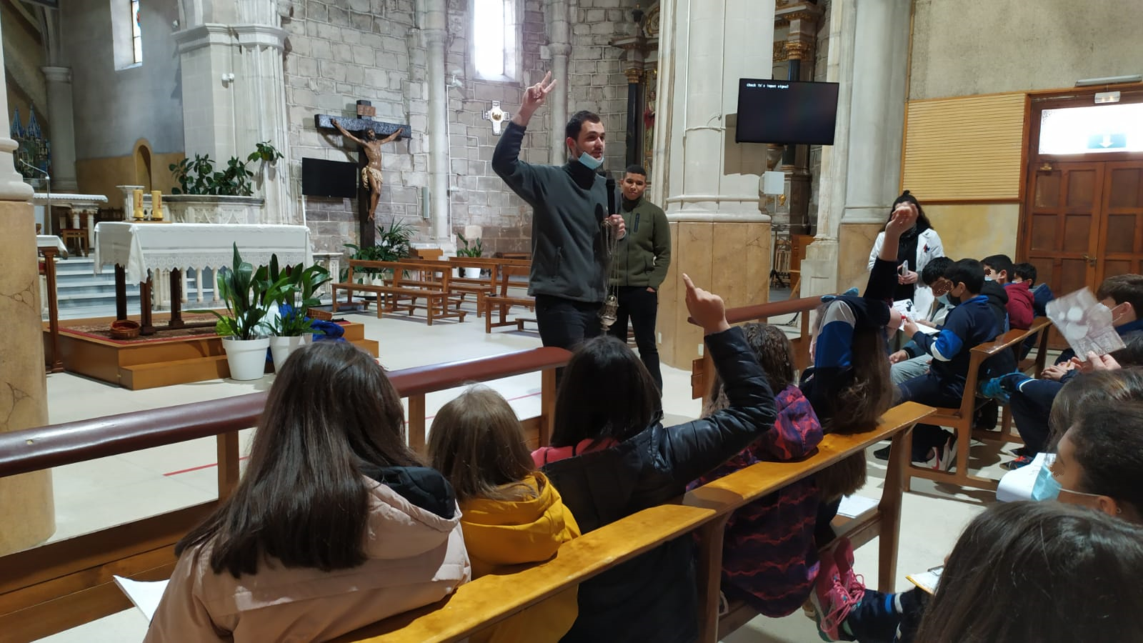
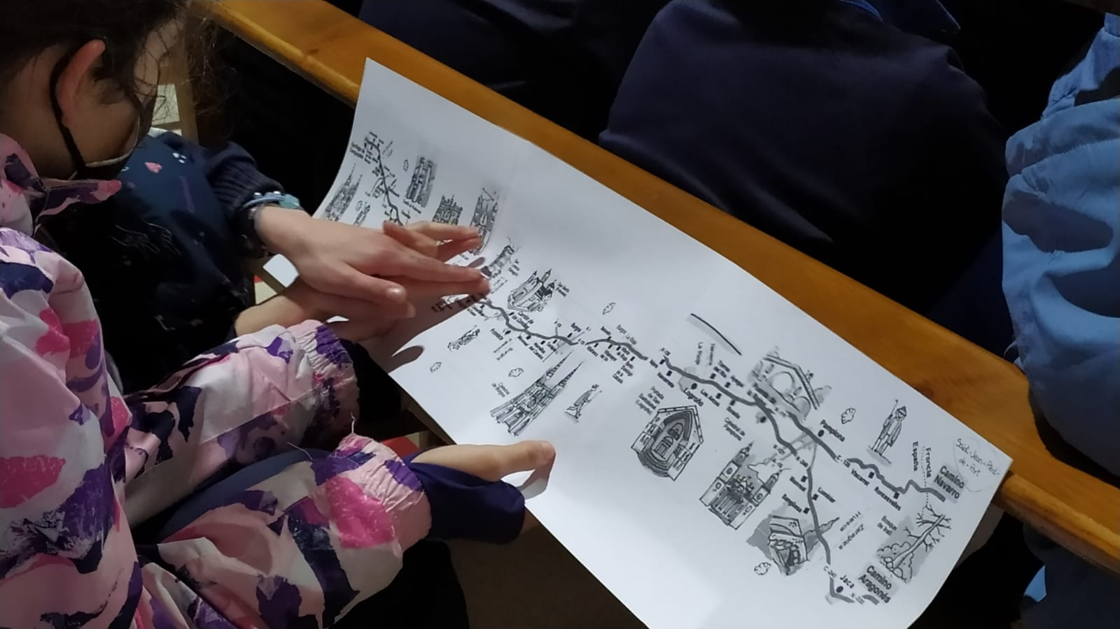

Slide 24
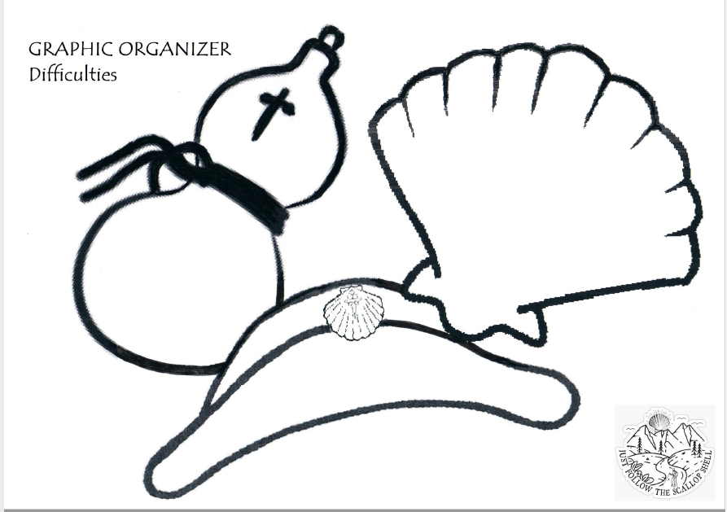
Graphic Organizer

Slide 25
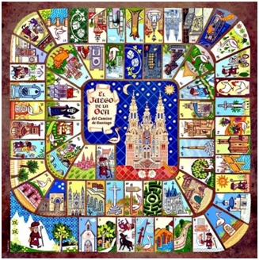
The Goose game

Slide 26
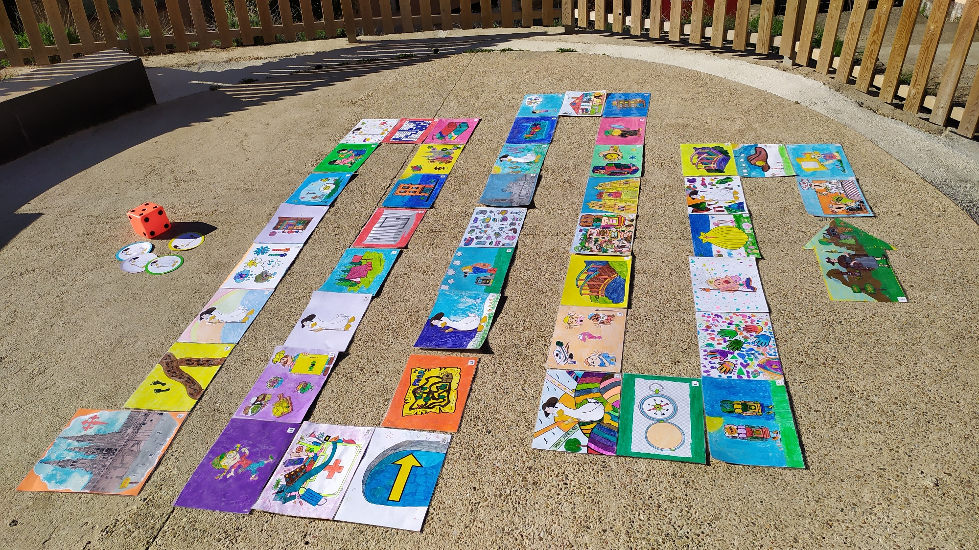

Slide 27
Grouping There were 4 fixed groups playing for 2 days (4-5 students each and 2 teachers).

Slide 28
Methodology: Firstly, each group threw the die, then faced the challenge and finally, waited for another turn. Therefore, the activity became boring and slow. So, to energize the dynamic, it was decided that the group threw the die, they were given the game and when the mission was accomplished and checked by the teacher, they could immediately throw the die again. In this way, pupils worked more autonomously and without waiting for so long.

Slide 29
It is also necessary to remark that, due to the difficulty that certain challenges implied to 1st and 2nd graders, it was necessary to find and adapt some of the challenges according to their levels.

Slide 30
Activity assesment: Main objectives were successfully achieved. Activities were taken into practice satisfactorily and students learned a lot about the topic The Way of Saint James in a more dynamic, more attractive and engaging way.

Slide 31
This project was made by: Margarita Retuerto Matía - English and P.E. Darío Ausín Tajadura – P.E. Ana Isabel Manso Ortiz – English Carlota Pinedo de la Torre – English and Art Gema Rayón Lapeña- English Isabel Heras Ruiz – English and Art Felipe Rodríguez Miguel – English Elena Sanmartín Puras – Art Mª Begoña García Irazábal - English and Art and students from 1st to 6th Primary at San Pedro y San Felices school

