Slide 1
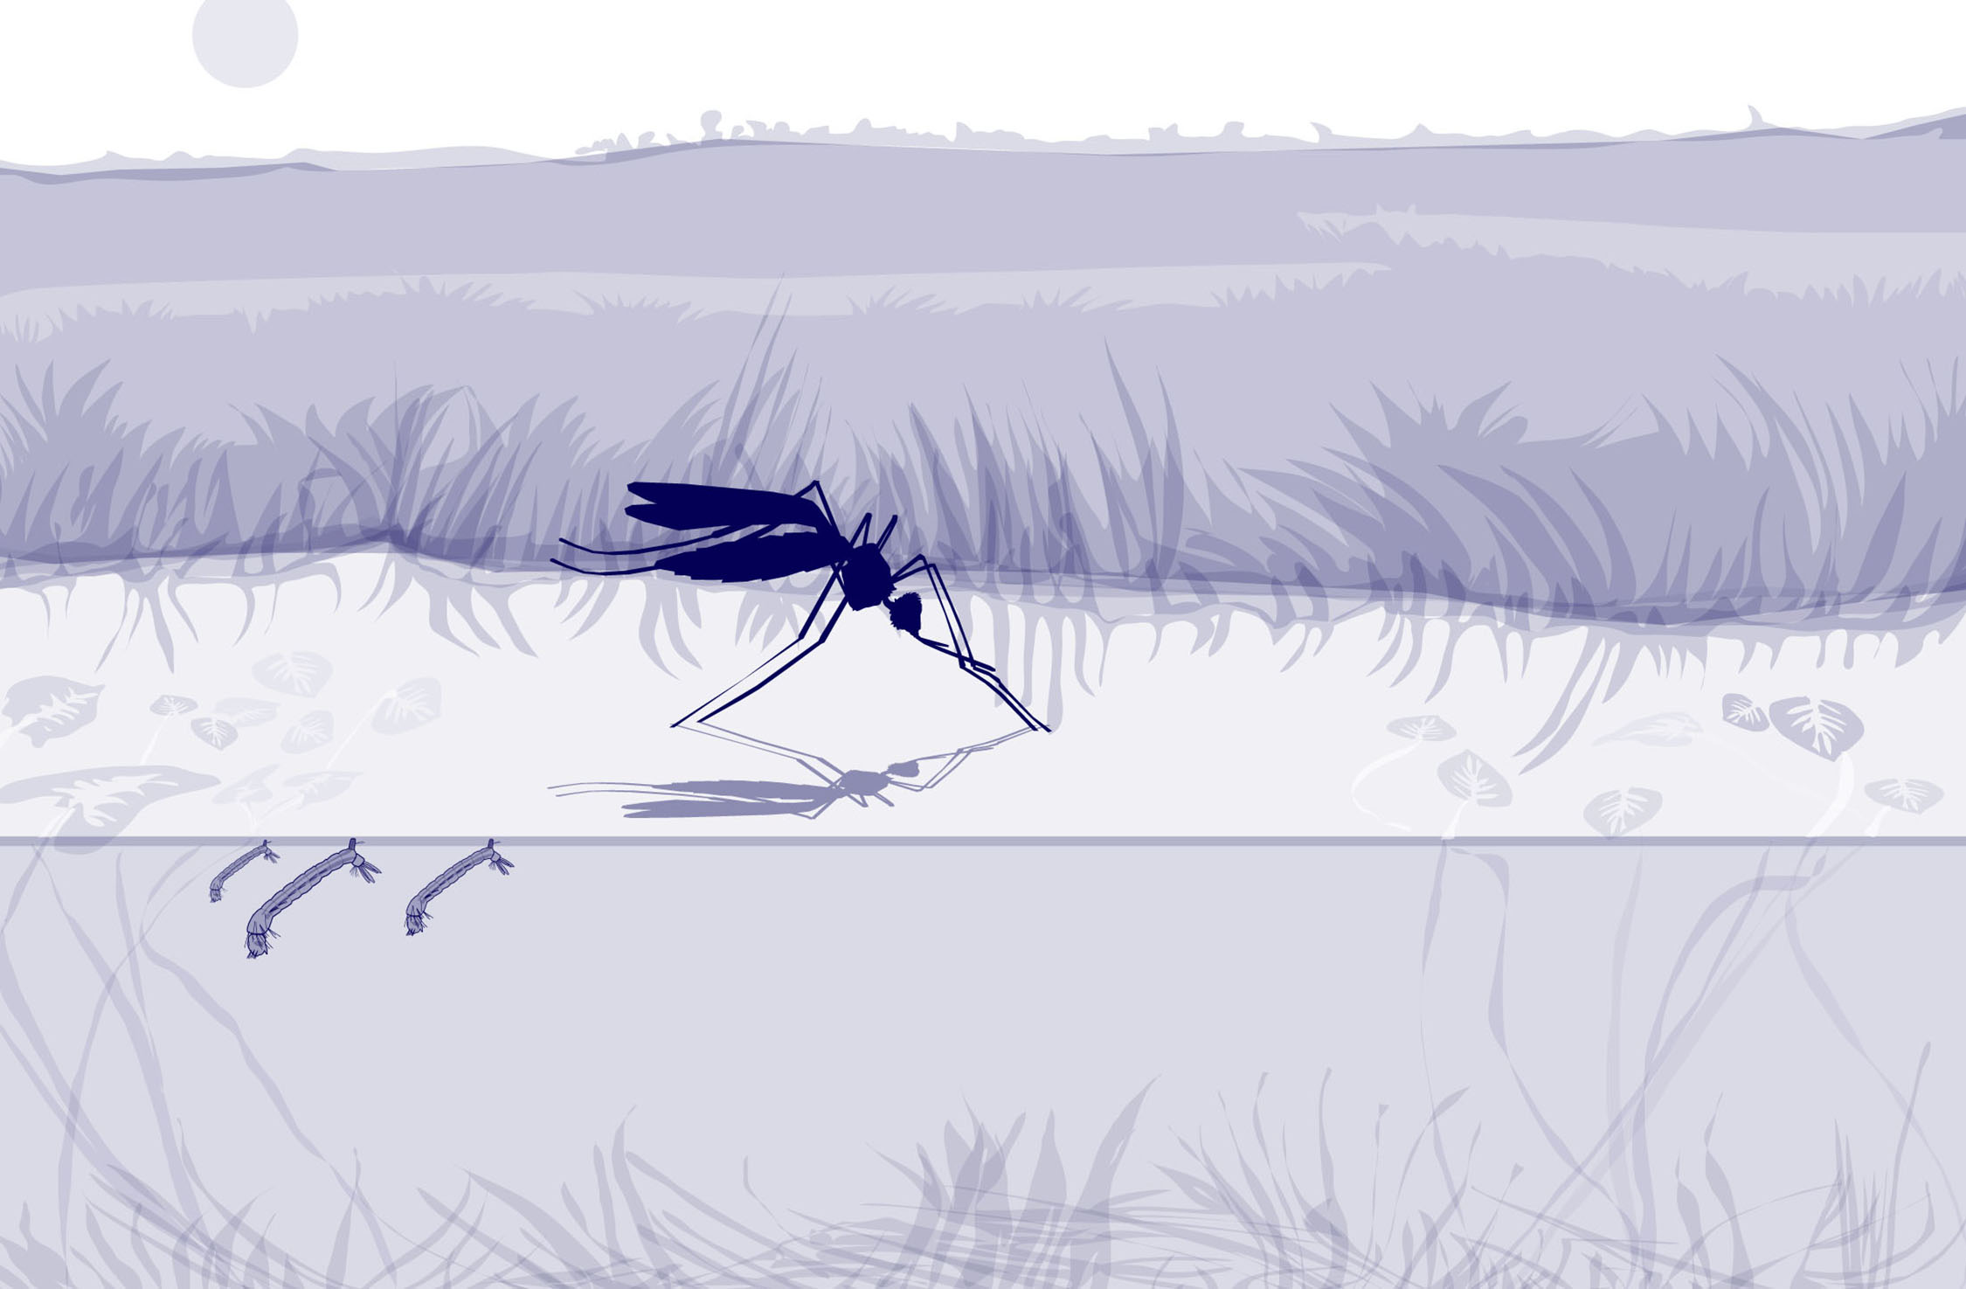
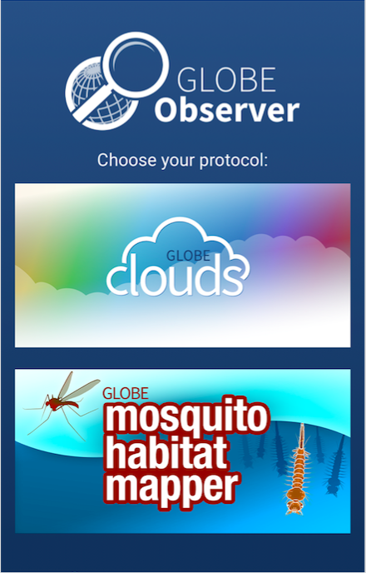
Slide One
Using the
GLOBE Observer
Mosquito Habitat Mapper

Slide 2
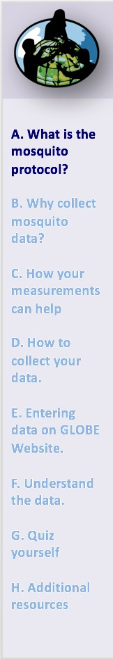
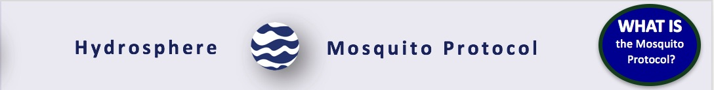
Overview
This module:
Reviews the use of the GLOBE Observer Mosquito Habitat Mapper
Learning Objectives
After completing this module, you will be able to:
Identify mosquito larvae in the breeding ground sampled at the study site
Understand the importance of representative sampling
Compare the number of mosquito larvae in each genus or species in different habitats
Explore relationships between the larvae, genus/species, climatic factors and disease
Collaborate with other GLOBE schools in collection and analysis of data
Report and visualize data using the GLOBE website
Estimated Time Needed to Complete Module: 1.5 hours

Slide 3
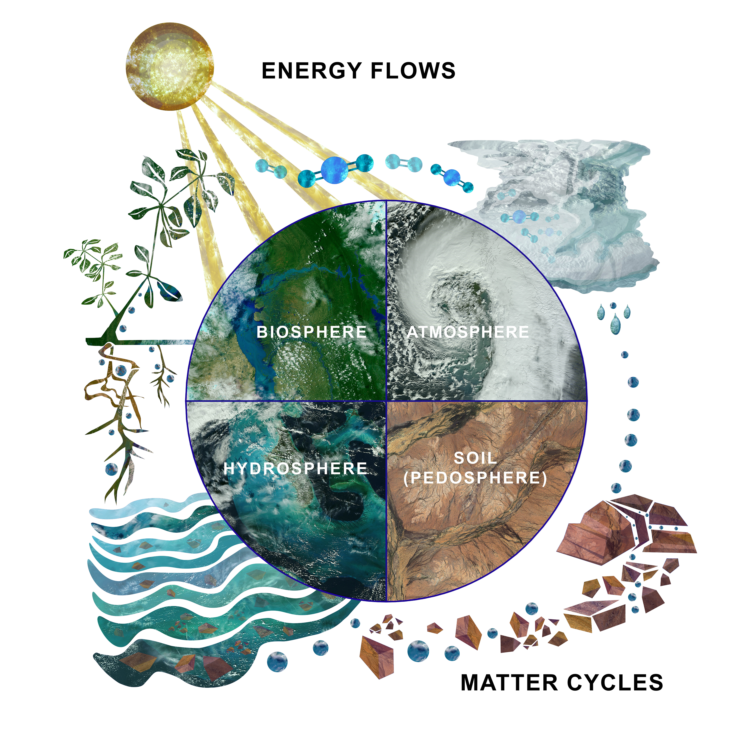
The Hydrosphere
The hydrosphere is the part of the Earth system that includes water, ice and water vapor. Water participates in many important natural chemical reactions and is a good solvent. Changing any part of the Earth system, such as the amount or type of vegetation in a region or from natural land cover to an impervious one, can affect the rest of the system.
The hydrosphere is home to many organisms, including the eggs, larvae and pupae of mosquitoes.
The Earth System: Energy flows and matter cycles.

Slide 4
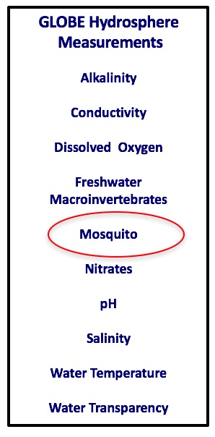
Hydrosphere Protocols
The Mosquito Protocol is one of the hydrosphere protocols used by GLOBE to describe the status of a water body.
Mosquitoes are common insects that occur in many places around the world particularly in the tropic and sub-tropic regions. Mosquitoes play an important role in ecosystems. They are food sources for many species of fish, birds, amphibians and reptiles. Male mosquitoes are pollinators and so they help to make fruits and vegetables.
There are over 40 genera and over 3500 known species. However, three of these genera, Anopheles, Aedes, and Culex, have species that transmit diseases that impact people including malaria, chikungunya virus, dengue fever, Zika virus, and West Nile virus.
Identifying the breeding areas of mosquitos that are disease vectors for humans is an important component of local disease management and eradication.

Slide 5
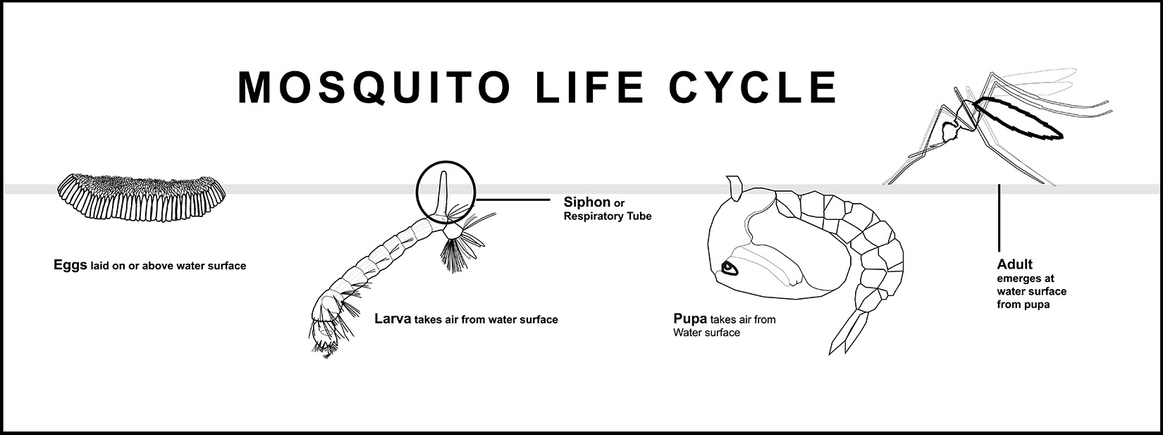
Hydrosphere-Biosphere Connection
The egg, larvae and pupae stages of the mosquito life cycle are dependent on water. The GLOBE mosquito larvae protocol focuses on collecting and identifying mosquito larvae in standing water.
Note that handling of eggs and the larvae is safe: the eggs and larvae do not transmit pathogens that result in disease. Only the bites of female mosquitoes transmit pathogens that can cause disease.

Slide 6
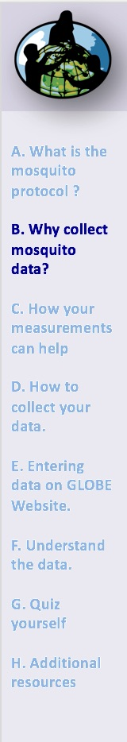
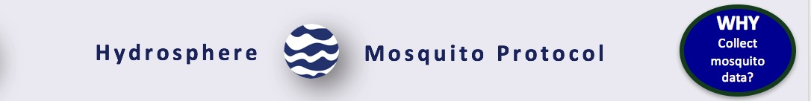
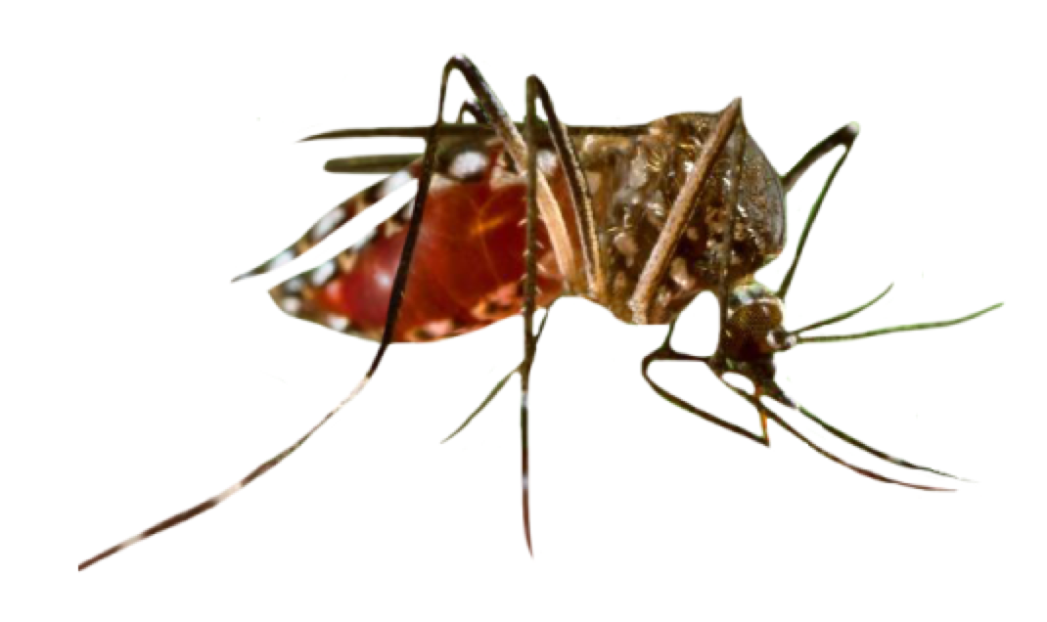
Mosquitoes and Climate Change
Climate models predict global average warming in the range from 2 to 4 °C (2–8 °F) by 2100. Rising temperatures may spread insect-borne diseases into areas where reports of infection have been relatively rare.
In the Earth system, “Everything is connected to everything else,” and changes in climate also have metabolic consequences for organisms, including Aedes aegypti, the mosquito that transmits the viruses responsible for yellow fever, dengue, chikungunya, and Zika . As the temperature rises, nearly everything about the biology of the Aedes aegypti mosquito speeds up when it comes to spreading disease.
Bill Reisen, entomologist at University of California Davis, explains: “With higher temperatures you have more mosquitoes feeding more frequently and having a greater chance of acquiring infection. And then the virus replicates faster because it's hotter, therefore the mosquitoes can transmit earlier in their life.” The thermodynamics of mosquitoes are "driven by temperature."
Read more here.
Image: CDC.

Slide 7
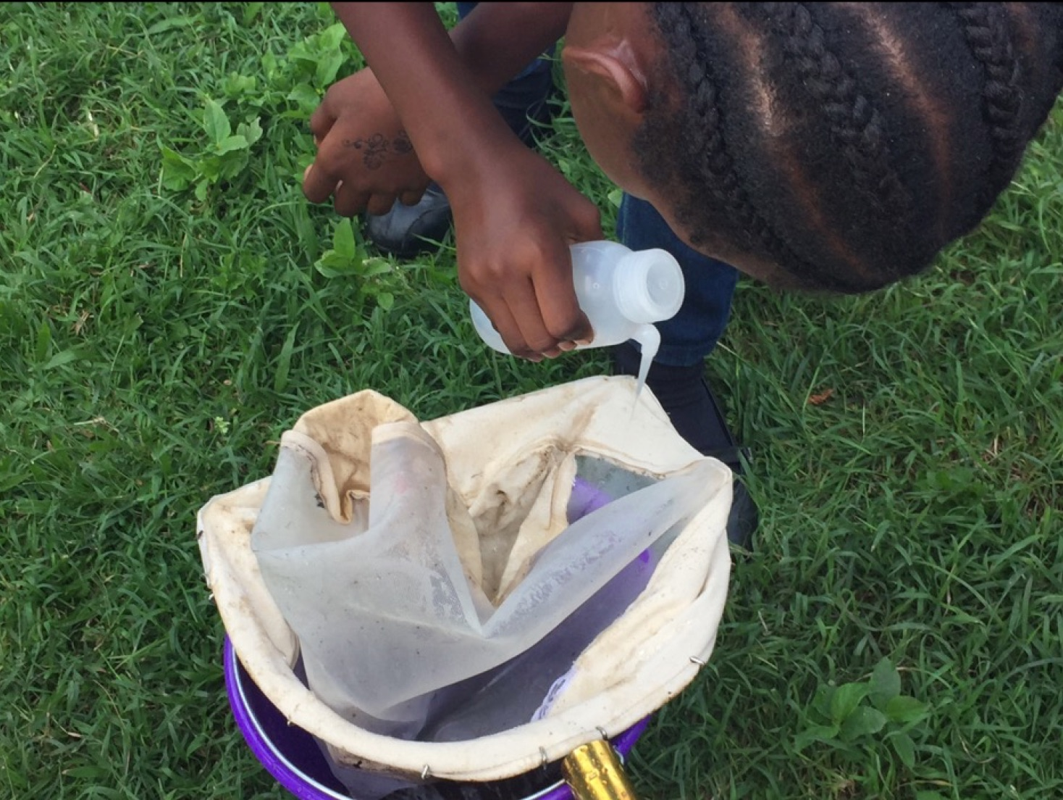
Why Collect Mosquito Data?
The life cycle of mosquitoes is closely related to their environment. By collecting mosquito and environmental data, students can contribute to better understanding the relationship between mosquitoes, the pathogens they may carry, and the environment. This kind of information can be used locally to determine when outbreaks of disease such as malaria or dengue most likely will occur, or when chemical or other controls will be most effective.
Globally, there is a major effort to use data from satellites to predict the onset, decline, and spread of vector-borne diseases. Reliable ground-based data are helpful for the development of realistic computer models based on satellite data.
In many parts of the world, sufficient "ground-truth" data are simply not available- so GLOBE observations are critically important to tracking and controlling disease.

Slide 8
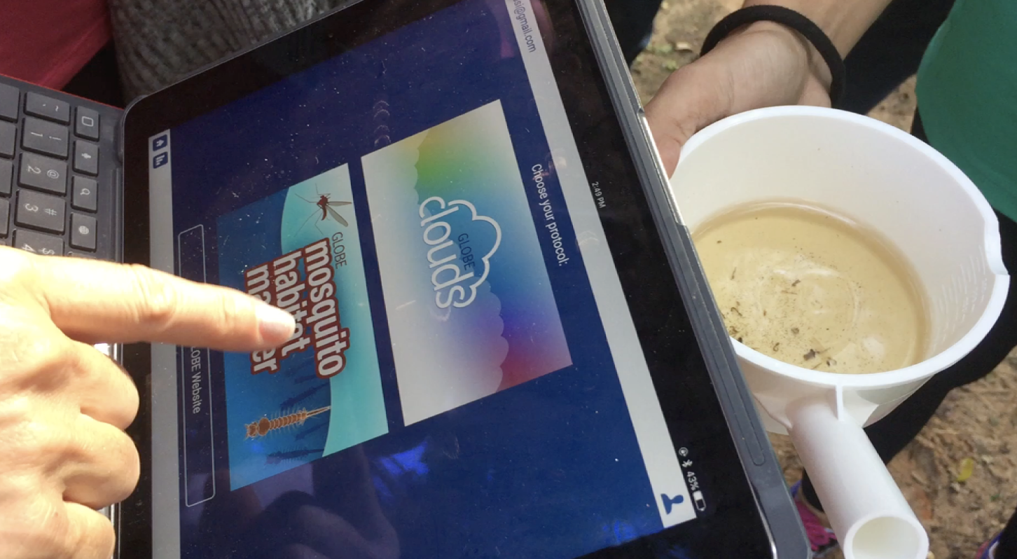
Why Collect Mosquito Data? (Cont’d)
Vaccines are not available for most mosquito diseases, including dangerous diseases such as Zika, chikungunya, malaria, and West Nile virus.
Where there are no vaccines available, there are only 3 ways to protect a community from mosquito vector borne disease. These are:
Surveillance
Habitat mitigation
Public education
The GLOBE Observer Mosquito Habitat Mapper supports all three!

Slide 9
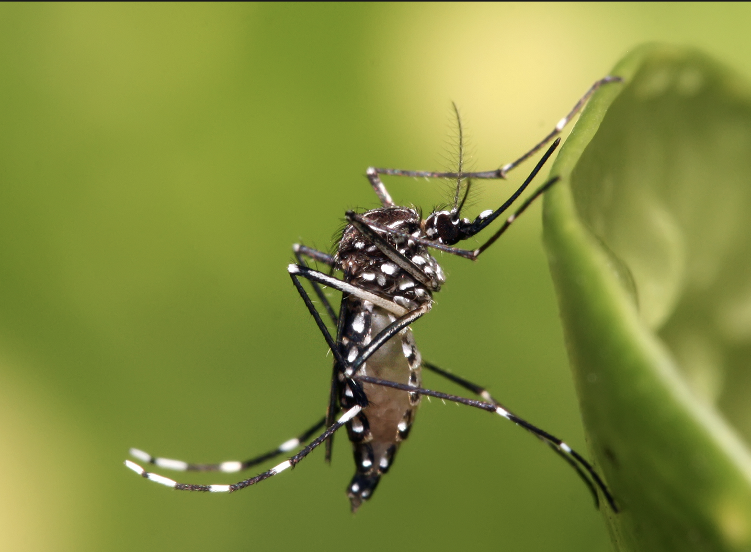
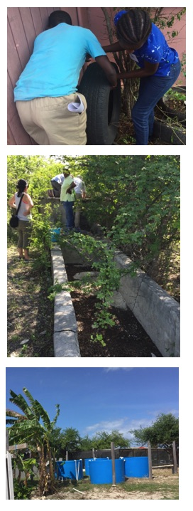
Mosquitoes and Zika Virus
The explosive spread of Zika throughout the Americas is raising questions about the best ways to predict and control outbreaks of mosquito-borne diseases. Zika is transmitted by the mosquito Aedes aegypti and Aedes albopictus. These mosquitoes are a serious health problem because they have evolved and adapted to human environments. They preferentially breed in manufactured containers that contain standing water. They are also found in natural containers, such as water pooled inside a bromeliad plant, cut bases of bamboo, and shells and husks of nuts.
These two species can also transmit other pathogens that cause a number of dangerous diseases, including dengue, chikungunya, and yellow fever.

Slide 10
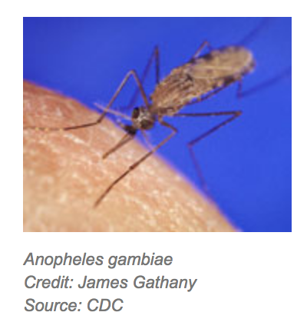
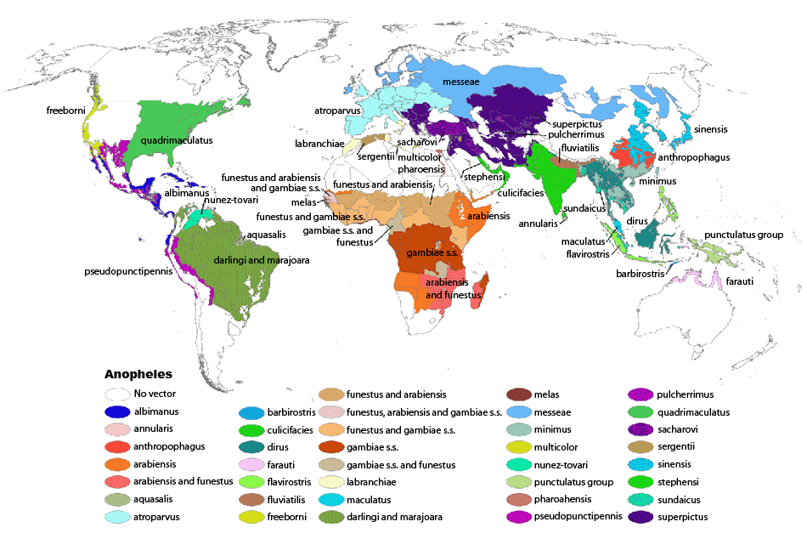
Mosquitoes and Malaria
The app also allows you to identify the larvae of Anopheles mosquitoes. Only about 40 species of the more than 500 species can transmit the pathogens to humans that cause malaria. If you are living in a malaria region, you will want to work with public health authorities and find out what species are found locally.

Slide 11
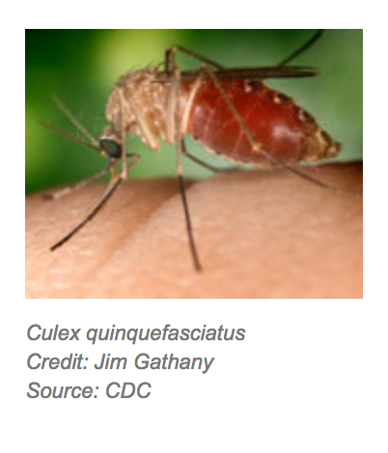
Culex Mosquitoes
There are over 1000 species of Culex mosquitoes, and more than 150 species are vectors of disease in animals and humans. However, there is usually only a few of importance in any region. Find out what species you have locally that can potentially transmit pathogens that can cause disease, and what diseases are found in your community.
Important Diseases- Culicine Mosquitoes
West Nile virus
Lymphatic filariasis
Rift valley fever
Encephalitis (Western and Eastern equine, Japanese, California)
Several other diseases can be transmitted to animals
Notes:
https://en.wikipedia.org/wiki/List_of_Culex_species

Slide 12
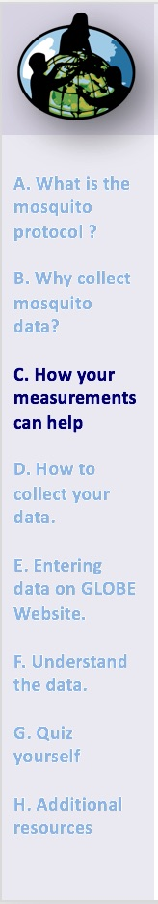
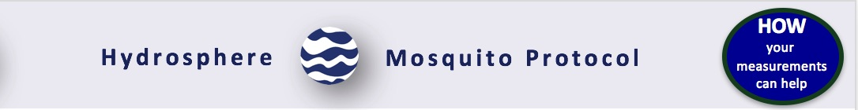
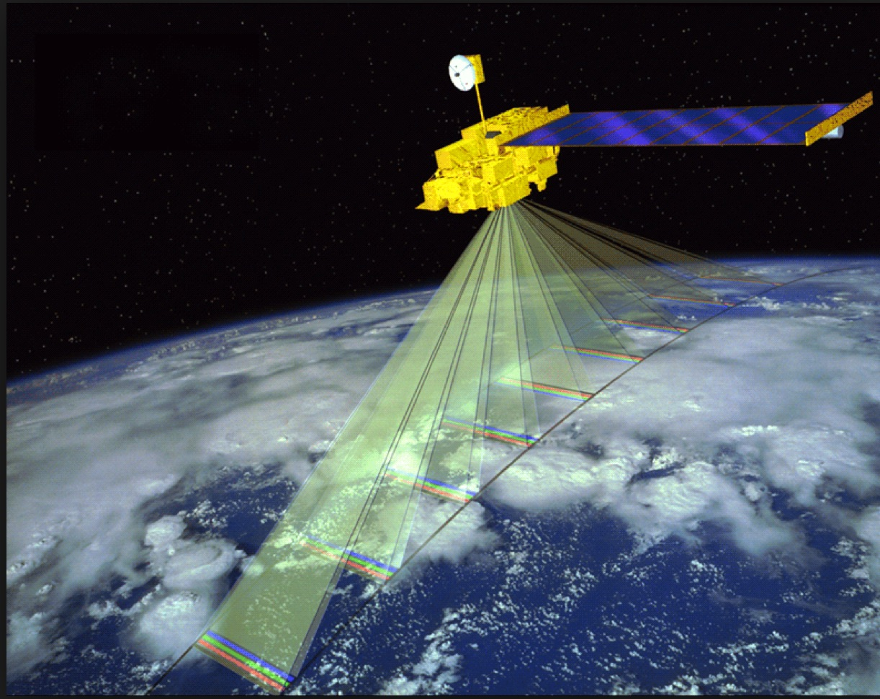
How Your Data Can Help
You Can’t See Mosquitoes from Space!
“I don't see mosquitoes from satellites, unfortunately, but I see the environment where mosquitoes are,” says Felix Kogan of the NOAA Satellite and Information Service in this video about his work. “Mosquitoes like warm and moist environments and this is what I see from the operational satellites.”
Seasonal patterns of temperature and precipitation may be altered by climate change where you live. These changes could affect the movement of insects such as mosquitoes. Climate change can affect the spread of mosquito borne diseases such as Zika, malaria and Dengue fever. Other factors such as land use are important factors contributing to the spread of diseases. These factors contribute to providing suitable habitat for mosquitoes to breed and grow, and how the disease is spread between people. Through ground-based observations, GLOBE students are able to augment broad scale satellite-based research with highly targeted local ground-based observations at a high level of granularity.
Read more here
Can’t quite see mosquitoes from here. Terra from space. Image: NASA.

Slide 13
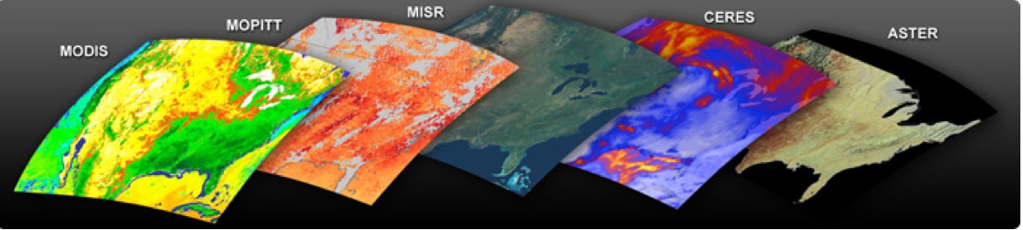
Satellite Data and Ground Verification
Remotely sensed data collected by instruments on planes and satellite can be used to estimate the probability of mosquito breeding and disease transmission.
Terra Instruments
Terra collects data about the Earth’s bio-geochemical and energy systems using five sensors that observe the atmosphere, land surface, oceans, snow and ice, and energy budget. Each sensor has unique features that enable scientists to meet a wide range of science objectives. Because all five instruments are on the same satellite making simultaneous observations, scientists are able to compare different aspects of Earth’s characteristics over time.
NASA’s Terra and Aqua satellites carry sensors used by researchers to measure mosquito-favoring environmental conditions on Earth. Image Credit: NASA. Read more here

Slide 14
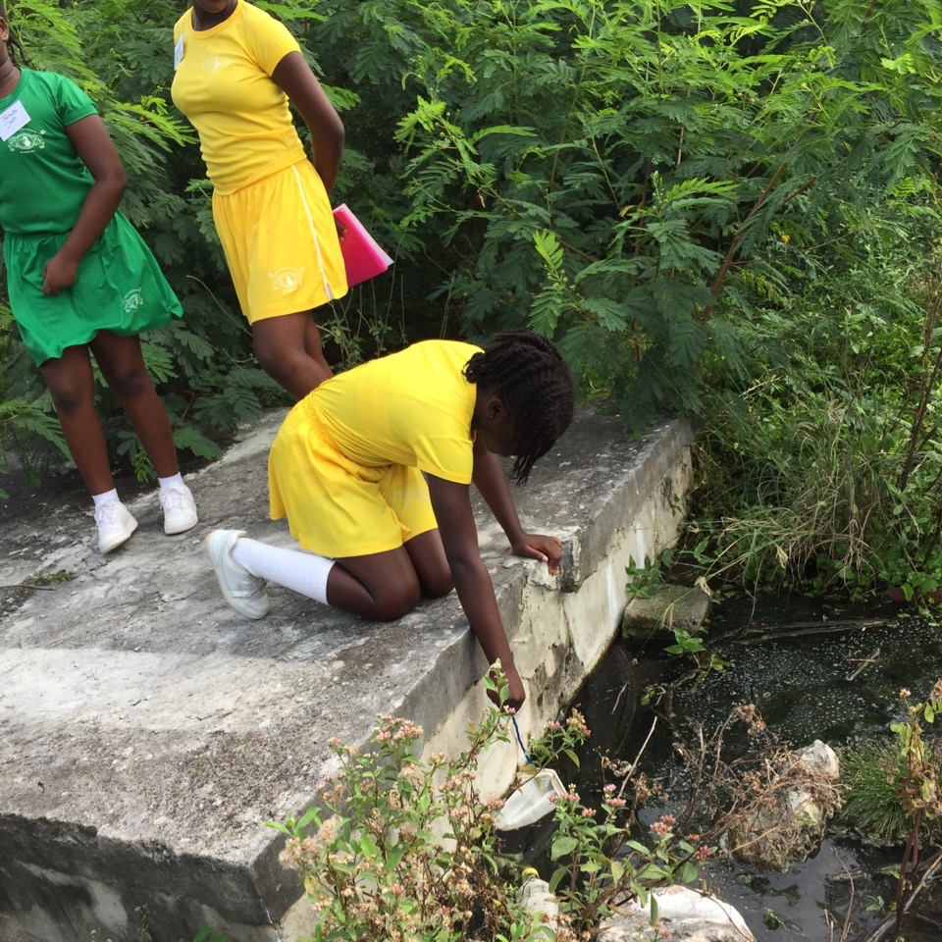
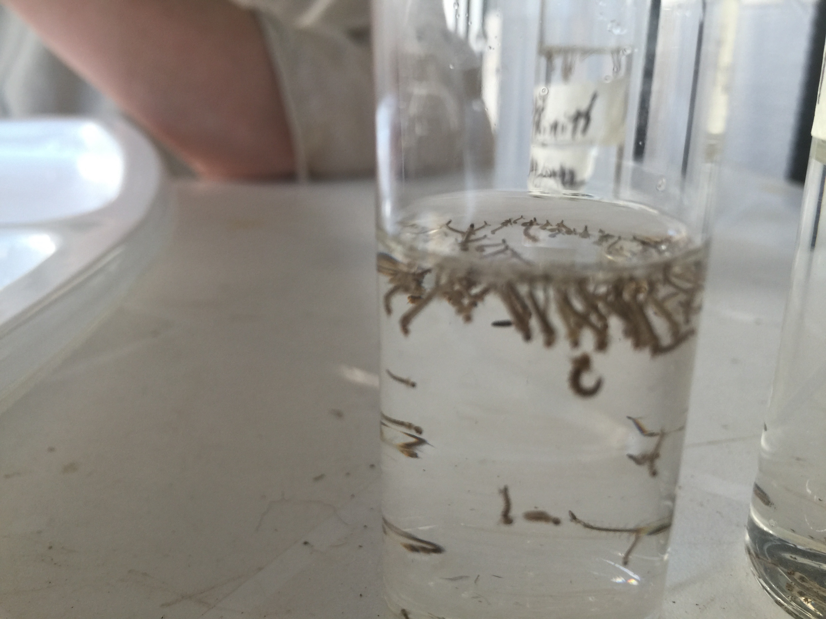
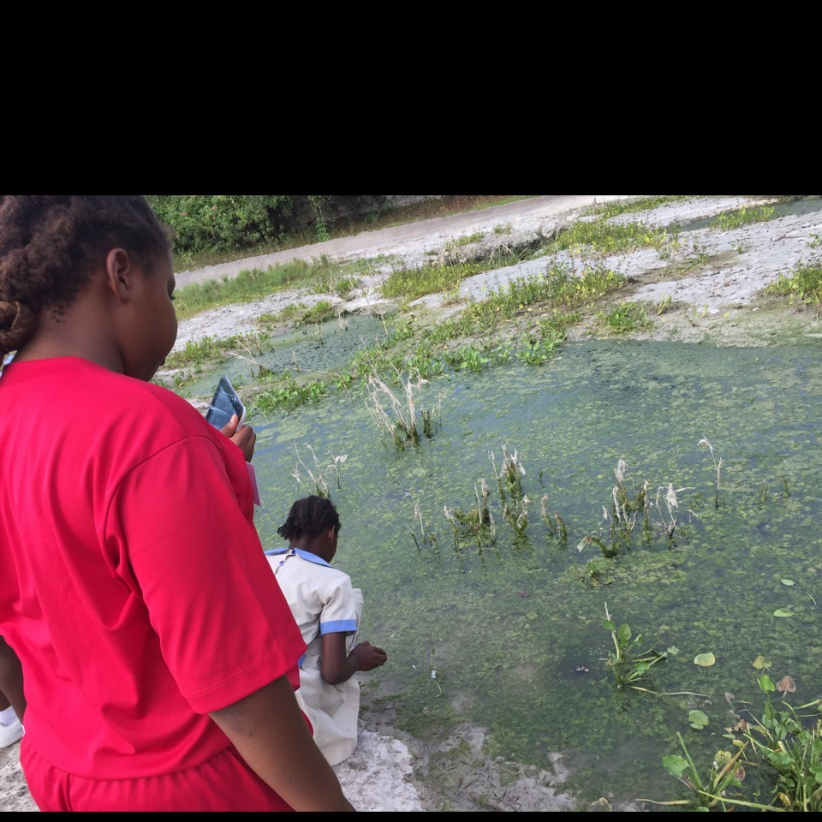
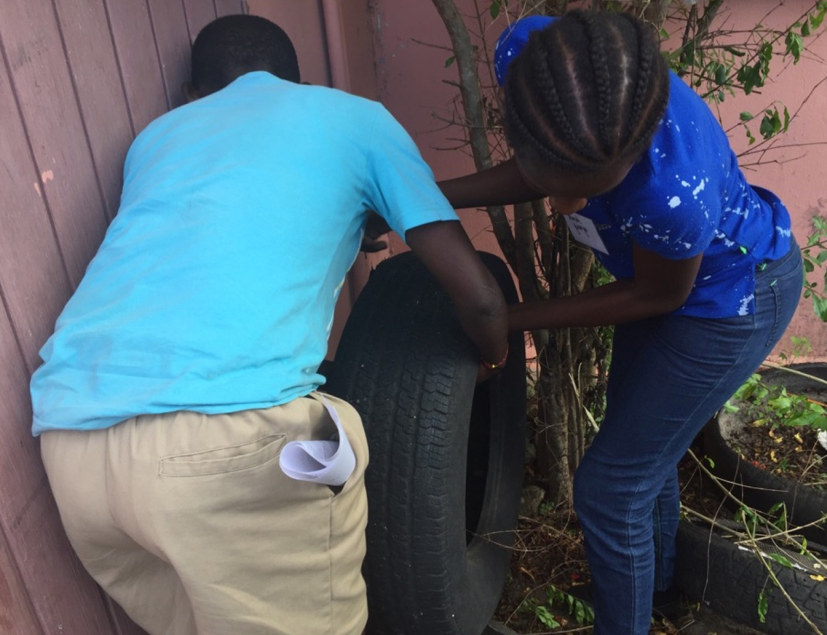
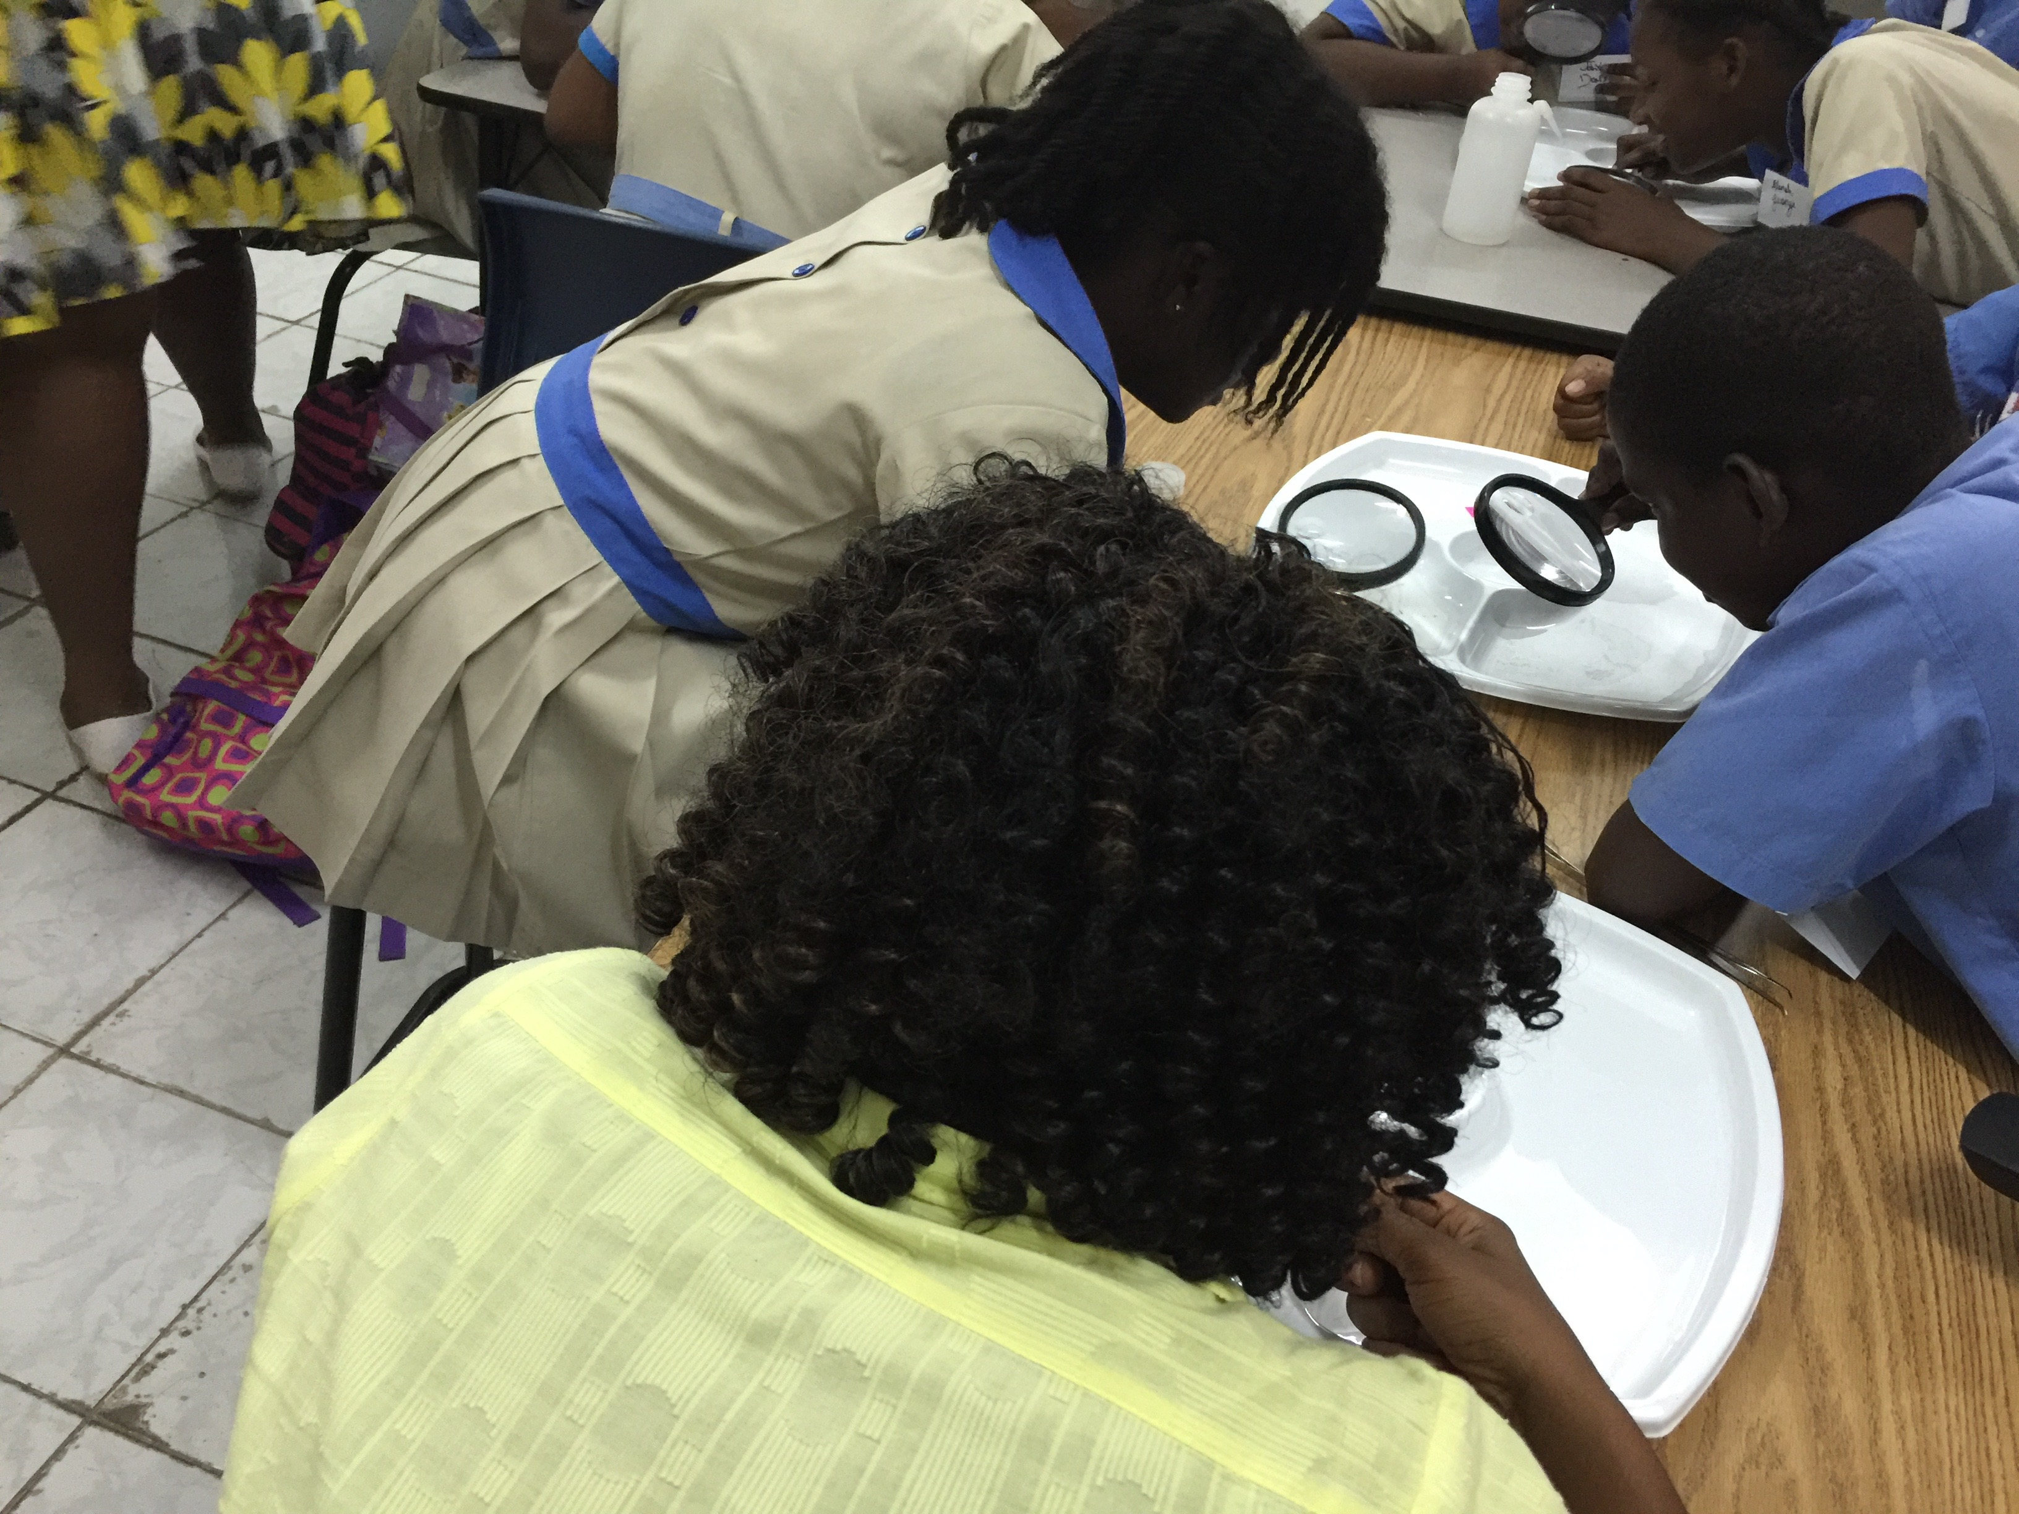
Summary so Far…
Seasonal patterns of temperature and precipitation may be altered by climate change where you live. These changes could affect the movement of insects such as mosquitoes. As well, it could affect the spread and intensity of mosquito borne diseases. Other factors such as landscape change and land use contribute to providing suitable habitats for mosquitoes.

Slide 15
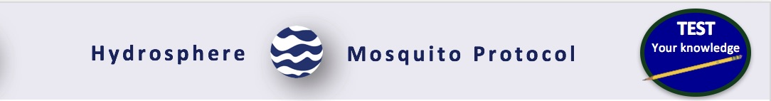
Let’s do a quick review before moving onto data collection! Question 1
Mosquitoes are part of the biosphere, but the protocol for mosquito larvae is found in the ________GLOBE Investigation area because it is the habitat of mosquito larvae.
Land cover
Hydrosphere
Lithosphere
Earth System
What is the Answer?

Slide 16
Let’s do a quick review before moving onto data collection! Answer to Question 1
Mosquitoes are part of the biosphere, but the protocol for mosquito larvae is found in the ________GLOBE Investigation area because it is the habitat of mosquito larvae.
Land cover
Hydrosphere- ☺ Correct!
Lithosphere
Earth System
Were you correct?

Slide 17
Let’s do a quick review before moving onto data collection! Question 2
Which mosquito genus is responsible for the transmission of Yellow Fever, Dengue Fever, Chikungunya and Zika virus?
Aedes
Anopheles
Culex
All of the above
What is the Answer?

Slide 18
Let’s do a quick review before moving onto data collection! Answer to Question 2
Which mosquito genus is responsible for the transmission of Yellow Fever, Dengue Fever, Chikungunya and Zika virus?
Aedes - ☺ Correct!
Anopheles
Culex
All of the above
Were you correct?

Slide 19
Let’s do a quick review before moving onto data collection! Question 3
What is the projected impact of a warming climate on mosquito populations?
It is projected that mosquito species will increase their range to areas where they are currently not found
It is projected that mosquito species will replicate more slowly, because their metabolism will slow down because of the heat
Both A and B
None of the above
What is the answer?

Slide 20
Let’s do a quick review before moving onto data collection! Answer to Question 3
What is the projected impact of a warming climate on mosquito populations?
It is projected that mosquito species will increase their range to areas where they are currently not found- ☺ Correct!
It is projected that mosquito species will replicate more slowly, because their metabolism will slow down because of the heat
Both A and B
None of the above
Were you correct?

Slide 21
Let’s do a quick review before moving onto data collection! Question 4
Why is the the mosquito larvae data collected by GLOBE important?
In many parts of the world, there are insufficient ground validation measurements, so the observations are critical to tracking and controlling disease using satellite data.
Students can collect data that can be used locally to predict outbreaks of mosquito-borne disease, such as malaria, dengue fever or zika.
Students can develop their own models to understand the specific ecological needs and tolerances of local mosquito populations, so that local breeding site eradication measures can take place.
All of the above
What is the answer?

Slide 22
Let’s do a quick review before moving onto data collection! Answer to Question 4
Why is the the mosquito larvae data collected by GLOBE important?
In many parts of the world, there are insufficient ground validation measurements, so the observations are critical to tracking and controlling disease using satellite data.
Students can collect data that can be used locally to predict outbreaks of mosquito-borne disease, such as malaria, dengue fever or zika.
Students can develop their own models to understand the specific ecological needs and tolerances of local mosquito populations, so that local breeding site eradication measures can take place.
All of the above - ☺ Correct!
Were you correct? Let’s now look at the data collection procedures in the protocol.

Slide 23
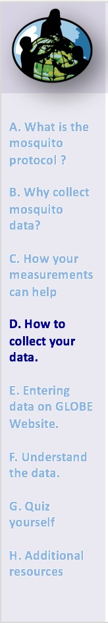
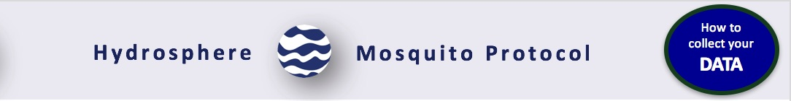
Mosquito Protocol: What do you need to start?
 | Ideally, weekly during the mosquito season, and three weeks before and after
Where | Neighborhoods, school grounds, parks, wetland sites, and around the home
Time Needed | 1-2 hours weekly
Prerequisites | none
Key Instruments | Dipper, magnifier, macro pipette (turkey baster), mobile device with GLOBE Observer Mosquito Habitat Mapper downloaded. A clip-on macro lens (60-100x) for your mobile device is recommended (available online)
Skill Level | Intermediate
References you need | GLOBE Observer Mosquito Habitat Mapper. Download at no cost from your app store to a mobile device.

Slide 24
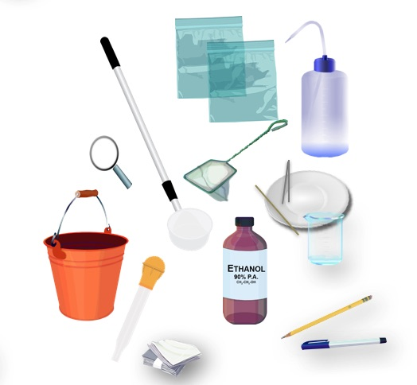
Assemble Field Equipment
GLOBE Observer Mosquito App
Measuring tape
Dipper, Net or Bulb Syringe (baster)
Bucket
Plastic zip bags
Permanent marker and pencil
White plastic plate
Forceps
Rinse bottle
Paper towels
Camera (phone camera is good)
Ethanol alcohol
Hand lens, magnifying glass or magnifying attachment for mobile device

Slide 25
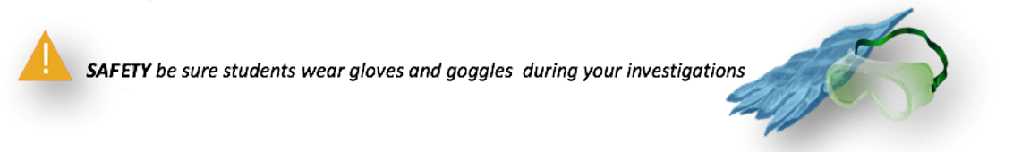
Start your Fieldwork with Safety Steps
Safety is important when conducting the Hydrosphere protocols. While you will need to use your judgment in selecting only hydrosphere study sites that are safe to access and sample, additional precautions are needed:
Students should wear protective gloves and goggles when handling water samples and chemicals to avoid danger from splashes.
For the mosquito protocol, it is important to protect students from exposure to biting mosquitoes. Ask your students to wear clothes that cover the body so little bite area is exposed. Apply insect repellent. The best time to collect samples is at the heat of the day, near solar noon, when mosquitoes are least active. Women who are pregnant or are planning to become pregnant should not participate in this activity.
Be aware that the eggs and larvae are not disease vectors, mosquito-borne disease is transmitted through the bite of the adult female mosquito.

Slide 26
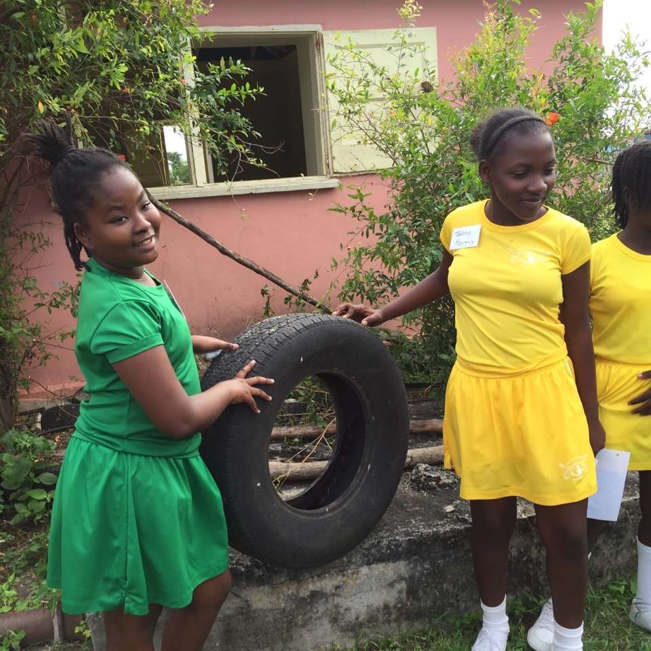
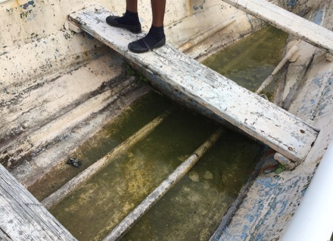
Identifying and Sampling potential mosquito breeding sites
Mosquitoes lay their eggs in places where water can collect. These can be natural places such as puddles or ponds, or artificial places such as flower pots or plastic bottles. How you collect your sample will depend on what type of place you are sampling. If you are sampling containers, you will either pour the water through the net if the container is small enough to do this. Or, if the container is big, you will use a net to gather a sample from the water in the container.
If you are sampling a pond, puddle, along a slow moving stream, or some other place that is not a container, you will dip a net or mosquito dipper in the water to collect the mosquito larvae. You will collect 5 samples waiting 3 minutes between sample collection. This is to make sure you get an accurate representation of how many larvae are in the water. With containers, you are gathering most or all of the larvae in the containers.
After collection, you will identify the mosquito larvae using keys and count the number of larvae within each genus or species.
*Note: if the breeding site is a natural hydrology site, it is recommended that you establish it as a hydrology study site. Then you can examine changes in the water parameters in conjunction with mosquito data, and record changes over time.

Slide 27
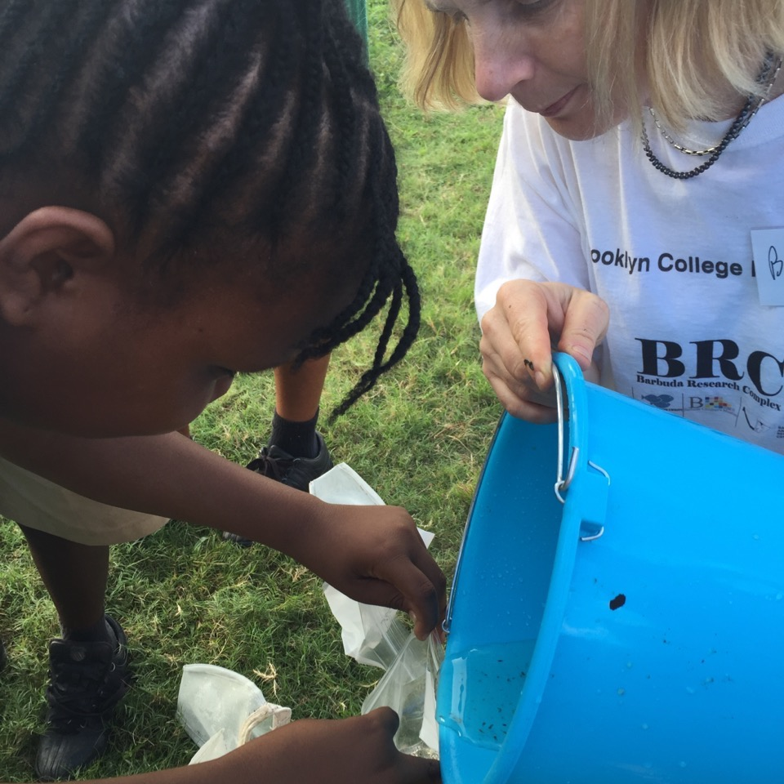
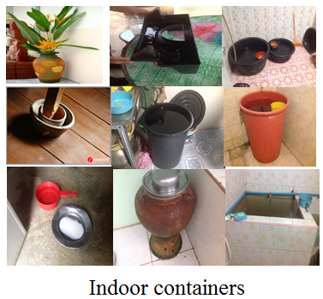
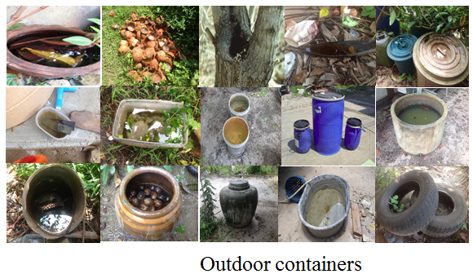
Site Selection: Containers
There are a variety of indoor and outdoor containers that can be sampled around homes, schools or other buildings. You may have other types of containers in your community as well!

Slide 28
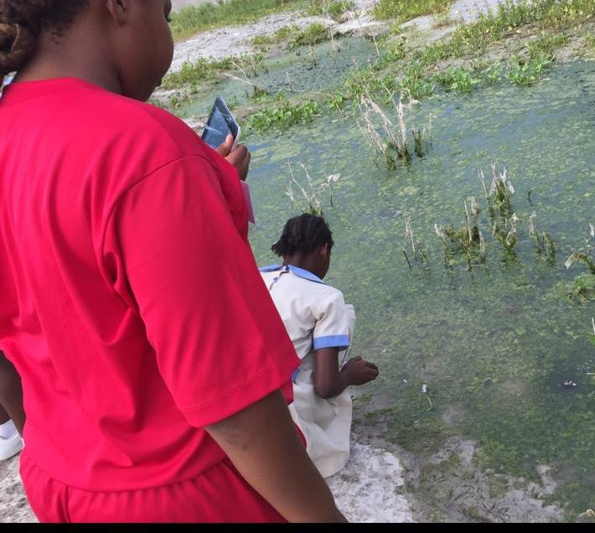
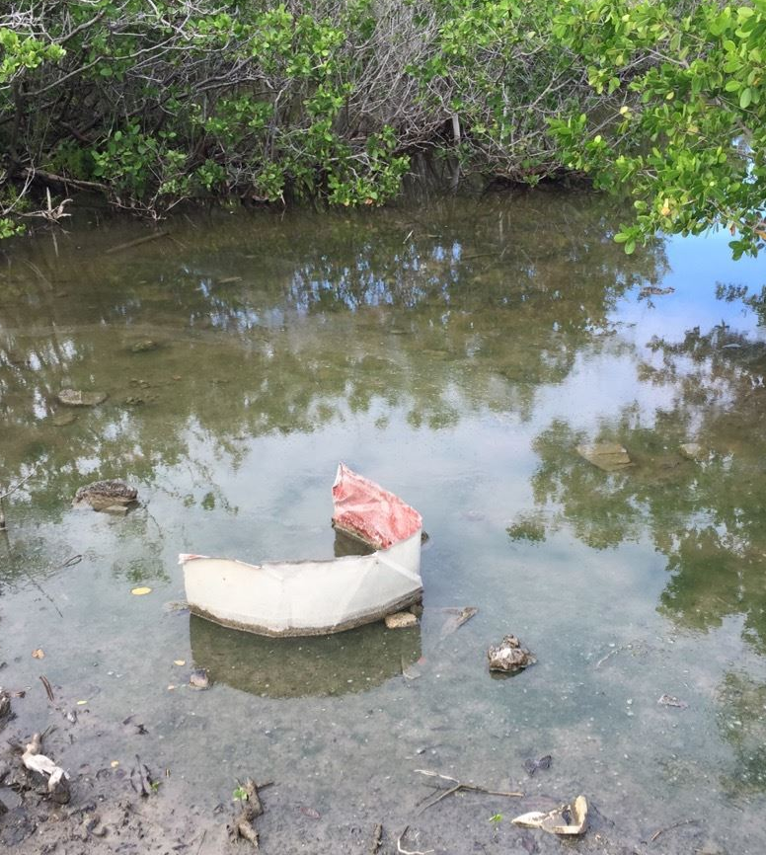
Site Selection: Non-container sampling sites
Sampling sites include habitats like ponds, streams, marshes, puddles along streets or in yards, or agricultural areas (e.g., rice fields). These are places where you cannot lift the container and pour the water into a net or container. If you are using a repeat sampling scenario, find a site that is easy for students to visit. The site should be large enough so that it does not quickly dry up and sampling can be done on a regular (twice monthly, if possible) basis.

Slide 29
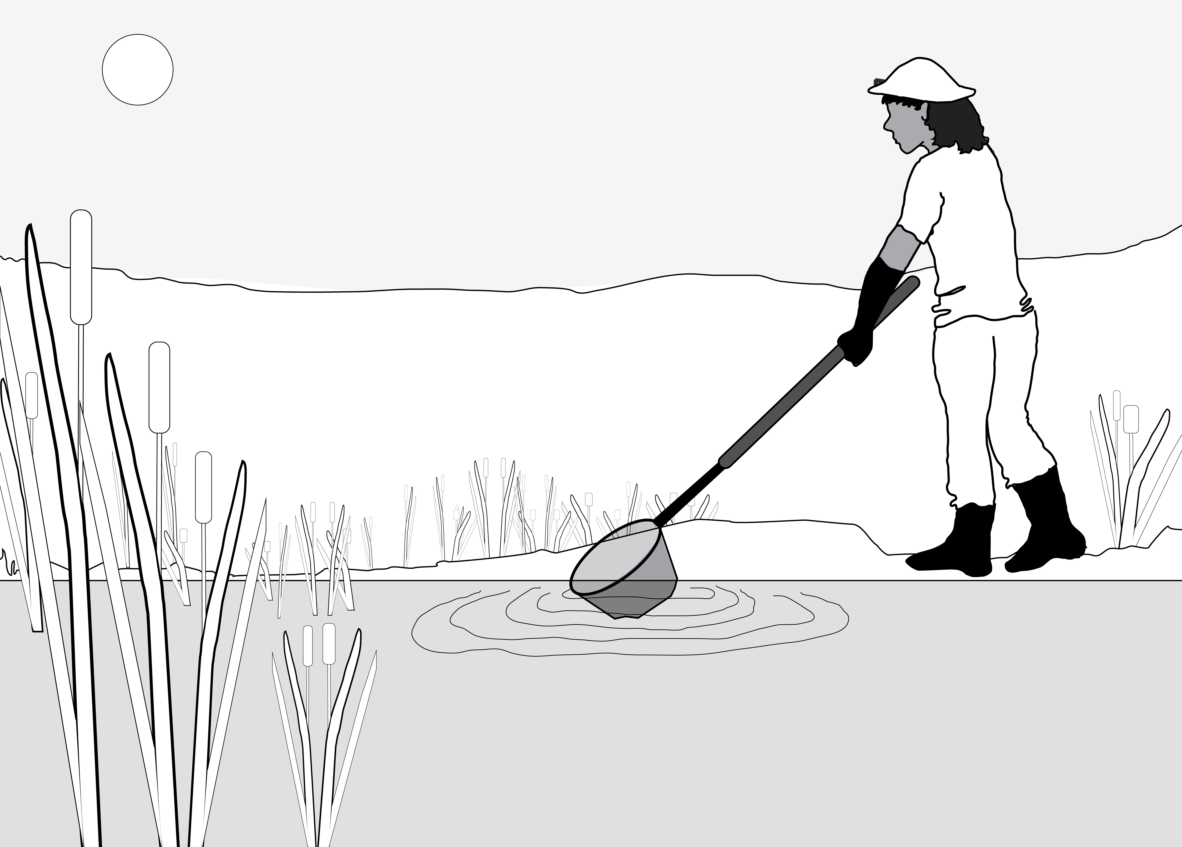
Mosquito Larvae Sampling: Natural Hydrology Sites
Using the mosquito dipper or net, skim the surface of the water. The net is maintained at an acute angle with respect to the water surface, see figure:
Take 5 samples. Wait 3 minutes between each sample. If you use a net, do the washing step next.
Larvae rest on the surface of the water but if they are disturbed they swim below the surface for safety. By waiting 3 minutes, the larvae will have returned to the surface to breathe
Tip: sample quickly! Try to not cast a shadow, because the larvae will dive to safety.

Slide 30
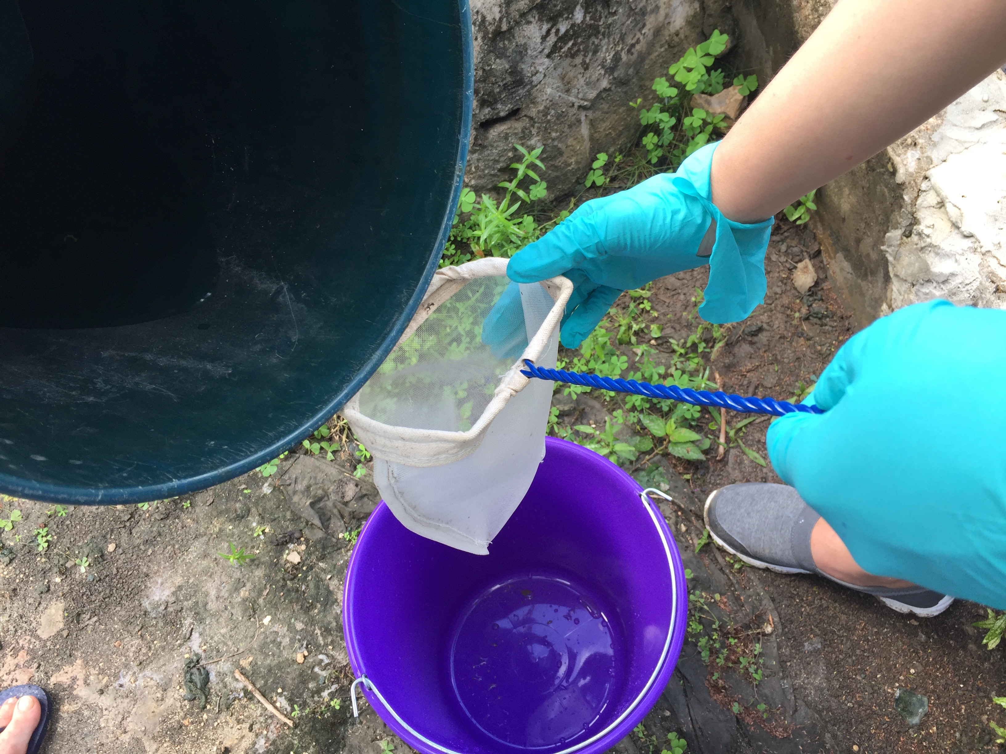
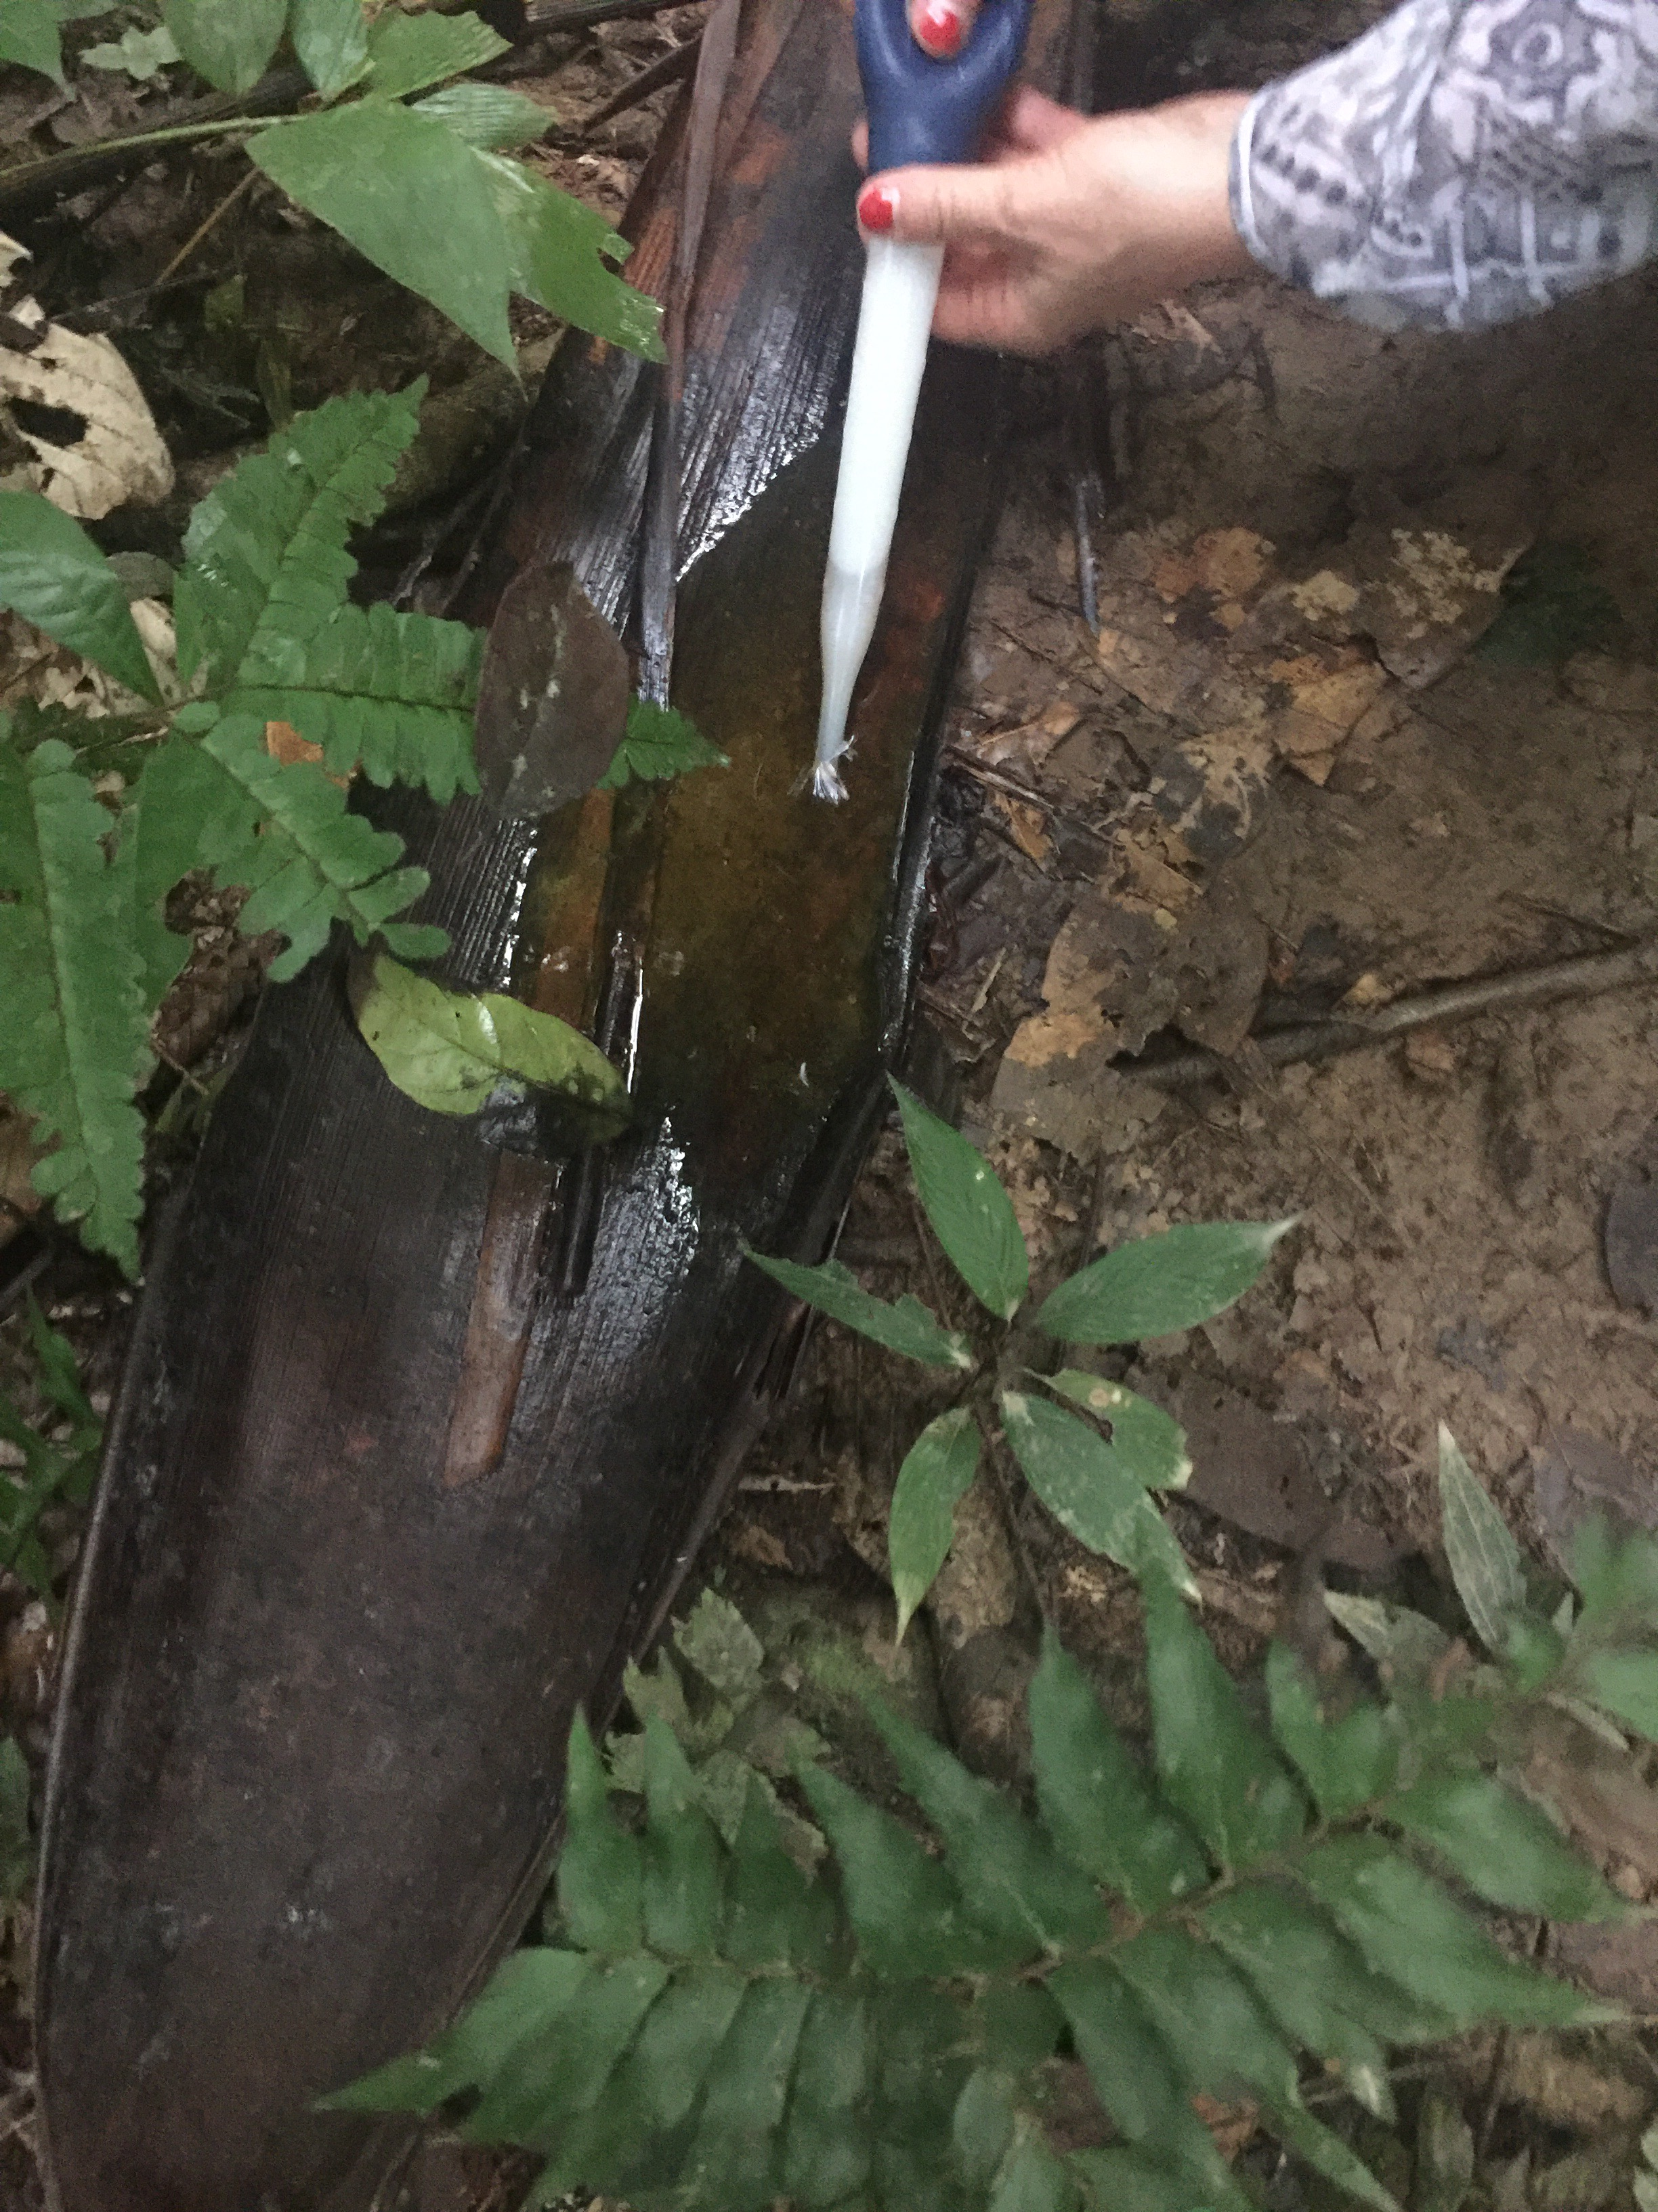
Mosquito Larvae Sampling Method: Small Containers
Pour sample water in container through net into a bucket. In the photo to the right, GLOBE students found an abandoned bucket that collected rainwater and created a sheltered habitat where mosquitoes could lay their eggs.
Or, you can use a dipper or a bulb syringe (turkey baster) to sample larvae. Here a bulb syringe is used to sample water puddled on a leaf in the Amazon.
Tip: when using a bulb syringe, depress the bulb before inserting and quickly pull in the water- don’t give the larvae a chance to swim away and escape!

Slide 31
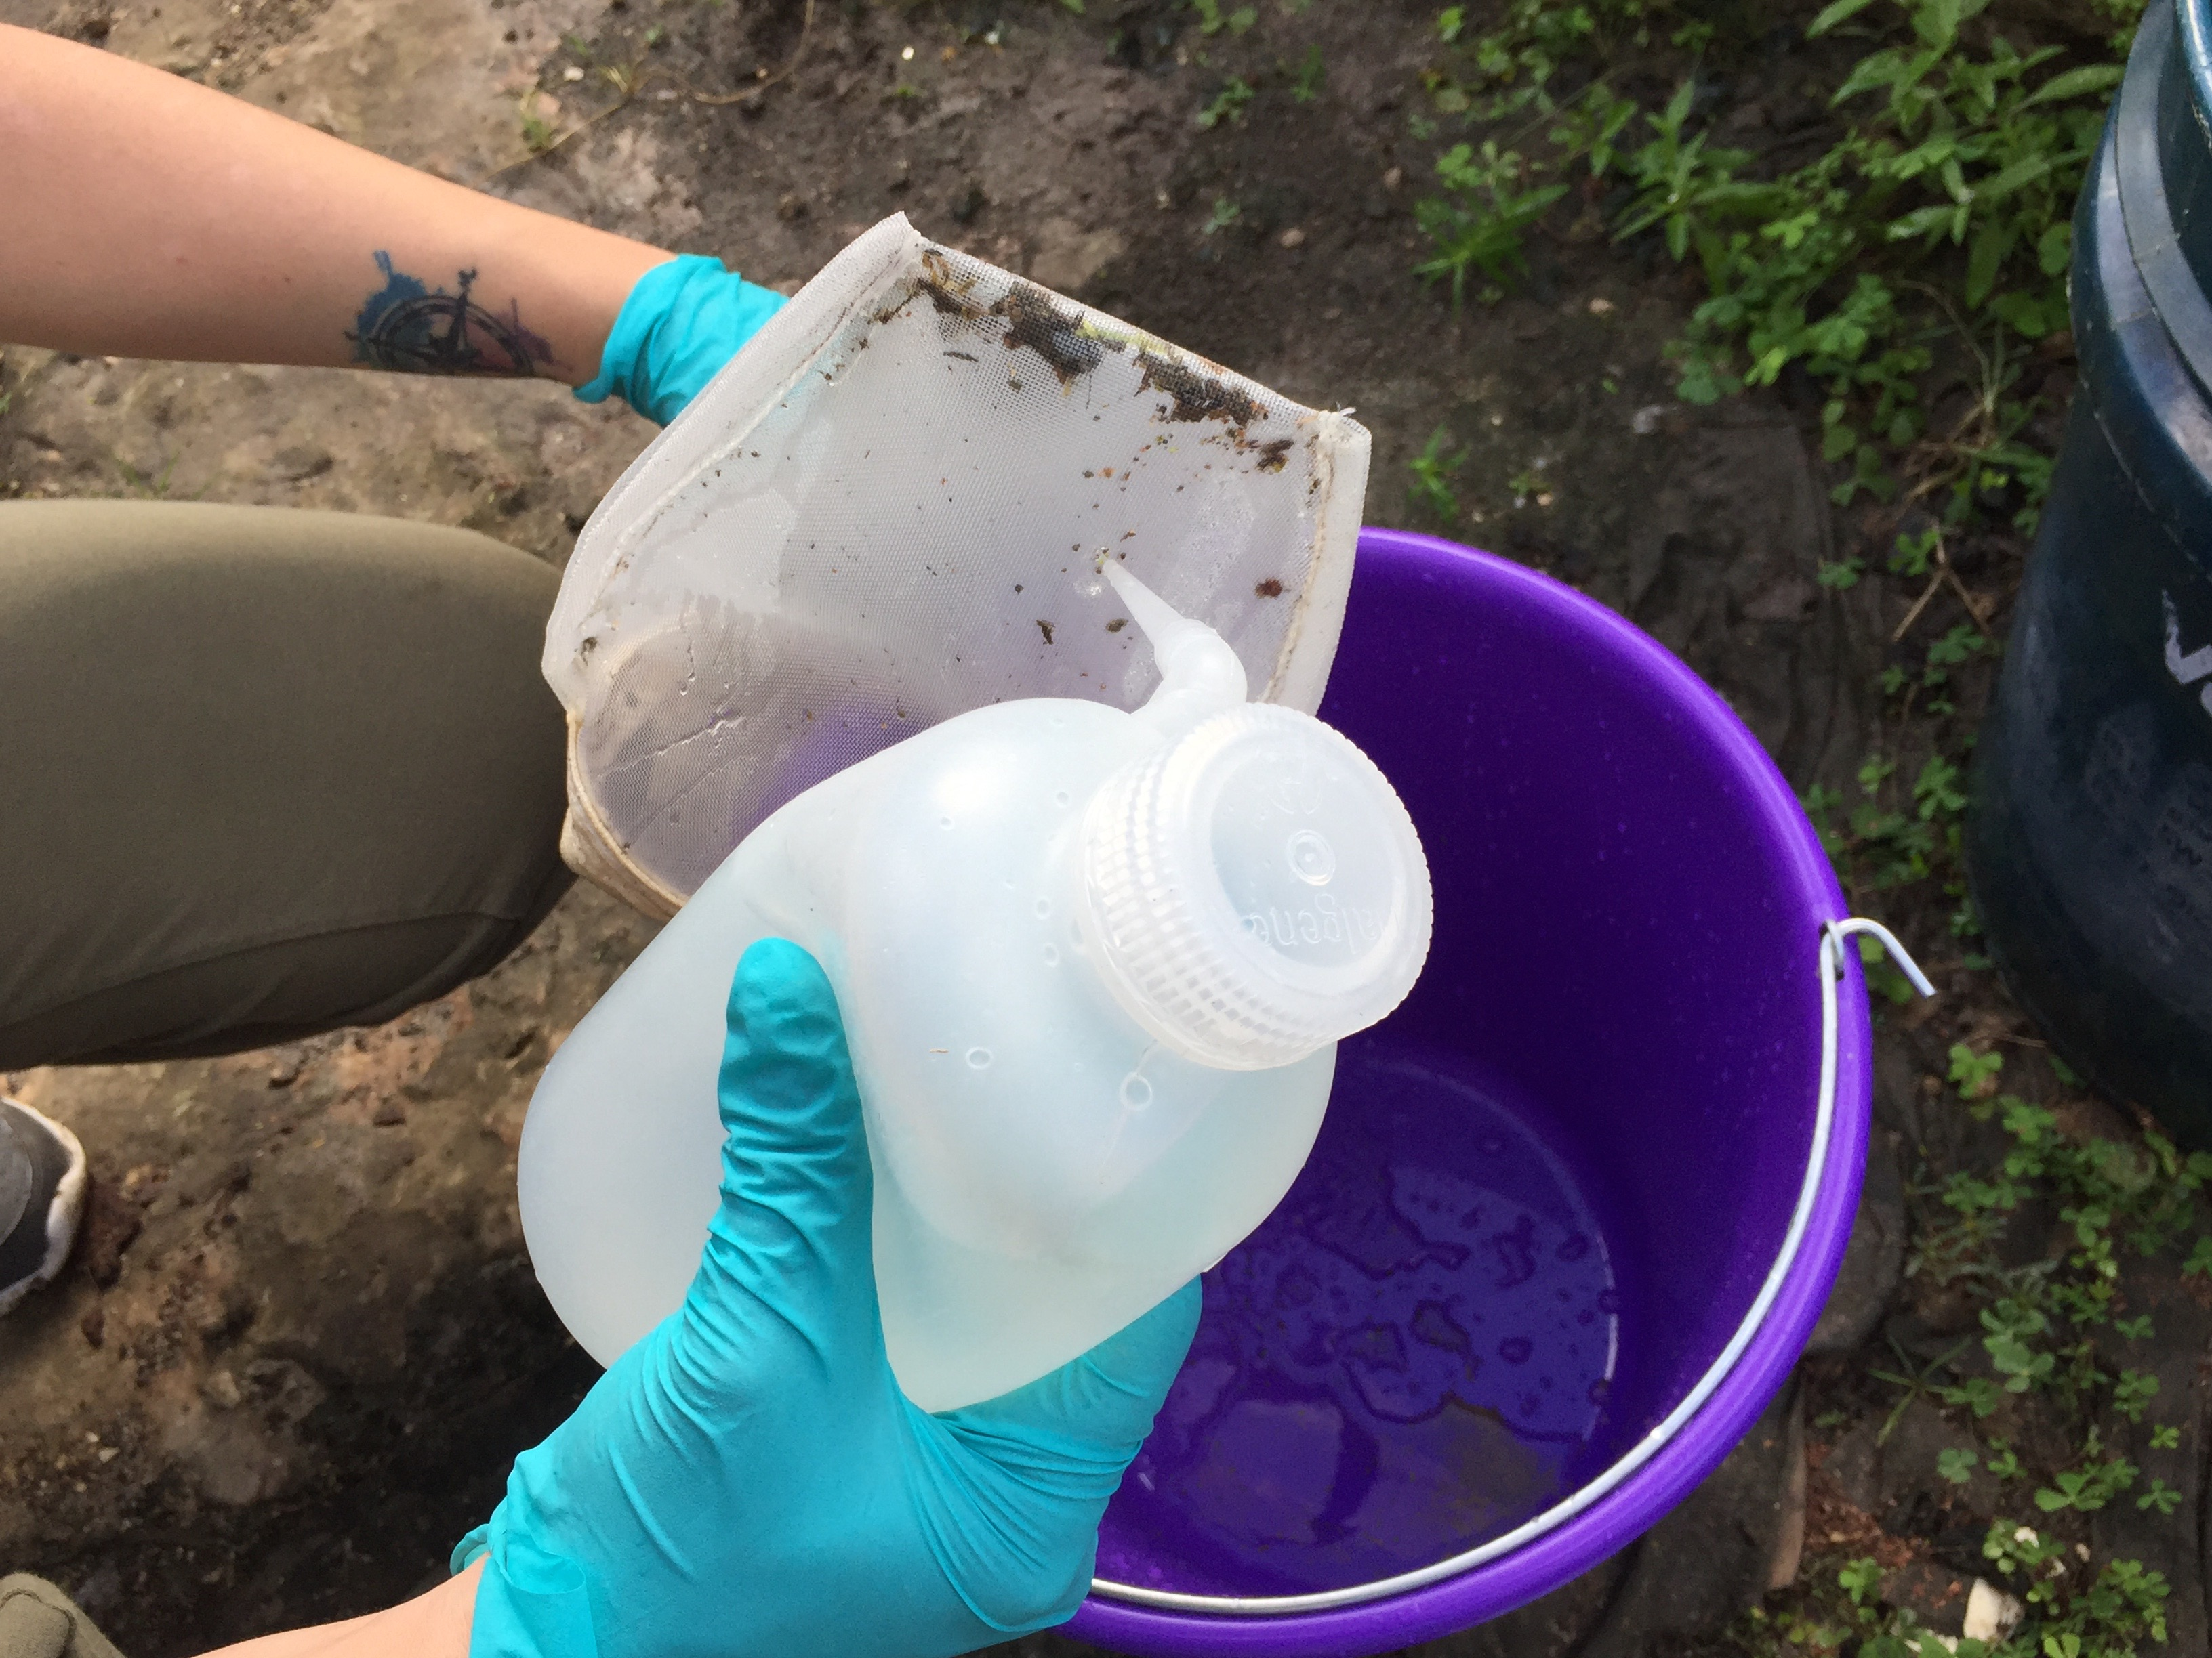
Mosquito Larvae Sampling- washing 1
After collecting a sample with a net, use a squirt bottle with water to gently remove the debris caught in the net into a bucket.
If you have used a dipper or a bulb syringe/macro pipette/baster, skip this step.

Slide 32
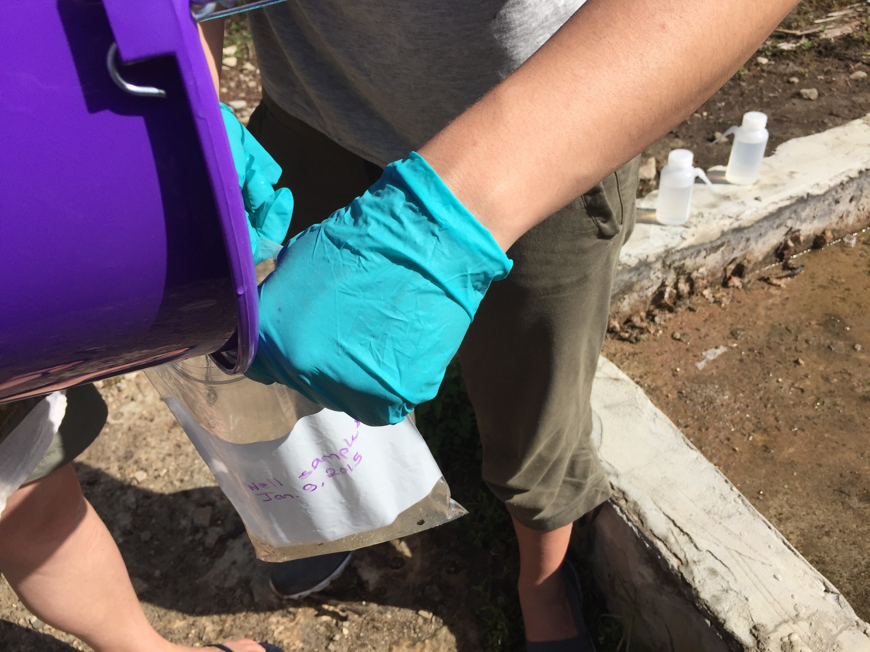
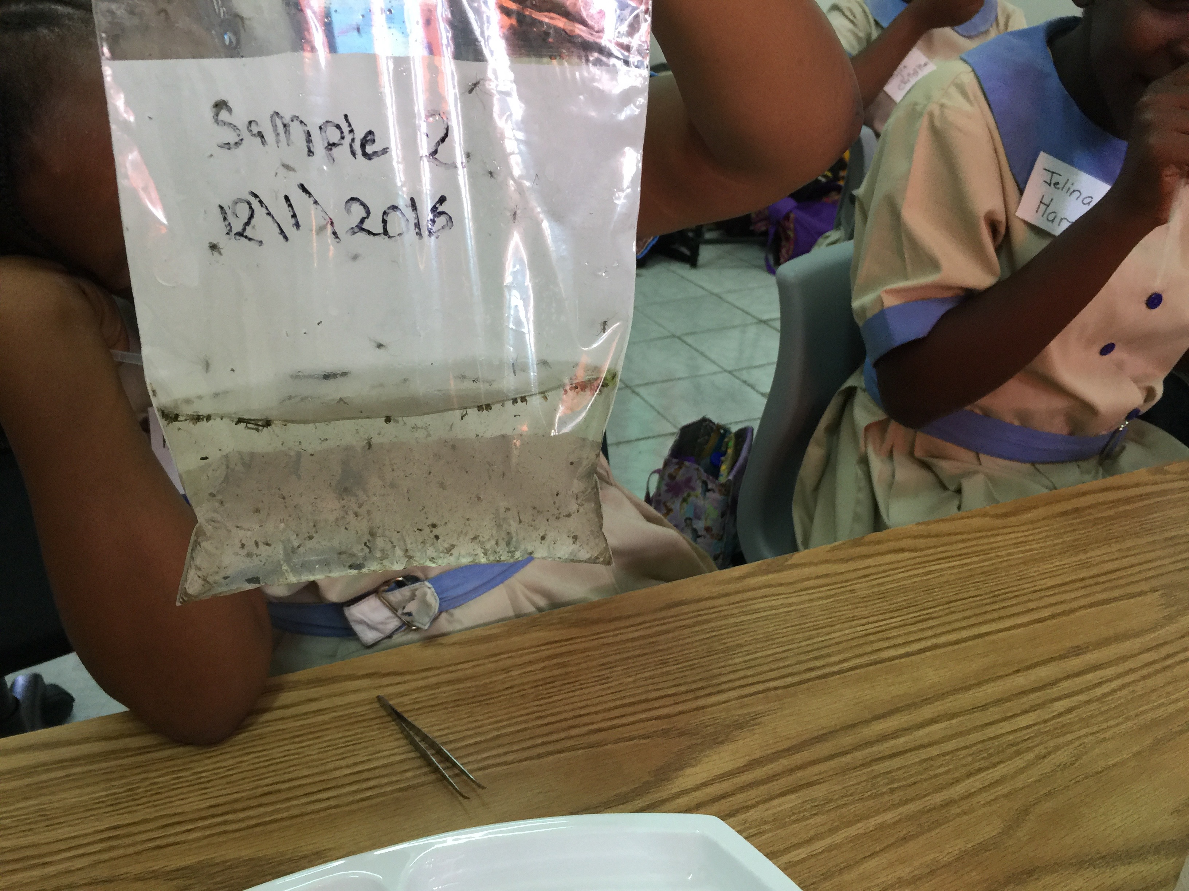
Mosquito Larvae Sampling 2
Pour sample in labeled plastic bags.
Leave air in bags so that larvae can breathe, and keep bags cool and in the shade. If they warm up in the sun, the larvae may die.
Identify the larvae soon after collection. If left overnight, any pupae in the sample may become adult flying mosquitoes.
If you find adult mosquitoes in your sample bag, shake the bag to drown the adult mosquitoes.
Tip: When you are done, your sample can be poured on the ground, any larvae will not survive. Do not pour samples into sinks or toilets where they might survive in a sewer.

Slide 33
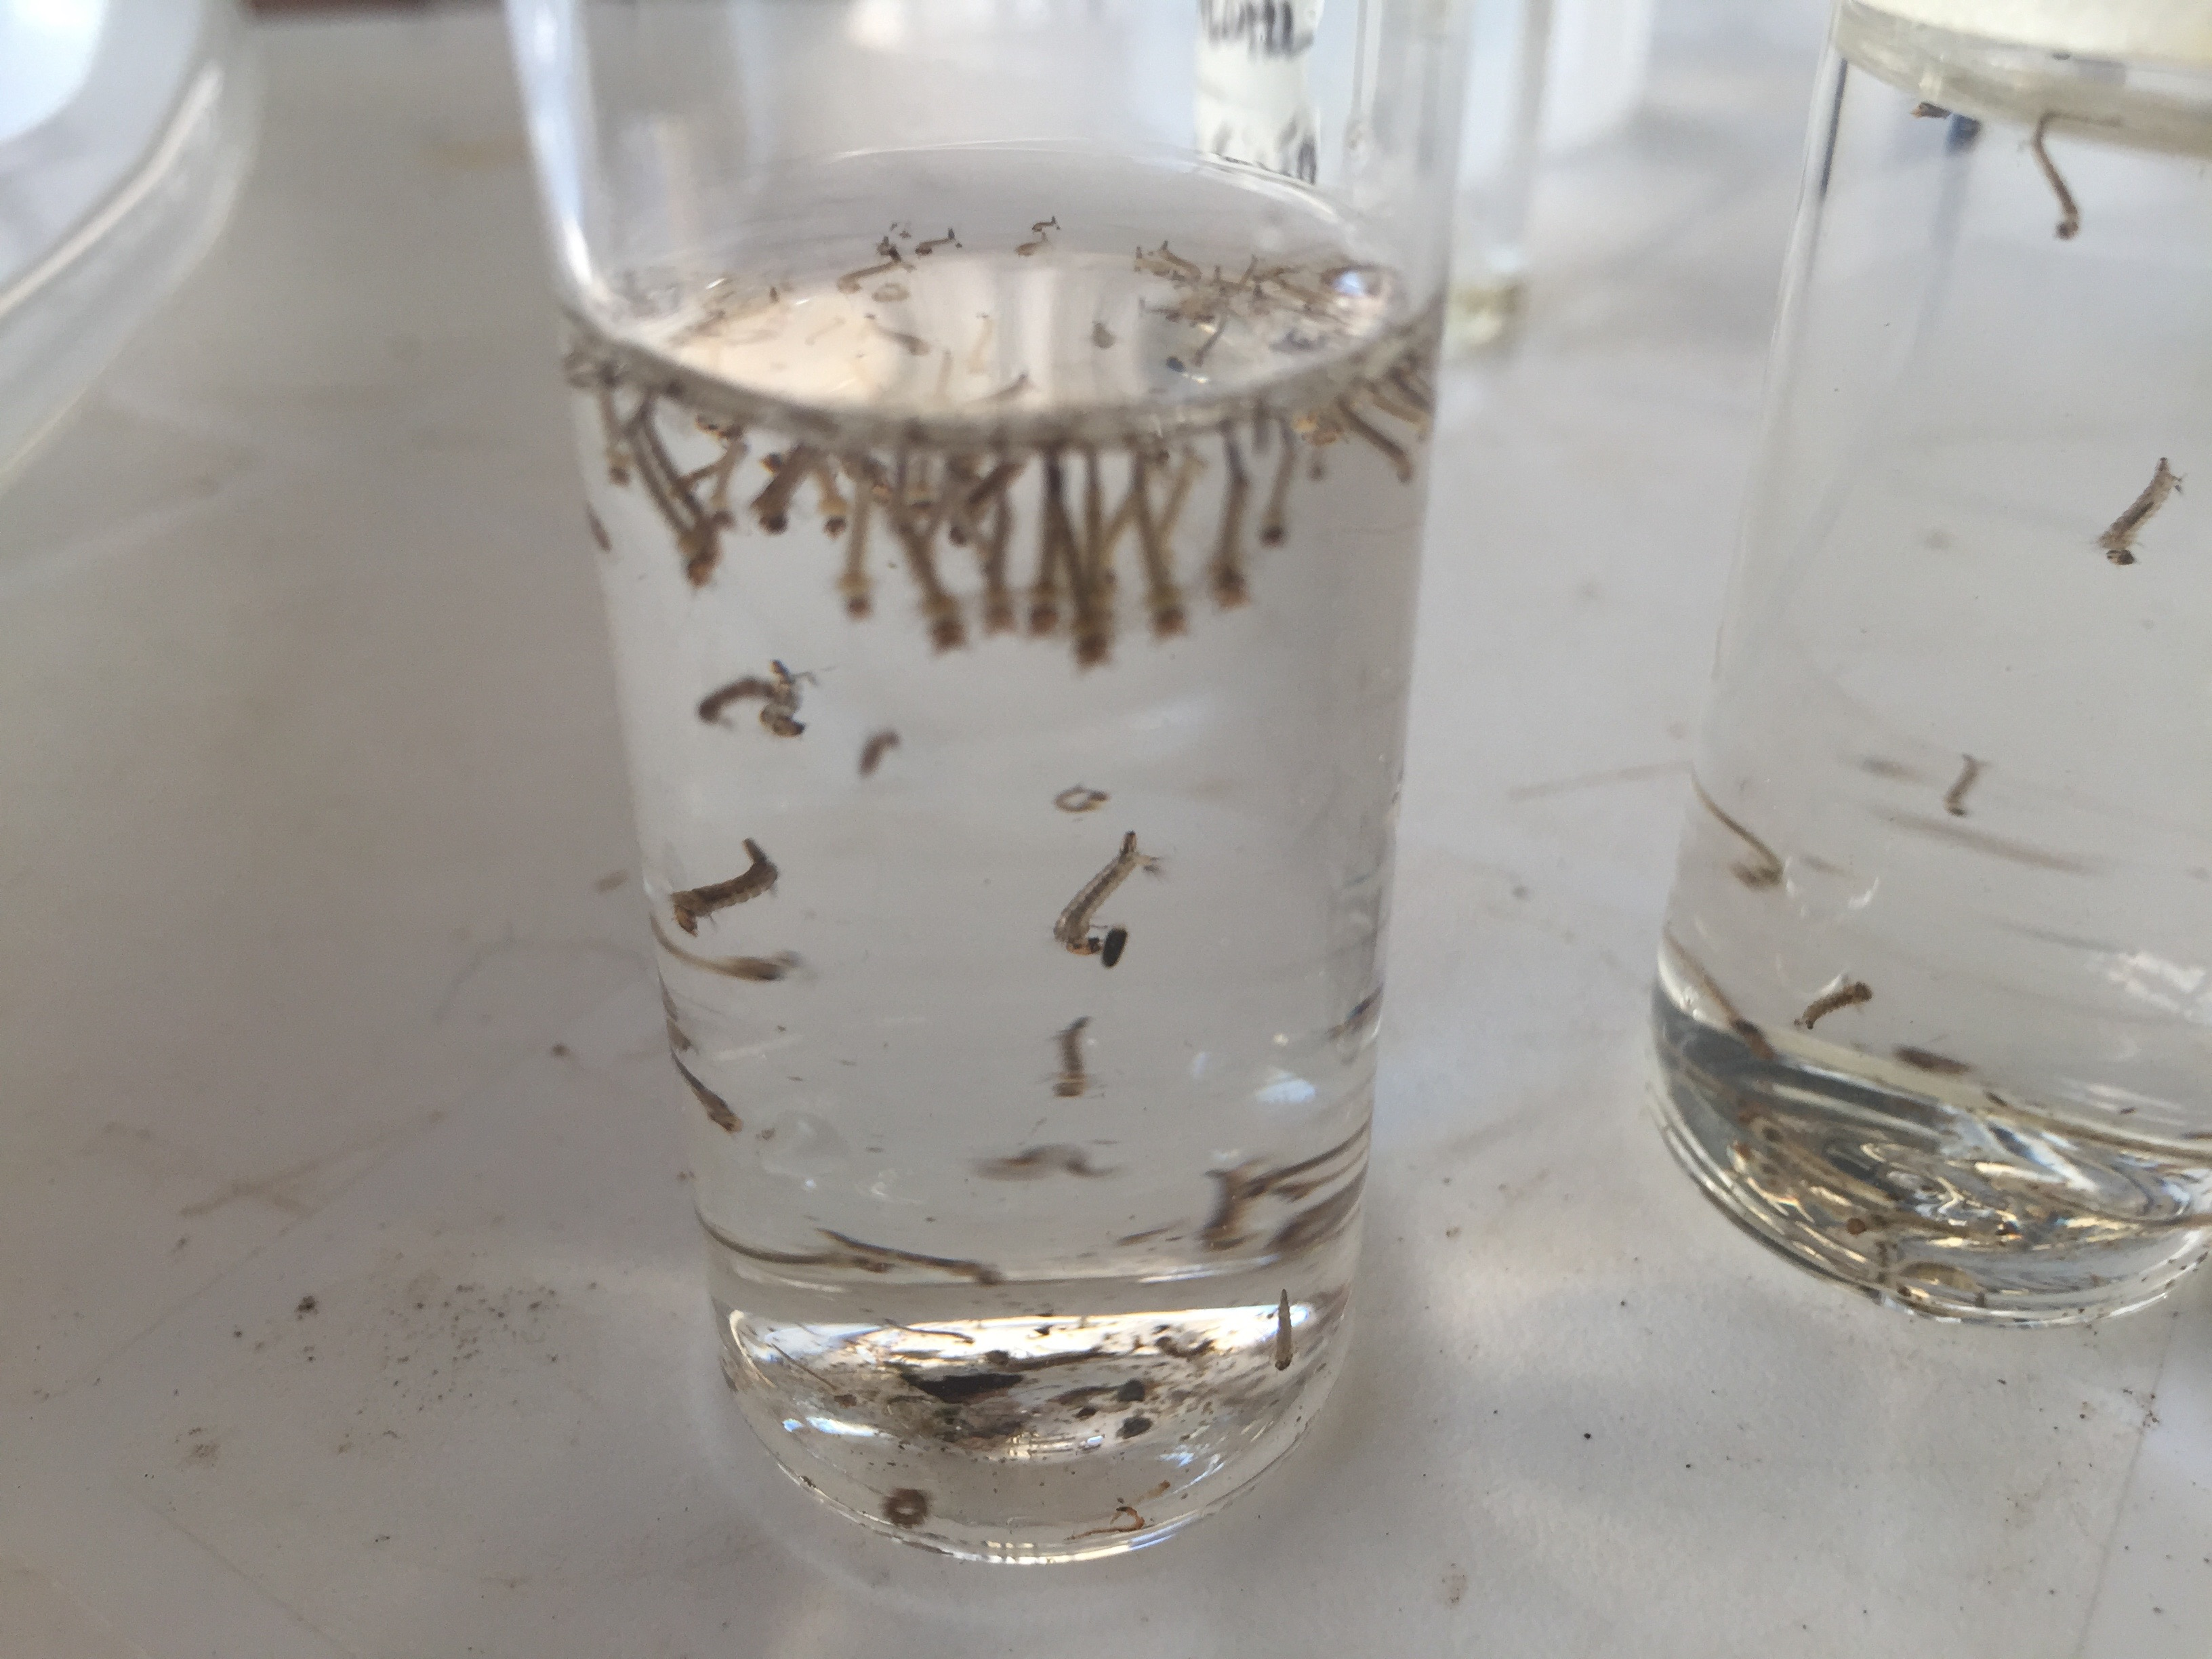
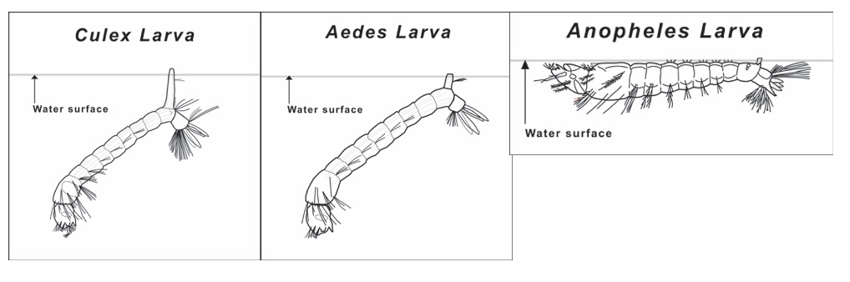
Mosquito Larvae Identification
You can place the larvae in vials to see how they suspend from the surface of the water to help with the identification. Only the larvae of one genus, Anopheles, has a resting position on top of the water. Most other mosquito genera will assume a resting position like seen in the picture (left).

Slide 34
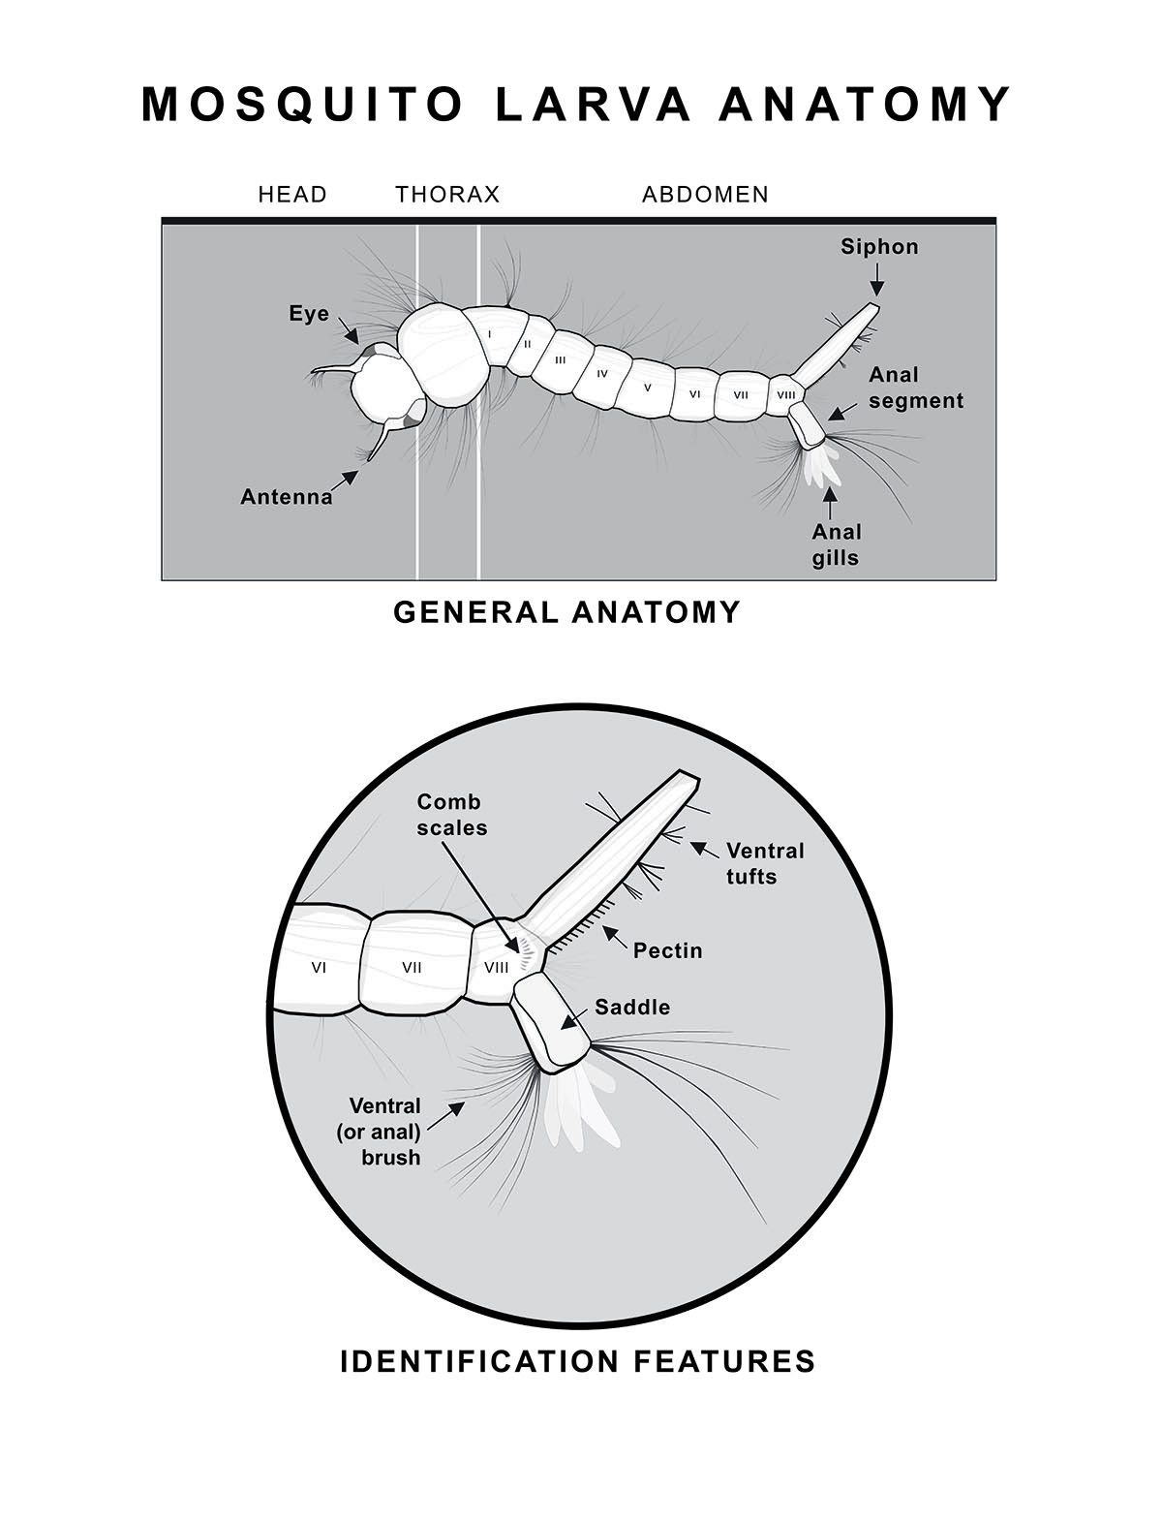
Mosquito Larvae
Identification
Familiarize yourself with the general anatomy of the mosquito larvae and the key features that distinguish those genera or species that are found in your locality. In particular, key features are often found on the anal segment and the siphon. Consult with mosquito experts or mosquito identification keys for your locality.

Slide 35
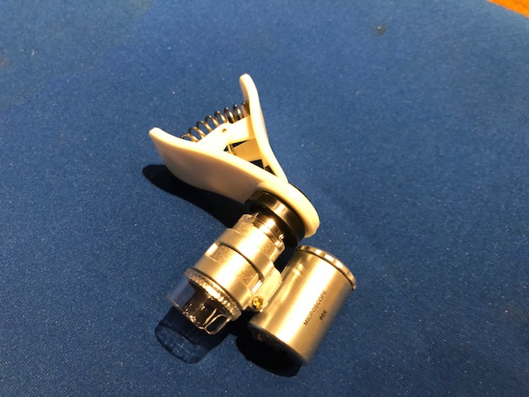
Mosquito Identification using a clip-on macro lens
Follow these instructions to make sure you get a clear view of your specimen.
For best results, use a clip-on macro lens on a mobile device. This will allow you to identify your specimen to species. Use a lens 60x-100x for best results.
Tip: You can also use hand lens to identify some of the characteristics and identify most specimens to genera. You can take a picture through the lens.

Slide 36
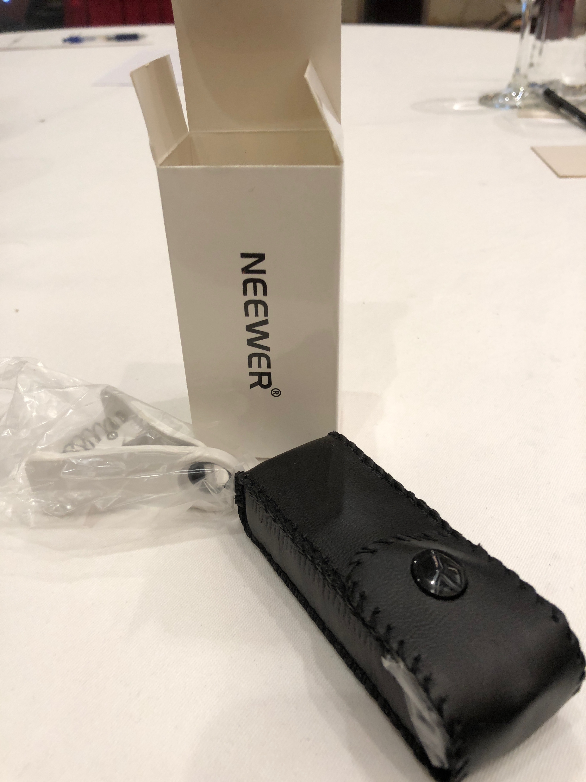
Mosquito Identification using a clip-on macro lens (Cont’d)
A note about lenses:
There are several types of lens available. Each has benefits. The 60x is very easy to use and is recommended, especially working with students. This is because it does not need to be focused.
If it is important for you to determine the difference between Aedes aegypti and Aedes albopictus, the 100x version, seen on the right, will provide sufficient resolution to see the comb scales on slightly older models. However it can be frustrating to learn to focus using this model. Select the right tool for your situation.
60x
100x

Slide 37
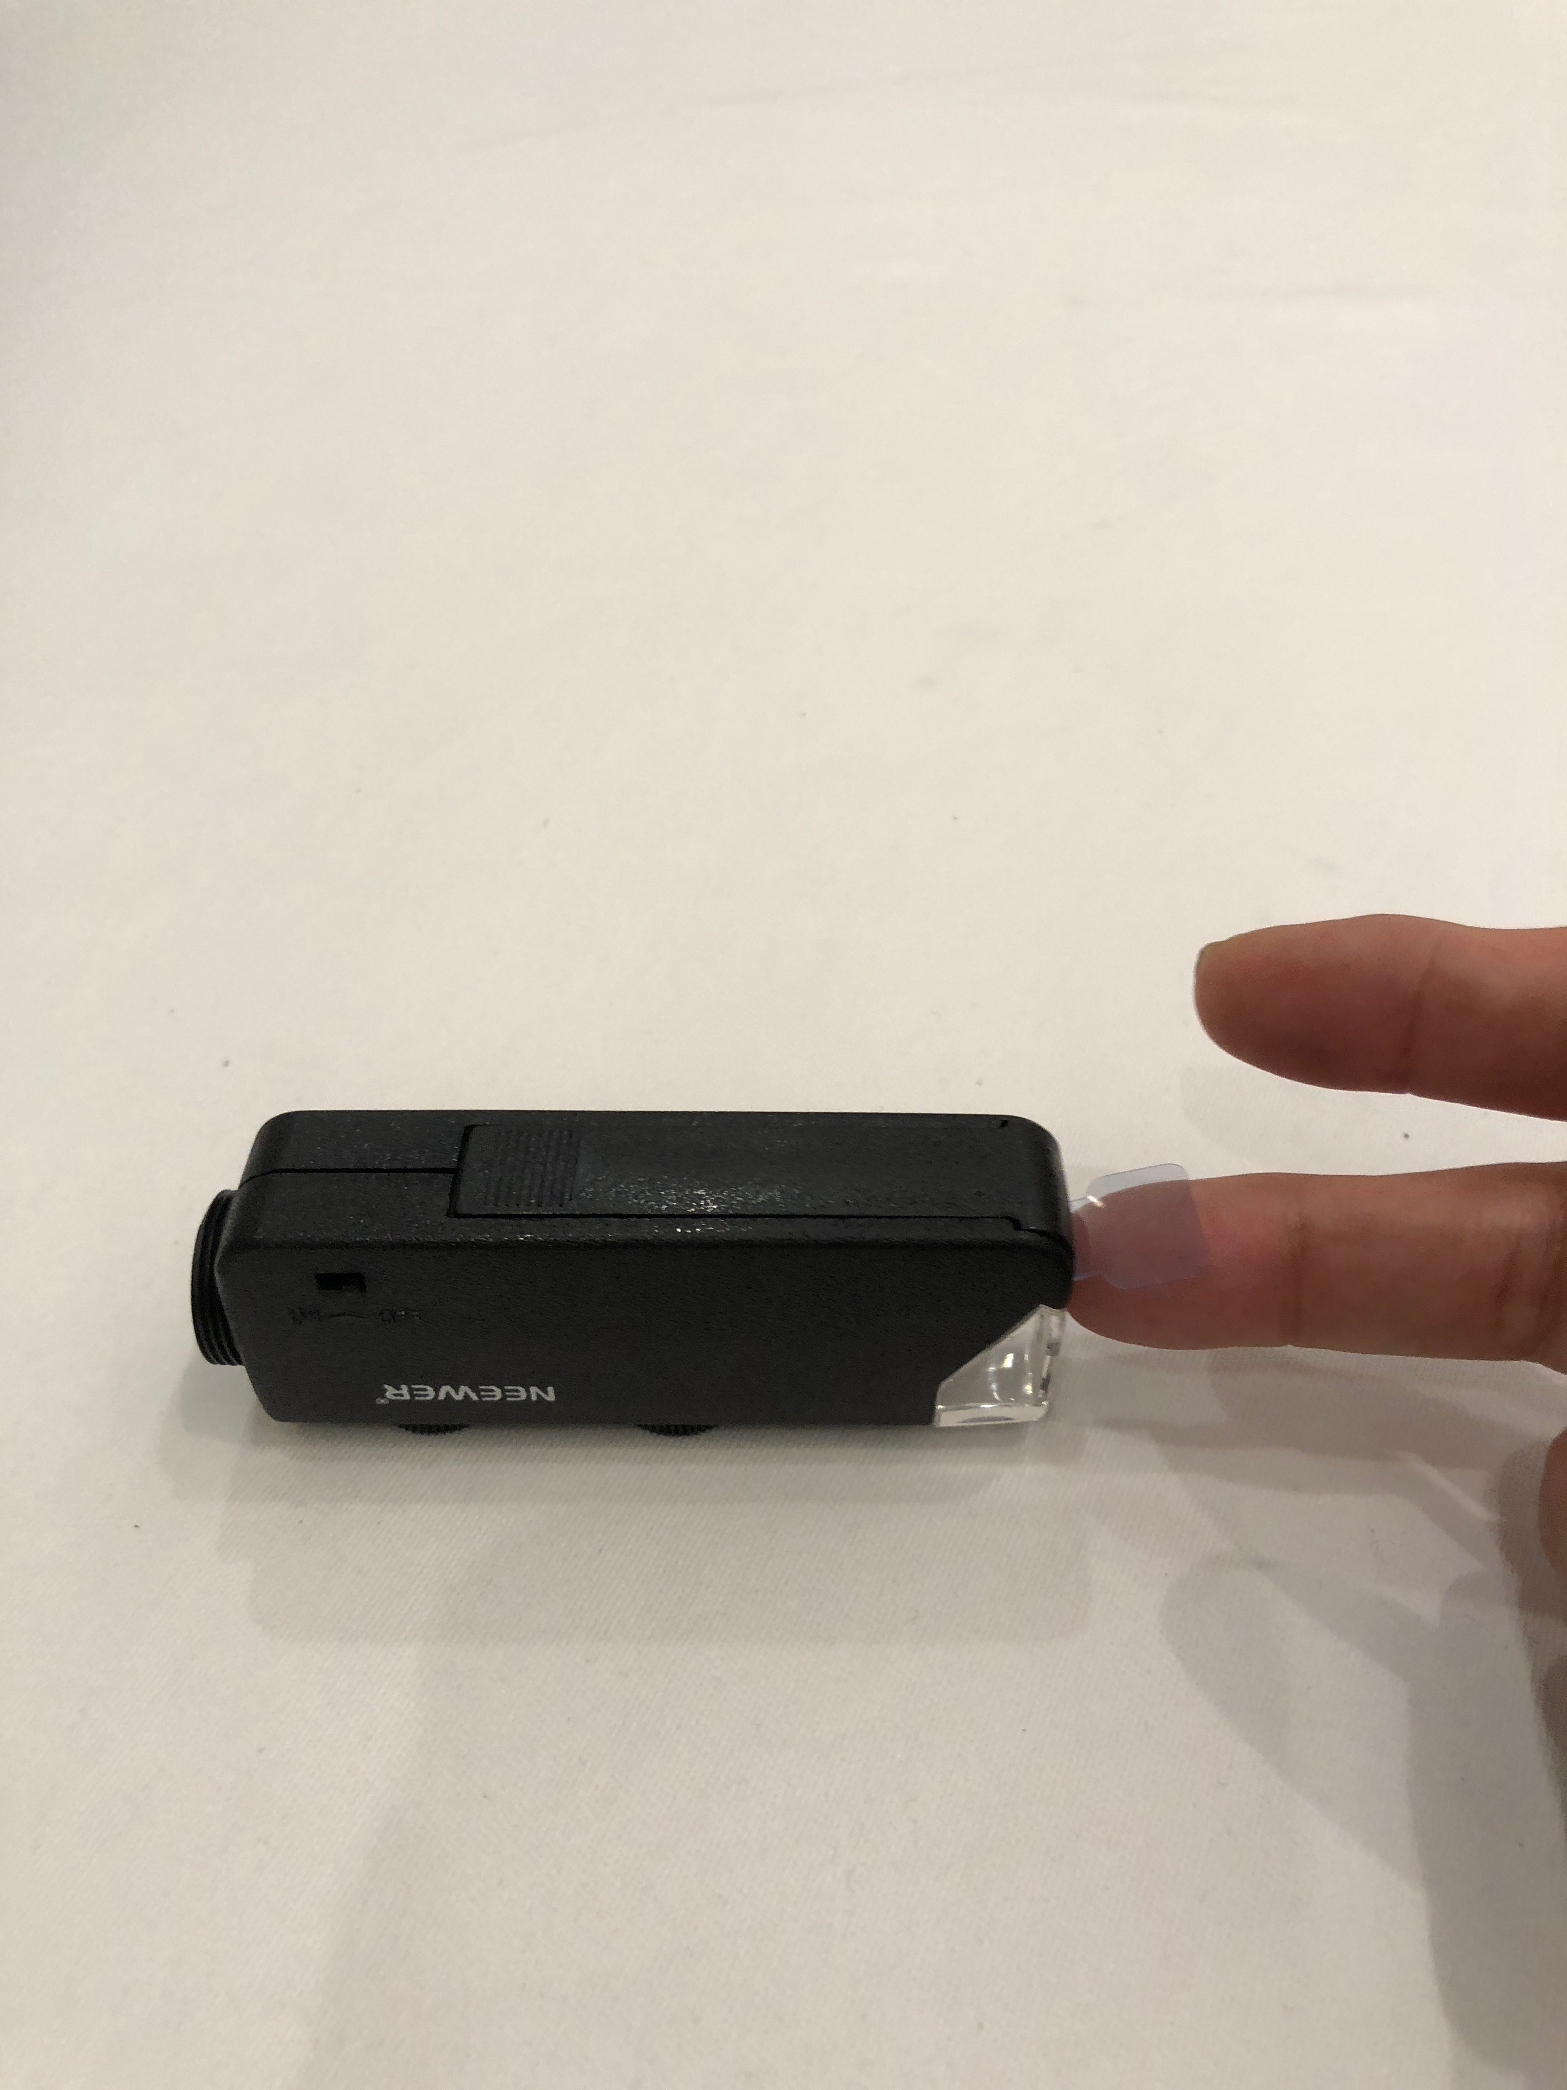



Here are a few tips using the 100x macro lens
Remove the plastic tab that is protecting the batteries.
Make sure the batteries are alternated with +, -, + in a line.
Use the box to make a bridge to support your mobile device. That will allow you to use your other hand to focus using the knobs.
For most models, the clear plastic sleeve rests on the plate. This provides the correct focal length. The specimen is positioned in the circle inside the plastic sleeve.

Slide 38

Recording your Data- using a macro lens
Clip the lens over the lens of the camera on the mobile device. Adjust the position until you have a perfect, white circle in the camera viewfinder.
Place the plastic sleeve of the lens on the surface where you are examining the larvae.
Focus, if necessary - you are ready to identify your specimen.

Slide 39
Let’s do a quick review before moving onto data entry: Question 5
Ideally, how many samples should you take when sampling a non-container water body?
3 samples, 3 minutes between each sampling with the net
5 samples, 3 minutes between each sampling with the net
1 sample, just like when containers are sampled, but split the sample into as many bags as you need.
What is the answer?

Slide 40
Let’s do a quick review before moving onto data entry: Answer to Question 5
Ideally, how many samples should you take when sampling a non-container water body?
3 samples, 3 minutes between each sampling with the net
5 samples, 3 minutes between each sampling with the net-☺ Correct!
1 sample, just like when containers are sampled, but split the sample into as many bags as you need.
Were you correct?

Slide 41
Let’s do a quick review before moving onto data entry: Question 6
Which of the following a part of the mosquito larva you would look at first to determine the genus or species of your specimen.
Anal segment and siphon
Thorax
Eyes
What is the answer?

Slide 42
Let’s do a quick review before moving onto data entry: Answer to Question 6
Which of the following a part of the mosquito larva you would look at first to determine the genus or species of your specimen.
Anal segment and siphon ☺ Correct!
Thorax
Eyes
Were you correct?

Slide 43
Let’s do a quick review before moving onto data entry: Question 7
What precautions will you want to make to ensure student safety in the field?
Protective gloves and goggles, as in all hydrosphere protocols
Clothing that covers and limits exposed skin surfaces
Application of insect repellent, with permission
Sample the larvae at or near solar noon
All of the above
What is the answer?

Slide 44
Let’s do a quick review before moving onto data entry: Answer to Question 7
What precautions will you want to make to ensure student safety in the field?
Protective gloves and goggles, as in all hydrosphere protocols
Clothing that covers and limits exposed skin surfaces
Application of insect repellent, with permission
Sample the larvae at or near solar noon
All of the above ☺ Correct!
Were you correct? Let’s now look at GLOBE data entry and visualization.

Slide 45



Submitting your data to GLOBE
You will use the GLOBE Observer Mosquito Habitat Mapper mobile application to submit your data.
The app will walk you through the steps.

Slide 46

These are the steps

Slide 47

Provide the date, time and location of your sample
Tip: If you don’t see your latitude and longitude, Make sure you have enabled “location services” on your mobile device.
Tip: You can manually adjust your position on the map by moving the location. Don’t touch the map unless you need to adjust your location- otherwise, you might accidentally provide the wrong coordinates.

Slide 48


Describe the mosquito larvae habitat site
Select the type of site. Each of these selections will lead to other choices. Select the description that best fits your site.

Slide 49

Count Larvae
If possible, count the larvae you see in your habitat. If the water is murky, you will have to count the number after you sample.
For container sites, it is best to try and count all the larvae you can see.
For natural sites, you will have to count the number in your sample, totaling all the larvae from the three dips of approximately a cup of water each time.
You will also be asked to say if you see eggs, adults, and pupae in the sample and environs.

Slide 50


Photograph Larvae
The app will ask you to take photographs of a representative larval specimen. The app provides a guide how to best photograph your larva. You can make up to 9 photos of your specimen. You will also be asked to photograph the terminal end of the abdomen where diagnostic features for identification can be observed.
Tip: These photos serve as photo voucher specimens and will be uploaded as metadata, so scientists can check the data.

Slide 51



Identify Larvae
Your photograph is uploaded in to the app and you can compare your specimen with descriptions and diagrams.
In the example to the left, the uploaded photograph has a cylindrical long siphon, indicative of Culex, not spindle shaped, like the example photo.

Slide 52

Site mitigation
Every site that is taken out of use by users is recorded in the app.
If it is a container site, you can take it out of use by mother mosquitoes by dumping out the water and picking up trash.
For water storage containers you can cover the opening with a net or a lid.
For natural breeding sites, such as a pond or lake, you do not mitigate. If you have found a natural habitat with mosquito vectors you can contact your mosquito control agency.
Remember that most mosquito species do not transmit pathogens- they play a vital role in the ecosystem- feeding birds, bats and amphibians, as well as pollenating plants!

Slide 53



Visualize and Retrieve Data-1
GLOBE provides the ability to view and interact with data measured across the world. Select our visualization tool to map, graph, filter and export data that have been measured across GLOBE protocols since 1995. Here are screenshots of the steps you will use when you use the visualization tool.
Link to step-by-step tutorial on using the GLOBE Data Visualization Tool

Slide 54

Visualize and Retrieve Data-2
Go to globe.gov and on the menu, select GLOBE data and click on “Visualize Data”.

Slide 55

Visualize and Retrieve Data-3
Select the data layer icon, and you will see the protocol layers. Select Hydrosphere.
Select “Data Counts” if you want to see all the data available within a range, or select a single day.

Slide 56

Visualize and Retrieve Data-4
In Hydrosphere, select Mosquito Habitat Mapper and the fields you want to examine.

Slide 57

Visualize and Retrieve Data-5
The data will populate the map. You can see the legend by clicking on the pull- out legend, lower right. You can zoom in and see on which street the data was found!

Slide 58


Visualize and Retrieve Data-6
Above: Data reported by citizen scientists since inception, using the GO MHM app, June-December 2017. See inset image, Rio de Janeiro, Brazil data hub, where an intensive training pilot took place in May-June 2017. N=1523. (https://vis.globe.gov/GLOBE/)

Slide 59

Visualize and Retrieve Data-7
Accuracy and data quality: voucher photo can be examined to ensure that the identifications are correct. Click on any data point to retrieve metadata for that location.

Slide 60

Accuracy and data quality
Accuracy and data quality: You can search by taxa, to see where different species or genera have been found.

Slide 61

Accuracy and data quality (Cont’d)
You can download data as a .csv or .kmz file by clicking on a data point and choosing the “Measurements” tab. Follow instructions to download.

Slide 62

Review questions to help you prepare to conduct the Mosquito Protocol
How many samples of a non-container site should you take?
What are some of the safety precautions that you need to take when conducting the Mosquito Protocol?
Ideally, how often can you do the Mosquito Protocol?
What are some of the types of data that you will report to GLOBE when conducting the GLOBE Mosquito Protocol?
If you were designing a research investigation to identify the environmental conditions that support successful Mosquito breeding seasons, what other GLOBE data sets might you consult?
True or false: mosquitoes can hatch and develop in open container environments as well as natural water bodies.
Name three genera of mosquitoes that can potentially transmit pathogens that cause disease in humans.
Which genus of mosquitoes carries Zika? Malaria?
What are the three things that we can do to reduce risk of mosquito borne disease, when there is no vaccine available? How does GLOBE Observer Mosquito Habitat Mapper help?
How does GLOBE Observer Mosquito Habitat Mapper ensure that data uploaded by GLOBE Observer users is scientifically accurate and reliable?

Slide 63
Are you ready to take your quiz?
You have now completed the slide set. If you are ready to take the quiz, sign on and take the quiz corresponding to Mosquito Larvae Protocol.
When you pass the quiz, you are ready to participate as a citizen scientist in the GLOBE Observer Mosquito Habitat Mapper network!

Slide 64


Frequently Asked Questions (FAQs)
What is the mosquito life cycle?
Adult → eggs (2 -3 days) → larvae (4 -5 days) → pupae (1- 2 days) → Adult. The times in each stage are environmentally dependent: in warmer temperatures, mosquito metabolism is faster.
How do you identify which one is the Anopheles, Aedes or Culex larvae (identify with unaided eyes)?
We can see the characteristics of mosquito larvae: In the water, Anopheles larvae cling parallel with the water surface. On the other hand, Aedes and Culex larvae cling at an angle of 45° with the side of the container. Aedes larvae have shorter siphons, Culex larvae tend to have have longer siphons.
What do the male mosquitoes feed on?
Male mosquitoes feed on any sugar source, including flowers, fruit, nectar and other insects.
At what seasons of the year are greater percentages of mosquito larvae found?
Most often they are found in the rainy season or shortly after the end of the rainy season.
What if I want to collect mosquito data and do not have a mobile device?
It is still possible to collect mosquito data. You will need to use the GLOBE Mosquito Protocol data form, and enter the data manually to the GLOBE data portal.
What if I want to collect mosquito data and do not have a clip-on macro lens to use with my mobile device?
You can use a hand lens. It is possible to take a picture of the larvae through the lens and upload it to the website. You can also use a school microscope, if available.

Slide 65

We want your Feedback!
Please provide us with feedback about this module. This is a community project and we welcome your comments, suggestions and edits! Comment here:
eTraining Feedback
Questions about module content? Contact GLOBE: help@globe.gov
Slides:
Russanne Low, Ph.D., Institute for Global Environmental Strategies, Arlington VA
Rebecca Boger, Ph.D., Brooklyn College, NYC, USA
Photos: Russanne Low
Cover Art: Jenn Glaser, ScribeArts
More Information:
The GLOBE Program, NASA Earth Science
NASA Global Climate Change: Vital Signs of the Planet
The GLOBE Program is sponsored by these organizations:
Version 5/6/2020. If you edit and modify this slide set for use for educational purposes, please note “modified by (and your name and date)“ on this page. Thank you.

