Slide 1
PISA 2015 results and future developments
Alfonso Echazarra
Analista PISA-OCDE

Slide 2
PISA 2015: A summary
Approximately 540 000 students…
  representing about 29 million 15-year-olds in the schools of the 72 participating countries and economies
  … took a computer-based test lasting a total of 2 hours…
  Not only evaluates if students can reproduce what they have learned at school…
  …assesses students’ capacity to apply creatively their knowledge and skills in a variety of situations
…and answered questions about their schools, personal context and attitudes towards learning
Parents, principals, teachers and policy-makers provided information about …
  School policies, practices, resources and institutional factors that can explain the differences in performance

Slide 3
PISA 2015: A summary
New features
  Science as core subject
  Computer-based assessment in most education systems
    Log-file data
  Collaborative problem-solving
  Teacher questionnaire
A tool to learn and improve
  Collaboration between countries, experts and social agents sharing experiences, policies and best practices
      Data triangulation combining the perspectives from students, teachers, principals, parents and policy-makers
  Evidence-based and constructive dialogue

Slide 4
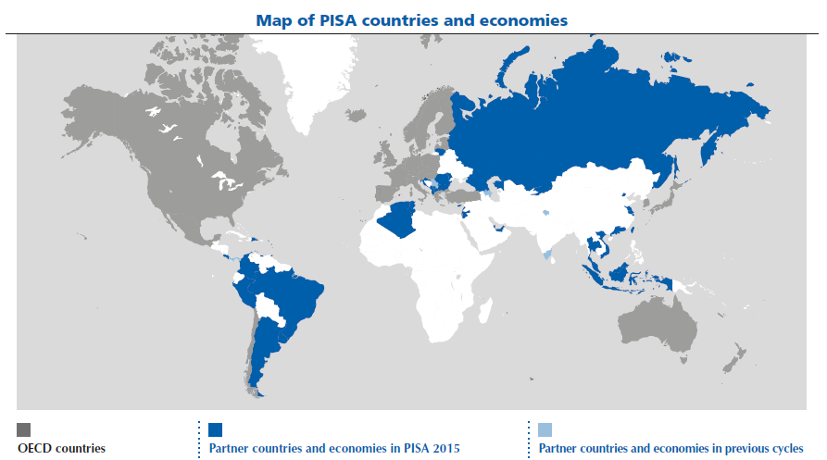
Map of PISA countries and economies

Slide 5
PISA 2015 reports
OECD Reports
  Volumen I: Excellence and Equity in Education
  Volumen II: Policies and Practices for Successful Schools
  Volumen III (Spring 2017): Students’ Well-Being
  Volumen IV (Spring 2017): Students’ Financial Literacy
  Volumen V (Autumn 2017): Collaborative Problem Solving
  Thematic reports (2018/2019): To be decided
    Options: Teaching and learning in science, rural and urban schools,
    out-of-school learning, …
National reports.
  PISA 2015. Programa para la evaluación internacional de alumnos:
  Informe español
  …

Slide 6
Performance in science
Figure I.4.2
Confidence interval (95%)

Slide 7
Mean science performance, after accounting for countries’/economies’ per capita GDP
Table II.2.11

Slide 8
Mean performance in science, by international deciles of the PISA index of economic, social and cultural status (ESCS)
Figure I.6.7
OECD median student
% of students in the bottom international deciles of ESCS

Slide 9
Percentage of low-achievers in science
Table II.2.2a

Slide 10
Percentage of top performers in science
Table II.2.2a

Slide 11
The global pool of top performers: A PISA perspective
Figure I.2.18

Slide 12
Performance in reading
Figure I.4.2
Confidence interval (95%)

Slide 13
Performance in mathematics
Figure I.5.2
Confidence interval (95%)

Slide 14
Students’ career expectations
Figure I.3.2
% of students with vague or missing expectations
Notes:
Note: Belgium refers only to French and German-speaking communities

Slide 15
Boys and girls’ expectations of a science career, OECD average
Figure I.3.5
Students who expect to work as...
Notes:
Note: Belgium refers only to French and German-speaking communities

Slide 16
Student performance in science, by immigrant background
Figure I.7.4
Only countries where the immigrant student population >6.25% are shown

Slide 17
Science performance by school location
Notes:
Rural: fewer than 3 000 people; Town: 3 000 to 100 000 people; City: over 100 000 people

Slide 18
Variation in science performance between systems, schools and students
Figure II.7.1

Slide 19
Higher-performing education systems in science-related outcomes
Figure II.2.2
Notes:
Countries and economies that are not above-average in any of the three variables: Albania, Algeria, Austria, Czech Republic, France, FYROM, Greece, Hungary, Indonesia, Italy, Latvia, Luxembourg, Moldova, Montenegro, Romania, Russia, Slovak Republic and Thailand.

Slide 20
Science-related extracurricular activities offered at school
Figure II.2.9

Slide 21
Teacher-directed instruction: explaining scientific ideas
Table II.2.18
Students who reported that their science teacher explains scientific ideas in many lessons or every lesson perform better in science

Slide 22
Adaptive instruction and science performance
Figure II.3.16
Students who reported that their science teacher adapts more frequently their lessons to students’ needs and knowledge perform better in science

Slide 23
Enquiry-based teaching practices and science performance, OECD average
Figure II.2.20

Slide 24
Change between 2012 and 2015 in student truancy
Figure II.3.2

Slide 25
Distribution across the education system of responsibility for school resources
Figure II.4.3

Slide 26
Distribution across the education system of responsibility for the curriculum
Figure II.4.4

Slide 27
Distribution across the education system of responsibility for approving students for establishing student disciplinary policies
Table II.4.2

Slide 28
Distribution across the education system of responsibility for establishing student assessment policies
Figure II.4.5

Slide 29
Distribution across the education system of responsibility for for approving students for admission to the school
Figure II.4.6

Slide 30
Public and private schools, and students’ science performance
Figure II.4.14
Students in public schools perform better
Students in private schools perform better

Slide 31
Change between 2009 and 2015 in grade repetition rates
Figure II.5.5
Notes:
Repeated a grade at least once in primary, lower secondary or upper secondary

Slide 32
Academic and social inclusion across schools
Figure II.5.12

Slide 33
Factors associated with equity in science performance
Figure II.5.13
More equity in science performance
Less equity in science performance
Notes:
Cross-country analysis. All variables included in the same regression model. R2: 44%.

Slide 34
Equity in resource allocation and science performance
Based on Figure II.6.4

Slide 35
Learning time and science performance
Figure II.6.23

Slide 36
Science performance and learning time
Figure II.6.23
OECD average
OECD average

Slide 37
PISA 2018 and beyond: New developments and proposals
PISA 2018
  Global competences: assessment and questionnaire
  Students’ well-being questionnaire: initiative linked to the Better Life Initiative looking to offer a holistic view about the well-being of students (economic situation, housing, health, education, physical safety, sense of well-being, …)
  Overlap with TALIS survey about teachers
  Adaptive testing
PISA 2021
  Creativity and critical thinking?
PISA 2024
  Skills in foreign languages?
  Entrepreneurship?

Slide 38
Developmental domains
Learning strategies (2000)
  Problem-solving (2003)
  Embedding of attitudinal aspects in assessment (2006)
  Digital literacy (2009)
  Creative problem-solving (2012)
  Collaborative problem-solving (2015)
  Global competences (2018)
  Creativity and critical thinking (2021)?

Slide 39
PISA definition of Global Competence
  Global competence is the capacity to analyse global and intercultural issues critically and from multiple perspectives, to understand how differences affect perceptions, judgments, and ideas of self and others, and to engage in open, appropriate and effective interactions with others from different backgrounds on the basis of a shared respect for human dignity.

Slide 40
Some questions PISA seeks to answer
  How well are students prepared for life and employment in culturally diverse societies and in a globalised world?
  How much are students exposed to global news and how do they understand and critically analyse intercultural and global issues?
  What approaches to multicultural, intercultural and global education are used at school?
  What approaches are used to educate culturally diverse students and how are schools leveraging this diversity to develop students’ global competence?
  What approaches are used to stimulate peer-to-peer learning between students from different cultures?
  How well are schools contesting cultural and gender biases and stereotypes, including their own?

Slide 41
Schools can make a difference
  Schools can:
  provide opportunities for young people to learn about global developments that affect the world and their lives
  teach students how they can develop a fact-based and critical worldview of today
  equip students with the means to access and analyse a broad range of cultural practices and meanings
  engage students in experiences that facilitate international and intercultural relations
  promote the value of diversity, which in turn encourages sensitivity, respect and appreciation.

Slide 42
The dimensions of Global Competence
Values
GLOBAL COMPETENCE
· Valuing Human Dignity
· Valuing Cultural Diversity
·Analytical and critical thinking
·Perspective taking
· Respectful communication
· Adaptability
Knowledge
Attitudes
Skills
· Knowledge of global issues
· Intercultural knowledge
· Openness towards people from other cultures
· Respect for other cultures
· Global-mindedness
An individual may have a large range of knowledge,
understanding and skills, but lack the disposition to use them. An “attitude” may be defined as the overall mind-set which an individual adopts and typically consists of four components: a belief or opinion about the object, an emotion or feeling towards the object, an evaluation (either positive or negative) of the object, and a tendency to behave in a particular way towards that object.
“Skills” are the capacities for carrying out a complex pattern of either thinking (in the case of a cognitive skill) or behaviour (in the case of a behavioural skill) in order to achieve a particular goal.
Global Competence requires numerous skills, including the ability to: communicate in more than one language; communicate appropriately and effectively with people from other cultures or countries; comprehend other people’s thoughts, beliefs and feelings, and see the world from their perspectives; adjust one’s thoughts, feelings or behaviours to fit new contexts and situations; and analyse and think critically in order to scrutinise and appraise information and meanings
Components

Slide 43
The cognitive test – from information to critical understanding of global and intercultural issues
The PISA test will assess how students can use their knowledge and critical thinking skills to understand issues of critical importance to the world (global issues) and issues that affect open and respectful interactions across cultures (intercultural issues).
Contexts
Personal, Local, Global
Analytical, critical and perspective taking skills
· Select information
· Assess claims
· Explain issues
· Recognize contexts and perspectives
·Understand implications
Knowledge
·Knowledge of global issues
· Intercultural knowledge
Global and Intercultural Understanding
Attitudes
  Interest in other cultures
  Interest in global issues
  Global mindedness
  Respect

Slide 44
Muchas gracias

