Slide 1

The culture of assessment in Science and English
La cultura de la evaluación en Ciencias e Inglés

Slide 2



Using assessment to support learning: A learning-oriented approach
Juliet Wilson

Slide 3
Learning-oriented
assessment…
Notes:
When we first started to explore the concepts underpinning LOA, the comment that kept coming back to us from colleagues was
“So … LOA, that’s a kind of formative assessment isn’t it?”
This is a really interesting proposition for two reasons, colleagues were:
Building meaning from the term LOA but also …
Attempting to locate LOA alongside two popular concepts in assessment
Summative assessment
Formative assessment
The discourse of assessment it seems is conceptually grounded within these two notions. So it seems that a good place to start is with:
A baseline review of formative and summative assessment because these are the terms that serve as our ‘conceptual touchstone’ about assessment
…. and to propose the possibility that this distinction is a false dichotomy in fact …
2. We may be restricting our thinking by locating concepts of assessment into either the formative or summative camp
So let’s orientate ourselves with general interpretations of SA and FA

Slide 4
…isn’t that the same as
formative assessment?
Notes:
When we first started to explore the concepts underpinning LOA, the comment that kept coming back to us from colleagues was
“So … LOA, that’s a kind of formative assessment isn’t it?”
This is a really interesting proposition for two reasons, colleagues were:
Building meaning from the term LOA but also …
Attempting to locate LOA alongside two popular concepts in assessment
Summative assessment
Formative assessment
The discourse of assessment it seems is conceptually grounded within these two notions. So it seems that a good place to start is with:
A baseline review of formative and summative assessment because these are the terms that serve as our ‘conceptual touchstone’ about assessment
…. and to propose the possibility that this distinction is a false dichotomy in fact …
2. We may be restricting our thinking by locating concepts of assessment into either the formative or summative camp
So let’s orientate ourselves with general interpretations of SA and FA

Slide 5
formative
assessment
summative
assessment
a kind of purpose
guiding what happens next
a kind of judgement
evaluating what has happened before
Notes:
Paul Newton, educational researcher, in 2007, questions whether the formative/summative distinction is meaningful at all? He argues that the distinction is “spurious” and that there is a need for greater clarity …
… and that instead of focussing on the nature of the assessment, we need to be thinking about the purpose and the use to which the assessment is put.
In which case it can be argued that:
Formative assessment is a kind of purpose guiding what happens next in the classroom
Summative assessment is a kind of judgement, a score

Slide 6
Question:
Can a “summative test” serve a formative purpose?
Notes:
But to find out whether there is really a difference between them – let’s ask the question..
Yes, it can.
How? We can use those test scores to inform what we do next in the lesson, curriculum
So this dichotomy is not a good one, not mutually exclusive categories

Slide 7
formative
assessment
summative
assessment
classroom
large scale
The light side…
…and the dark side
Notes:
It’s like building a wall – good guys and bad guys
Not helpful distinction

Slide 8
classroom assessment
large scale
assessment
Learning
Notes:
Whatever we are dealing with, perhaps a more enlightened way of dealing with it is to say they are actually both about learning
All assessments should have as a key aim to help learning

Slide 9
“For all tests, whether predominantly summative or formative in function, a key aim is to promote student learning”
Carless 2009
Notes:
But to find out whether there is a difference between them – let’s ask the question..
Yes, it can. So this dichotomy is not a good one, not mutually exclusive categories

Slide 10
Learning-Oriented
Assessment
Notes:
Perhaps this is a more helpful term…

Slide 11
A learning-oriented approach to assessment
“…involves the collection and interpretation of evidence about performance so that judgements can be made about further language development”
…to promote learning.
Purpura 2004
Notes:
By necessity, as Jim Purpura says …
Learning-oriented assessment
“involves the collection and interpretation of evidence about performance so that judgements
can be made about further language development”
To promote learning

Slide 12
How can classroom assessment be learning oriented?

Slide 13
A Question:
After a day at school, which of the statements below are you more likely to think of?
Today what I taught was…
Today what my student learned was…
Notes:
Be honest, ask yourself this

Slide 14
Today what I taught was…
Prepared
Lesson
Taught Lesson
Marked Lesson
Notes:
Not even thought about learners!

Slide 15
Observation
Interpretation
Adjusting teaching cycle
Performance
Setting clear learner objectives
Today what my student learned was…
?
Notes:
On the other hand, a different model could be – what my student learnt. And this would be understood by observing and interpreting student performance.
The question is:
How can we interpret what we observe?

Slide 16
Observed evidence
has to exist in relation to something else
  previous performance
  learning goals and objectives
  assessment criteria
  writing and speaking exemplars
  can do statements
  course curricula
Notes:
To reflect on student performance, we need a framework of reference. This could involve these things….

Slide 17
Setting clear learner objectives
Observation
Interpretation
Adjusting teaching cycle
Performance
Using a framework of reference
Notes:
Using a framework of reference brings about a full reflective learning oriented assessment cycle
Harder but more rewarding!

Slide 18
A learning-oriented approach to assessment
“…involves the collection and interpretation of evidence about performance so that judgements can be made about further language development”
…to promote learning.
Purpura 2004
Notes:
By necessity, as Jim Purpura says …
Learning-oriented assessment
“involves the collection and interpretation of evidence about performance so that judgements
can be made about further language development”
To promote learning

Slide 19
…can large scale assessment be learning oriented?

Slide 20
C2
C1
B2
B1
A2
A1
At this level, can ride a bike.
At this level, can count from one to ten.
At this level, can swim 100m using the breaststroke.
At this level, can order pizza for delivery.
At this level, can skip rope.
At this level, can determine value of x in an algebraic equation.
Notes:
These can do statements don’t have anything to do with each other – what’s needed can dos which have a good theory of ability
Quantitative (measurement) dimension
Qualitative (individual) dimension: individualisation

Slide 21
C2
C1
B2
B1
A2
A1
At this level, can calculate integrals and derivatives.
At this level, can determine mathematical probabilities.
At this level, can determine value of x in an algebraic equation.
At this level, can perform multiplication and division.
At this level, can perform addition and subtraction.
At this level, can count from one to ten.
Notes:
In this example, this relates to a theory of mathematical theory
Quantitative (measurement) dimension
Qualitative (individual) dimension: individualisation

Slide 22
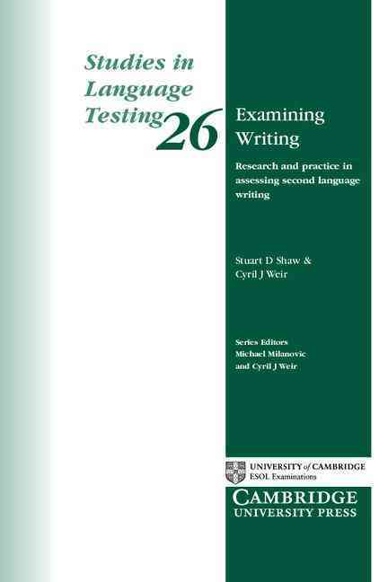
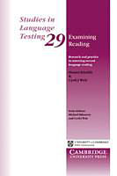
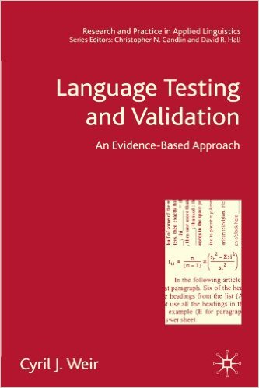
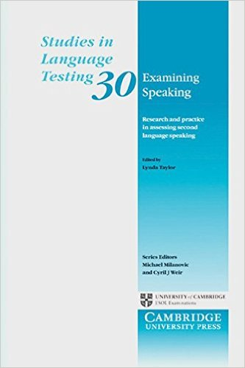
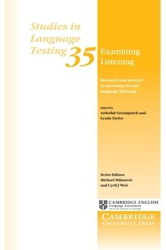
C2
C1
B2
B1
A2
A1
Notes:
Can do statements in CEFR
Gathered these statements, expert judgement, easy to hard.
In and of themselves do not have a theory but they do relate to a theory of language ability
Cambridge English’s approach is the socio cognitive approach – theory of what actually might be happening in each skill
See the four SILT volumes – one about Listening, Reading, Writing and Speaking

Slide 23
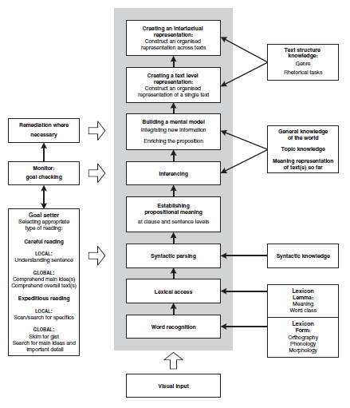
Notes:
This slide shows the theory of reading which underpins the Cambridge reading tests
Grey bit – what goes on in your head in the process of reading
On right, what knowledge you need
On left what happens just before and as you start to read – Goal setter - what kind of reading? Contract? Specific reading?
This provides a testable theory

Slide 24
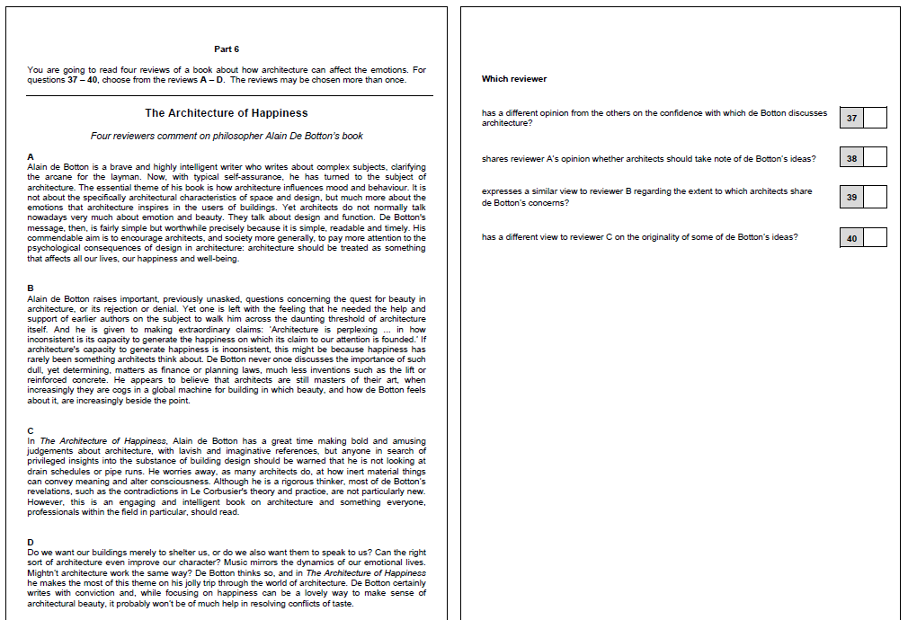
Notes:
Several texts – forces reader to figure out relationship ideas
Good theory = good rationale for level based test design
If you have a well-developed test, then teaching to the test is not a bad thing!
Language tests can be developed that are aligned with public scales

Slide 25
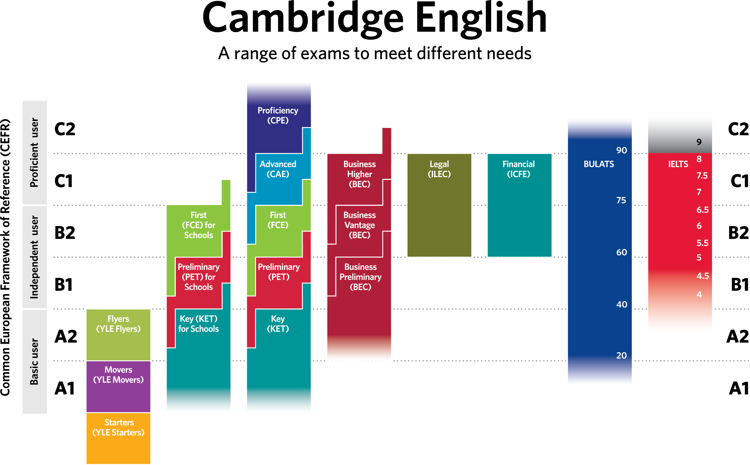
Notes:
Vertical dimension Quantitative (measurement) dimension
Qualitative (individual) dimension: individualisation

Slide 26
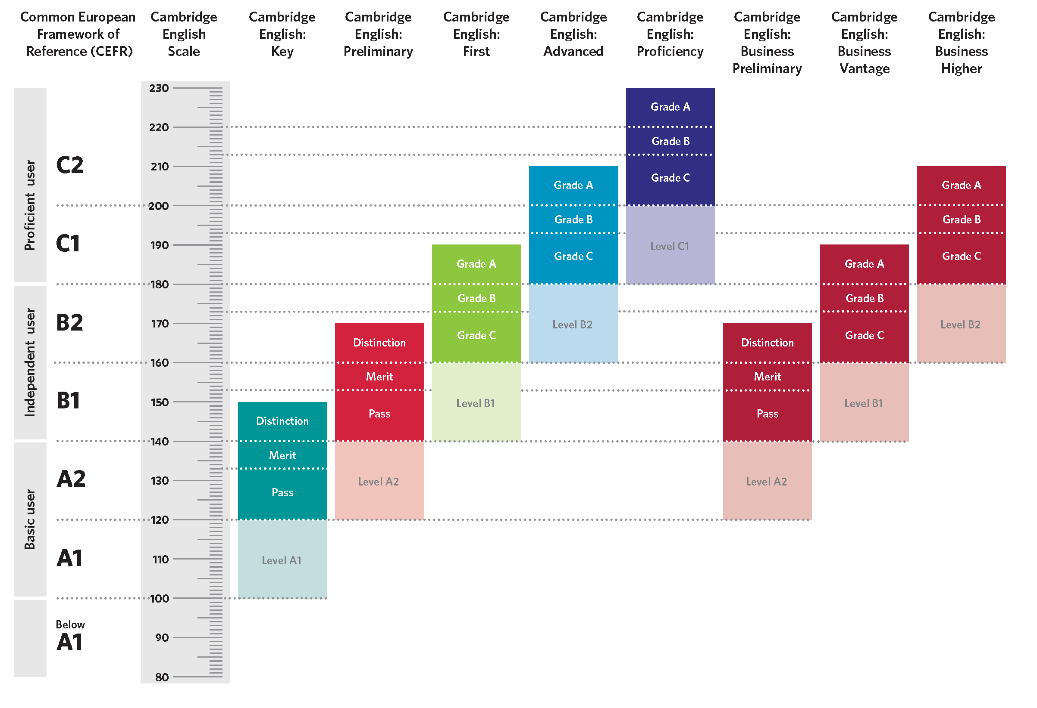
Notes:
Cambridge English Scale makes the relationship between levels more transparent.

Slide 27
Putting the
two together
Notes:
We’ve looked so far at how classroom assessment can be learning oriented and whether large scale assessment can be learning oriented. Now we are going to see if we can put these two concepts together.

Slide 28
Are these consistent with an LOA approach?
 | Yes | No
Using large scale assessment for accountability purposes (i.e. students’ performances used to evaluate their teachers)
Reporting assessment outcomes in norm referenced fashion (i.e. relative to other students in the class)
Reporting assessment outcomes as a letter/number
Reporting assessment outcomes in terms of grammatical structures a student has mastered/not mastered
Notes:
No! Shifts focus from learning to teaching. Shifting focus to themselves! Will either give the students the answers or not put students into the exam.
Pitches students against each other – not saying what an individual student has learned. You could knee cap another student and you come out top!
It can have an impact on learning –… can affect motivation but in and of itself a number or a letter can’t really give helpful feedback – you need some sort of descriptor about what someone knows ‘can do….’
Not just grammatical structures!

Slide 29

C2
C1
B2
B1
A2
A1
Notes:
Remember that we need the quantitative (measurement) dimension – and also the qualitative (individual) dimension: individualisation
At the heart of LOA

Slide 30
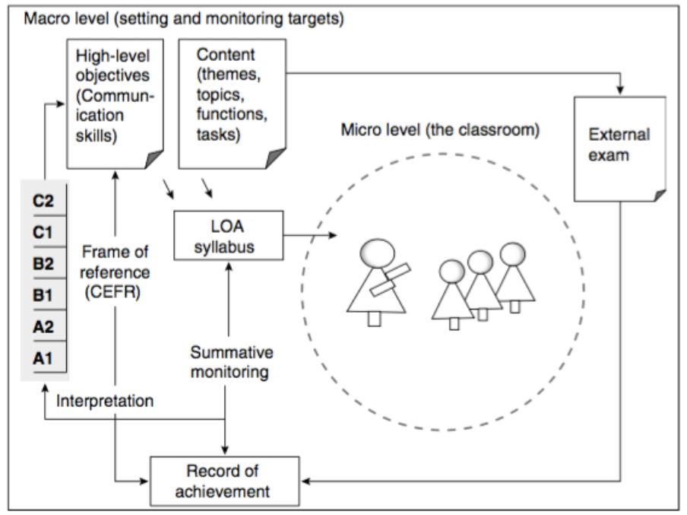

Notes:
Learning oriented assessment as reflective teaching practice: external and internal assessment integrated

Slide 31
Learner-oriented assessment in practice

Slide 32
Effective learning-oriented assessment? Rate the impact 0 - 5
 | Effect
Students taking frequent tests
Teacher providing feedback to students
Formative evaluation by teachers
Teaching test preparation
Students self questioning
Teacher/student setting goals for learning
Hattie 2009
Notes:
Hattie, J. 2009. Visible Learning: A Synthesis of Over 800 Meta-Analyses Relating to Achievement. London: Routledge.
Rate the impact 0 = nothing , 5 -= very positive impact

Slide 33
More effective learning-oriented assessment?
 | Effect
Formative evaluation by teachers | 4.0
Teacher providing feedback to students | 3.3
Students self-questioning | 2.9
Teacher/students setting goals for learning | 2.5
Students taking frequent tests | 1.5
Teaching test preparation | 1.0
Hattie 2009
Notes:
Hattie, J. 2009. Visible Learning: A Synthesis of Over 800 Meta-Analyses Relating to Achievement. London: Routledge.

Slide 34
Setting clear learner objectives
Observation
Interpretation
Adjusting teaching cycle
Performance
Using a framework of reference
Notes:
Using a framework of reference brings about a full reflective learning oriented assessment cycle

Slide 35
Question:
In your classroom context, what sort of evidence about student performance could you collect?
Notes:
In the survey, 80 of you answered the question about what you do with the evidence obtained from assessments – you already have lots of ideas!

Slide 36
Question:
In your classroom context, could you use the following to make learning-oriented assessment practical?
weekly tests, peer assessment, online tools, self-assessment, writing samples, other ideas?

Slide 37
A learning-oriented approach to assessment
“…involves the collection and interpretation of evidence about performance so that judgements can be made about further language development”
…to promote learning.
Purpura 2004
Notes:
By necessity, as Jim Purpura says …
Learning-oriented assessment
“involves the collection and interpretation of evidence about performance so that judgements
can be made about further language development”
This is teaching and learning, as two sides of the same coin.
To promote learning

Slide 38

Questions

