Slide 1

The culture of assessment in Science and English
La cultura de la evaluación en Ciencias e Inglés

Slide 2

Please download the following app on your phone:
Kahoot!

Slide 3



Best practice in assessment
What makes a good exam?
The Principles of Assessment
Belinda Cerdá
Cambridge English

Slide 4

Why is Assessment Literacy important?
We can develop tests that….
We can evaluate and select tests which…
Notes:
The important thing is that we do reflect on best practice and understand this because without the required assessment literacy, we will struggle:
To create reliable, fair exams which have a positive impact on students and promote learning and increase motivation
Select the right assessment tool for our students and understand its strengths and weaknesses

Slide 5


Slide 6
Was it challenging?
Fairness
Accuracy
Different task types
Positive impact
Notes:
When we asked whther this was difficult to do: the majority of you said YES Again. Some of the reasons given were related to the challenge of:
Adapting the exam to the level of the students and being fair
Ensuring the exam had a positive impact on learners
Ensuring a range of task types

Slide 7
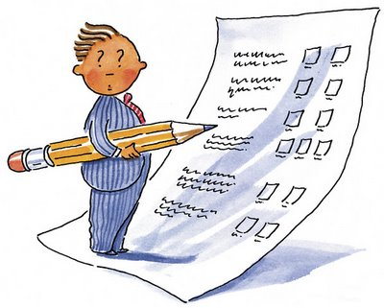
What makes a good exam?
Assesses the four skills
Using a range of task types
Well presented with simple questions

Slide 8
What makes a good exam?
Motivates students to learn
demonstrates what they know
Evaluates their real world
knowledge

Slide 9


Slide 10
VRIP
VALIDITY
Fitness for purpose:
Does it test what you want to test?

Slide 11
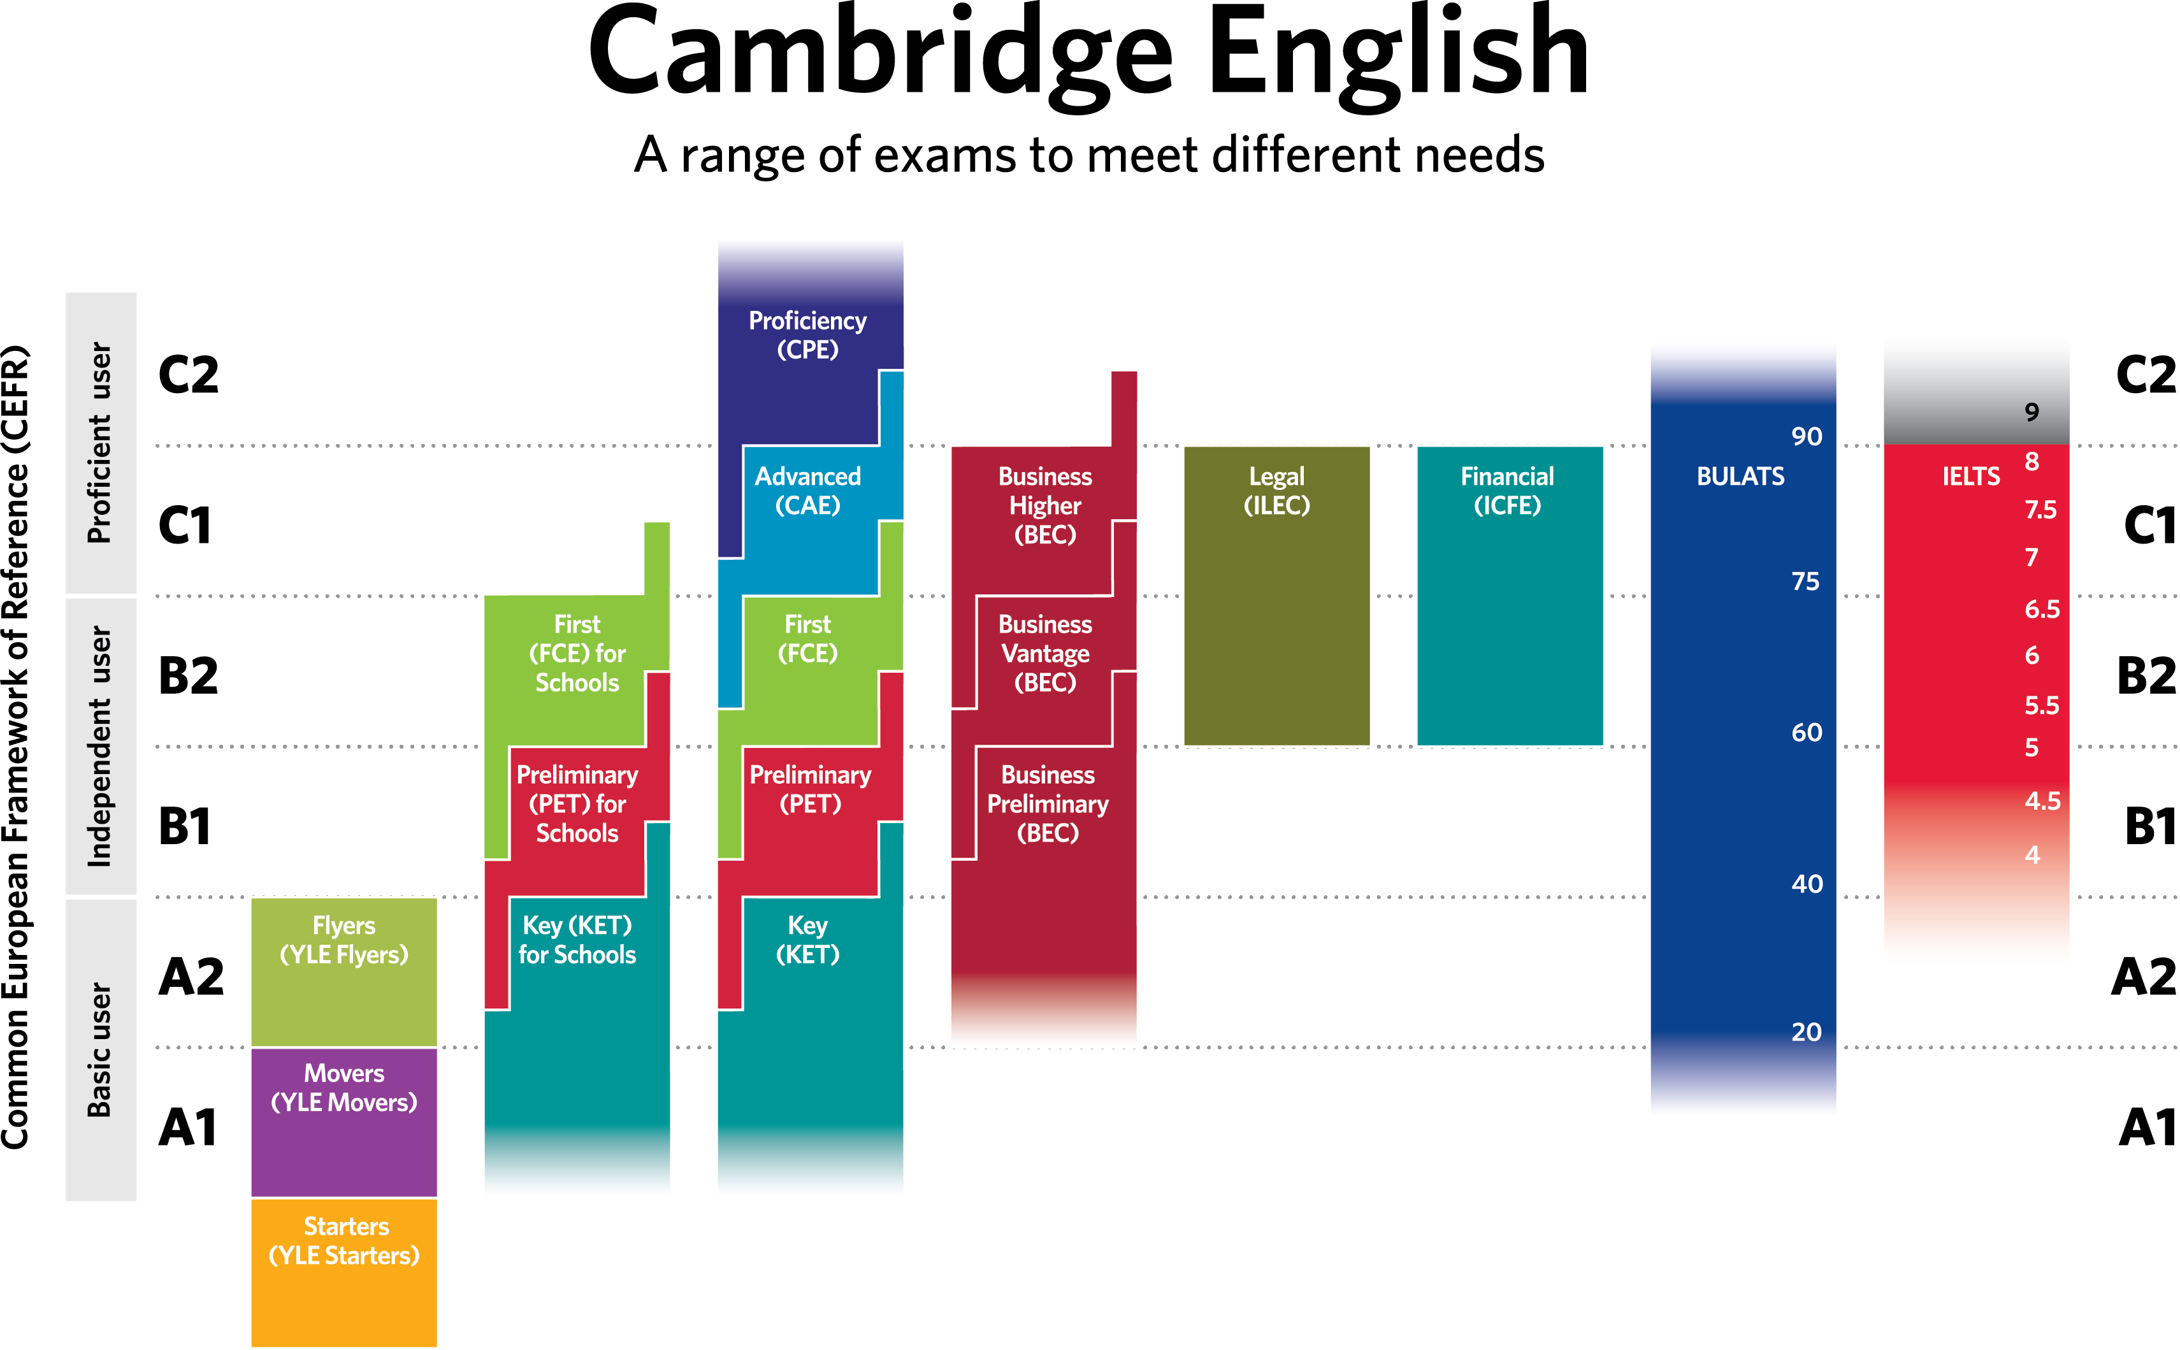
Notes:
THIS IS WHY WE HAVE EXAMS AT DIFFERENT LEVELS from A1 – C2 and exams focussing on different skills and language competences.

Slide 12
VRIP
VALIDITY
= Fitness of purpose
RELIABILITY
Repeatability:
Is the same exam in different sessions equally difficult?

Slide 13
An item banking system
Standards consistently applied
Measurement scale
Item bank links all levels
90
. .
Intermediate
80
Test 1
70
. .
60
Test 2
Preliminary
50
40
Test 3
. .
Breakthrough
30
Tests at appropriate level
Learners located on scale

Slide 14
Notes:
This the text as it will appear in the test after all the pre-editing, editing, vetting and proofreading has taken place. It will have been seen/reviewed by at least ten experts before it is ready and will have complete statistical analysis conducted in order to support the expertise and advice contributed/provided by the SO, Chair, IWs, proofreaders and vetters.

Slide 15
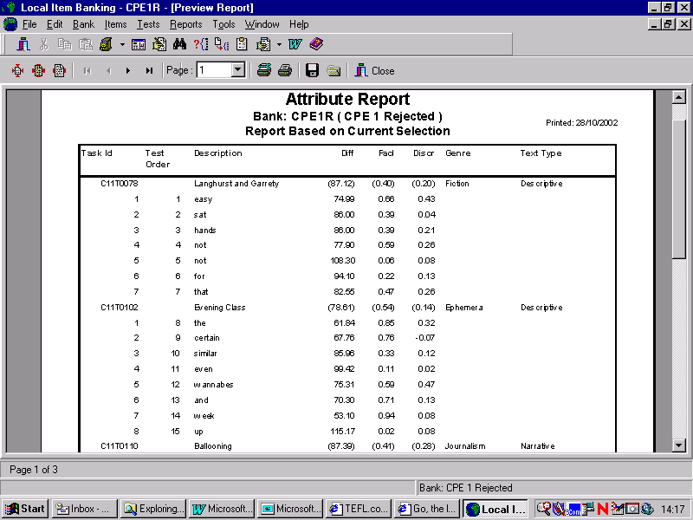

Slide 16

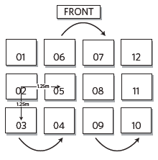
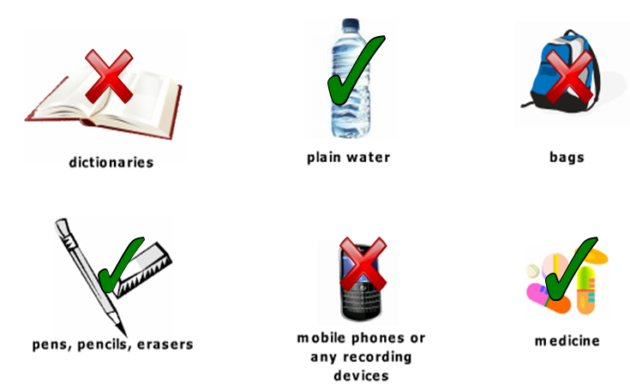
Exam day
Notes:
Not all of you will be able to do this but there are other ways we can ensure reliability. I will go on to look at two more:
the same exam day experience for all students regardless of who they are and where they are taking the exam:
This series of standardised procedures ensure that every candidate has a similar experience and so it is fair for all and ensures reliability, since wherever and whenever the candidates take one of our exams, they will take the exam under similar conditions.
CLICK
We provide detailed instructions as to how to set up the exam room itself, including the distances between candidates, and what can and cannot be on display within the exam room. A record is kept of where each candidate was sitting for each part of the test, and sent with the answer sheets.
CLICK
We are very clear about what candidates can have with them at their desk during the exam. Candidates can have water (in a plastic bottle), writing materials and any medication they may need to take, but bags, school books and of course mobile phones must be left in a designated area away from the candidate.
CLICK
Candidates must be able to control the timings of their exam, so a clock must be visible in the exam room. At the beginning of the test, the invigilator writes on the board the start and end times for the test, using the clock on the wall, so every candidate has the same time reference. Invigilators announce to candidates when ten and five minutes remain before the end of the test.

Slide 17
Examiner assessment
Recruitment
Training
Certification
Standardisation &
Recertification
Monitoring
Examiner Administration
Notes:
SLIDE:EXAMINER ASSESSMENT
If we reconsider the teacher’s role during the writing process, this section can also be applied to the role that the teacher adopts at the end of the writing process.
So how do we ensure reliability of our speaking and writing exams
The key here is that the raters (writing assessors) should work to some agreed standard, so that all students / candidates are marked according to the same yardstick (as we saw at the beginning of the talk in the ideas put forward by Hamp-Lyons).
In order to ensure reliability, at Cambridge English we have a, training and continual monitoring of examiner performance that allows us to maintain what we believe is a high level of reliability. Examiners have to meet strict professional standards and then successfully complete a course with an exam at the end. Their performance is then checked every year and there is follow up training as necessary.
What this means is that they all assess to the same standard but also provide the same testing experience to each candidate thus ensuring reliability and validity.
How is this managed by Cambridge English?
STANDARDISATION
All writing examiners are trained extensively on how to work with the marking criteria at the different CEFR levels before they begin working as writing examiners. They are also required to undergo refresher training every year.
COORDINATION
DUPLICATION
Each candidate text is marked by two examiners independently. In the case that there is a wide discrepancy in the marks between the two examiners, the script will be marked by a third examiner.

Slide 18
VRIP
VALIDITY
= Fitness of purpose
RELIABILITY
= Repeatability
IMPACT
PRACTICALITY
Positive effect on individuals and on society
Cost? Time? Resource?

Slide 19
Quick check!
Notes:
So lets have a look at how comfortable we feel with these concepts
The questions on the following slide (along with the answers on slide 22) are in the Kahoot quiz, which I can set up for you on the day.
Kahoot allows us to provide an online quiz, with people voting / answering questions using the app on their mobile phones. The audience will have 30 seconds to answer each question, by selecting the right option on the voting buttons provided on their mobile phones.

Slide 20
VRIP
A language exam only has gap-fill grammar questions
The instructions of a language exam use language which is more complex than the level of the test
An exam is incredibly reliable, but is over six hours long
A driving exam consists only of a written theoretical component

Slide 21
VRIP
V = A driving exam consists only of a written theoretical component
I = A language exam only has gap-fill grammar questions
R = The instructions of a language exam use language which is more complex than the level of the test
P = An exam produces incredibly accurate results, but is over six hours long

Slide 22
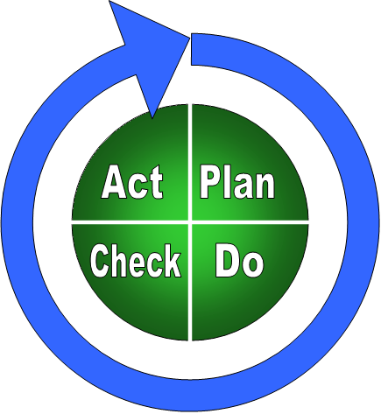
Notes:
And what does Quality mean? Well, quality is about all of the processes, policies and procedures that we have in place to make things happen!
It is about having a theory of action to aim for continual improvement and about making sure that work we do on the quality of our exams is properly supported by the right frameworks and structures. (This means we can use our fire-fighting skills where they are most needed – ie when the unexpected happens – rather than all the time. )
A simple model that is used on QMS systems throughout the world is the plan , do , check , act model – this ‘does what is says on the tin’ i.e is as straightforward as it looks
It shows that in any process, in any piece of work that we do we need to first plan, then carry out our plans, then check that what we actually did, met our plans. If for any reason it did not then this is the place to act, to make improvements.

Slide 23
Question paper production cycle
Commissioning of material
Pre-editing
Editing
Rejection
Pretesting & Trialling
Revision
Pretest Review
Test Construction
Exam Overview

Slide 25
Notes:
EXAMPLES
Class references taken out which would bias some candidates over another
Maybe the text is cut so that it is within the IW guidelines limit and to avoid unnecessary information
Confusing. Make sure the key is tight or that there is not a double key.

Slide 26
Notes:
This the text as it will appear in the test after all the pre-editing, editing, vetting and proofreading has taken place. It will have been seen/reviewed by at least ten experts before it is ready and will have complete statistical analysis conducted in order to support the expertise and advice contributed/provided by the SO, Chair, IWs, proofreaders and vetters.

Slide 27
What do you want to take from this event?
How standardised tests are created
Practical ways of assessing speaking and writing
I would like to share, learn and reflect

Slide 28
Everything to make me better!

Slide 29


Slide 30
Notes:
About 70% or 65% of you teach English in primary school

Slide 31
Notes:
The majority of English teachers and probably science teachers too already teach in a bilingual programme ou do already

Slide 32

Questions

