Slide 1
The culture of assessment in Science and English
La cultura de la evaluación en Ciencias e Inglés

Slide 2
Bilingual Implementation in CEIP. Nª Sra. del Villar
Laguna de Duero
Virginia Olivar Aguado
Yolanda Arranz Sánchez

Slide 3
FIRST STEPS
READING REQUIREMENTS: ORDEN EDU/6/2006, January 4th.
PROFESSIONAL DEVELOPMENT: Training sessions about Bilingual Programs in October 2007.
IMPLEMENTATION: Staff approval and commitment: 19/11/2007

Slide 4
STARTING THE PROGRAM SCHOOL YEAR 2007-2008
Developed in accordance with educational law of Castilla y León.
Characteristics:
- At least 2 non-linguistic subjects: Natural and Social Sciences (Taught in English and Spanish in alternating courses), PE and Arts.
- No more than 50% English in the total schedule: 6-7 hours.
- Complete planning in 1st and 2nd grades.

Slide 5
INFORMATION AND COORDINATION
TO THE FAMILIES:
- Because parents were afraid students’ lack of understanding and comprehension.
- Because families wanted to help their
children.
TO THE TEACHERS:
-To decide which topics to teach in English and in Spanish.
- To agree on the schedule, methodology and
activities.

Slide 6
REVIEWS AND UPDATES
REVIEW: To utilize the program in 2nd and 3rd Grades.
ANNUAL REVIEWS: To adjust contents and change methodology.
UPDATES : To adapt the project to the present educational law.
COMMITMENT: Teachers do training courses in bilingualism.

Slide 7
METHODOLOGY
CEIP. Nuestra Señora del Villar (Laguna de Duero)

Slide 8
GROUPINGS
We are in a three bilingual courses per grade bilingual school (around 662 students in total).
The bilingual areas are: P.E. and Arts (1st. to 6th. Primary) and Natural and Social Sciences.
Natural Sciences are taught in 1st. ,3rd. and 5th. Primary course.
Social Sciences are taught in 2nd., 4th. and 6th. Primary course.

Slide 9
FLEXIBLE GROUPINGS
Students with special needs comprehending Science topics and information in English are taught Social and Natural Sciences in Spanish.
Our bilingual program reflects the possibility of supporting students in the area of English language.

Slide 10
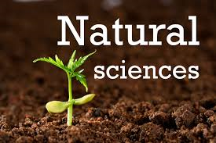
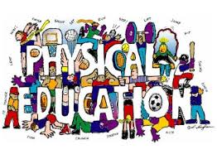
THE BILINGUAL AREAS ARE TIGHTLY CONNECTED

Slide 11
CREATING OUR OWN MATERIAL
Due to different changes of the law we had to work without any text books.
By preparing our own material students…..
…. are more motivated,
…. learn more through videos, power point presentations, playing games, listening to songs, etc.
….obtain better results!!!!!!

Slide 12
WORKING OUT ACTIVITIES
CEIP. Nuestra Señora del Villar (Laguna de Duero)

Slide 13
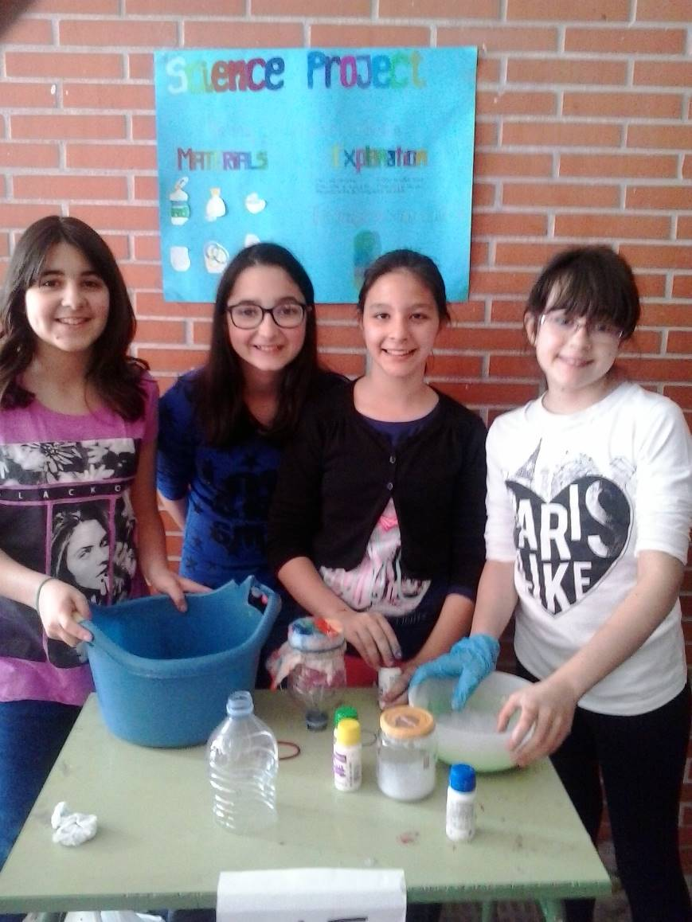
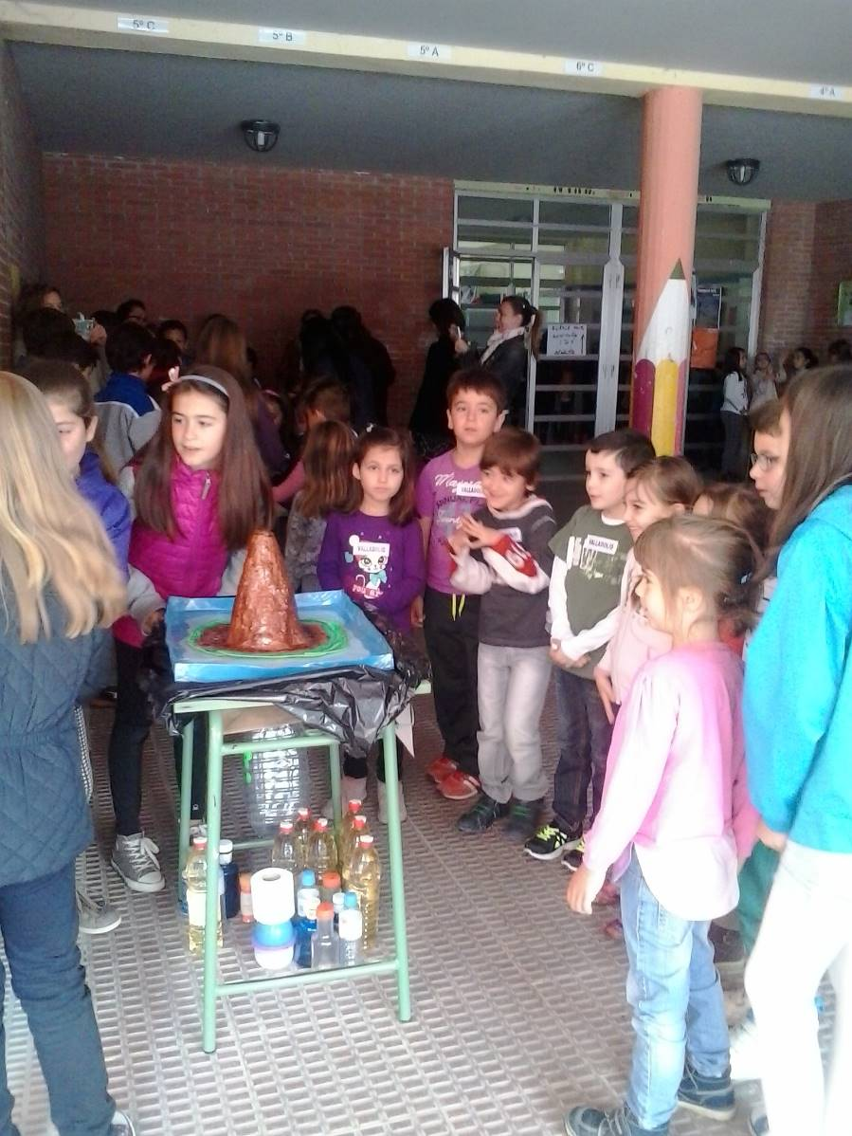
SCIENCE FAIR DEMONSTRATION IN THE SCHOOL

Slide 14
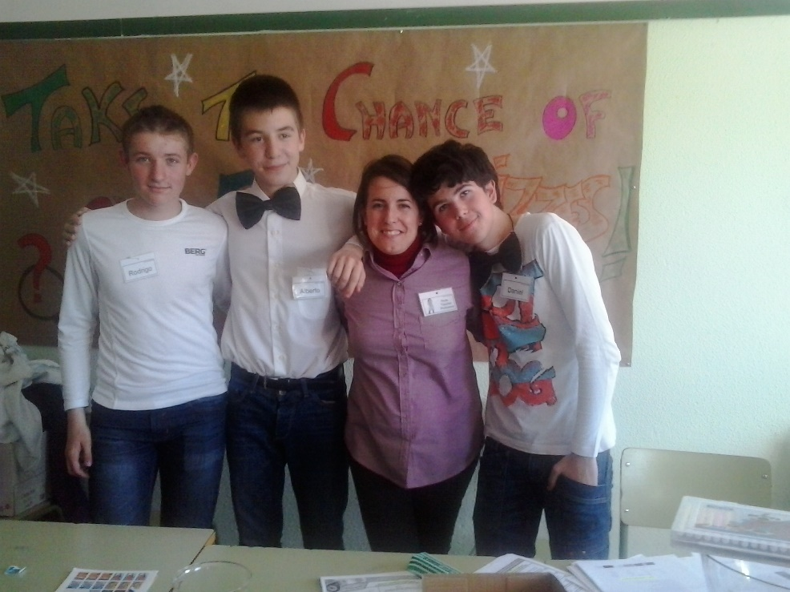
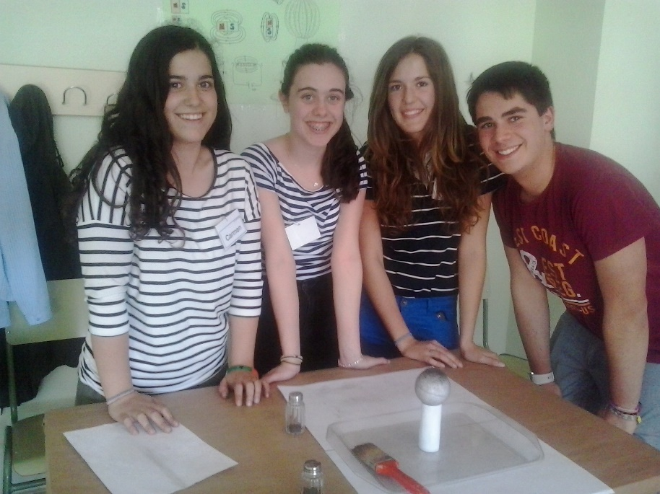
SCIENCE FAIR DEMONSTRATION IN LAS SALINAS HIGH SCHOOL
https://www.youtube.com/watch?v=eVDiyZKYtHQ

Slide 15
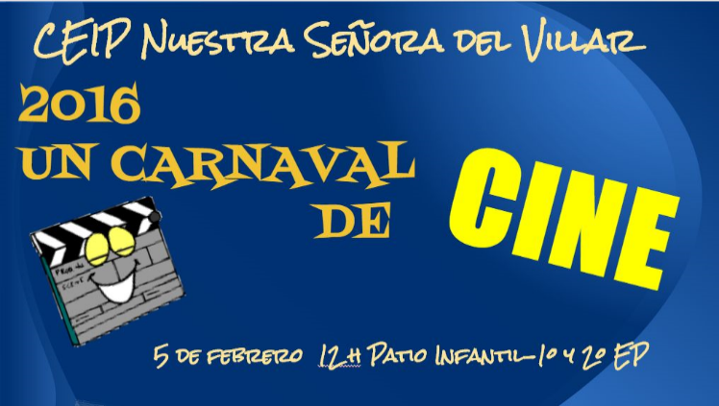
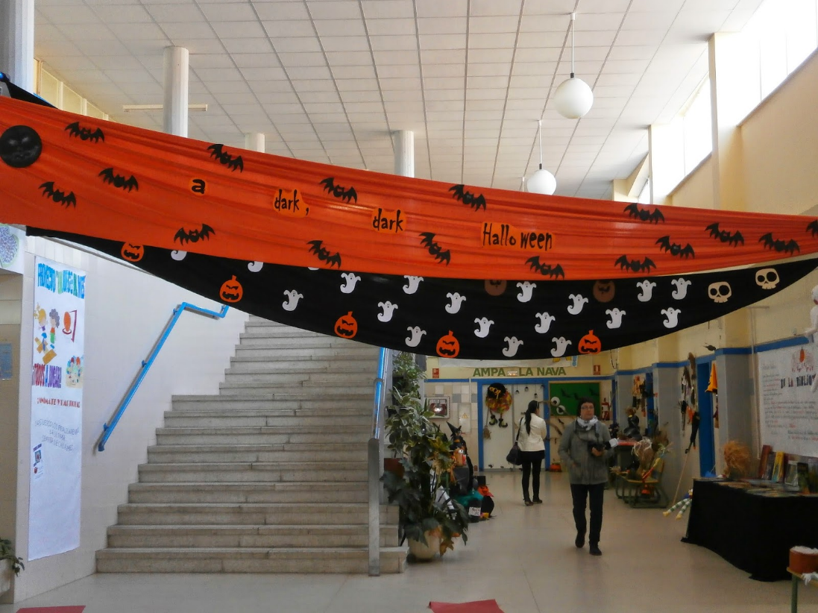
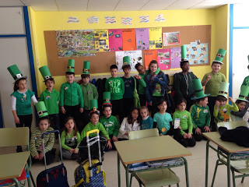
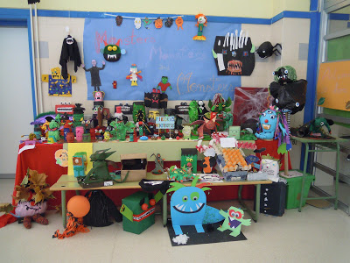
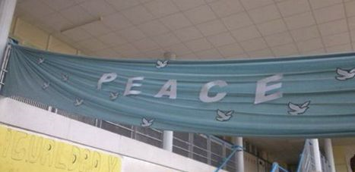
TAKING PART IN ALL THE ACTIVITIES THAT ARE PLANNED IN THE SCHOOL

Slide 16
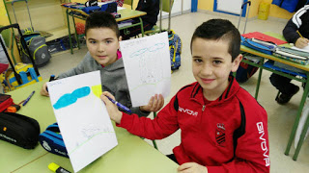
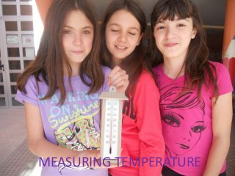
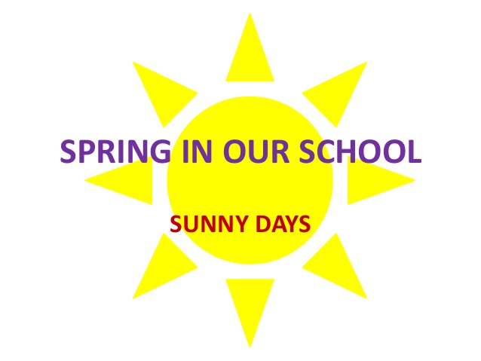
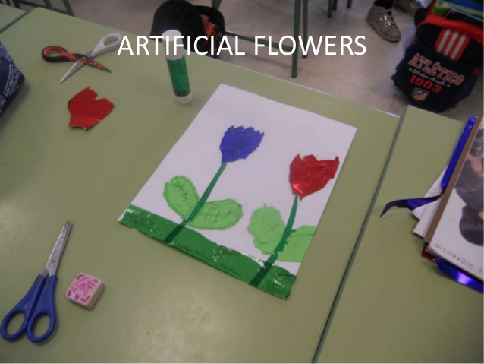
PARTICIPATING in E-TWINNING PROJECTS

Slide 17
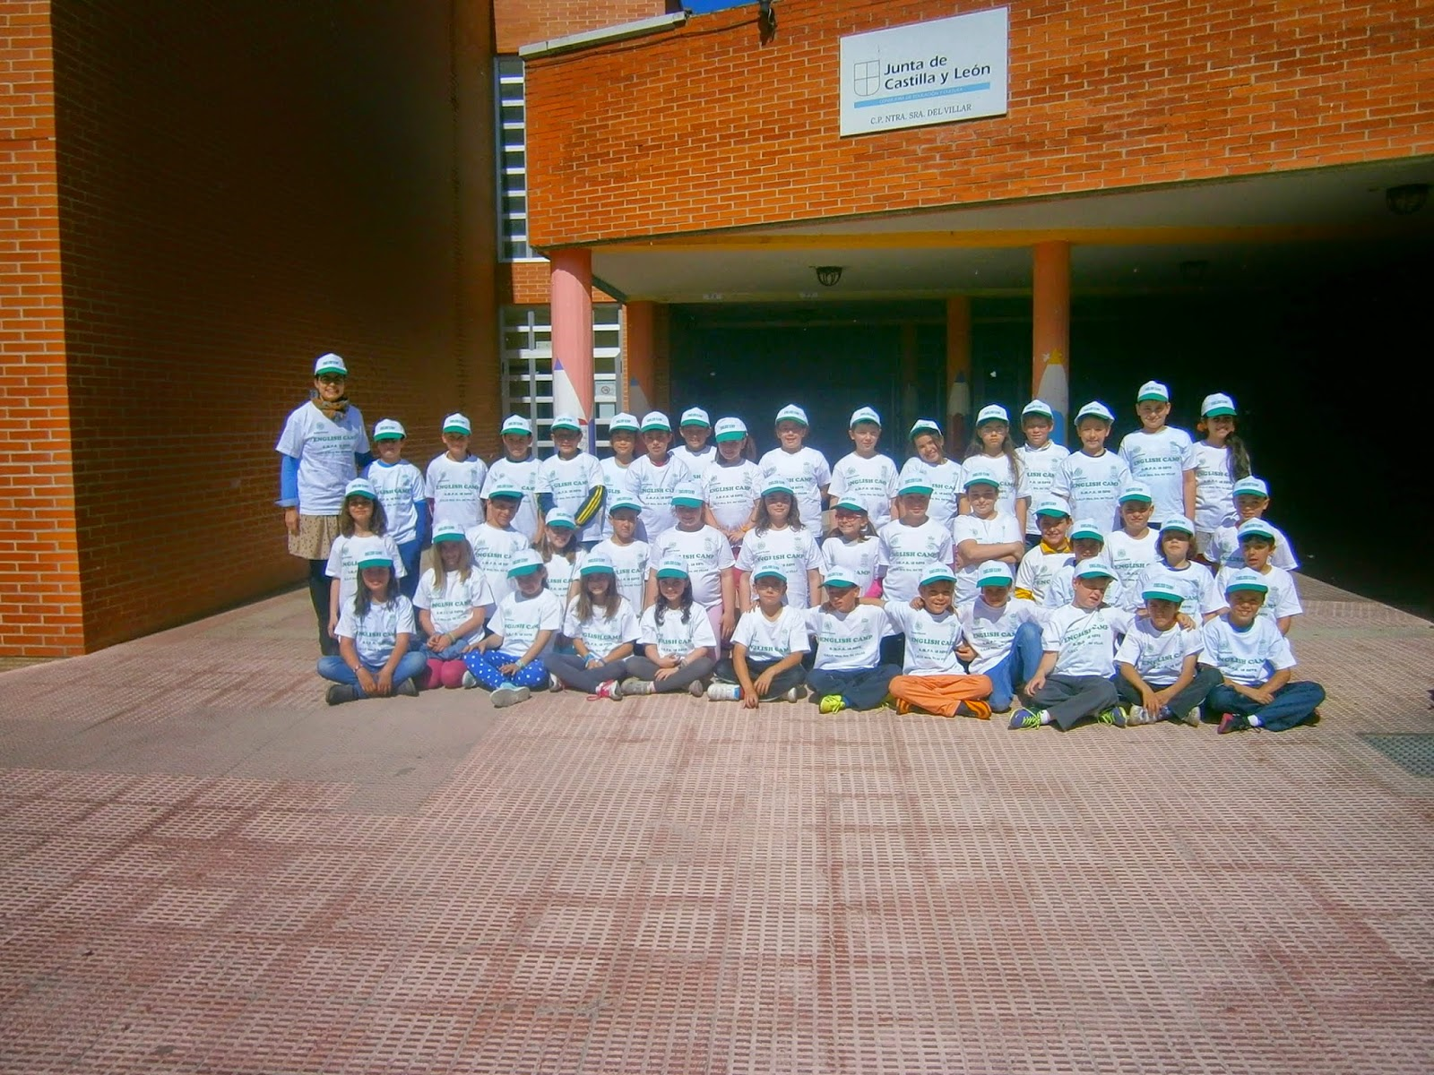
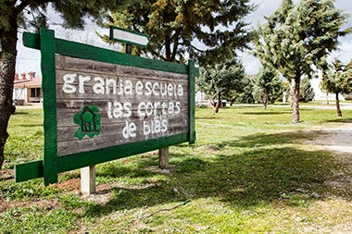
ENGLISH CAMP (3RD. PRIMARY)

Slide 18
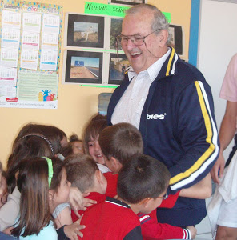
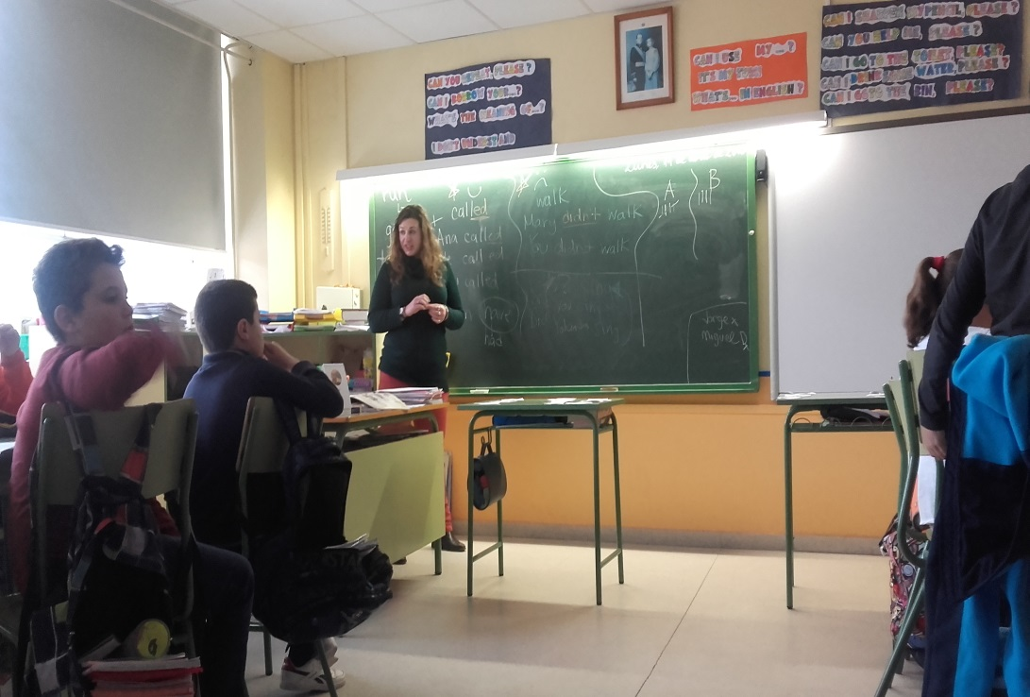
HAVING GREAT CONVERSATION HELPERS
Patrick from Ireland
Mary from Iowa
Alan from Australia

Slide 19
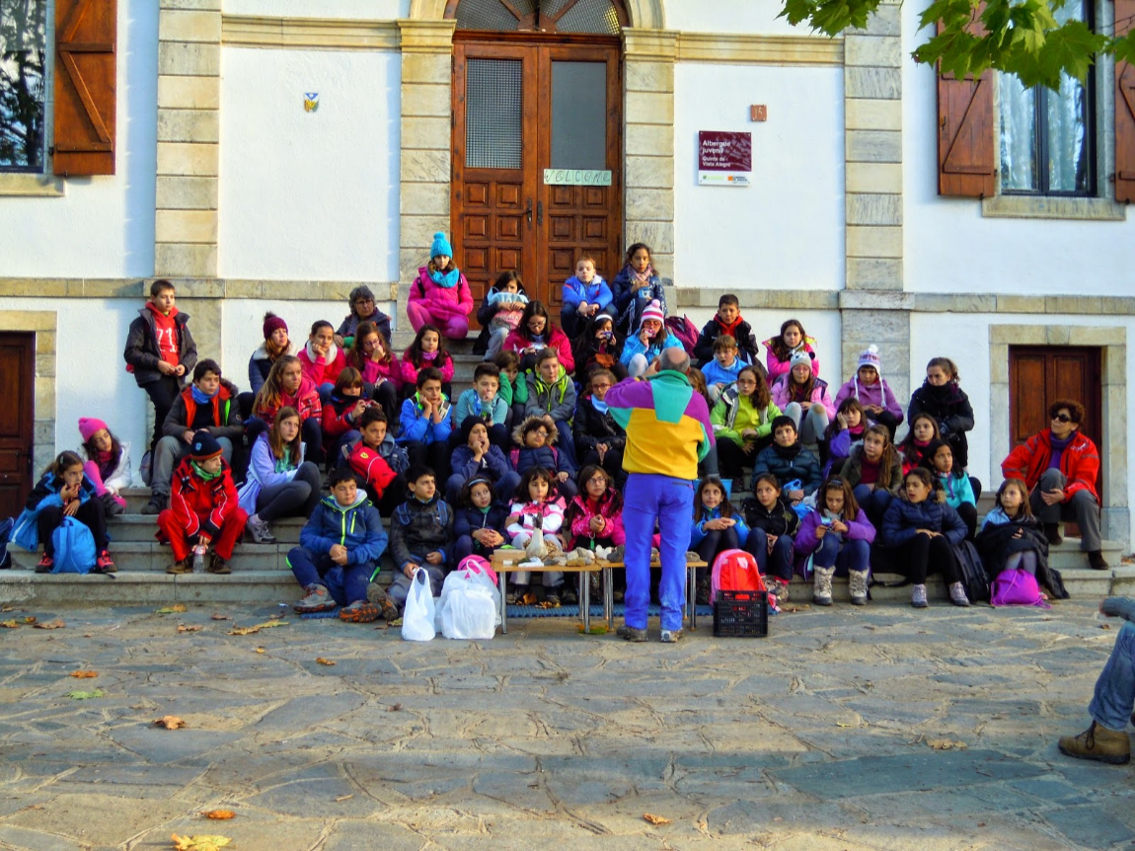
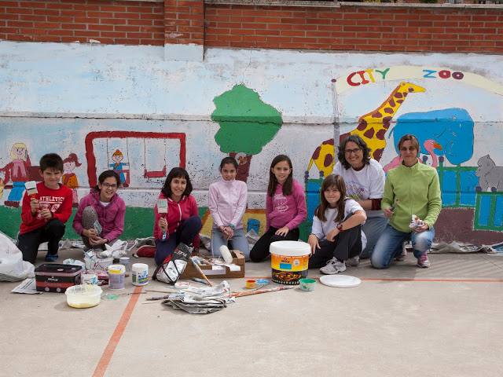
OTHER ACTIVITIES
English Language Immersion for 6th. Primary:
Pueyo de Jaca (course 2.014-2.015)
Teachers´and AMPAS´Workshops: Street Painting, Handy Kids, Kids Brain…
Organizing general parents’ meetings (especially in first Primary course).
Labeling and decorating the school using English and Spanish.
Having Student Teachers from different universities (ATLANTA &SCIENCEPRO PROJECT from the University of Valladolid)

Slide 20
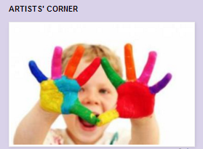
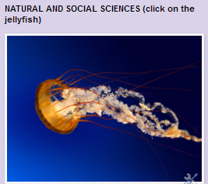
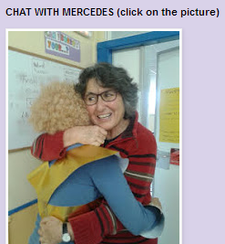
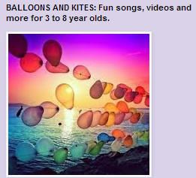
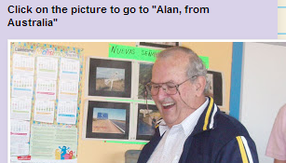
We have eight blogs in one:
El Villar speaks English: English blog
The artists’ corner: Arts and Crafts blog
Natural and Social Sciences blog
Balloons and kites: English Infant Education blog
Chat with Mercedes blog
Physical Education blog
Education for Citizenship blog (LOE)
Alan from Australia blog

